Slide 1
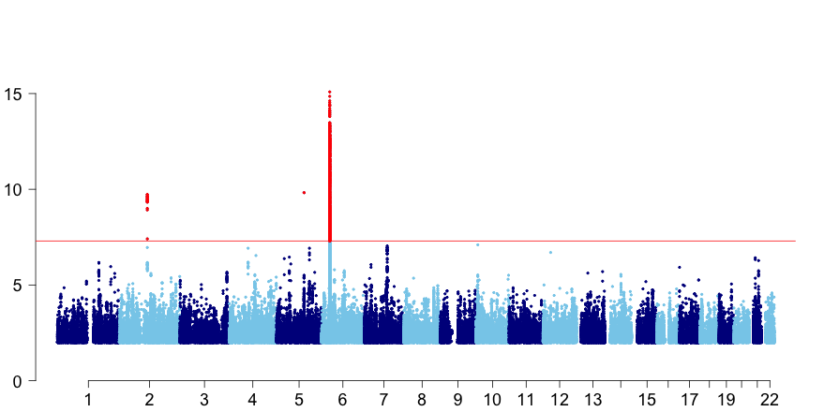
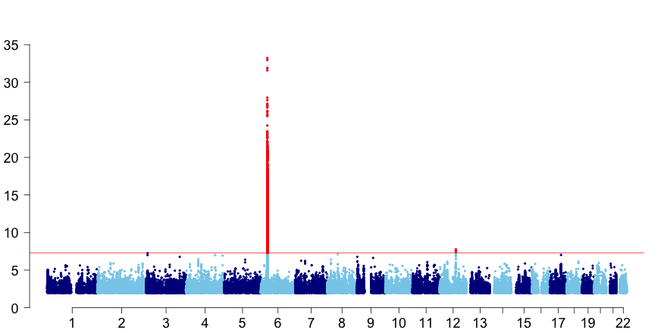
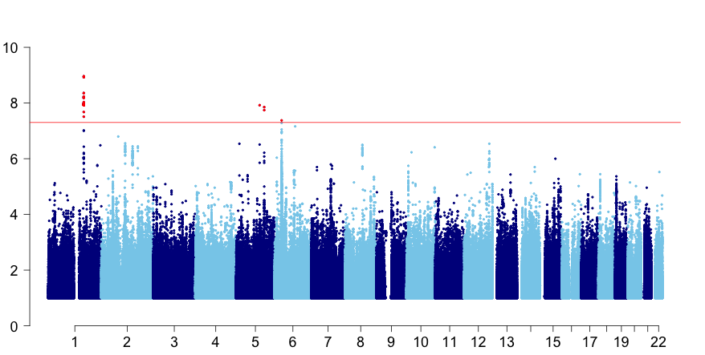
a
All EGPA vs controls
HLA-DQ
TSLP
-log₁₀ p-value
BCL2L11
rs34574566
CDK6
b
MPO+ve EGPA vs controls
HLA-DQ
-log₁₀ p-value
12p21
c
ANCA –ve EGPA vs controls
GPA33
TSLP
C5orf56
HLA
-log₁₀ p-value
Chromosome

