Slide 1
Figure 1. Age affects the cytokine response in the blood to vaccination. Neonatal (7 day old: black symbols), young adult (6-8 weeks: red symbols) and elderly (16 months: green symbols) mice were immunised intramuscularly (i.m.) with 4.5 μg influenza antigen (1.5 each of H1N1, H3N2 and influenza B) with (closed symbols) or without (open symbols) MF59 adjuvant. Serum cytokine levels were measured over 6 days. Data points represent n=5 animals +/- SEM.

Slide 2


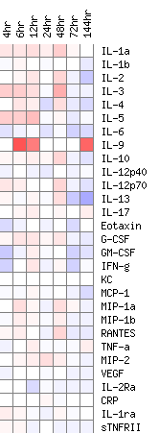


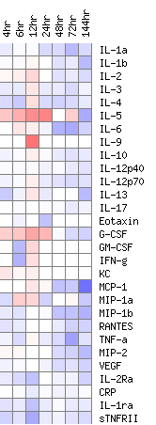
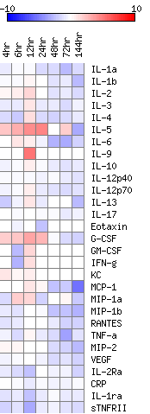
A
Non-Adjuvanted
Adjuvanted
Neonatal (∆)
Young Adult
(∆)
Aged
(∆)
Neonatal
(▪)
Young Adult
(▪)
Aged
(▪)
Log2 Fold change
B
Young Adult
C
Neonatal
Aged
Figure 2. Immunisation with MF59 normalises response across different aged animals. Neonatal (black symbols), Young adult (red symbols) or aged (green symbols) mice were immunised intramuscularly (i.m.) with influenza antigens with (filled squares) or without (open triangles) MF59 adjuvant. Serum cytokine levels were measured over 6 days and heat maps generated. Heat maps show mean log2 fold change from the 0 hour measurement of each group of n=5 mice (A). Two (B) and three (C) dimensional Principal Component Analysis (PCA) was performed to visualise the overall inflammatory response over time using standardised Area Under the Curve values of inflammatory responses plotted in figure 1.

Slide 3
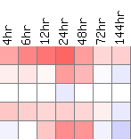
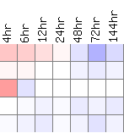
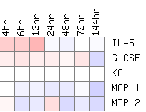
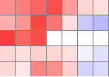
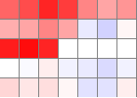
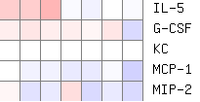
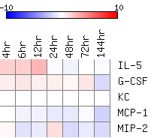
A
B
C
Neonatal
Young Adult
Aged
Non-Adjuvant (∆)
Adjuvant (▪)
Log2 Fold change
Figure 3. Cytokine response to booster immunisation. Mice received two intramuscular immunisations of influenza antigens with (▪) or without MF59 (∆), 4 weeks apart. Serum cytokine levels were measured over 6 days (A). Two dimensional PCA was performed to visualise the overall inflammatory response over time using standardised AUC values of inflammatory responses (B). Heat maps of log2 fold change from the 0 hour measurement of each group (C). Points represent mean and SEM of n≥4 mice (A). Symbols represent p<0.05 between † neonatal, * young adult or # aged animals receiving adjuvant or vaccine alone.

Slide 4
Figure 4.
Figure 4. Vaccine induced anti-influenza serum IgG production is dependent on age. Neonatal (A: black symbols), young adult (B: red symbols) and aged (C: green symbols) mice received two intramuscular immunisations of influenza antigens with (closed symbols) or without (open symbols) MF59, 4 weeks apart (day 0 and day 28: indicated by arrows). H1N1 specific antibody responses measured by ELISA over time course of immunisation (A-D), H3N2 (E) and Flu B (F) were measured after the second immunisation. Correlation between the peak anti-H1N1 antibody response and IL5 (G), MCP-1 (H), KC (I) or G-CSF (J). Lines and points represent mean and SEM of n≥3 mice, *p<0.05 measured by t test (A-C) or one way ANOVA with post test (D-F); correlation by Pearson.

Slide 5
Figure 5.
Figure 5. Prime-boost immunisation regime protects against influenza in neonatal and young adult mice but not aged mice. Mice received two intramuscular immunisations of 1.5 μg HA antigen with or without MF59, 4 weeks apart as neonates (A,D), young adults (B, E) or aged adults (C, F). Four weeks after last vaccination, animals were infected intranasally with 5x10⁵ PFU A/England/195/2009 H1N1 influenza. Weight change (A-C) and lung viral load (D-F) were measured at multiple time-points after infection. Lines and points represent mean of n≥4 mice. ***p<0.001, of immunised mice compared to unimmunised, # p<0.05, ### p<0.001 comparing adjuvanted to non-adjuvanted, measured by two-way ANOVA.

Slide 6
Figure 6.
Figure 6. Cytokine expression is polarised into the lungs of influenza challenged mice. Mice were infected intranasally with 5x10⁵ PFU A/England/195/2009 H1N1 influenza. Serum cytokine levels were measured over 6 days after influenza challenge (A). Viral load (B) Lines and points represent mean and SEM of n≥4 mice.

Slide 7
Figure 7.
Figure 7. Effect of immunisation on cytokine response at challenge. Mice received two intramuscular immunisations of 1.5 μg HA antigen with or without MF59, 4 weeks apart. Four weeks after last vaccination, animals were infected intranasally with 5x10⁵ PFU A/England/195/2009 H1N1 influenza. Serum cytokine levels were measured over 6 days after influenza challenge. Lines and points represent mean and SEM of n≥4 mice. * p<0.05 comparing naïve lungs or immunised lungs, # comparing adjuvanted sera with non adjuvanted or naïve sera, † comparing adjuvanted lung with non adjuvanted lung.

