Slide 1

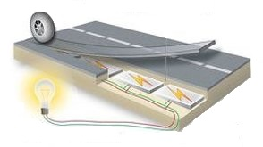
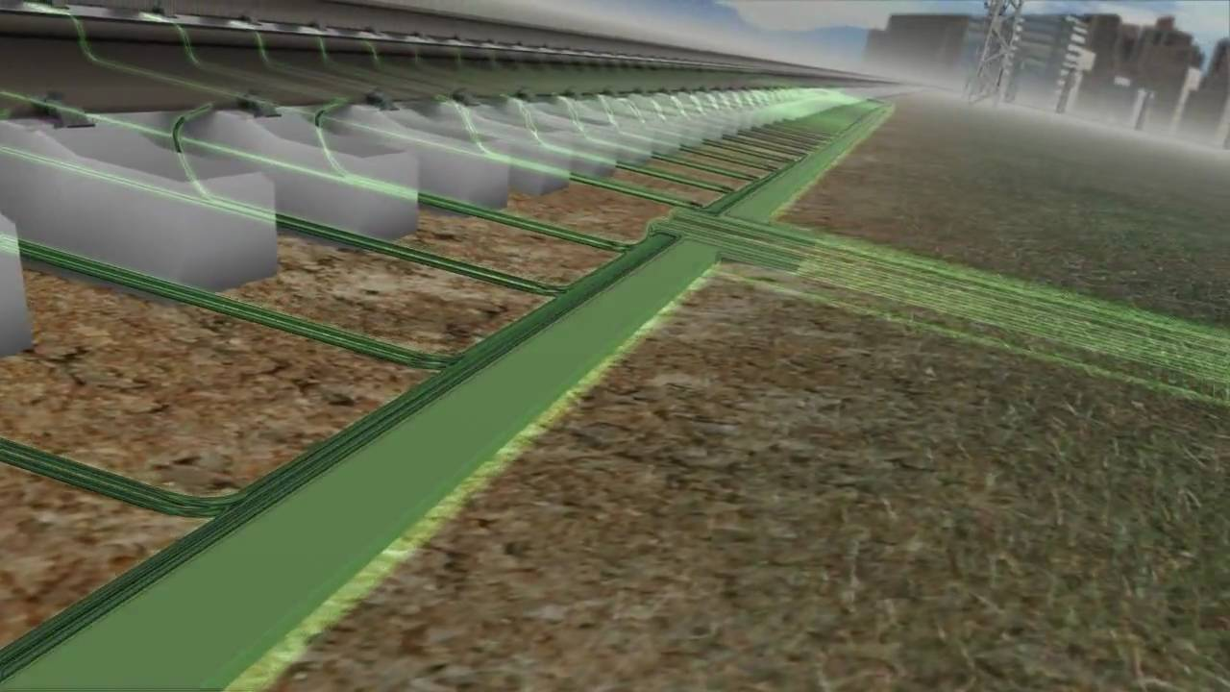
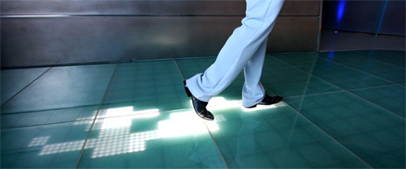
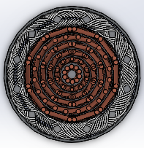
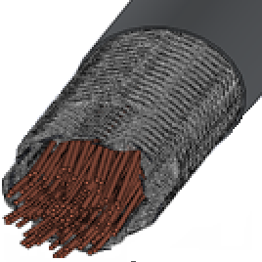
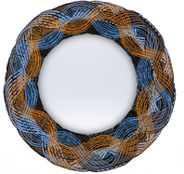
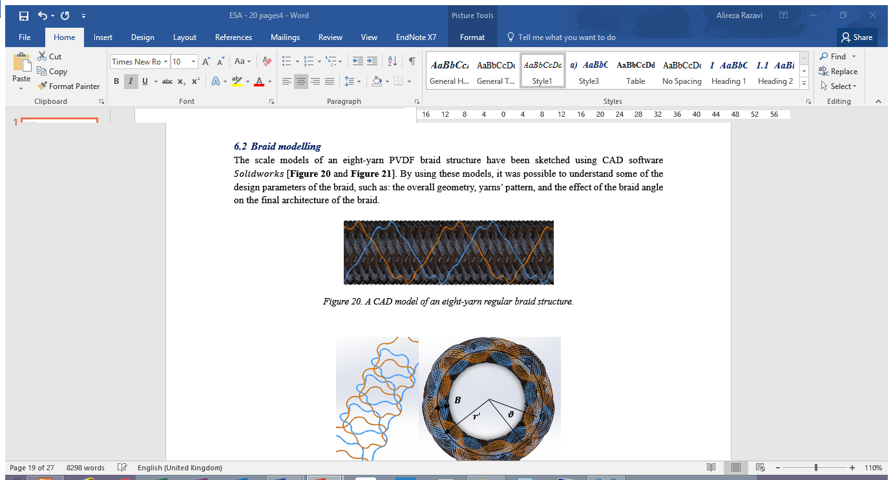
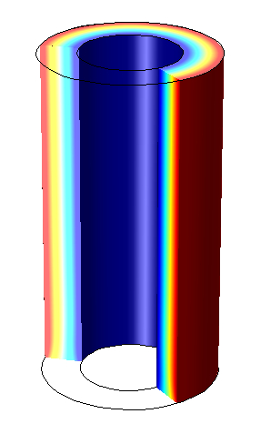
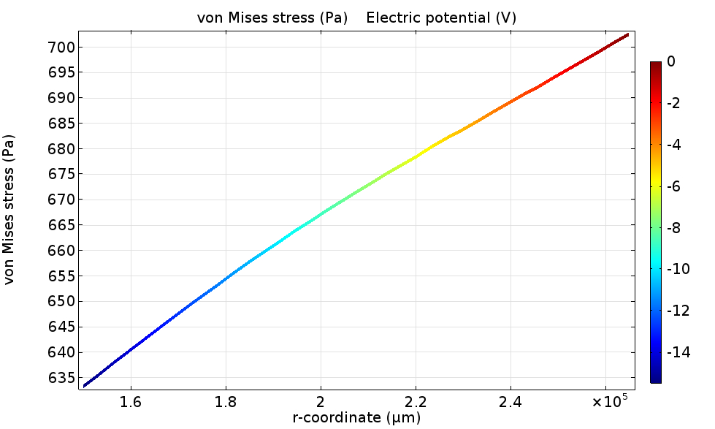
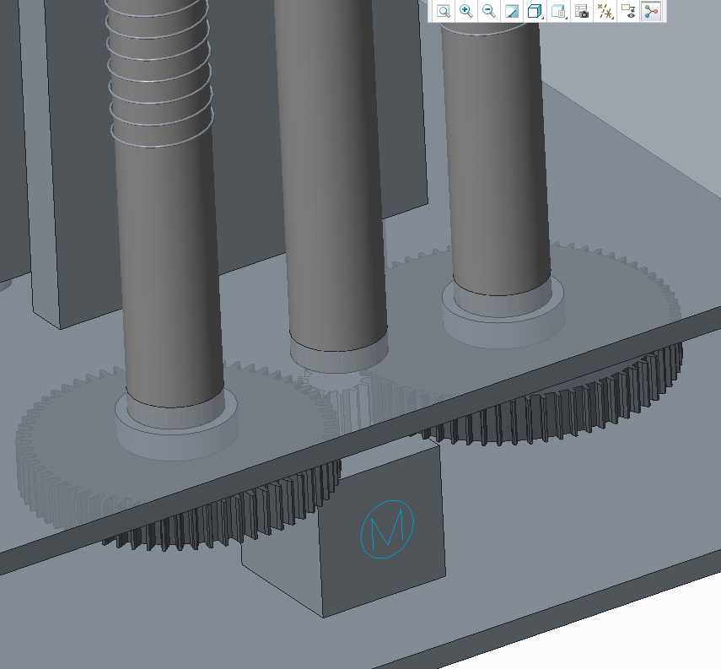
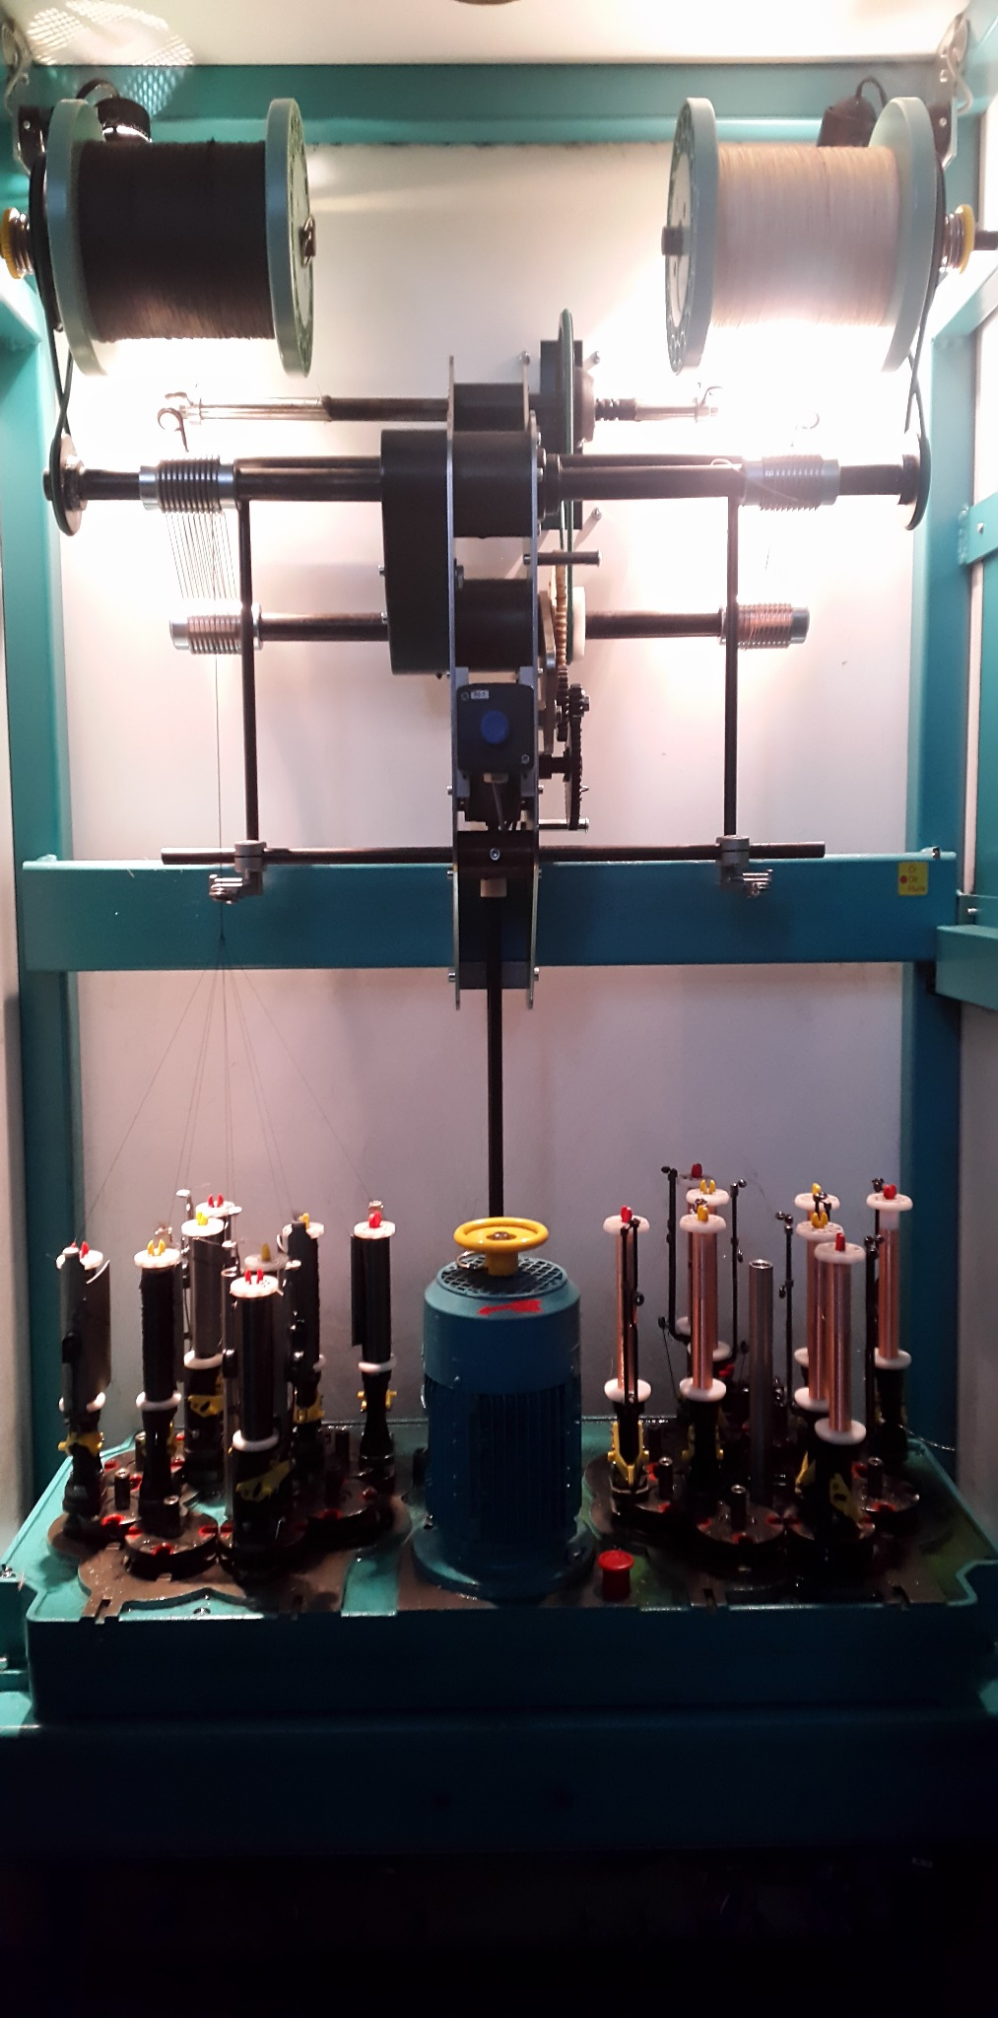
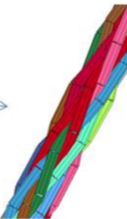
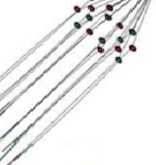
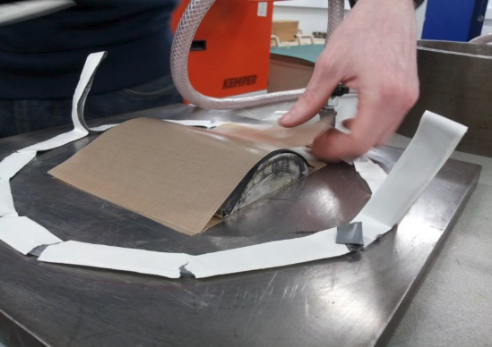
17th EUROPEAN CONFERENCE
ON COMPOSITE MATERIALS
ECCM17
Piezoelectric ‘Smart Fibre’ Sensor
Alireza Razavi ¹, Lorenzo Iannucci ¹, Emile Greenhalgh ¹
¹Department of Aeronautics, Imperial College London, UK
AIMS AND OBJECTIVES
To develop a piezoelectric Polyvinylidene Fluoride (PVDF) smart fibre for the composite materials sensing and energy harvesting applications .
Building a custom in-house poling apparatus to pole the PVDF yarn based on utilising the Simultaneous Stretching and Corona Poling (SSCP) technique.
Incorporating the braiding manufacturing technique to develop a continuous, large-scale production of the piezoelectric smart fibre.
BACKGROUND
Piezoelectric materials are smart materials capable of transducing mechanical energy into electricity in a reversible and
timely-manner response. These include ceramic and polymer based materials, amongst which the use of
the latter has been gaining importance within a wide range of sensing and energy harvesting
applications. PVDF polymer, in particular, exists in both film and fibre forms and has
shown to have the most favourable properties for the sensing purposes,
such as:
a high piezoelectric voltage constant (g_{ij} (V.N⁻¹));
flexibility for manufacturing;
fatigue resistant; and
chemical resistance.
(a)
(b)
(c)
Piezoelectric Energy Harvesting applications: (a) walking tiles; (b) road; and (c) railway.
CORONA POLING
The poling process involves placing the PVDF under an application of a high electric field and mechanical stretching tension simultaneously – in order to induce permanent piezoelectric properties into the material. A custom design poling system has hence been proposed to polarise the PVDF yarns based on using the SSCP poling method – after which the ‘smart yarn’ is ready to be manufactured as a smart fibre .
MODELLING
A FE model of a 100 mm section of a ‘smart yarn’ with associated inner and outer electrode layers was developed with COMSOL Multiphysics 5.2.
An axial displacement was applied to the model to predict the piezoelectric effect of the PVDF smart fibre.
Opposite charged copper electrodes creating a high electric field medium on the PVDF yarn.
A CAD model of the PVDF braid (Solidworks).
A schematic of the piezoelectric smart fibre.
Schematic of a custom
designed SSCP system.
Gear mechanism to apply mechanical stretching tension on the PVDF yarn.
Outer electrode
Inner electrode
Graph shows a potential of 14V generated as result of an applied 30N axial load (COMSOL).
MANUFACTURING
The braiding manufacturing technique was used to fabricate the piezoelectric smart fibre. In this process, a set of eight poled PVDF yarns were braided – three times, over a conductive copper core wire. Finally, the compound was over braided with eight thin copper strand wires – as for the outer electrode.
FUTURE DEVELOPMENT
The fabricated smart fibre will be embedded within a Fibre Reinforced Polymer (FRP) composite structure in order to investigate the sensing and energy harvesting applications of the PVDF smart fibre. In addition, further work on the modelling includes simulating the braiding manufacturing process that can resemble the real-life experience of the braiding of the smart fibre (using the FE software LSDYNA).
~ 0.6 mm
~ 0.3 mm
8-Yarn PVDF braid
+
~ 0.7 mm
The core copper electrode
16-Yarn PVDF braid
Smart Fibre
~ 0.77 mm
+
~ 0.1 mm
=
~ 1 mm
A potential host composite structure in which the smart fibre can be embedded as a sensor/energy harvester device.
24-Yarn PVDF braid
8-Strand copper
wire braid
Braiding process for the production of the smart fibre.
Braiding process simulation with LS-DYNA .
REFERENCE
Del Rosso, S., Micro-scale Hybrid Fibres for Low Cost Polymer Armours. Imperial College London, 2014.
Razavi, A., Feasibility Study of Design and Manufacturing of Composite Leaf Springs, Sheffield Hallam University, 2013, p. 128.
Measurement SpecialistTM, Piezo Spiral Wrapped Coaxial Cable. 2011.

