Slide 1


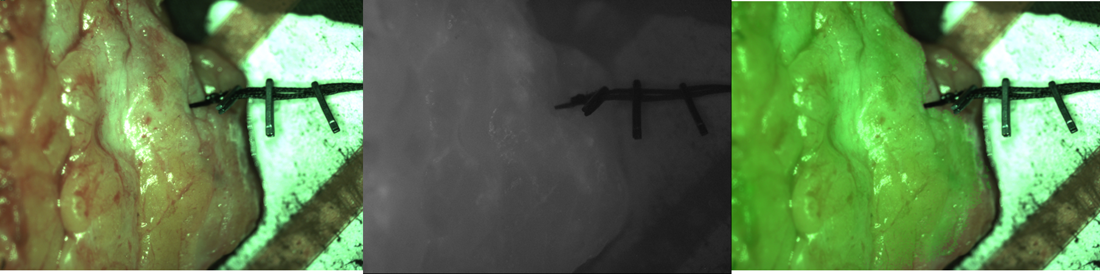
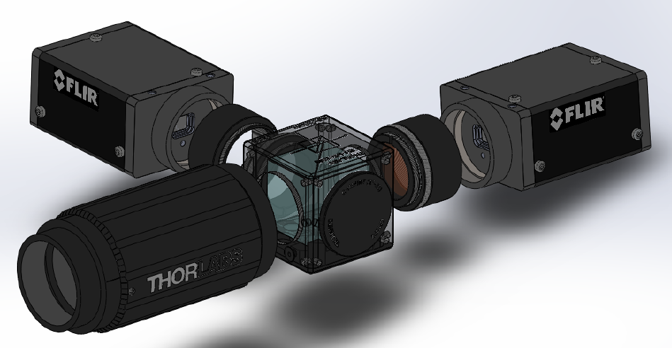
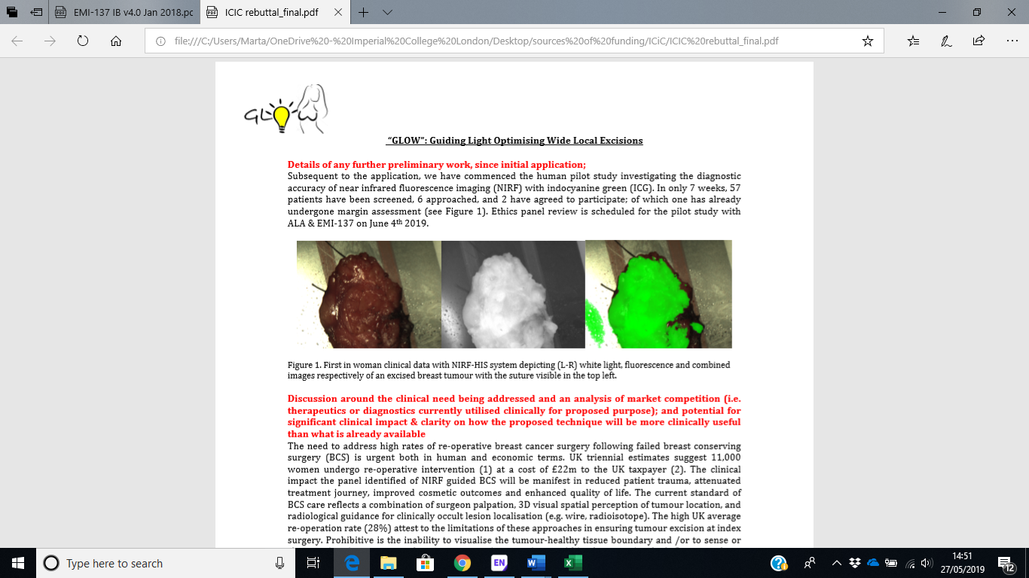
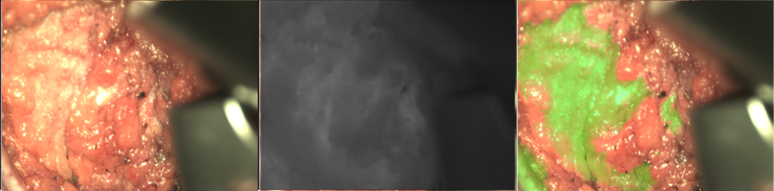
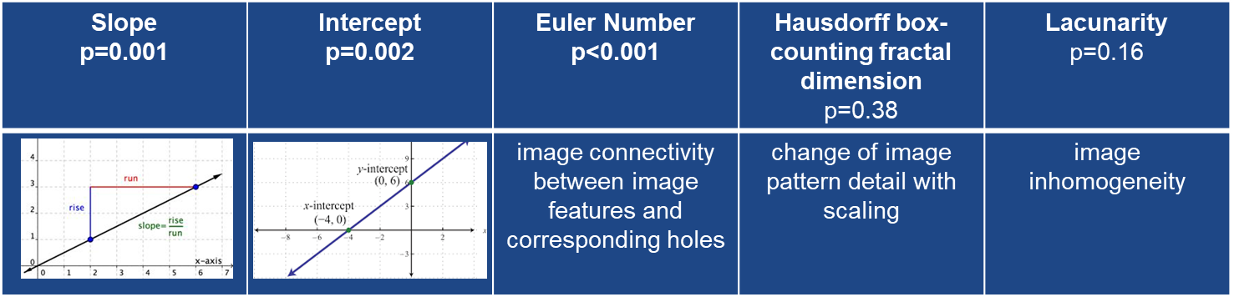





First in Human Study Using the ‘GLOW’ Near Infrared Camera System in Breast Cancer
M. Kedrzycki^{1,2,3}, M. Leiloglou^{1,2,}, V. Chalau^{1,2}, P.T.R. Thiruchelvam^{1,3}, J. Lin³, D.S. Elson^{1,2} , D.R. Leff^{1,3}
1. Department of Surgery and Cancer, Imperial College London, 2. Hamlyn Centre for Robotic Surgery, Institute of Global Health Innovation, 3. Imperial College Healthcare Trust
Introduction:
The clinical challenge :
1 in 4 women undergoing breast conserving surgery will have positive tumour margins on resection, thus necessitating further surgery.
Our solution :
Fluorescence from molecules in the tumour can guide tumour resection in real time. This is known as Fluorescence Guided Surgery (FGS).
Our objectives are to develop the imaging system and test its performance in clinical trials.
Our research question is: Can the system accurately detect the cancer and reliably guide surgeons?
Impact of this work:
Preventing positive margins and thus subsequent operations will benefit the patient (cancer treatment & cosmesis), and could save the health service millions of pounds annually.​
‘GLOW’ Camera Development:
Results:
Conclusions:
First in woman study using the GLOW camera for fluorescence-guided BCS
Fourier transform and image primitive analysis of the GLOW images are worth investigating to reveal differences between tumour and normal tissue
Future studies will focus on further image analysis with ICG and the use of targeting fluorophores such as ALA (REC 19/LO/0927) to further analyse the potential of fluorescence guided breast cancer surgery
Patient Demographics:
Figure 2: Ex-vivo specimen images taken using GLOW camera system
Figure 1: The dual camera head system
1: The lens system simultaneously collects visible light and fluorescence.
2: A beam splitter separates the light in two beams.
3: Fluorescence is transmitted through a band-pass filter to the
monochrome camera.
4: Colour images are captured in the second camera.
Mean Age 56 (45-70)
BMI 24.2 (19.2-30.2)
No adverse events recorded
TBR 1, but 2 cases of aberrant vasculature noted
Colour
NIRF
Overlay
Images taken of tumour specimen using colour camera, near infrared camera (NIRF), and display of overlay of both images.
3
4
1
2
Tumour Characteristics:
Histology
Histology of tumours (IDC= Invasive Ductal Carcinoma, DCIS= Ductal Carcinoma in Situ, IMC= Invasive Mucinous Carcinoma).
RGB
NIRF
Overlay
RGB
NIRF
Overlay
Methodology:
single centre prospective clinical study
UK Research Ethics Committee Approval (18/LO/2018)
10 patients due to undergo BCS recruited
Injected 12.5mg ICG intraoperatively
Colour & NIRF images taken of:
  - tumour in situ - tumour ex vivo
  - cavity shaves - lymph nodes
Fourier transform and image primitive analysis applied in post-processing
Receptor Status
Receptor Status of Tumours where ER= estrogen, PR= progesterone, Her2= Herceptin.
Figure 3: Image Analysis
Results of post-processing image analysis.
Margin Status
Marginr Status of Tumours where AP= anterior or posterior positive margins.
ACKNOWLEDGEMENTS
This research was funded by the NIHR i4i programme (grant II-LB-0214-20009) with infrastructure support from the Cancer Research UK Imperial Centre. Maria Leiloglou was supported by the NIHR Imperial BRC (Biomedical Research Centre ) and the Foundation for Education and European Culture for her studies.
Contact: mkedrzyc@ic.ac.uk

