Slide 1
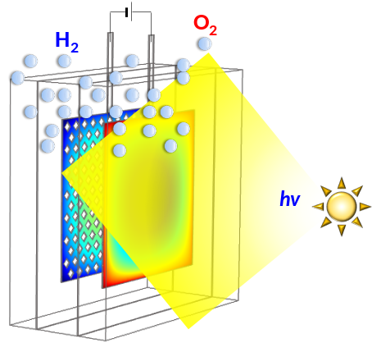
Lessons from solar water splitting prototype field tests
Anna Hankin
anna.hankin@imperial.ac.uk

Slide 2
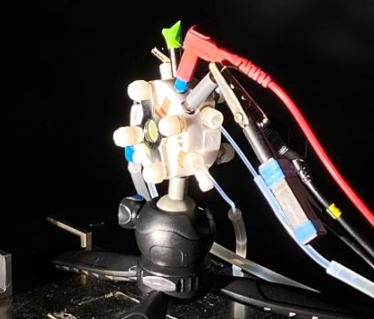
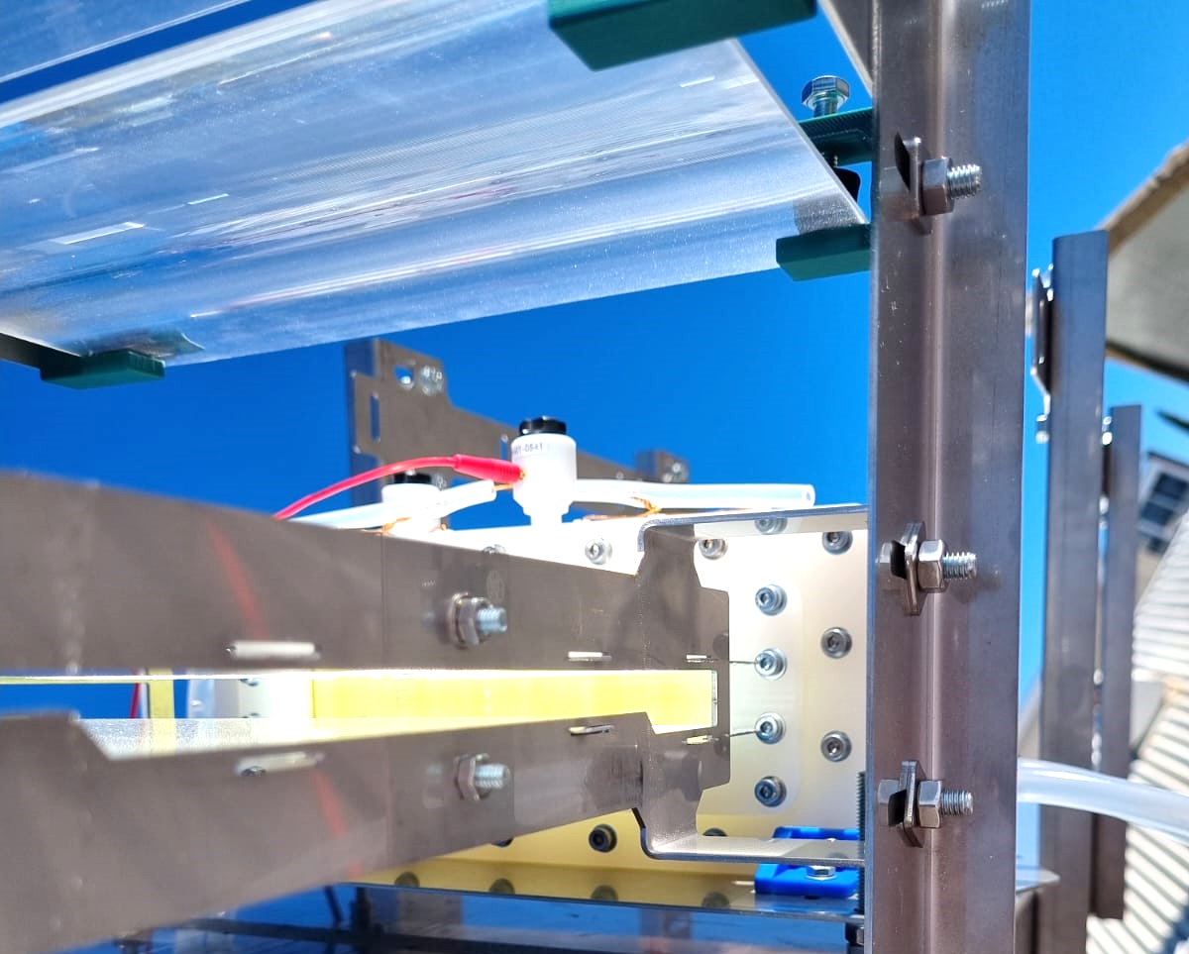
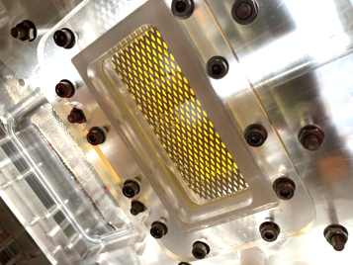
Materials and reactor development for photoelectrochemical hydrogen production
Aim:
Reactor development for up-scaled photoelectrochemical H₂ production
Key objectives:
Synthesis and optimization of photoelectrode materials
Development of optics for reactor irradiation
Operation and characterisation of up-scaled PEC reactor prototypes
~ 1 cm² scale
~ 30 - 50 cm² scale
2

Slide 3
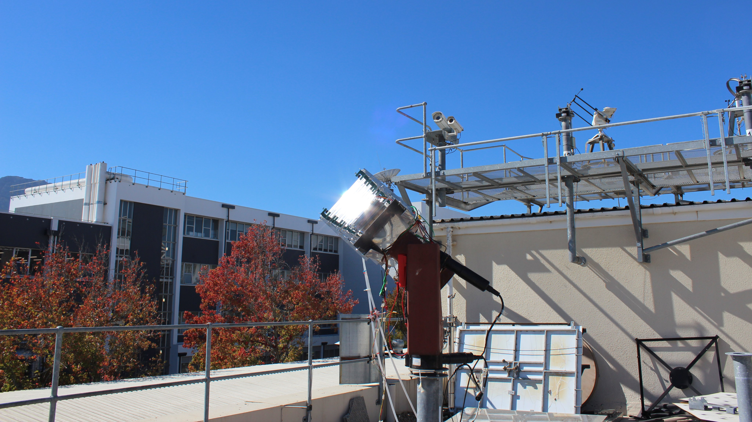
Stellenbosch, South Africa
Reactor + concentrator optics

Slide 4
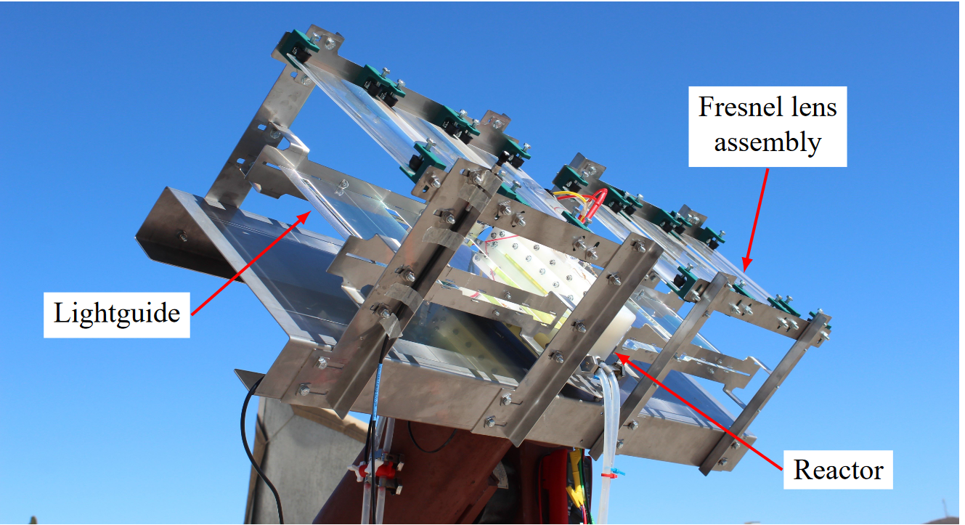
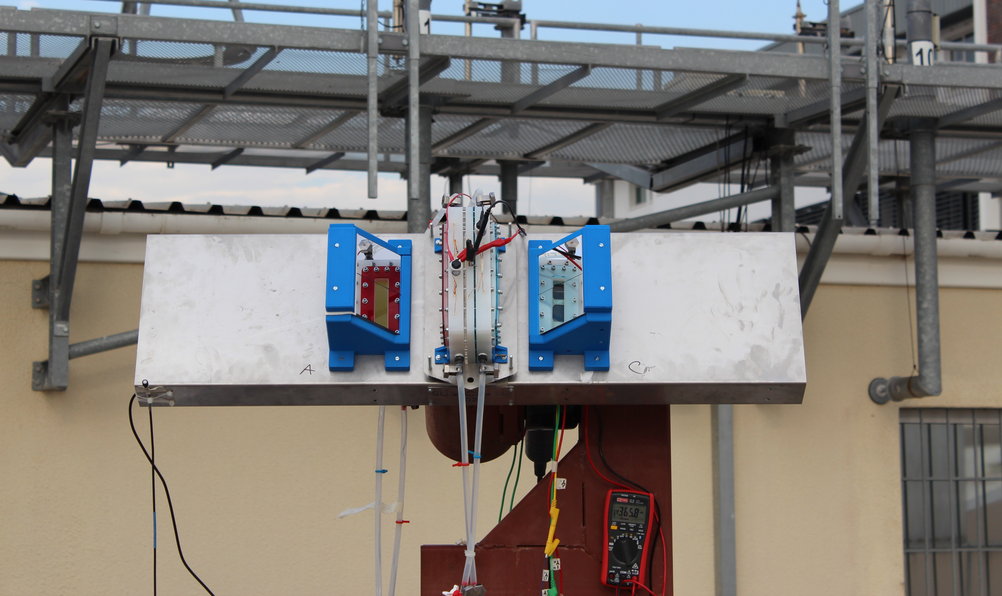
Coupling optics and photoelectrochemical reactors
  Light concentrated by a factor of four ( 4 suns)
  Light reflected by Al and Ag mirrors
Cosine receptor
Cosine receptor
Al-coated mirror
Ag-coated mirror
  Reactor + optics mounted on a 2-axis tracking platform
4

Slide 5
Different irradiance strategies

Slide 6
PV-biased photoelectrochemical device
Photoelectrochemical device
Device taxonomy: Nielander, Shaner, Lewis et al., Energy Environ. Sci., 8, 16 – 25 (2015)

Slide 7
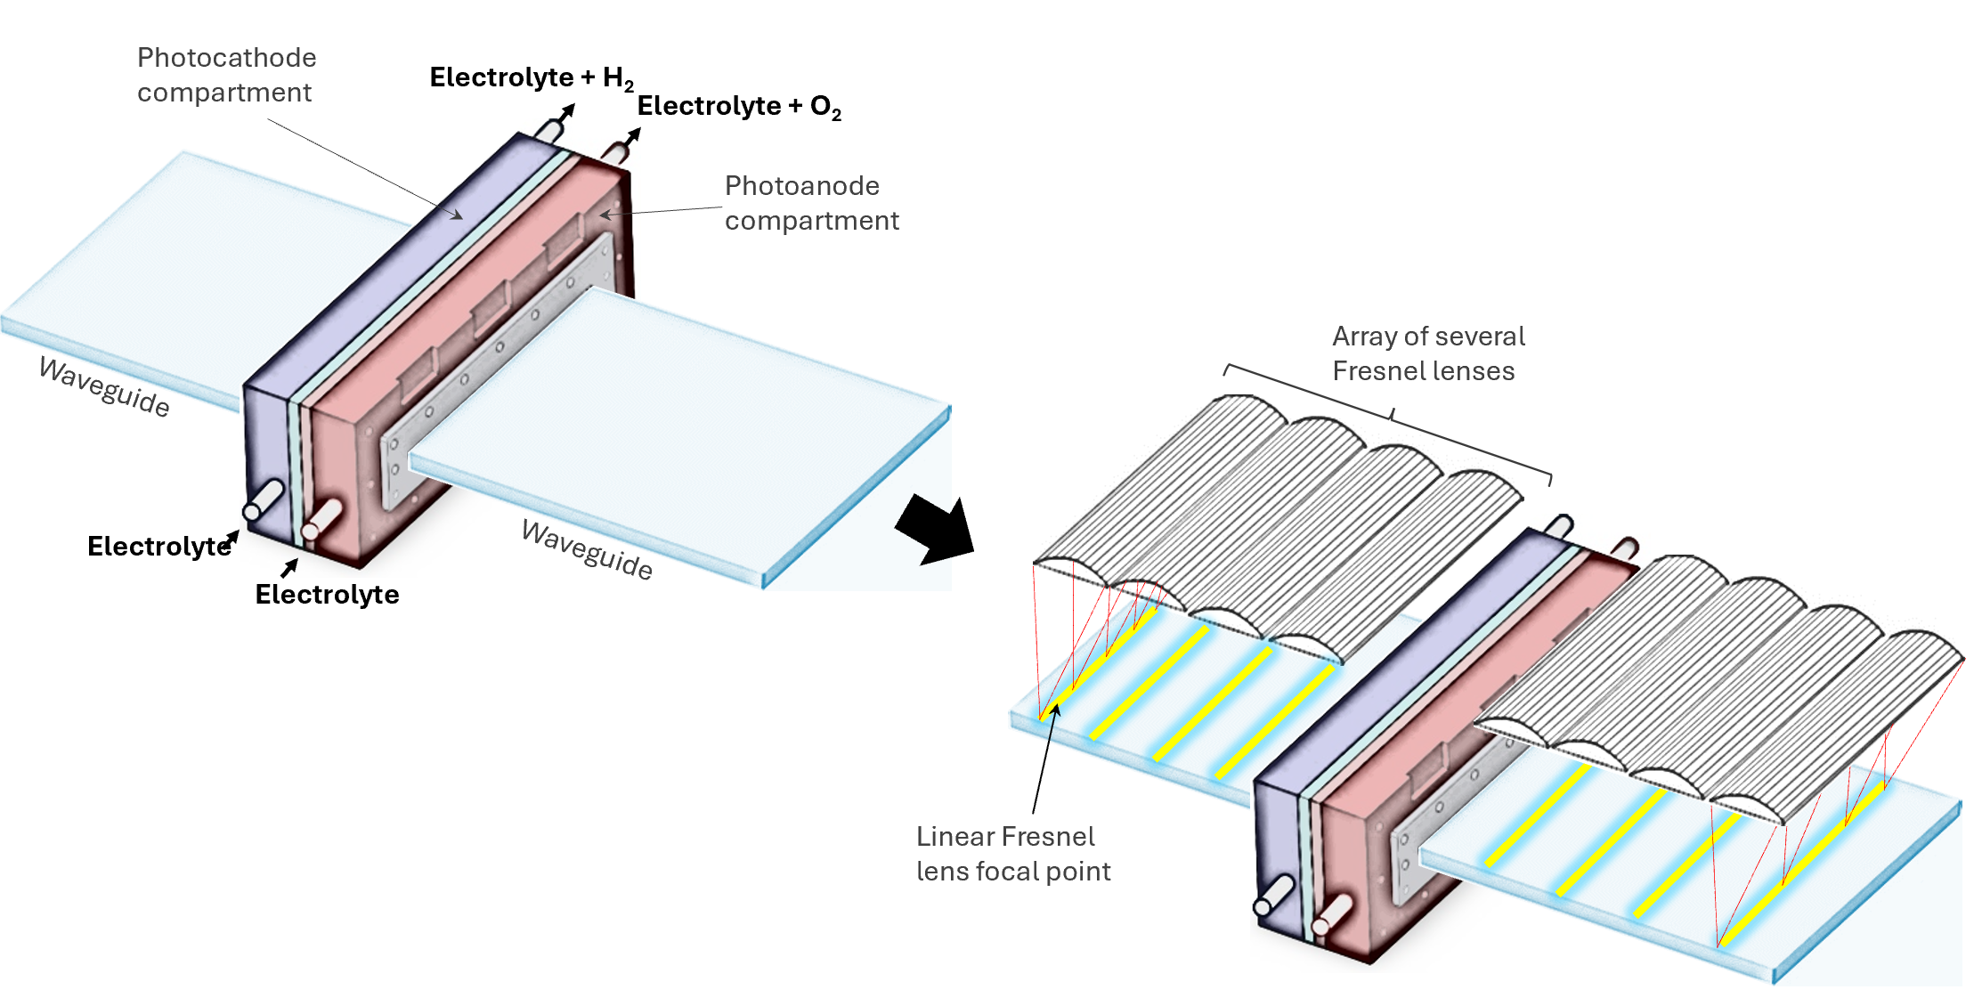
Optical concentration & two-sided irradiation
N. Vu and S. Shin, Energies, 2016, 9, 71
J. Karp et al., Opt. Express, 2011, 19, 673

Slide 8
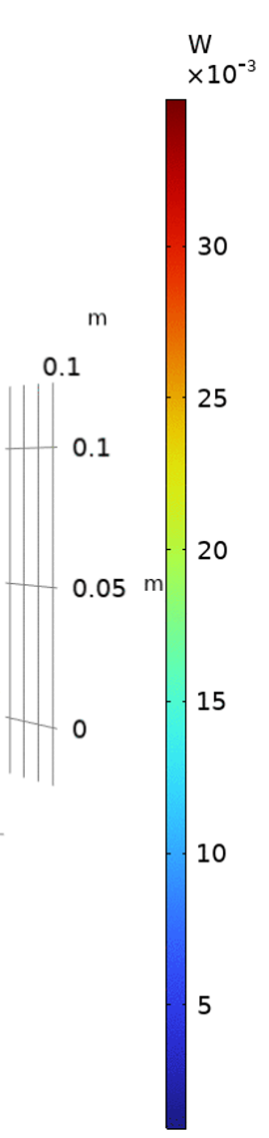
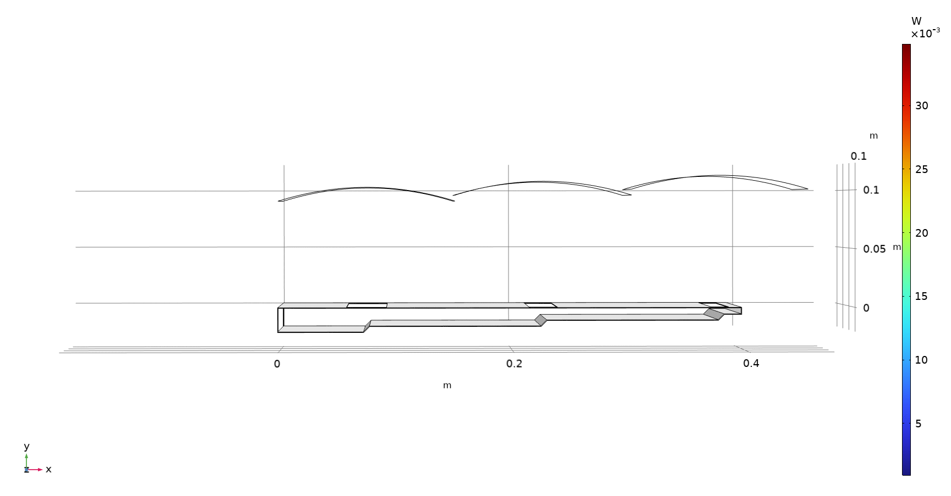
Light concentration using linear Fresnel lenses and waveguides (COMSOL Multiphysics model)
Linear Fresnel lens #3
Linear Fresnel lens #2
Linear Fresnel lens #1
Waveguide edge
/ light fed into PEC reactor
Stepped waveguide

Slide 9
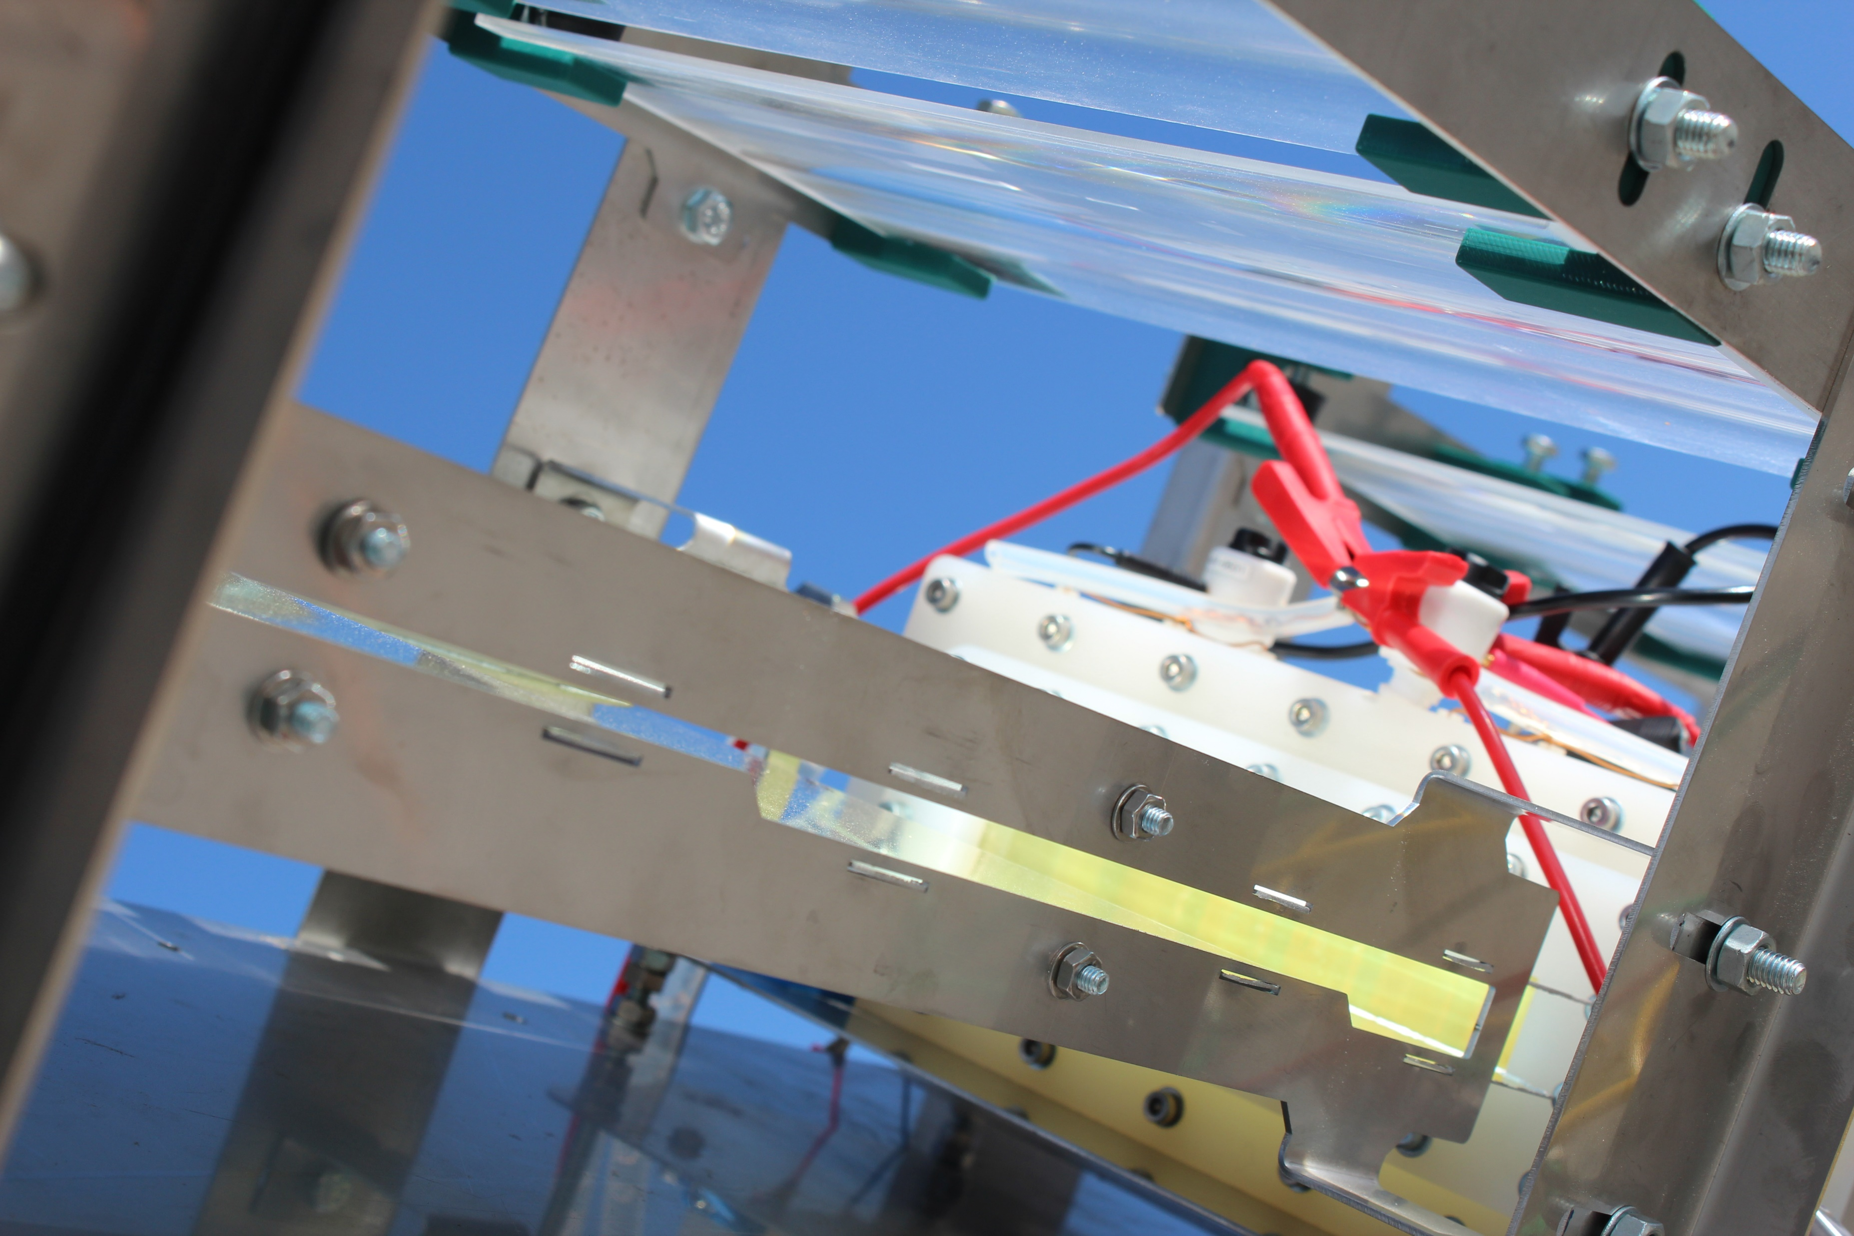
9

Slide 10
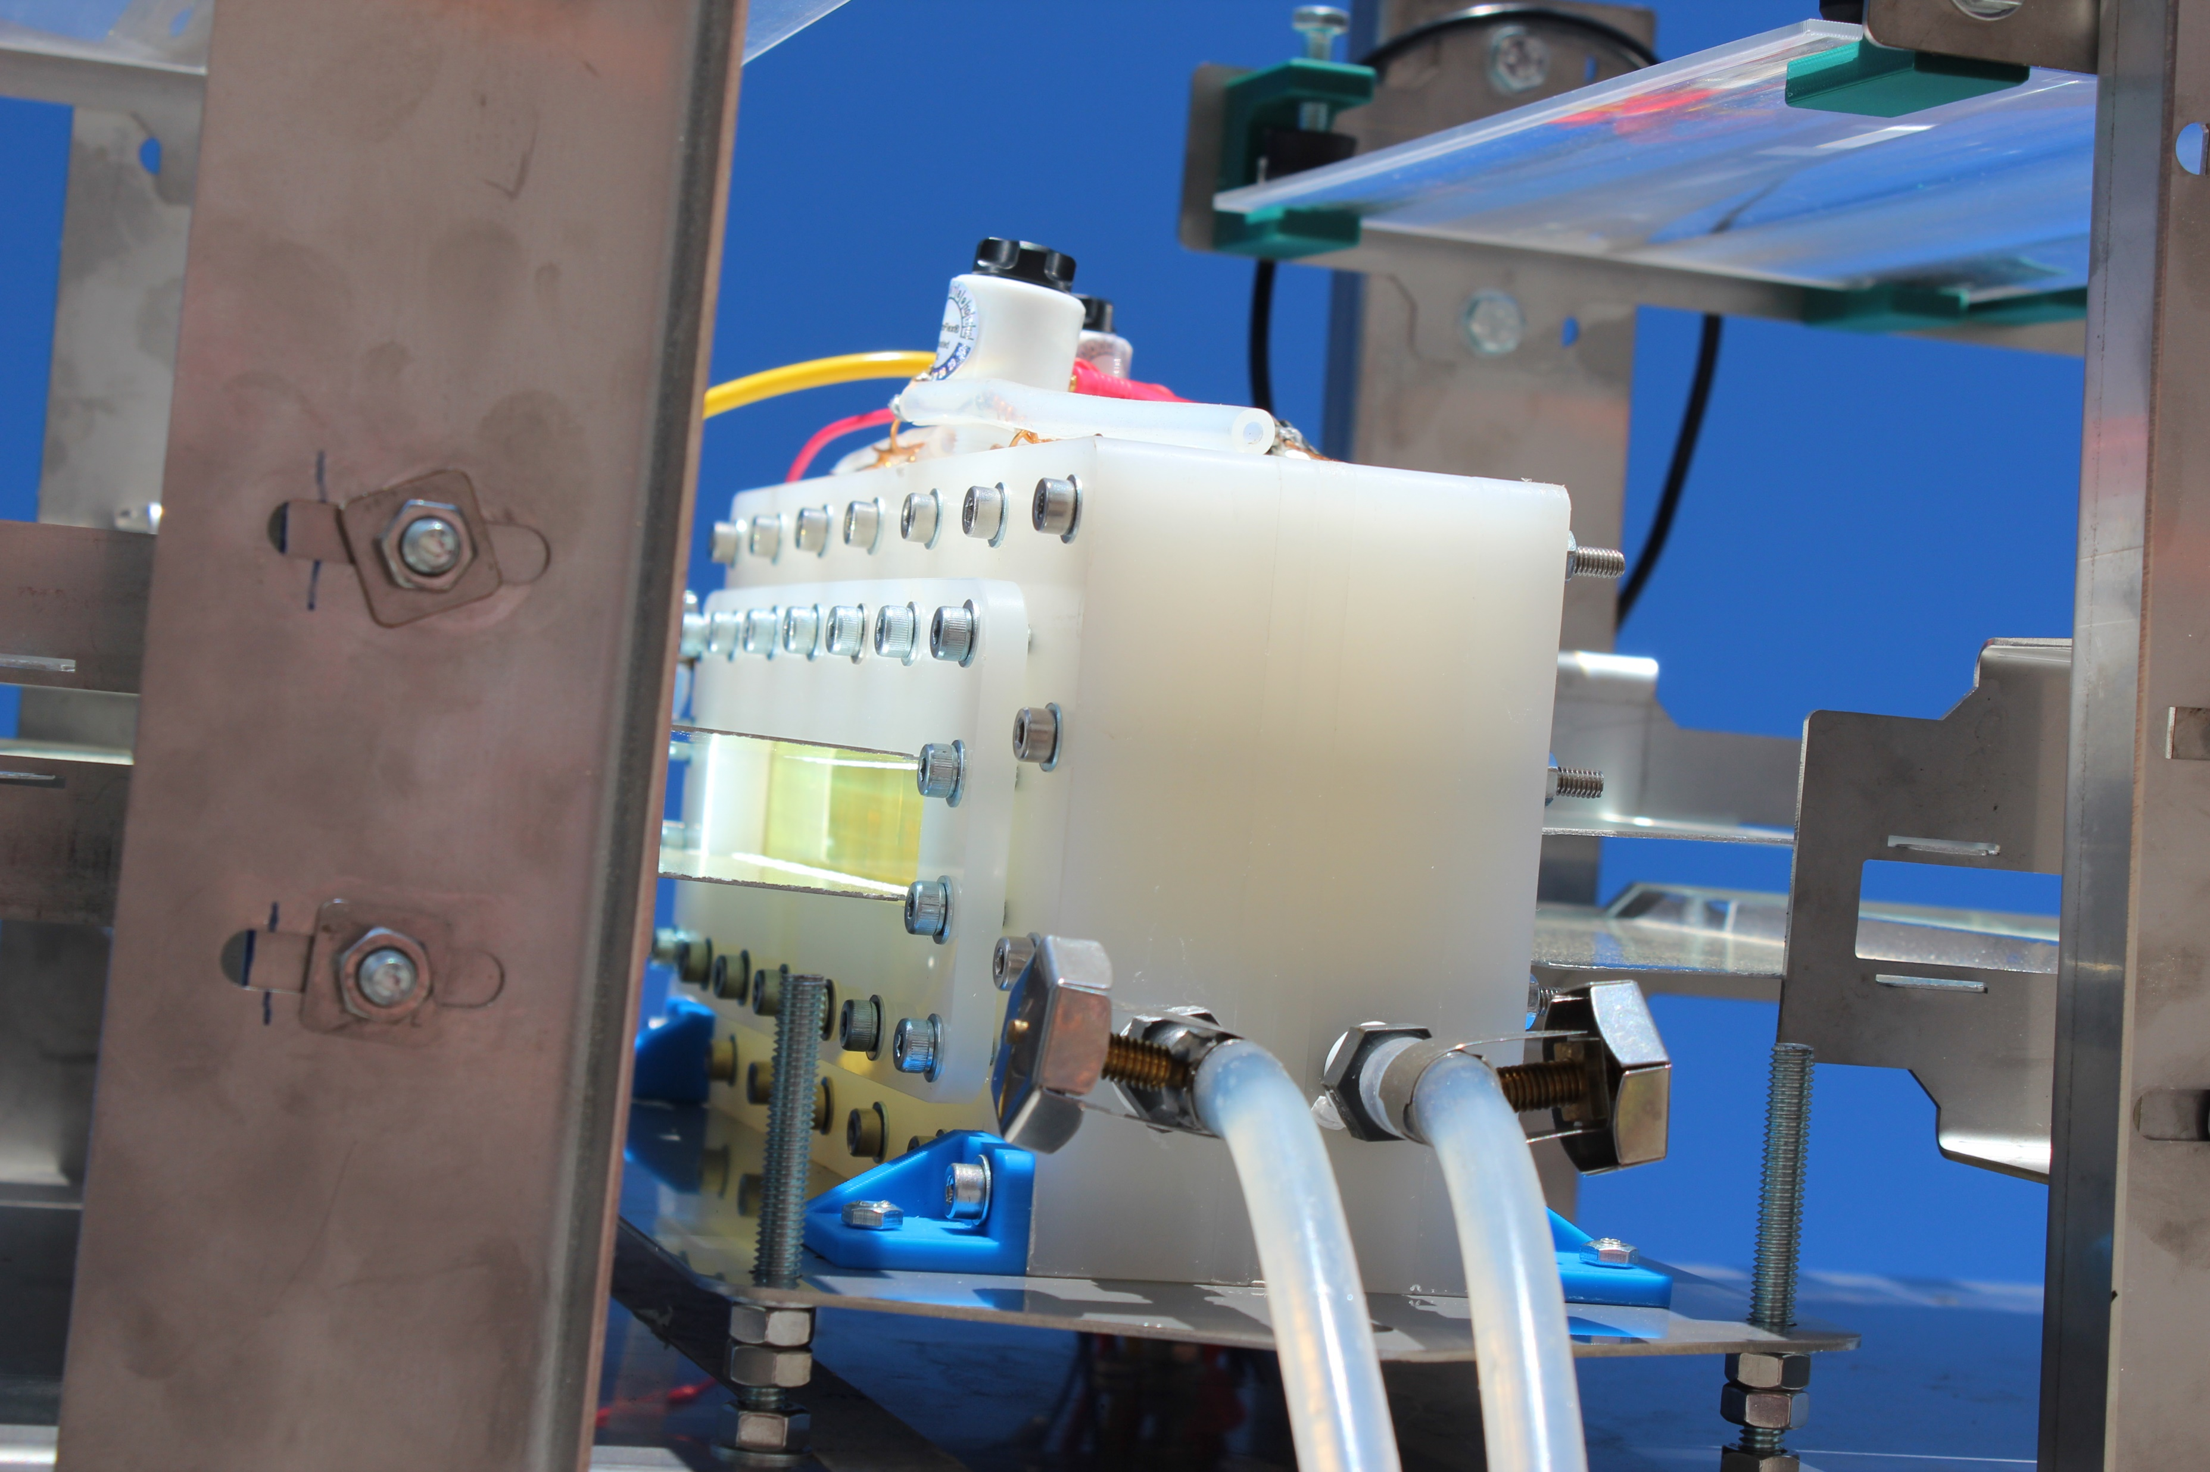
10

Slide 11
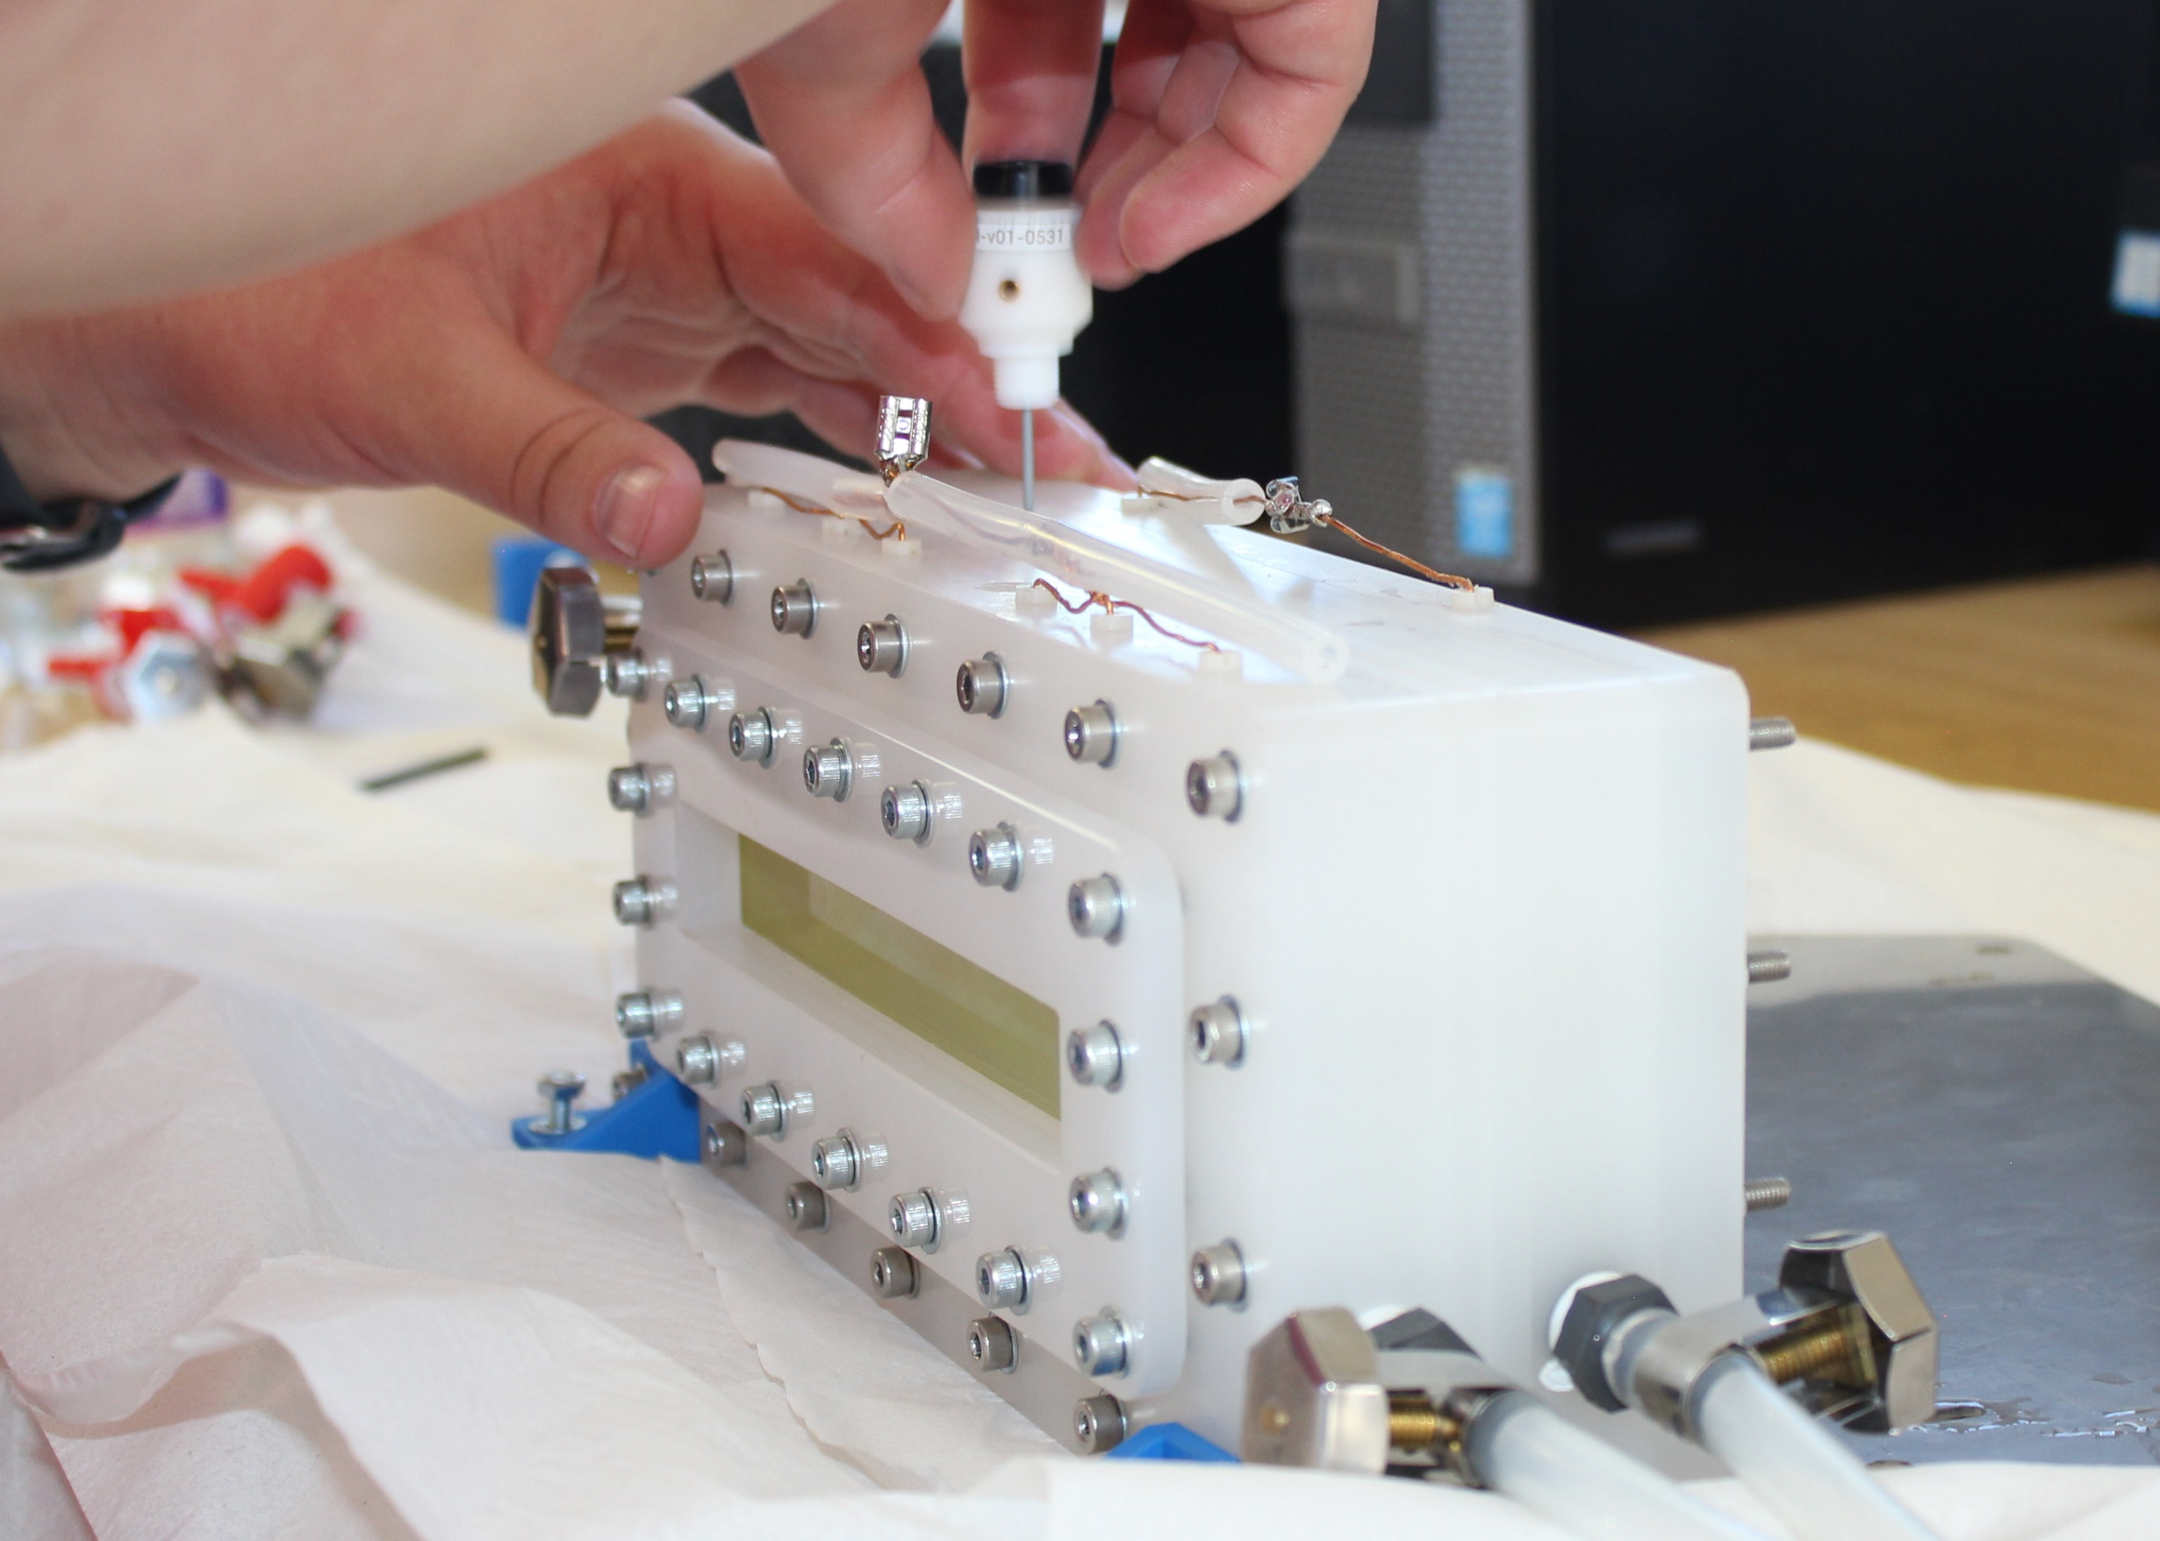
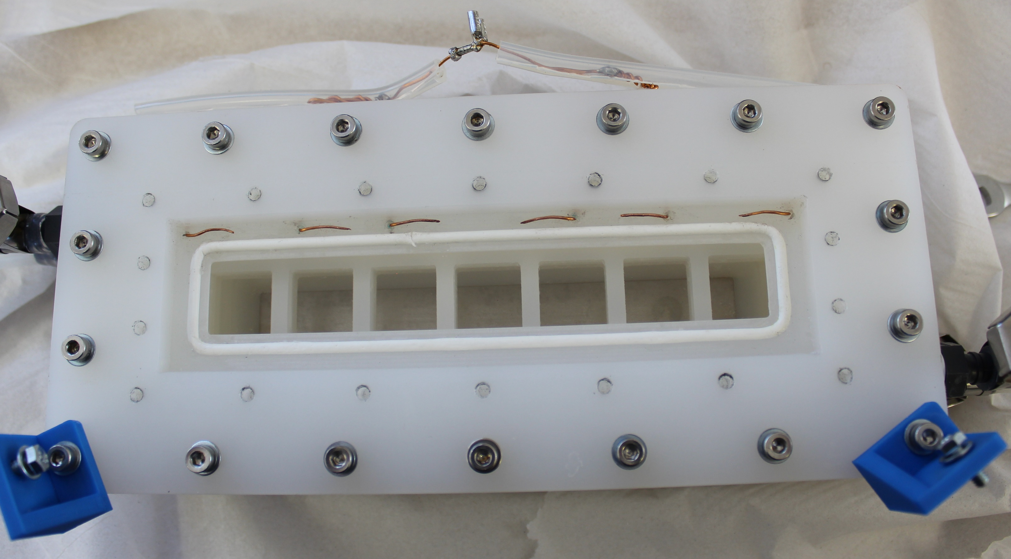
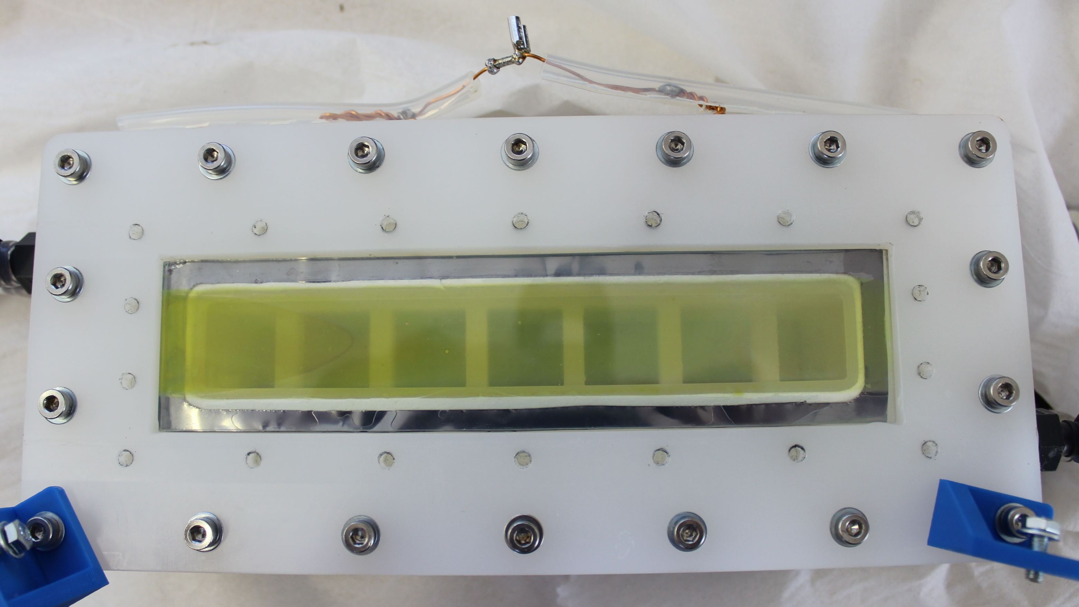
RHE reference electrode
Electrical contacts
Flow inlets
Ta foil current collector
11

Slide 12
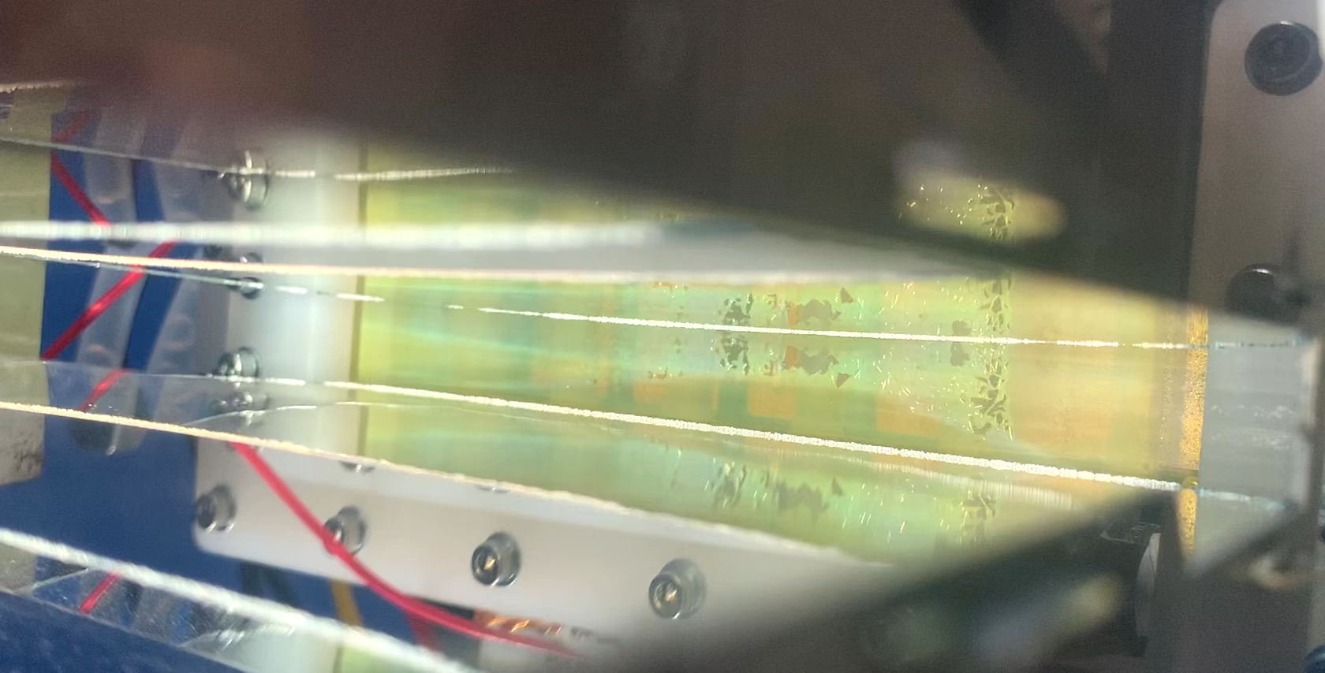
FTO / WO₃ / BiVO₄ / NiOOH photoanode degradation under 4 x sun irradiance
12

Slide 13
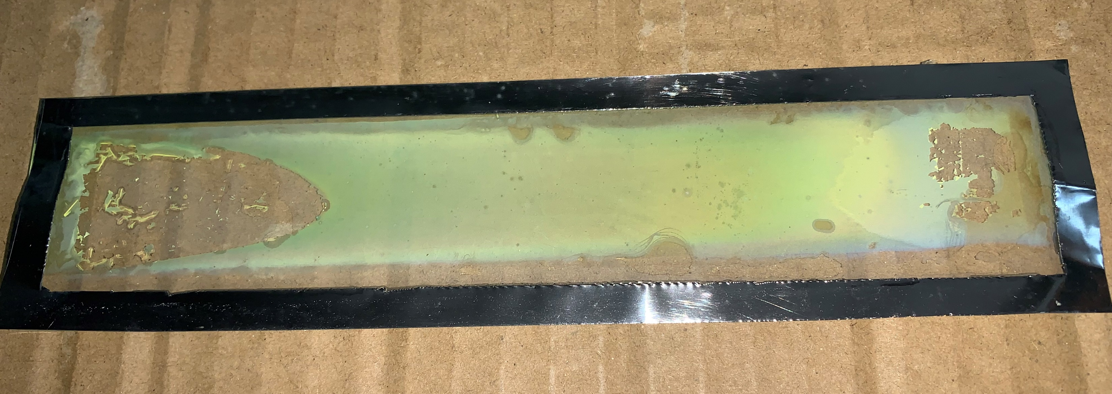

Slide 14
Why double-sided irradiation?

Slide 15
Optical and electronic pathways:
-
+
PV
-
+
Other modes of operation?
H₂O
H₂O
H₂O
H₂O
PV
Quartz
WO₃/ BiVO₄
Quartz
Ni mesh
Membrane
WO₃/ BiVO₄
Membrane
Ni mesh
Optical pathway
Optical pathway
Photoanode: FTO/WO₃/BiVO₄/NiOOH
Cathode: Nickel mesh
Photoactive area: 36 cm²
Membrane: Nafion 115
Electrolyte: pH7, 0.1 M KPi (K₂HPO₄/KH₂PO₄)
15

Slide 16
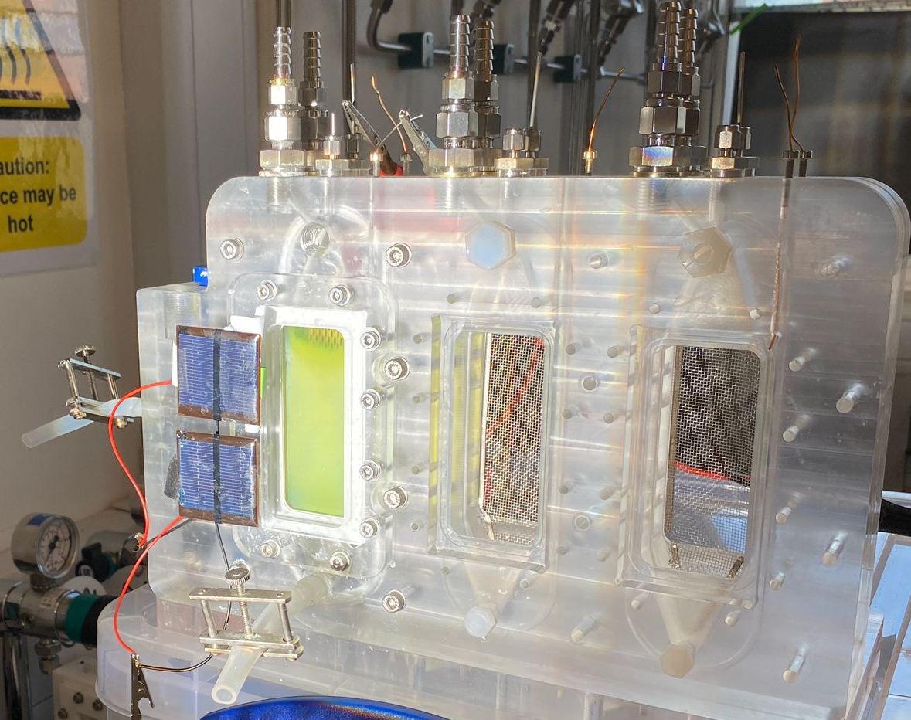
16

Slide 17
PV-PEC operation: side-by-side or tandem?
WO₃/BiVO₄/NiOOH electrode with 0.5 M Na₂SO₃ hole scavenger.
PVs in tandem vs side-by-side, with WO₃/BiVO₄ /NiOOH electrode with 0.5 M Na₂SO₃
17

Slide 18
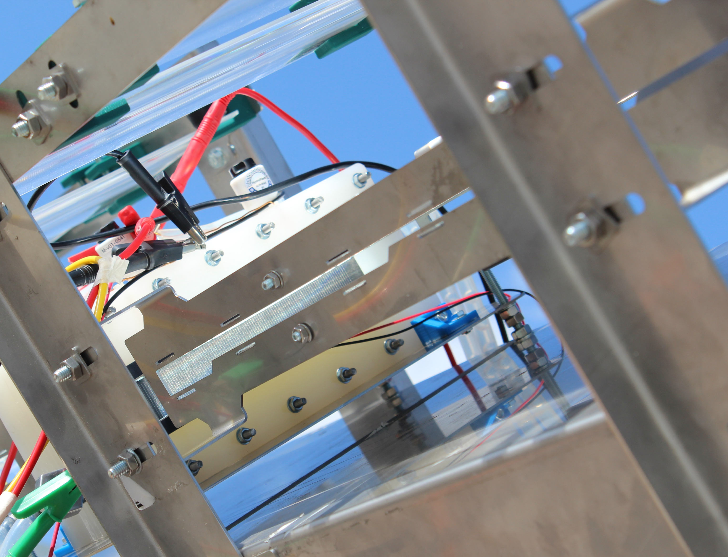
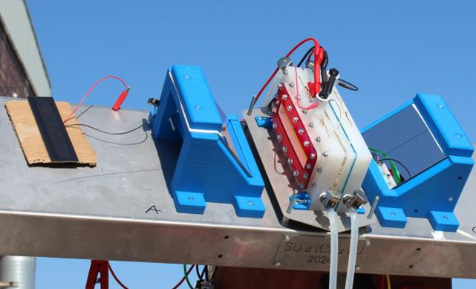
With concentrator optics
Directly irradiated

Slide 19
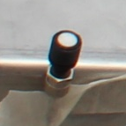
Irradiance measurements
A spectrophotometer is needed!
Cosine receptor

Slide 20
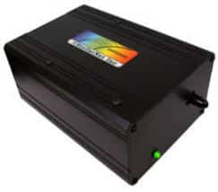
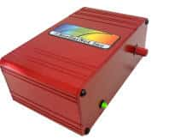
Our Abet Technologies Solar Simulator output (with AM 1.5 filter)
TiO₂
Si
20

Slide 21
Spectral response of a Si photodiode
Low sensitivity!
21

Slide 22
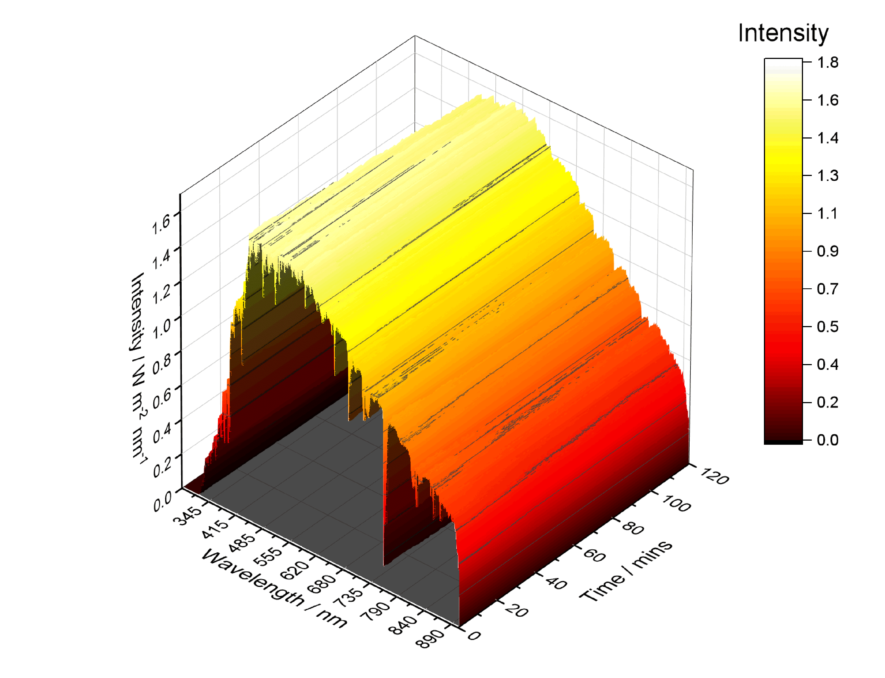
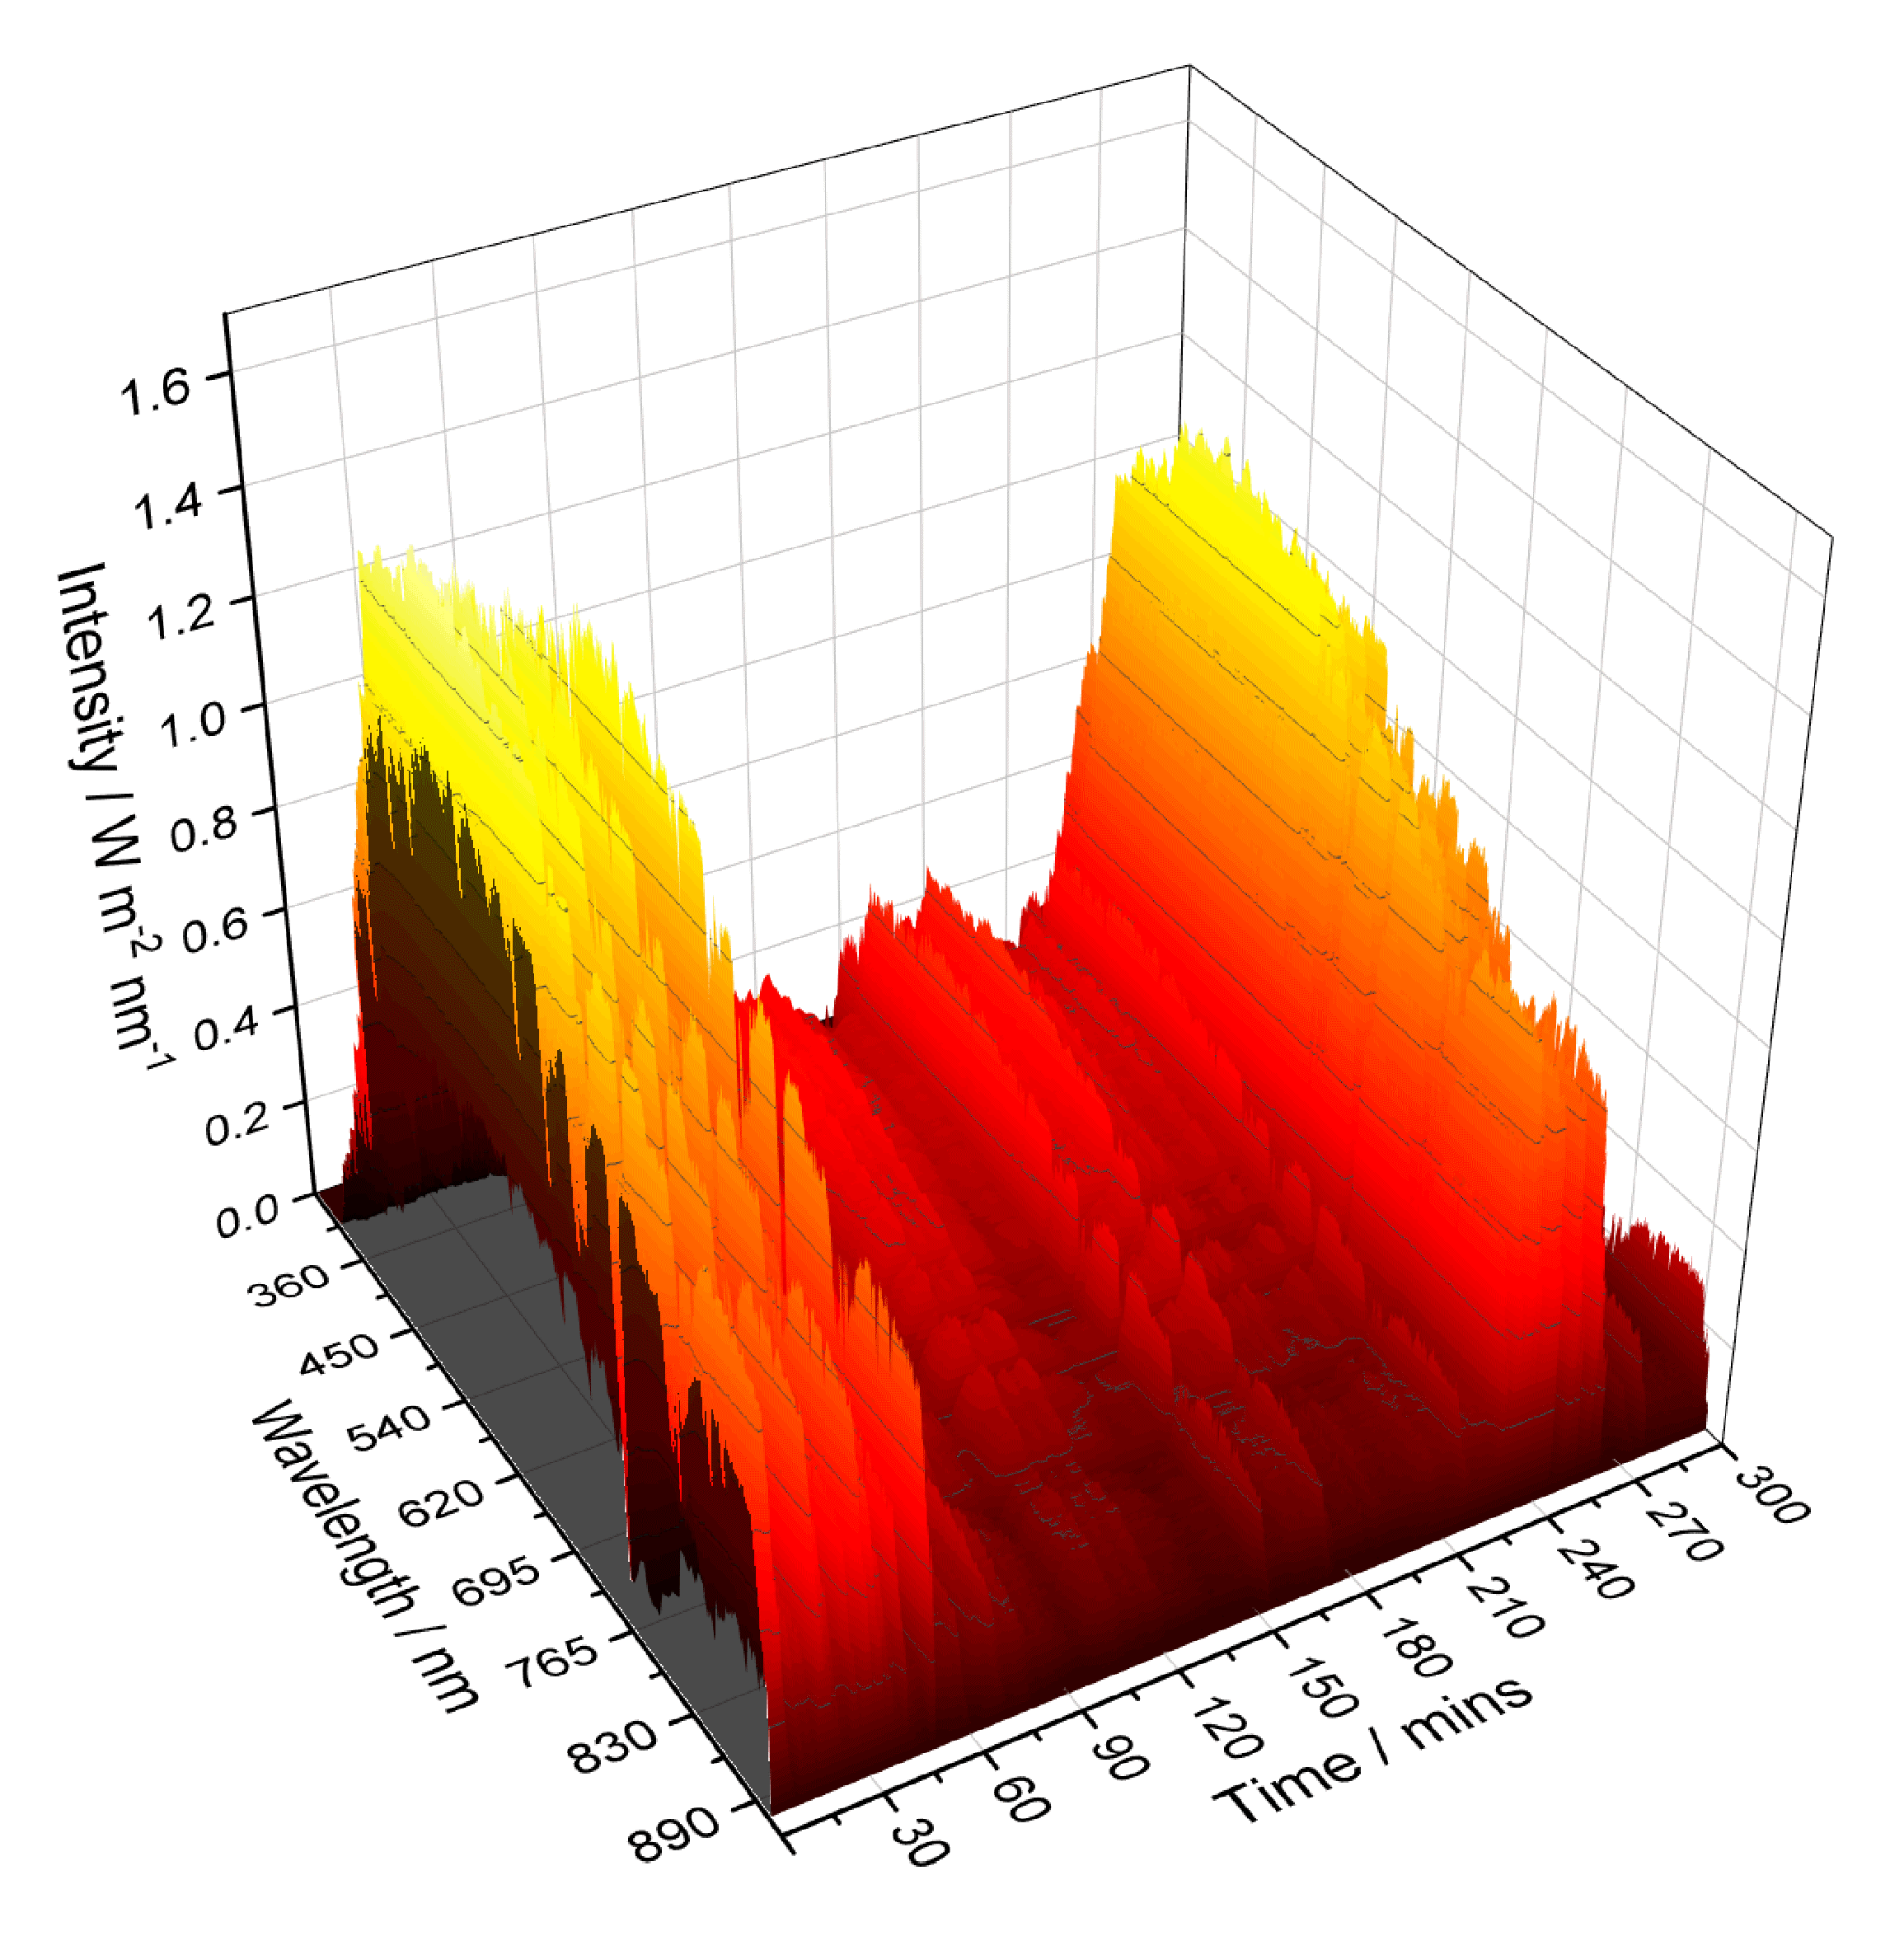
Temporal measurements recorded during experiments at Stellenbosch
Cloudless day
Cloudy day
22

Slide 23
Photoelectrode materials
& other components

Slide 24
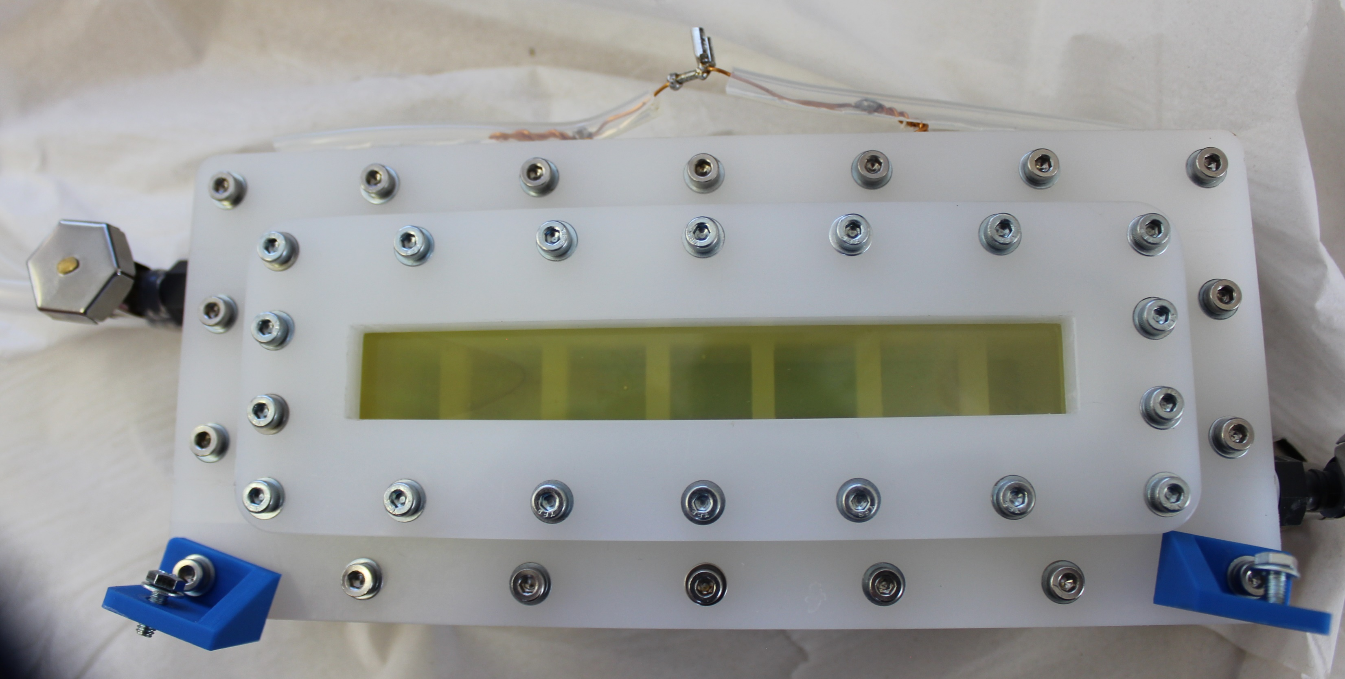
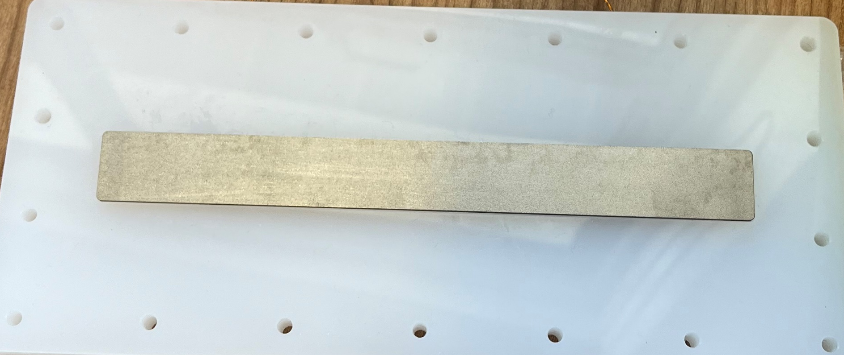
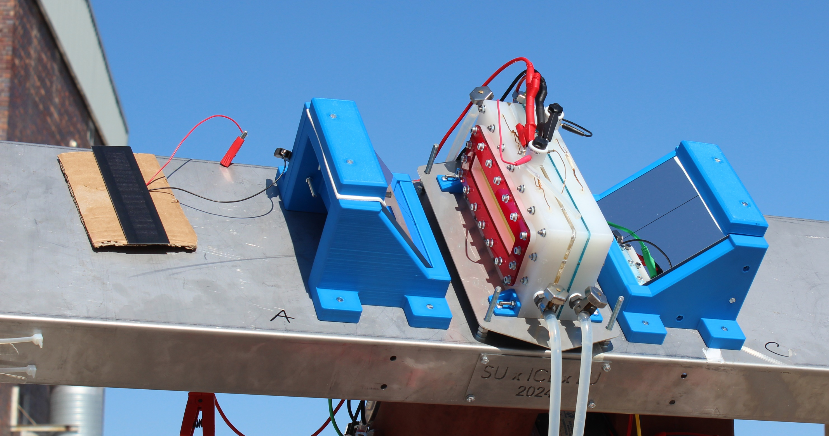
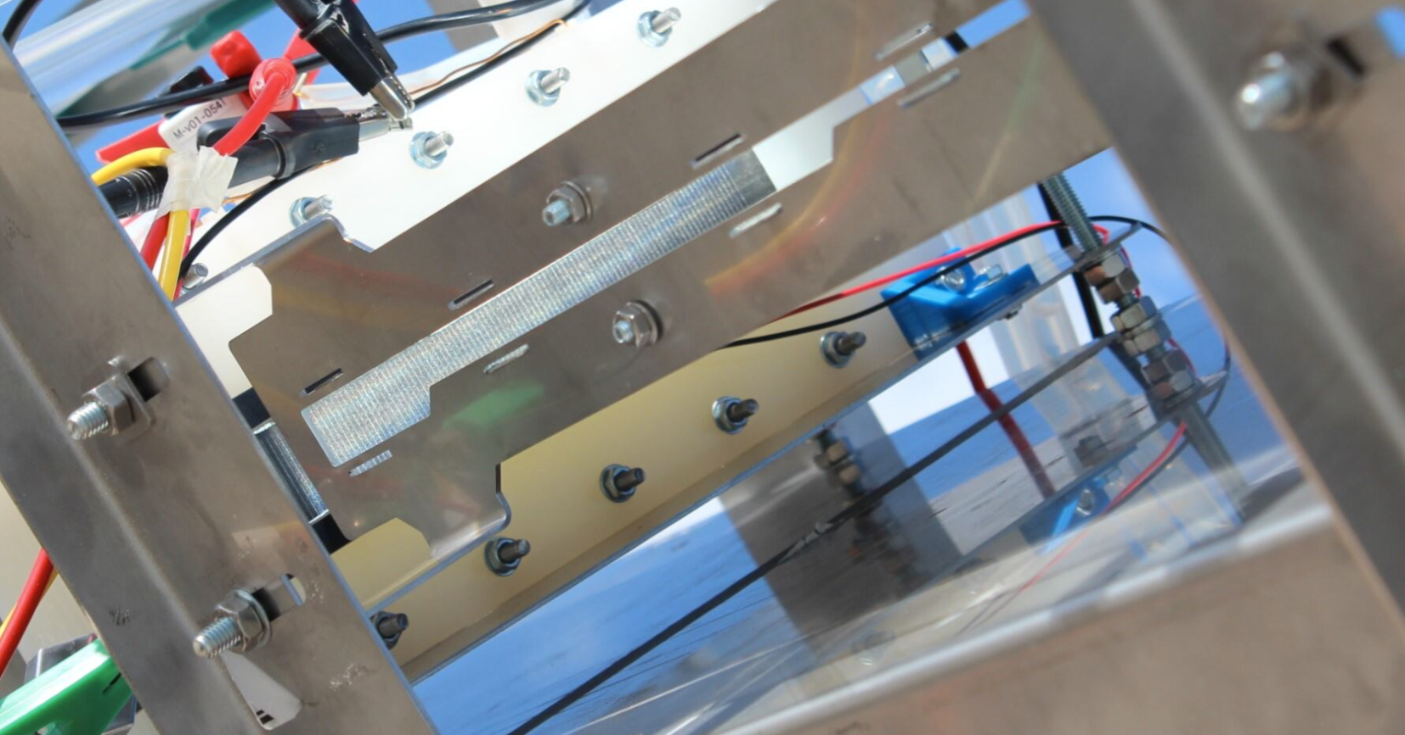
Materials
For non-concentrated & concentrated irradiance tests
  FTO / WO₃ / BiVO₄ / NiOOH photoanode (15 cm x 2 cm)
    1M pH 9 borate buffer
    Ta foil current collector (insulated from electrolyte)
    Back-side illumination
  Cation permeable membrane (Nafion 115)
  Ni cathode
    1M pH 9 borate buffer
  c-Si PV (Mr Watt, Italy)
    Mounted externally

Slide 25
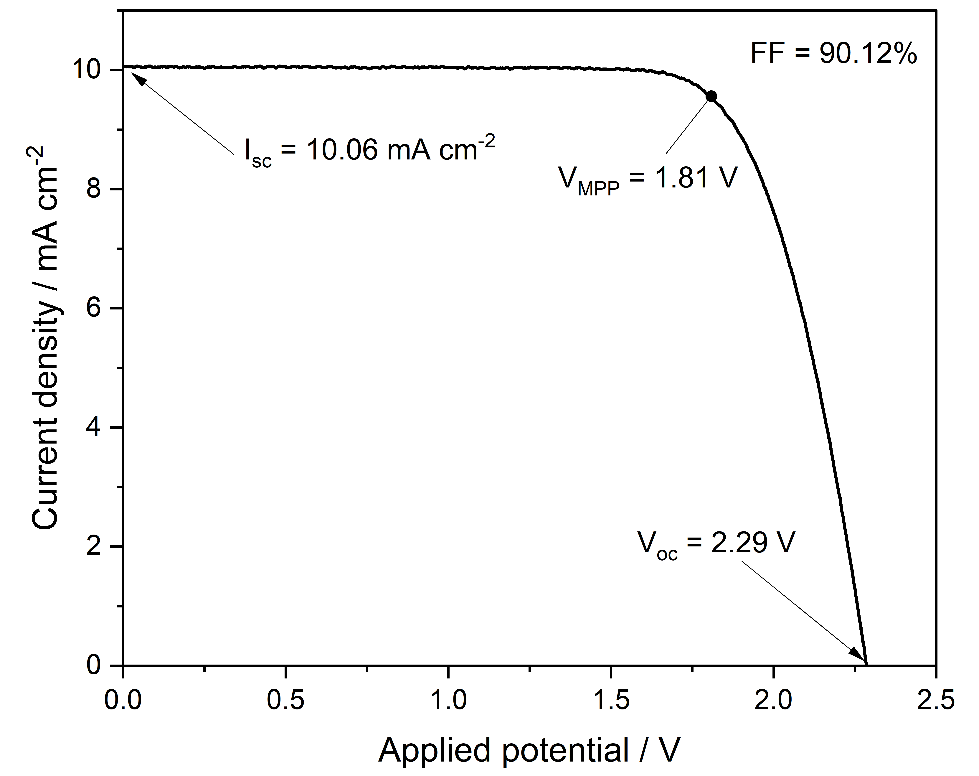
  c-Si PV (Mr Watt, Italy)
30 cm² PV cell (Mr Watt, Italy), under continuous illumination by simulated sunlight (AM 1.5 G, 100 mW cm⁻²). Power output = 621 mW

Slide 26
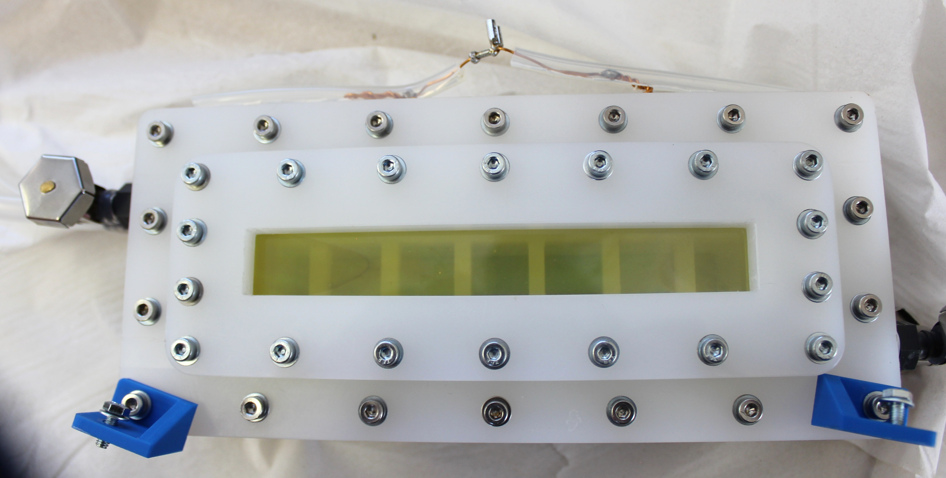
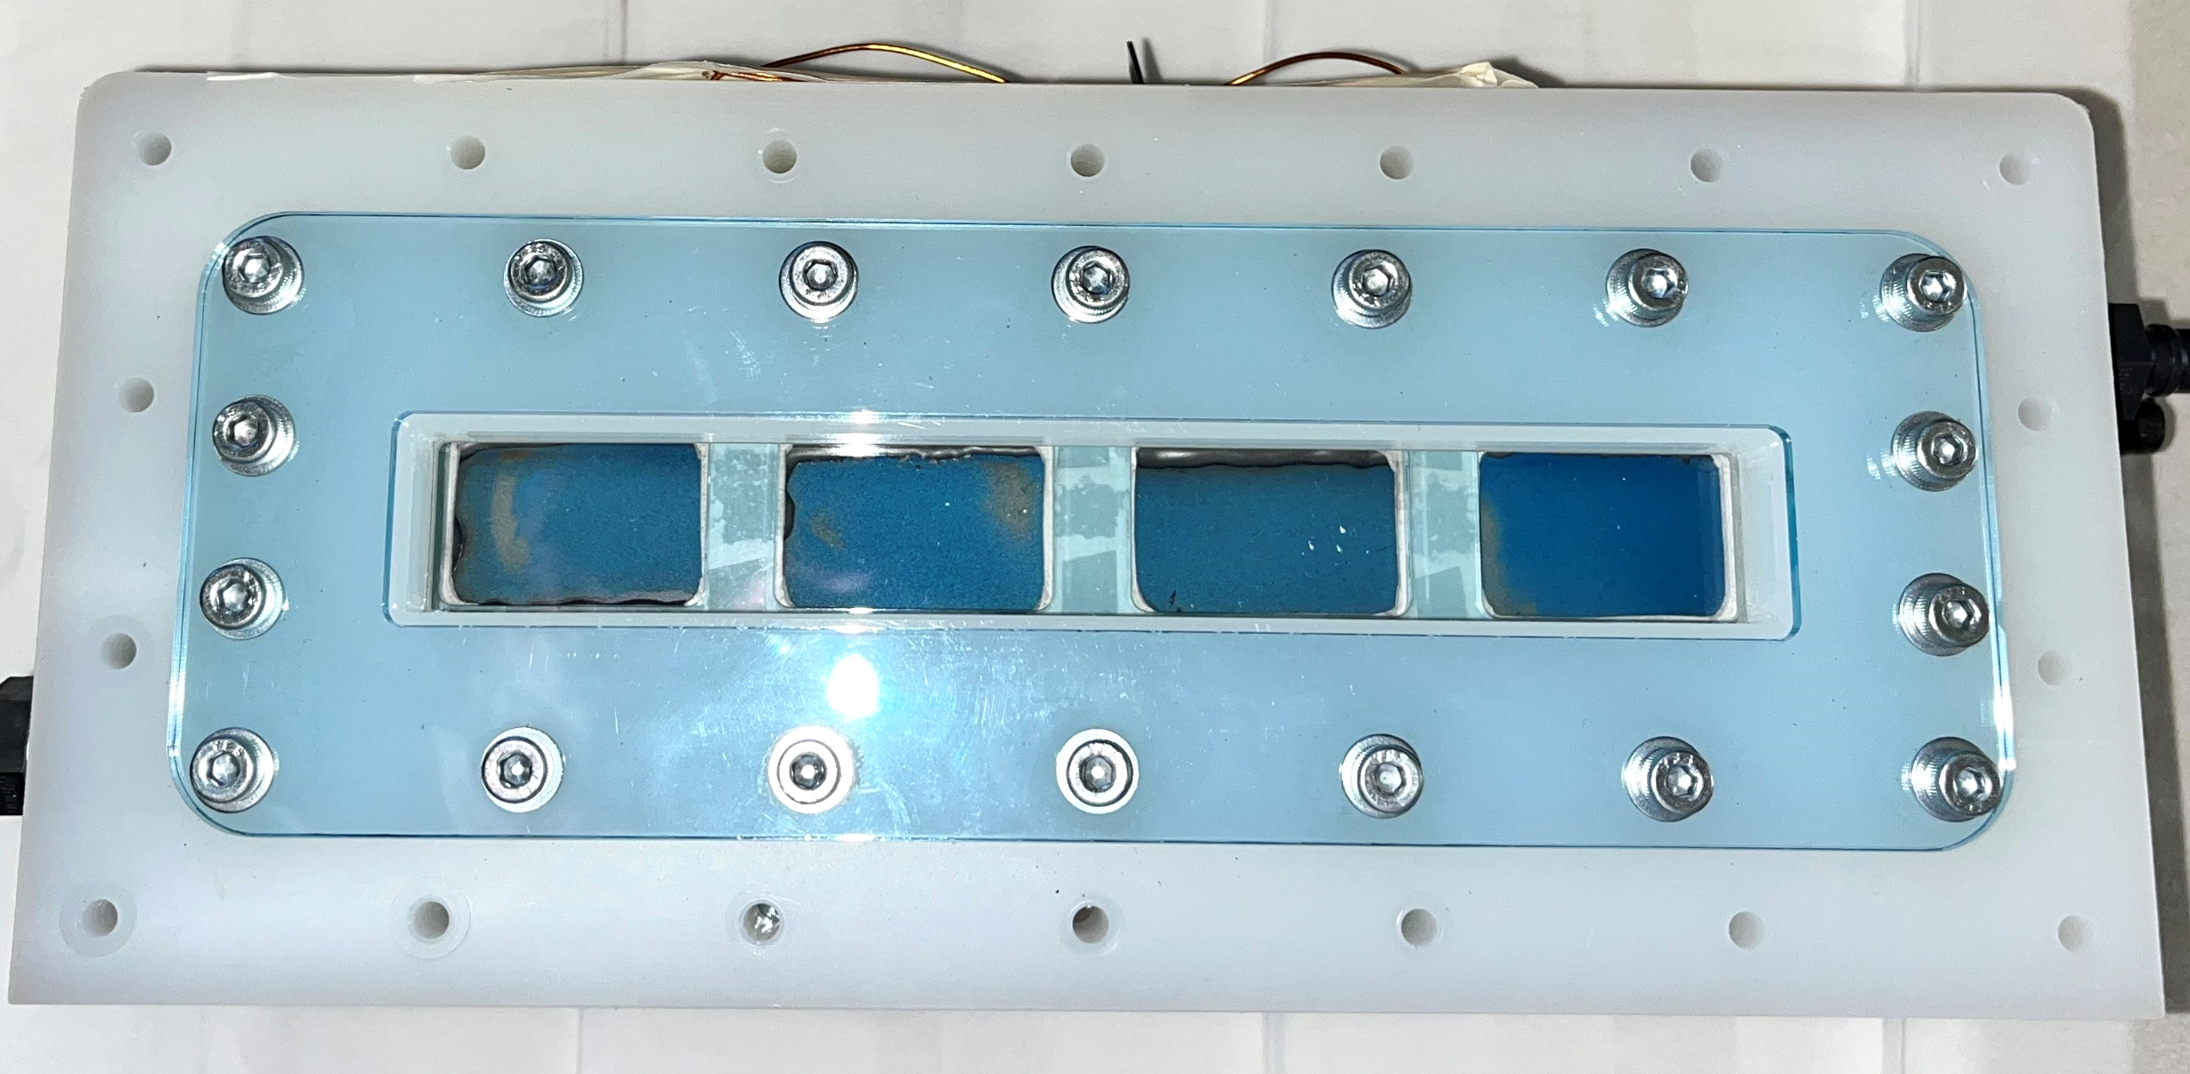
Materials
For non-concentrated irradiance tests with mirrors:
  FTO / WO₃ / BiVO₄ / NiOOH photoanode (15 cm x 2 cm)
    1M pH 9 borate buffer
    Tantalum foil current collector (insulated from electrolyte)
    Back-side illumination
  Cation permeable membrane (Nafion 115)
  FTO / Au / Sb₂Se₃ / CdS / TiO₂ / Pt photocathode (s)
  (4 lots of 3 cm x 2 cm, connected in parallel)
    0.1 M H₂SO₄
    Tantalum backing foil current collector
    Front-side illumination

Slide 27
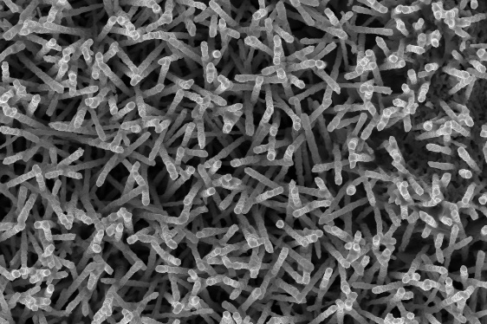
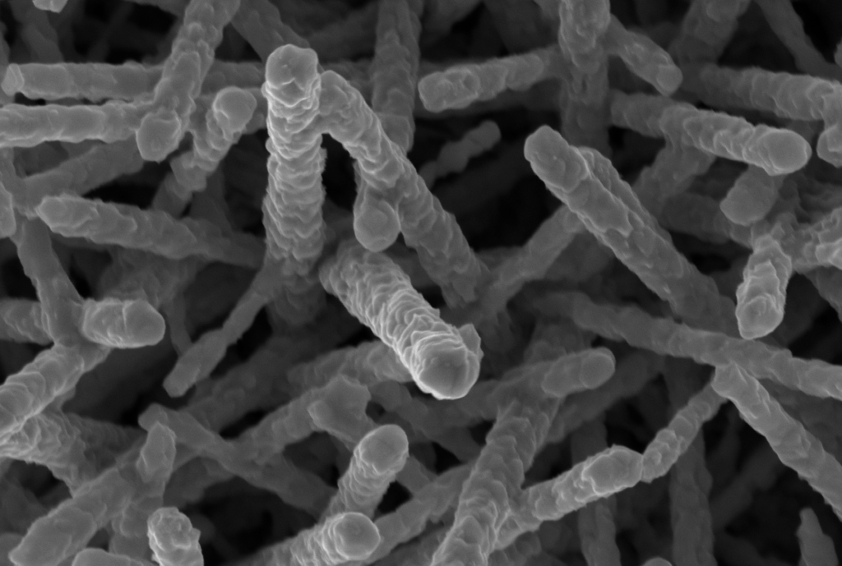
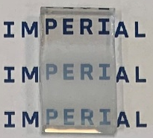
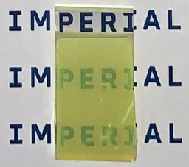
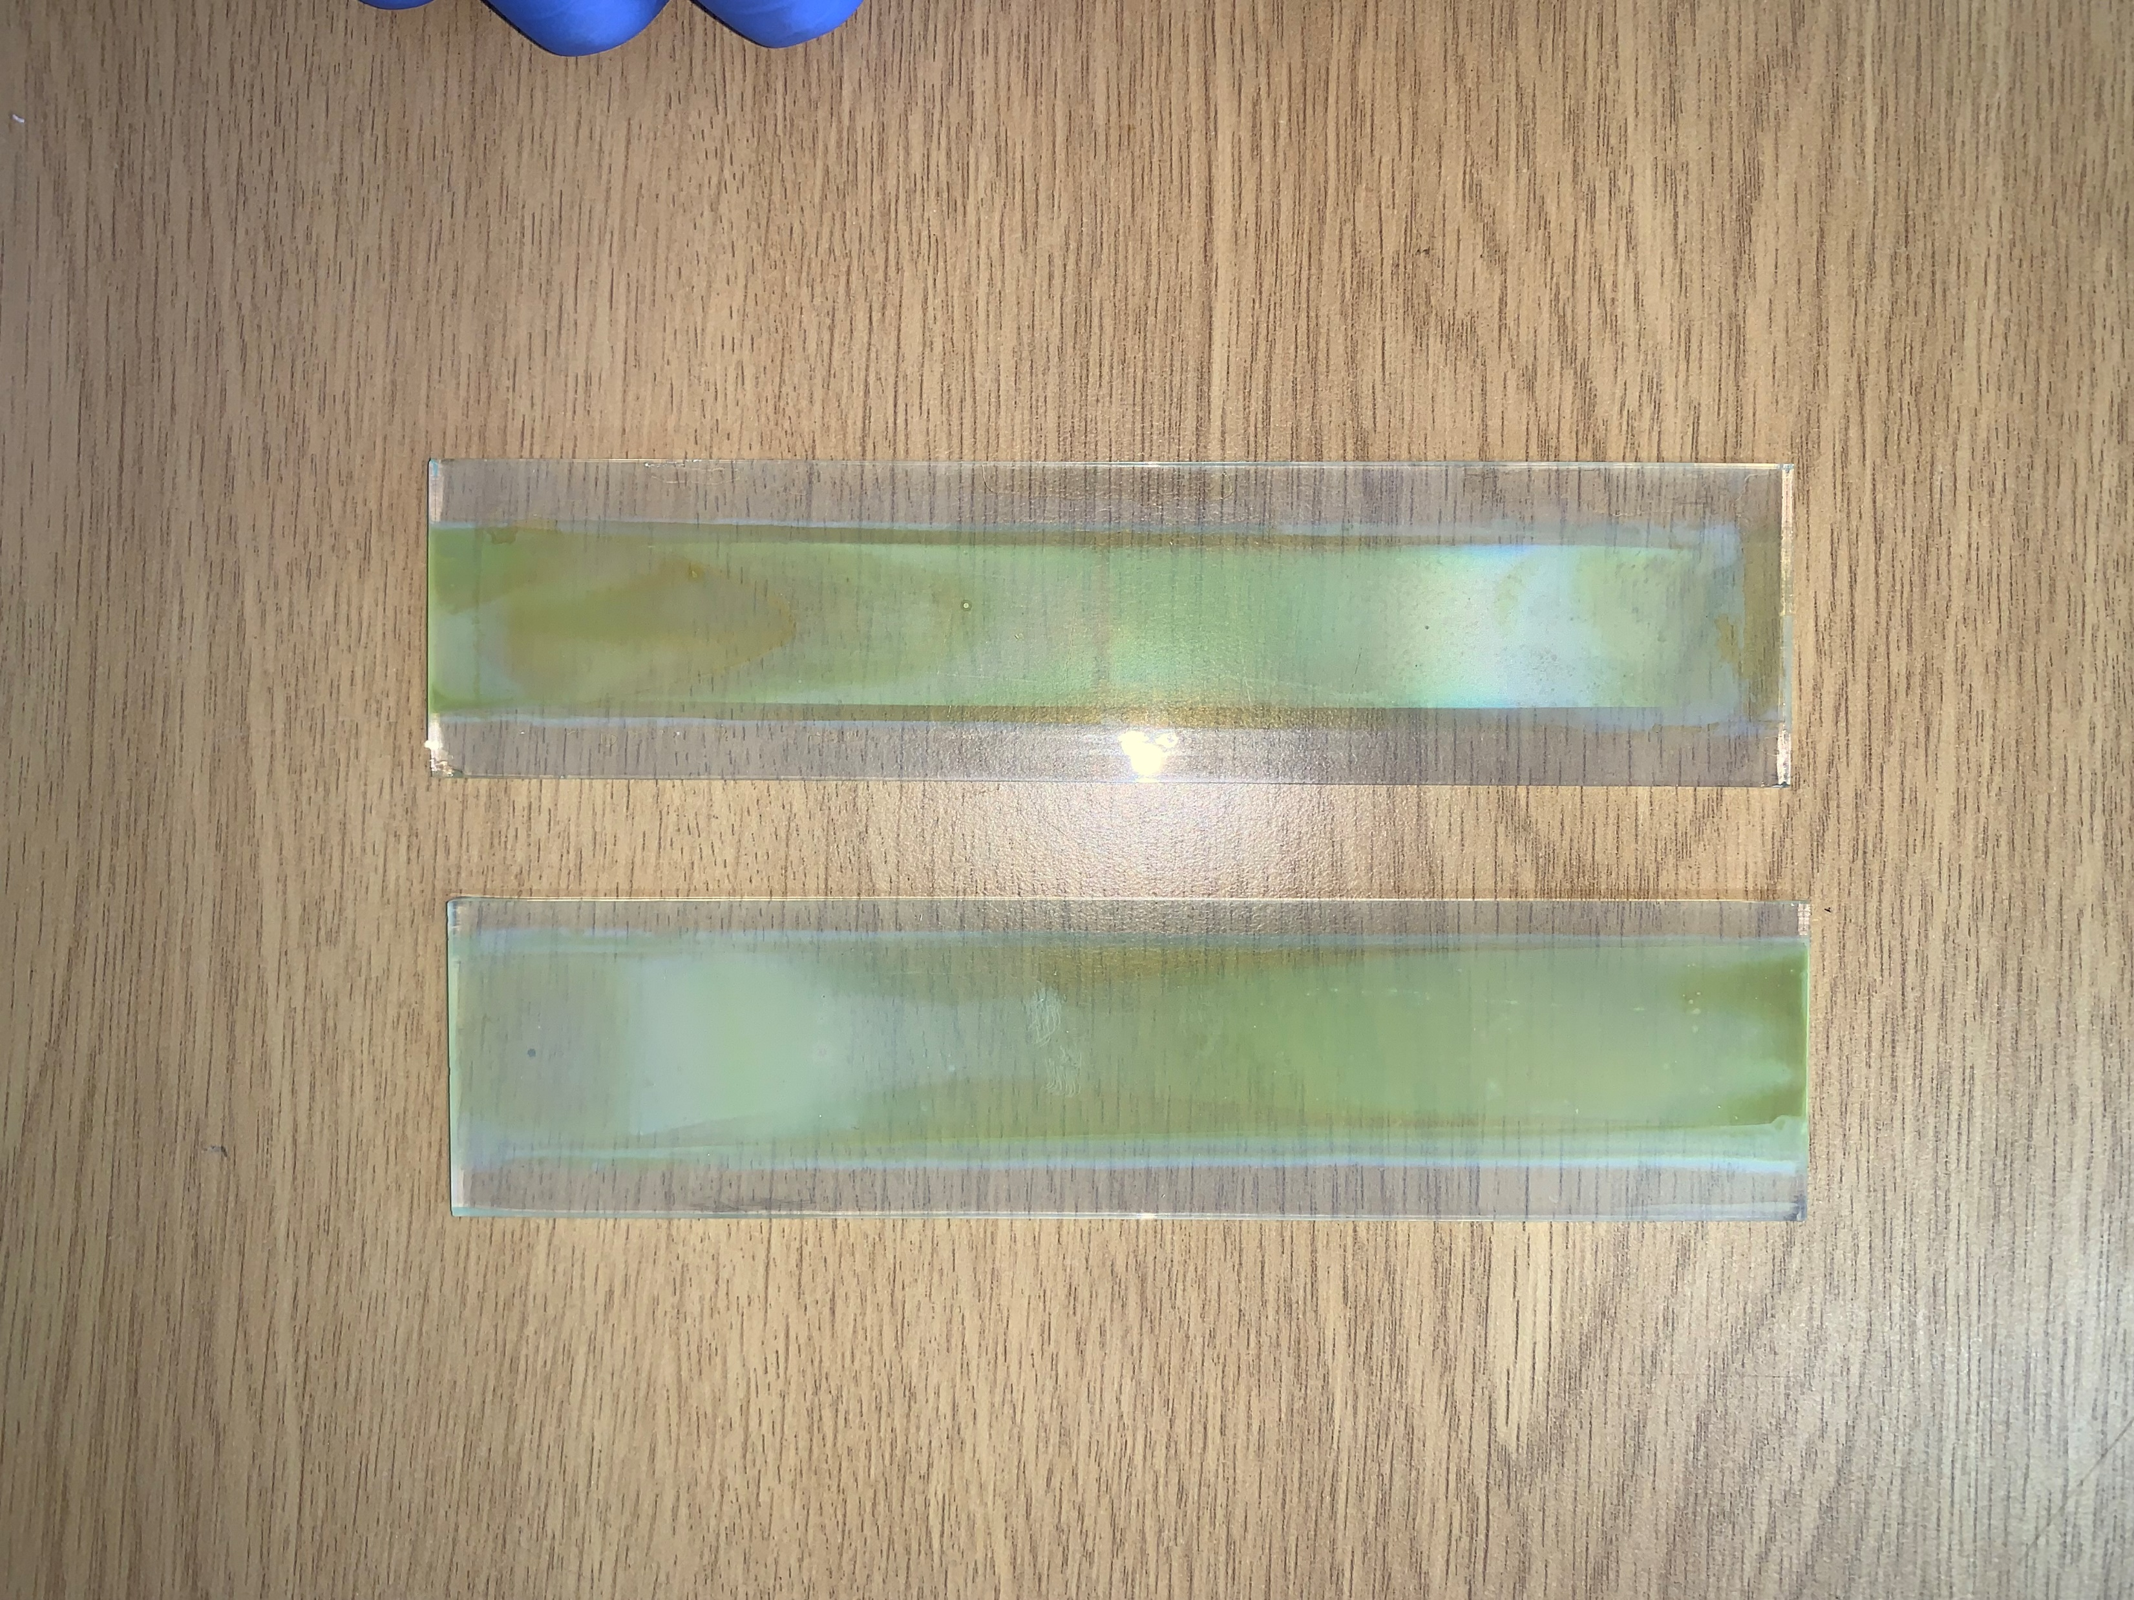
Engineering photoanodes for up-scaled solar water splitting
FTO | WO₃ nanoneedles
FTO | WO₃ nanoneedles | BiVO₄ | NiFeOOH
500 nm
500 nm
1 µm
200 nm
2.5 cm
1 µm
1.5 cm
17 cm
4 cm
27

Slide 28

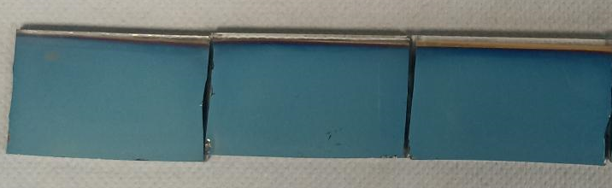
Engineering photoelectrodes for up-scaled solar water splitting
High-performance and stable photocathodes for solar water splitting
3 electrode arrangement
FTO | Au | Sb₂Se₃ | CdS | TiO₂ | Pt
Pt mesh counter electrode
Ag/AgCl (4 M KCl) reference electrode
0.1 M H₂SO₄ (pH 1, quiescent)
Scan rate: 5 mV s⁻¹
Yang et al. Nat Commun 2020, 11, 861.

Slide 29



H₂O splitting spontaneity under device irradiation
Photoanode current
$$O_{2}+4H^{+} ← {2H}_{2}O+4h^{+}$$
//
Current density
0
$$E_{H^{+}/H_{2}}$$
$$E_{O_{2}/H_{2}O}$$
//
Photocathode current
$$4H^{+}+ 4e^{−} → {2H}_{2}$$
-0.6
-0.4
-0.2
0
0.2
0.4
0.6
0.8
1.0
1.2
1.4
1.6
1.8
2.0
Electrode Potential (RHE) / V

Slide 30
H₂O splitting spontaneity under device irradiation
Photoanode current
$$O_{2}+4H^{+} ← {2H}_{2}O+4h^{+}$$
Current density
//
0
$$E_{H^{+}/H_{2}}$$
//
$$E_{O_{2}/H_{2}O}$$
Photocathode current
$$4H^{+}+ 4e^{−} → {2H}_{2}$$
-0.6
-0.4
-0.2
0
0.2
0.4
0.6
0.8
1.0
1.2
1.4
1.6
1.8
2.0
Electrode Potential (RHE) / V

Slide 31
Reactor operation with two waveguides
PV-biased photoelectrochemical device
Device taxonomy: Nielander, Shaner, Lewis et al., Energy Environ. Sci., 8, 16 – 25 (2015)

Slide 32
Spontaneous operation with WO|BVO|NiOOH photoanode, Ni cathode & Si PV (with lenses & waveguides)

Slide 33
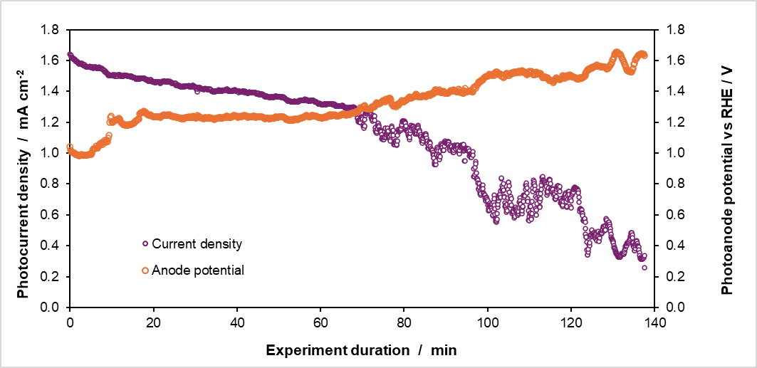
FTO / WO₃ / BiVO₄ / NiOOH photoanode degradation promoted by:
    High current & high temperature (under concentrated light)
    Excessive PV bias at low irradiance (under low, diffuse irradiance)

Slide 34
Photoanode degradation during PV-PEC operation
4 cm
15 cm
Photoanodes are excessively biased by the PV during periods of low irradiance (cloudy conditions)
Temperature effect – particularly with concentrated light
Large-scale AA-CVD method requires more optimisation to improve uniformity
Influence of flow dynamics in the up-scaled system was greater than expected

Slide 35
Investigating mechanical and (photo)electrochemical stability of scalable WO₃ and BiVO₄ based photoanodes (20 °C)
Planar
Hybrid
Nanoneedle
LSV curves in 0.1 M H₂SO₄ (pH 0.8), with and without 0.5 M Na₂SO₃ as a hole scavenger. Scan rate: 20 mV s⁻¹.
Creasey et al., J. Mater. Chem. A, 2025.

Slide 36
Investigating mechanical and (photo)electrochemical stability of scalable WO₃ and BiVO₄ based photoanodes
36

Slide 37
Reactor operation with two mirrors
Photoelectrochemical device
Device taxonomy: Nielander, Shaner, Lewis et al., Energy Environ. Sci., 8, 16 – 25 (2015)

Slide 38
Light re-direction using mirrors (non-concentrated light)

Slide 39
Spontaneous PEC reactor operation with WO₃ | BiVO₄ | NiOOH photoanode
& Au | Sb₂Se₃ | CdS | TiO₂ | Pt photocathode
with mirrors

Slide 40
Photoanode & photocathode (with mirrors)

Slide 41
Full PEC operation with photoanode & photocathode (with mirrors)
No photoelectrode degradation observed during this experiment

Slide 42
Bismuth vanadate degradation

Slide 43
Pourbaix predictions for BiVO₄
The Materials Project Pourbaix diagrams
next-gen.materialsproject.org/pourbaix
Toma et al., Nat. Commun., 2016, 7, 12012

Slide 44
Bismuth Pourbaix diagram
The Materials Project Pourbaix diagrams
next-gen.materialsproject.org/pourbaix

Slide 45
Zhang et al., J. Phys. Chem. C, 2019, 123, 38.
Zhang et al., ACS Appl. Energy Mater. 2020, 3, 10, 9523

Slide 46
PEC-MS
WO₃ (nanoneedles) | BiVO₄
1 M borate (pH 9)
Room temperature

Slide 47
Takeaway points
Influences of different reactor components on overall performance need to be understood, to make sure that while optimising for one thing, other issues are not exacerbated.
More needs to be done to explore thermal effects within integrated systems
Matching between photoelectrode(s) and PV performance needs to be investigated
More needs to be done on the effect of electrolyte on bubble detachment and gas collection efficiency
Multiple methods for guiding light into reactors needs to be explored
Should photoelectrochemical reactors move around to track the sun? On not?

Slide 48


Huge thank you to the group, our collaborators and sponsors

