Slide 1
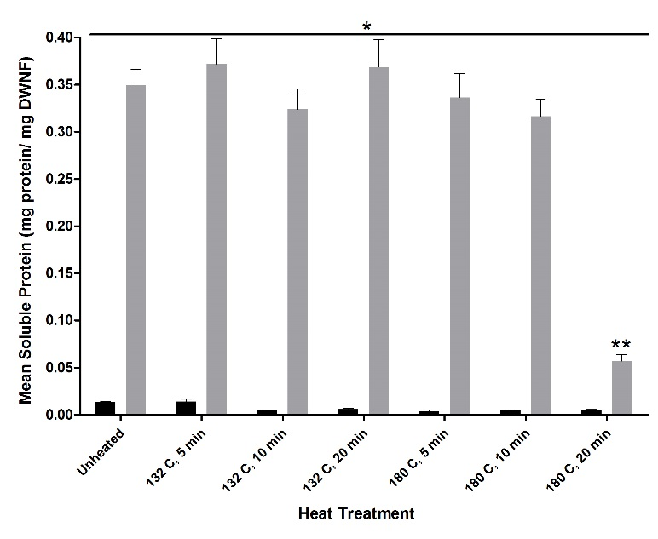
M Downs
Figure 1

Slide 2
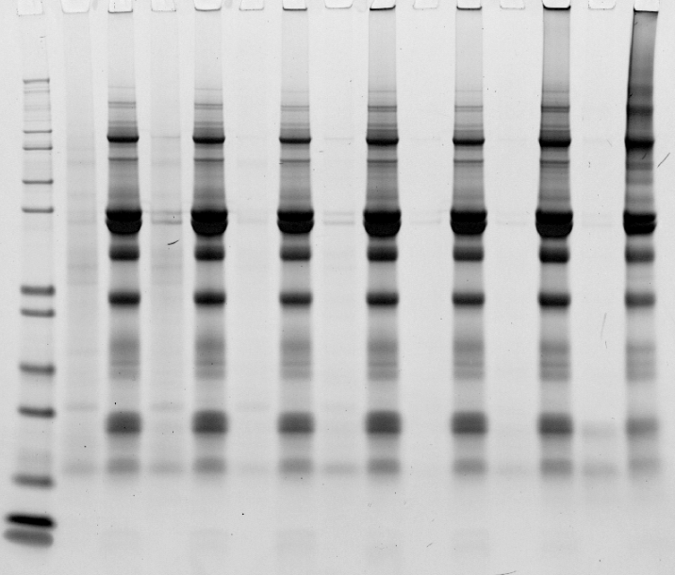
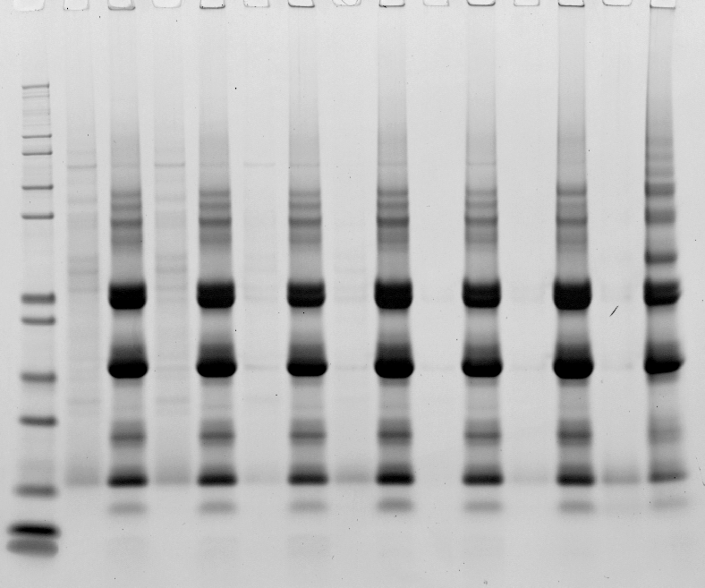
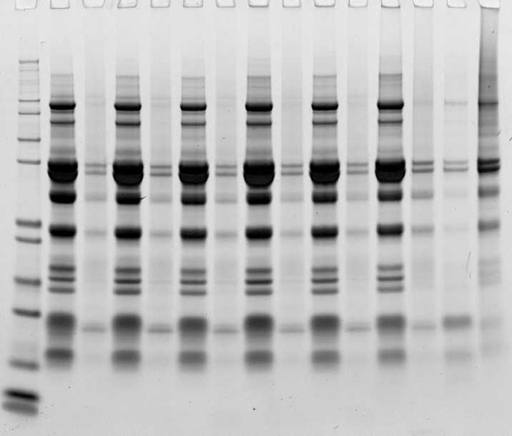
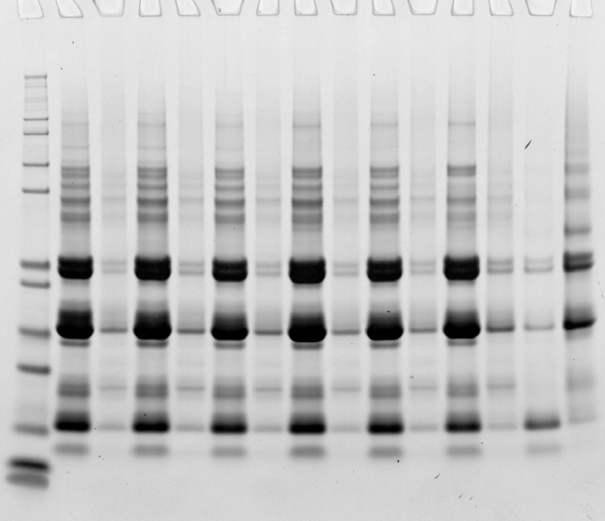
M Downs
Figure 2
Non-Reduced
Reduced
MW
UH
132 °C
180 °C
MW
132 °C
180 °C
S
P
S
5
P
10
20
5
10
20
UH
5
10
20
5
10
20 min
S
P
S
P
S
P
S
P
S
P
S
P
S
P
S
P
S
P
S
P
S
P
S
P
200
116.3
97.4
66.3
55.4
Saliva Extraction
36.5
31.0
21.5
14.4
6.0
3.5
2.5
200
116.3
97.4
66.3
55.4
NaCl Extraction
36.5
31.0
21.5
14.4
6.0
3.5
2.5

Slide 3
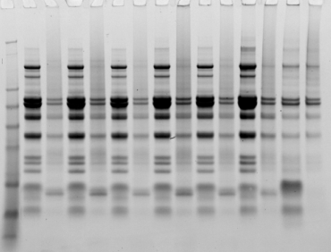
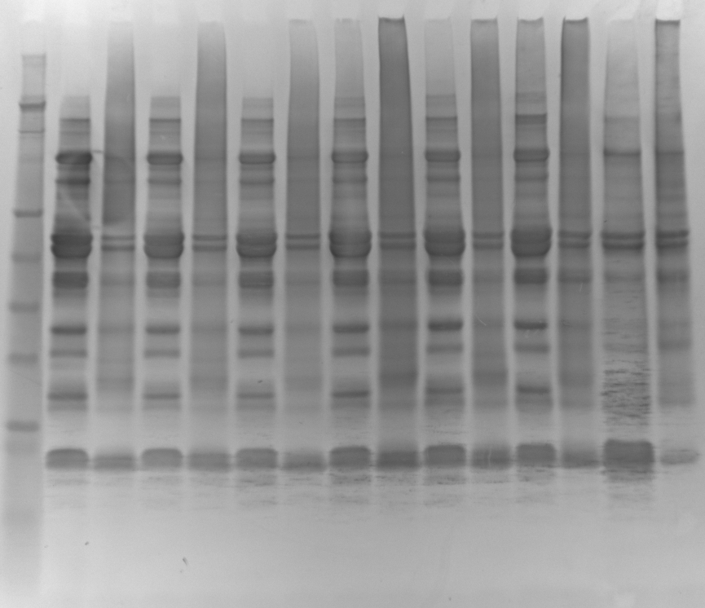
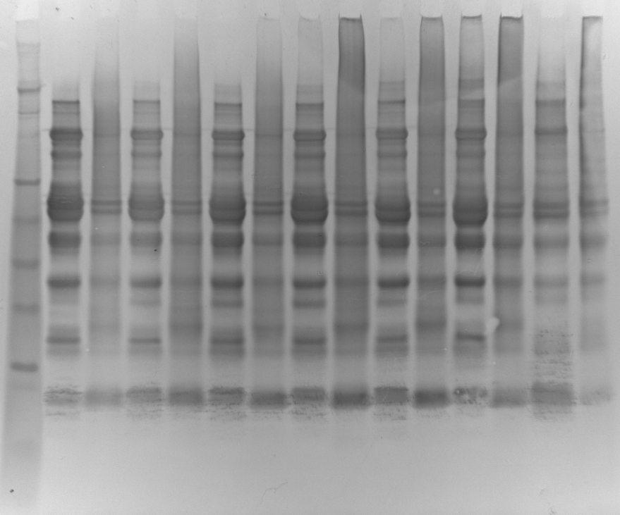
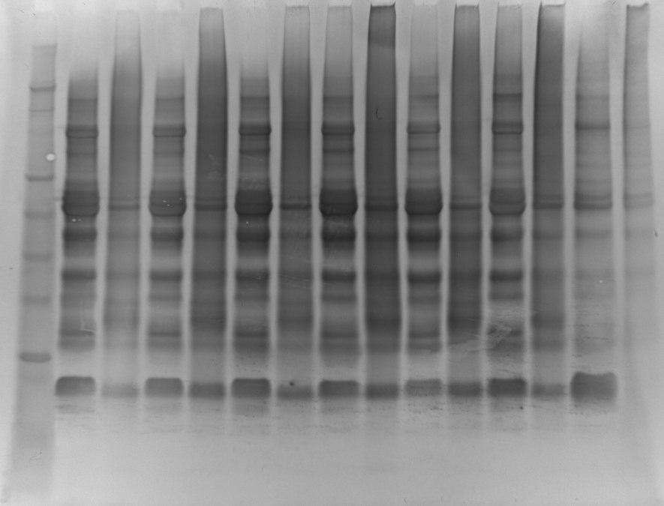
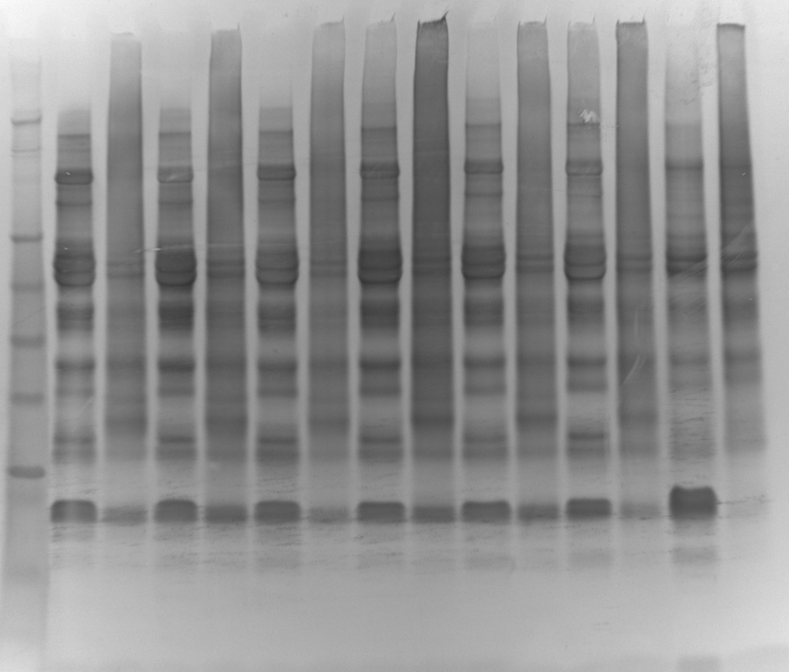
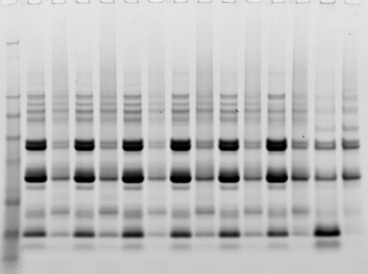
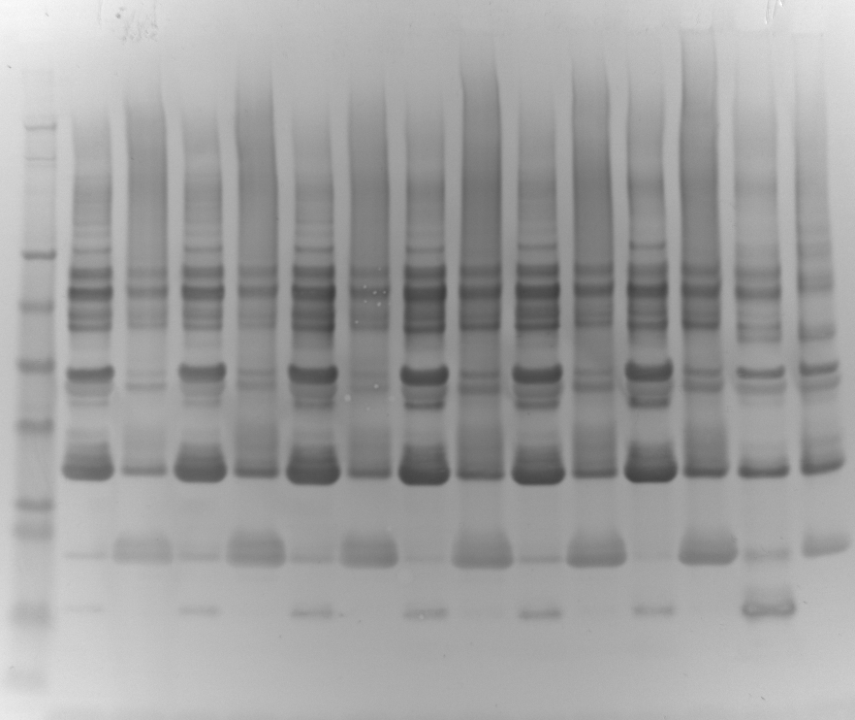
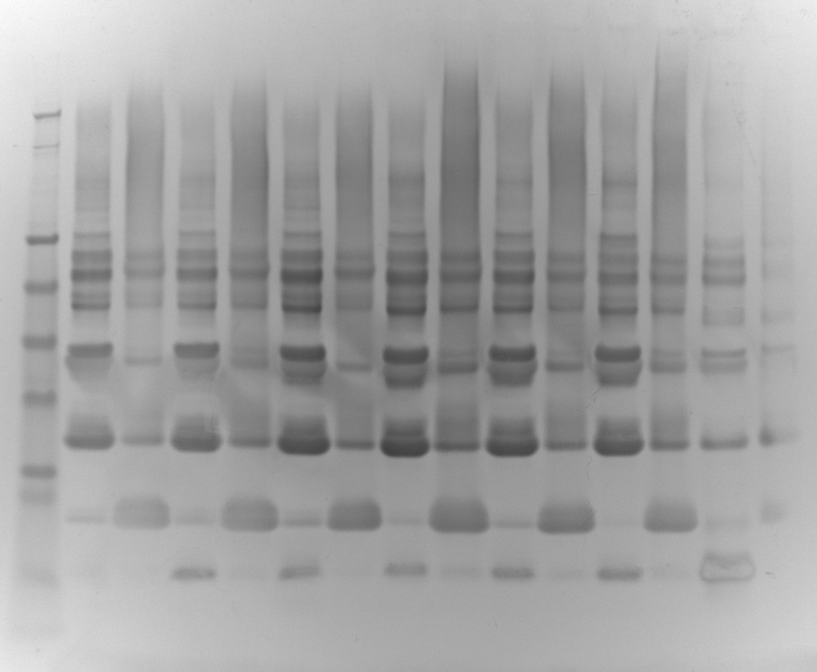
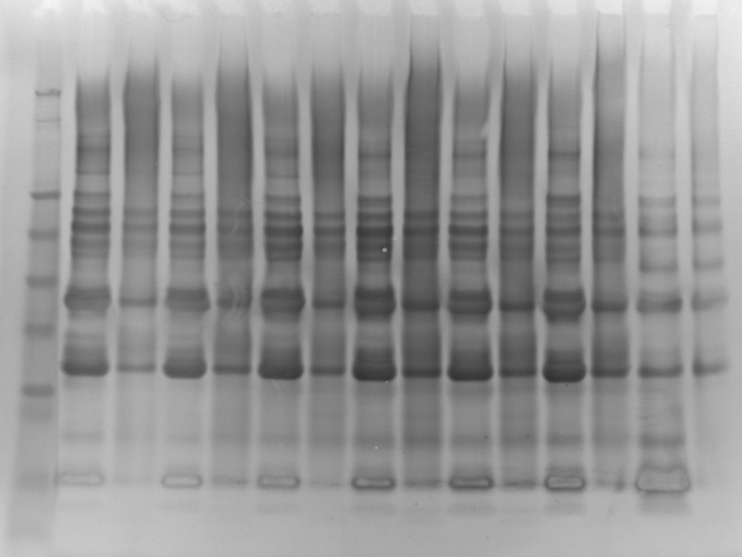
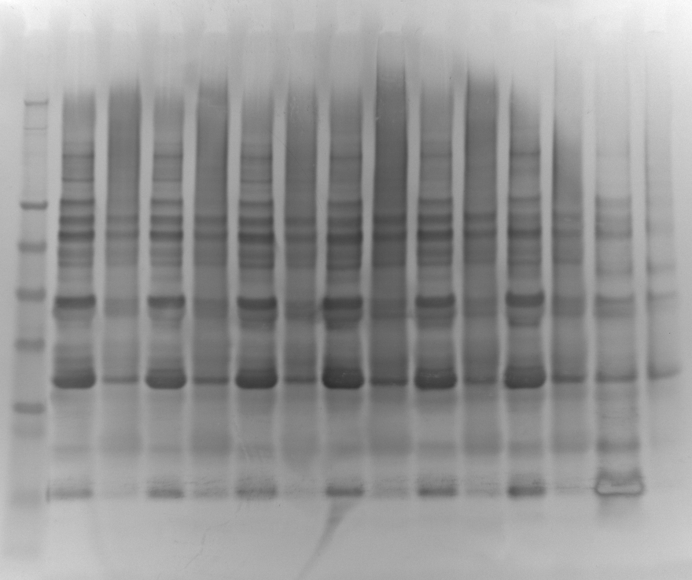
M Downs
Figure 3
132 °C
180 °C
132 °C
180 °C
132 °C
180 °C
UH
132 °C
180 °C
132 °C
180 °C
MW
UH
5
10
20
5
10
20 min
UH
5
10
20
5
10
20
UH
5
10
20
5
10
20
S
5
10
20
5
10
20
UH
5
10
20
5
10
20
S
P
S
P
S
P
S
P
S
P
S
P
S
P
S
P
S
P
S
P
S
P
S
P
S
P
S
P
S
P
S
P
S
P
S
P
S
P
S
P
S
P
S
P
P
S
P
S
P
S
P
S
P
S
P
S
P
S
P
S
P
S
P
S
P
S
P
S
P
188
62
49
Non-Reduced
38
28
18
14
6
3
188
62
49
Reduced
38
28
18
14
6
3
1D-PAGE
Rabbit Anti-Raw
Rabbit Anti-Roasted
Sheep Anti-Raw
Sheep Anti-Roasted

Slide 4
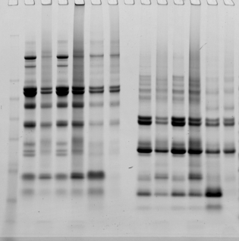
M Downs
Figure 4
Non-Reduced
Reduced
Non-Reduced
Reduced
Non-Reduced
Reduced
Non-Reduced
Reduced
UH
132
180
UH
132
180
UH
132
180
UH
132
180
UH
132
180
UH
132
180
UH
132
180
UH
132
180
MW
S
P
S
P
S
P
S
P
S
P
S
P
S
P
S
P
S
P
S
P
S
P
S
P
S
P
S
P
S
P
S
P
S
P
S
P
S
P
S
P
S
P
S
P
S
P
S
P
188
62
49
38
28
18
14
6
3
1
2
3
4
5
6
7
8
9
10
11

Slide 5
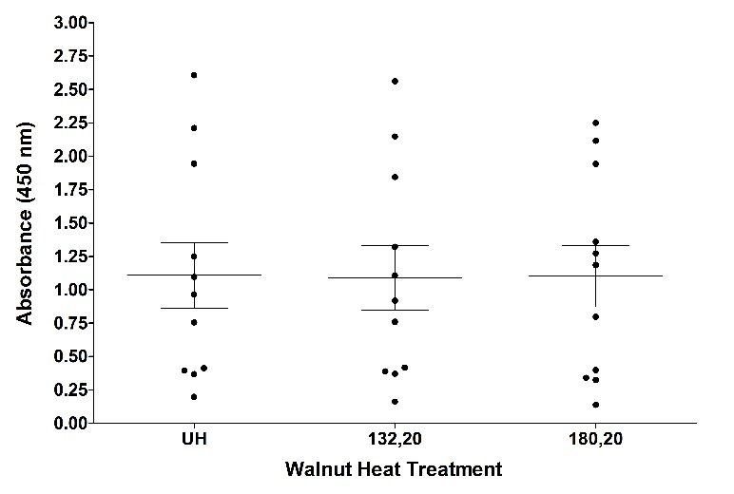
M Downs
Figure 5

