Slide 1
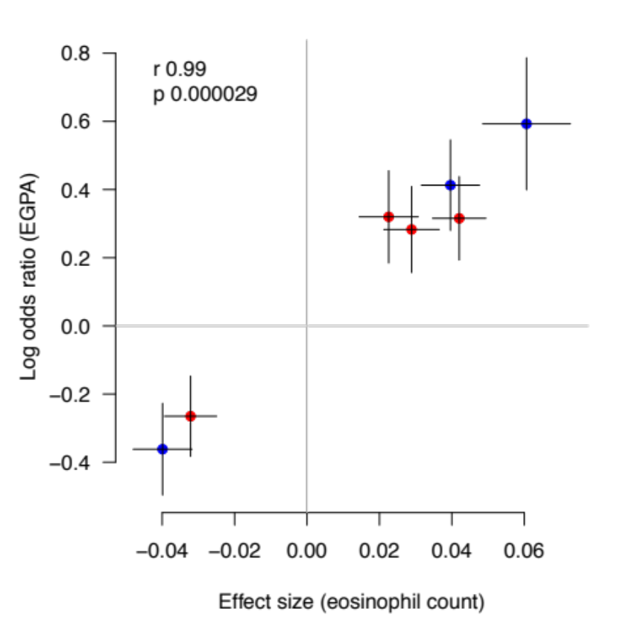
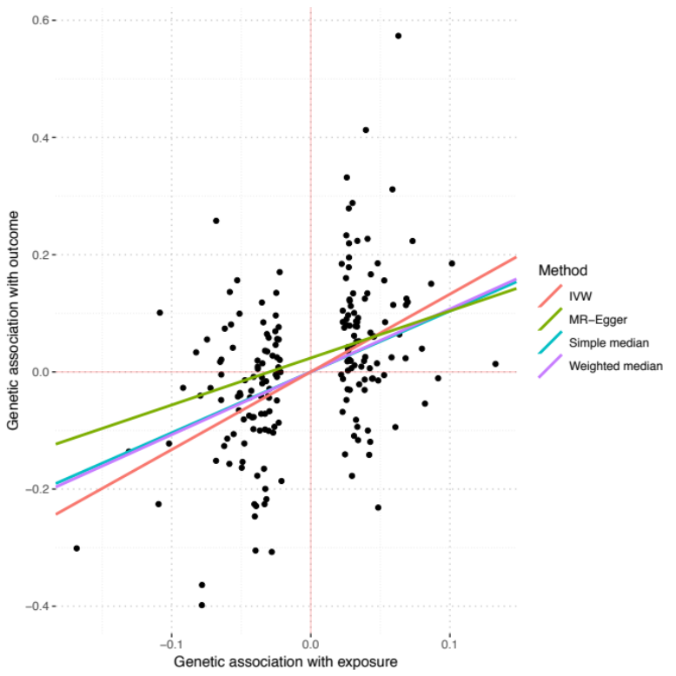
a
Log odds ratio (EGPA)
Genetic effect size on eosinophil count
b
Log odds ratio (EGPA)
Genetic effect size on eosinophil count

