Slide 1
CT Scan
chILD present, non-diagnostic
Specific diagnosis possible?
chILD unlikely
Blood tests
Diagnostic
Appropriate
diagnostic
work-up
Fibreoptic
bronchoscopy
& BAL indicated?
Diagnostic
Plan treatment
Lung biopsy
indicated?
Notes:
Figure 1

Slide 2
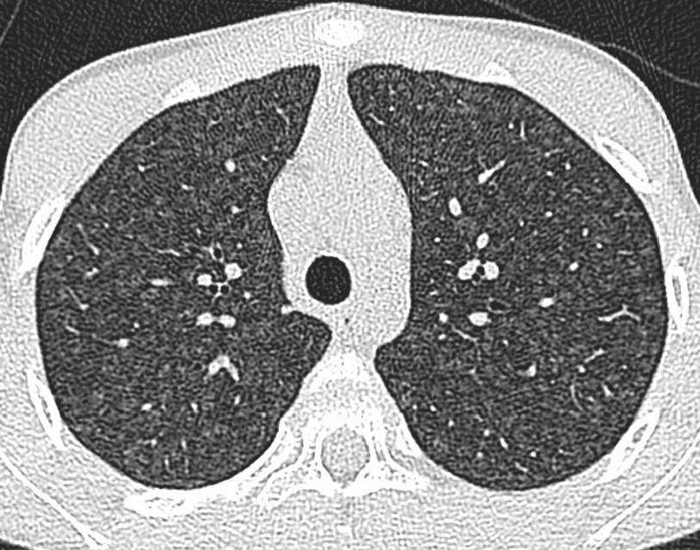
Notes:
Figure 2a

Slide 3
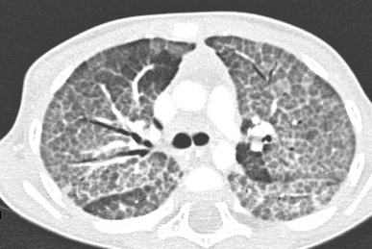
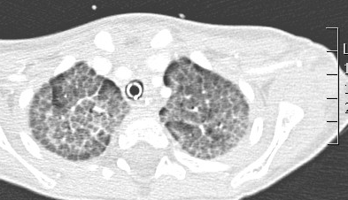
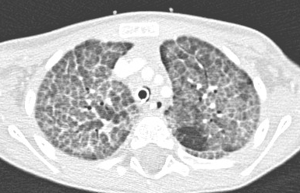
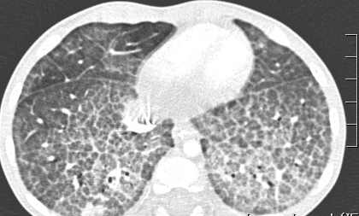
Notes:
Figure 2b

