Slide 1



Peer Research Training Resource
© 2022 Patient Experience Research Centre, Imperial College London
Unless otherwise noted this work is licensed under CC BY-NC 4.0. To view a copy of this license, visit http://creativecommons.org/licenses/by-nc/4.0/
Suggested citation: V Papageorgiou, J Bruton, H Johnson, H Ward. Peer Research Training Resource (2022). Patient Experience Research Centre: Imperial College London. DOI: 10.25561/94819

Slide 2
Acknowledgments
We thank our co-researchers (Josh, Husseina, Karl, Wezi) and Positively UK who collaborated with us on this project. A special thank you to Silvia Petretti (CEO, Positively UK) for her support and feedback throughout and to Kabelo Murray (NIHR ARC North West London) for his help recruiting and training our peer researchers.
We also thank those we spoke to when preparing our training, particularly Bakita Kasadha (Terrence Higgins Trust) and James Watson (MAP Centre for Urban Health Solutions) who provided invaluable advice on the intricacies of training and supporting people living with HIV as peer researchers. Also, thank you to Carmel McGrath (University of Southampton, NIHR Applied Research Collaborative West & NIHR Health Protection Research Unit Behavioural Science and Evaluation at University of Bristol) for her feedback during early discussions when designing the project.
All other contributions are acknowledged in the reference lists of individual training sessions.
This work was supported by the Imperial College London Societal Engagement Team 2020 Rapid Response Seed Fund, NIHR Imperial Biomedical Research Council and ESRC LISS DTP CASE Studentship.

Slide 3
How to use this resource
We have created this resource to be used by academics and public involvement practitioners interested in training people with lived experience in qualitative research (interviewing).
Any material that we suggest should be edited is highlighted
Please note: any images have been sourced from Unsplash (with appropriate credit). Icons have been sourced from Microsoft Office. Therefore, these images were considered to be copyright free when these slides were compiled in November 2021.
Our suggested citation is V Papageorgiou, J Bruton, H Johnson, H Ward. Peer Researcher Training Resource (2022). Patient Experience Research Centre: Imperial College London. DOI: 10.25561/94819
For further questions on the project please contact Vas Papageorgiou, vasiliki.papageorgiou17@imperial.ac.uk or the Patient Experience Research Centre at publicinvolvement@imperial.ac.uk

Slide 4
Table of contents
Click the hyperlinks below to view the relevant section (must be in slideshow view)
Induction Training (slides 5-31)
Session 1 - Research Integrity (slides 32-77)
Session 2 – Qualitative Research and Public Involvement (slides 78-122)
Session 3 – Interviewing Skills and Emotional Wellbeing (slides 123-161)
Session 4 – Analysing Interview Transcripts (slides 162-190)

Slide 5

Welcome meeting & introduction to ethics in research
Photo by Ashkan Forouzani on Unsplash

Slide 6
Agenda
Icebreaker (10 mins)
Project background (10 mins)
Introduction to ethics (10 mins)
First feedback activity e.g. reviewing the interview topic guide (25 mins)
Next steps & anything else (5 mins)
Notes:
Aim of today:
Plan our PPI/Meet the team
Gain insights on how topic guide needs to be adapted (guide for your activity post meeting)

Slide 7

Before we get started…
Allow everyone to speak, one at a time
Respect everyone’s comments and suggestions (no wrong answers)
Keep your microphone muted unless you have something to say
Raise your hand to let us know you would like to speak or use the chat to add any comments
Use the chat/raise hand to ask any questions – please do stop and ask any questions throughout
We will be recording the meeting to help us keep track of comments – we will only use the audio
Notes:
Thoughts icon

Slide 8

Icebreaker
Name
Where you’re from
3 words to describe yourself
Photo by Dylan Shaw on Unsplash
Notes:
10 mins

Slide 9

The project
Photo by Marten Bjork on Unsplash

Slide 10
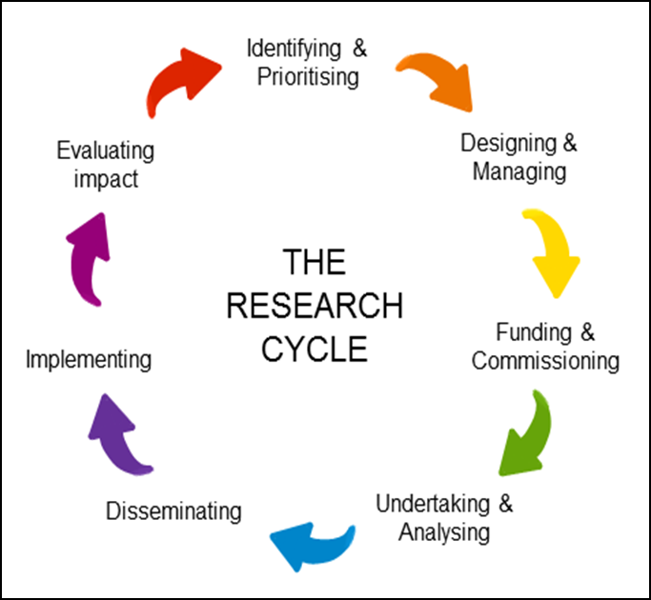
What is public involvement in research?
People sharing their views and experiences to guide and inform how research is designed, carried out, shared and adopted
Research is done ‘with’ or ‘by’ members of the public, rather than ‘to’ them
The term ‘public’ includes patients, potential patients, carers and people who use health and social care services as well as people from specific communities and from organisations that represent people who use services.
Members of the public can get involved at many stages across the research cycle, including to help develop research question, apply for funding and/or ethical approval, carry out the research and help disseminate findings.
Notes:
Quick recap

Slide 11

What is our research about?
Add detail here on the background of project (including how the research question came about), why it is being established and what the aims of the project are

Slide 12
Research aim and objectives
Add text here

Slide 13


What are our main goals?
Why do you think it’s important that we involve people living with HIV in our research?
What do you think it will help us to achieve?
Notes:
Researcher/PPIE lead to come with some ideas of main goals to help prompt those involved

Slide 14
What may (positively or negatively) influence us from achieving our stated goals?

Slide 15






What are the group’s values and principles?
 | Values | Summary principles | Our principles
Respect |  | Researchers, research organisations and the public respect one another’s roles and perspectives
Support |  | Researchers, research organisations and the public have access to practical and organisational support to involve and be involved
Transparency |  | Researchers, research organisations and the public are clear and open about the aims and scope of involvement in the research
Responsiveness |  | Researchers and research organisations actively respond to the input of public members involved in research.
Fairness of opportunity |  | Researchers and research organisations ensure that public involvement in research is open to individuals and communities without discrimination
Accountability |  | Researchers, research organisations and the public are accountable for their involvement in research and to people affected by the research

Slide 16
How will you be involved?
Add role
Provide overview of role (e.g. peer researcher, advisory group member)
Add expected meetings
Add expected training
Add any other expectations outlined in role profile
You will be provided with a role description which also outlines these points
Notes:
Be open about expectations & any limitations of role/funding constraints

Slide 17
How will you be involved?
Format of meetings could be one-to-one, all together, workshop activities – we will ask for what you prefer!
Help us to evaluate your impact on the research (and to you personally) – we will send you reflection sheets to complete after each activity
Notes:
Quick recap

Slide 18

Reflection points
To be completed after each activity
  What went well?
  What could I have done better?
  What did I learn from this experience and why?

Slide 19
Our plans for involvement
Add list of involvement opportunities currently planned for in budgeting (e.g. coding transcripts, interpreting findings etc)
Try to include across research cycle (from applying for ethics to sharing findings). For further information see NIHR Centre for Engagement and Dissemination, Briefing notes for Researchers: Public Involvement in NHS, Health and Social Care Research
Notes:
This is what we’ve planned so far to do in Zoom meetings. These are however, not fixed but as you get started and more familiar with the project, we want to make sure you have an opportunity to get involved in the project where you would like to - or where your skills/experience fits best, but don't really have a discussion at this stage. As such we think it would be good to review this plan frequently, but it would be great to know your thoughts on how frequently we should do this
We are anticipating that these will be over Zoom – is there anything we haven’t thought about in terms of accessibility or things we can do to support you using Zoom that you can think of now? You can also send ideas outside of this time today ☺

Slide 20



Rough timelines and ideas of meeting topics
Everyone meets
Peer researchers meet
Add a rough timeline for project
Include details of what is planned at each stage
Specify who will be involved in discussions – check if everyone agrees
Notes:
We can change these depending on circumstances

Slide 21
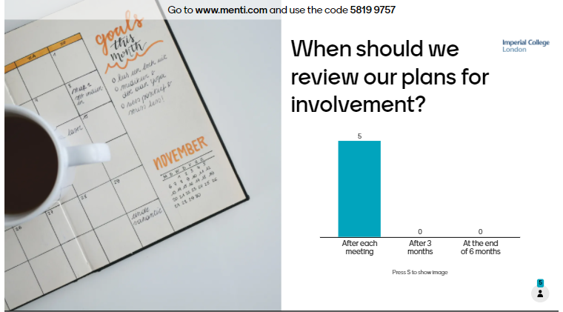
Notes:
Include vote on when we should review plans for involvement

Slide 22

What are ethics in relation to research?
Ethics are “a set of principles that guide researchers carrying out research with people”
Ethical principles are “designed to protect the safety, dignity, rights and wellbeing of the people taking part” (e.g., informed consent)
An ethics committee (either internal or external to the research organisation) is required to review each research study
More can be found at the FutureLearn course by the University of Leeds – Introduction to Research Ethics: Working with People

Slide 23
What is the ethical approval process?
Explain how the process works for your institution and provide an explanation of the documents required for ethics e.g.
  We will be applying for an amendment to an existing ethics application with Imperial College London Research Ethics Committee (ICREC)
  This means we have to resubmit any documents (see right hand side) which require edits for them to be reviewed and approved
  This can take several weeks (sometimes months!) therefore it’s important we try to submit everything as soon as possible as we cannot start collecting data until we receive approval to do so
Study Protocol
Consent forms
Interview topic guide
Email invite
List of support resources
Anything new?
Demographics survey
Participant Information Sheet
Notes:
Do you want to review support resources?
Protocol is the “instruction manual” which outlines the overall plan for the study
Protocol (including adding you as co-researchers)
Participant consent forms
Participant information sheets
Interview topic guide
Invitation email (& list of support resources)
Reflection sheets for peer researchers *NEW*

Slide 24

Example activity 1: reviewing the interview topic guide
It is important that topic guide:
Has clear and focussed questions
Asks everything we want to know to answer our research aim
Uses language/terminology that is inclusive and acceptable
Has enough prompts to help interviewees who need a bit of encouragement to open up
Is realistic to cover in time allocated for the interview (1-1.5 hours)
Remember to keep the above in mind ☺ - a reminder is on the slides too.
We will focus on the topics of personal experience & HIV treatment and care today.
Notes:
25 mins
We generated our initial topic guide following our community activity in June 2020.
What to look for – language, comprehensiveness
Things that can and cant be changed
We will prepare guidance for you to look at rest of ethics docs in your own time.
Today: we will focus on topics of personal experience & HIV treatment and care

Slide 25
Interview topic
Remember:
Language?
Understandable?
Tone?
Order of Qs?
Any topics missing?
Useful prompts?
Add each interview question to a slide and add any helpful notes to provide context
Note:
We end interviews in this way to give the interviewee a chance to share anything we may have missed from the topic guide and to recognise their contribution. In this study, we also send a follow-up email thanking them with a list of resources which may be helpful.
Note:
We often start interviews in this way to help people feel comfortable and settled and build a good rapport with the interviewer

Slide 26
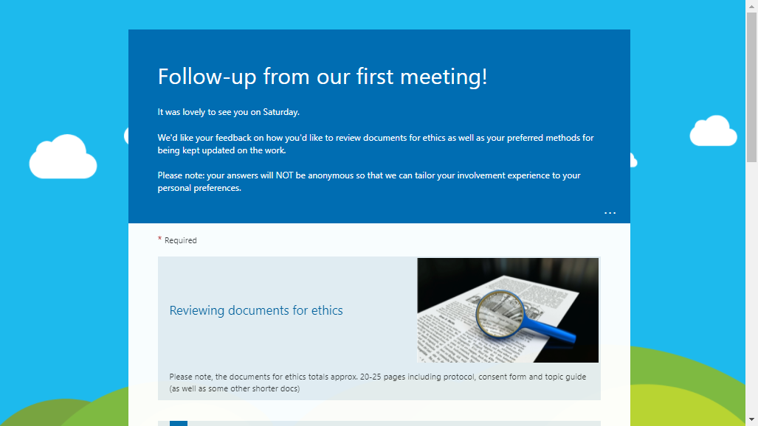
Notes:
We will give you different options in the guidance document ☺
Complete this form in your own time (once we share the slides)

Slide 27
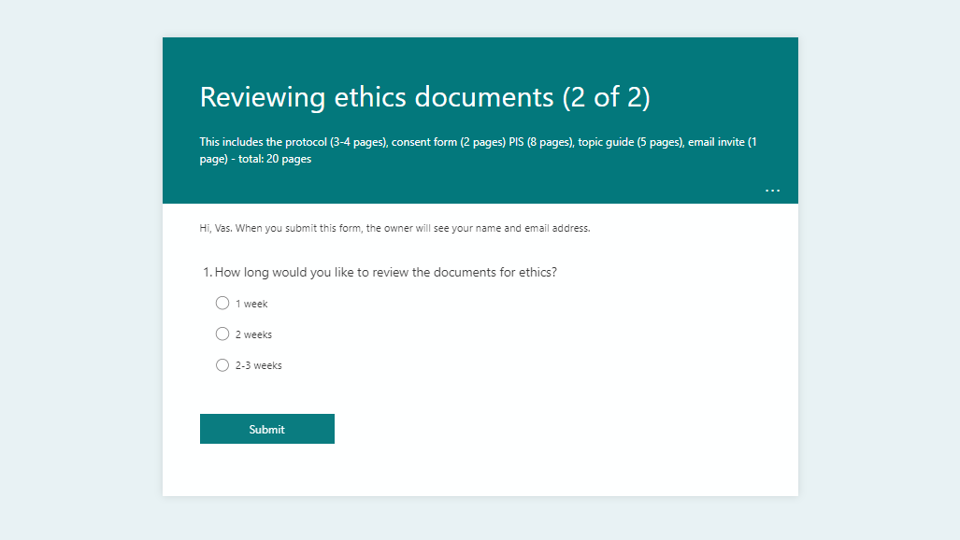
Notes:
Complete this form in your own time (once we share the slides)

Slide 28

Questions?
Photo by Jon Tyson on Unsplash

Slide 29

Next steps
Add detail of next steps – forms to be completed, how honorarium payments will be processed & any follow up activities
Add detail of upcoming meetings/training
Add contact details of project coordinator
Photo by Estée Janssens on Unsplash

Slide 30

Team photo
Feel free to turn off your camera if you’d prefer not to be included (we can block your name out too)
Photo by Nadine Primeau on Unsplash
Notes:
Thanks for today! Have a good weekend ☺

Slide 31
References
Thanks to Carmel McGrath whose work has been used to help design this session. Her presentation is adapted from the W.K. Kellogg Foundation. Using Logic Models to Bring Together Planning, Evaluation, and Action-Logic Model Development Guide W.K. Kellogg Foundation 2004 [cited 2020 August].
NIHR Centre for Engagement and Dissemination (2021). Briefing notes for researchers* – public involvement in NHS, health and social care research (version 1.0 – April 2021). Available from: https://www.nihr.ac.uk/documents/briefing-notes-for-researchers-public-involvement-in-nhs-health-and-social-care-research/27371#Identifying_and_prioritising_research [Accessed 10 January 2022]
*see briefing notes one and eight
NIHR INVOLVE (2022). Jargon Buster. Available from: https://www.invo.org.uk/resource-centre/jargon-buster/ [Accessed 10 January 2022]
Introduction to Research Ethics: Working with People by the University of Leeds (2022). FutureLearn. Available from: https://www.futurelearn.com/courses/research-ethics-an-introduction [Accessed 10 January 2022]

Slide 32

Session 1 Training:
Research Integrity
(Ethics & Research Data Management)
Photo by 🇸🇮 Janko Ferlič on Unsplash

Slide 33

Agenda
Time | Topic
5.30pm-5.40pm | Team building: ‘something I can’t live without’
5.40pm-5.50pm | Since our last meeting: reflection points and ethics amendment
5.50pm-6.30pm | Research Integrity Part 1: ethics & quiz
6.30pm-6.40pm | Tea break
6.40pm-7.10pm | Research Integrity Part 2: research data management & quiz
7.10pm-7.20pm | Scenarios
7.20pm-7.30pm | Wrap up & next steps

Slide 34
Reminders…
Allow everyone to speak, one at a time
Respect everyone’s comments and suggestions (no wrong answers)
Keep your microphone muted unless you have something to say
Raise your hand to let us know you would like to speak or use the chat to add any comments
Use the chat/raise hand to ask any questions – please do stop and ask any questions throughout
We will be recording the meeting to help us keep track of comments & so you can re-watch in your own time

Slide 35

Something I can’t live without…
Photo by AbsolutVision on Unsplash
Notes:
Team building – show something on camera that you can’t live without (flag this before the session so people are prepared)

Slide 36
Since last time…
Some changes already made (acknowledge individual contributions)
Next steps
Add clear steps of what is going to happen before next meeting (e.g. ethics process)

Slide 37
Reflection points
To be completed after each activity
  What went well?
  What could I have done better?
  What did I learn from this experience and why?

Slide 38

Is there anything else you think we should be capturing on reflection points document?
Photo by Jason Leung on Unsplash
Notes:
Discussion here (stop sharing slides)
Potential additional Qs:
Do you think your involvement in this activity has made a difference to the research?
Potential prompts: any new skills, new knowledge etc. (question about what did I learn)

Slide 39

Research Integrity
“promote and maintain a culture of honesty, openness and responsibility”
Photo by Dan Dimmock on Unsplash
Notes:
“conducting research in such a way that allows others to have confidence and trust in the methods and the findings of the research“
Definition: https://www.imperial.ac.uk/research-and-innovation/about-imperial-research/research-integrity/

Slide 40
Research integrity
Ethics
Data collection and retention
Research misconduct
Authorship and open access
Public interest disclosure
Conflicts of interest
Intellectual Property
Peer review
More here: https://www.imperial.ac.uk/research-and-innovation/about-imperial-research/research-integrity/
Notes:
Broadly this covers (and we will explore today):
Ethics
Data collection & retention
Other areas:
Research misconduct
Authorship and open access
Public interest disclosures
Conflicts of interest
Intellectual property
Peer review

Slide 41

Ethics
Photo by Scott Graham on Unsplash

Slide 42
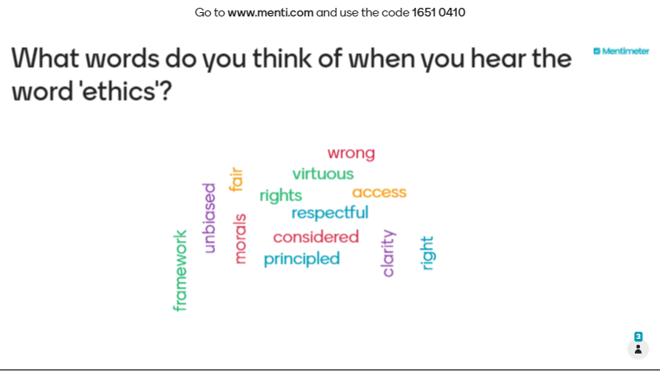

Slide 43
See video on history of ethics as part of the FutureLearn course ‘Introduction to Research Ethics: Working with People’ by the University of Leeds: https://www.futurelearn.com/courses/research-ethics-an-introduction
Notes:
Other histories: Tuskegee – syphilis
Watch up to 3:47.

Slide 44
Declaration of Helsinki
Medical research involving human subjects
2013 World Medical Association Annual Assembly voted to support changes which:
Increased protection for vulnerable groups involved in research
New provision for compensating people harmed as a result of participating in research
Requirements for post-study arrangements to ensure participants involved in research are informed of the results and have access to any beneficial treatments that emerge
Notes:
First adopted in 1964 and amended 7 times since then – current version (2013) is most recent one
There are other 3 Declarations which cover:
Modern Hippocratic Oath (Declaration of Geneva)
Guidelines for Physicians to prevent torture (Declaration of Tokyo)
Research on health databases, Big Data and biobanks (Declaration of Taipei)

Slide 45


Why is ethics important?
Research generates new knowledge therefore, significant physical & emotional risks are possible
Research Ethics Committees (RECs) consider research proposals & researchers who propose the research
You cannot start research without approval – and some funders may not provide funding until you have received REC approval
Notes:
Research generates new knowledge; therefore, significant risks are possible: physical & emotional
New process of care may place burden on participants
Asking about experiences may be distressing but also represents highly sensitive data

Slide 46
Key ethical principles in research
Respect: autonomy, capacity & dignity
Beneficence: wellbeing, minimise risk & protect
Justice: risk/benefit, equity & special protection of vulnerable groups
Photo by Scott Graham on Unsplash
Notes:
There are 3 key ethical principles in research.
Respect - Autonomy, self-determination. Capacity to decide, make choices. Dignity of people and the individual. Respect for the community and local culture. Respect & create the conditions for these
2. Beneficence - Physical, mental and social well-being; Risks reduced to a minimum, non-maleficence. Protection of participant is primary responsibility of the researcher. Benefits for the communities where the research is conducted
3. Justice: Distribution of risk and benefit. Equitable recruitment of research participants. Special protection of vulnerable groups

Slide 47
Who would you consider to be a vulnerable participant?
Photo by Jason Leung on Unsplash
Notes:
Discussion here (stop sharing slides)

Slide 48
Vulnerability
Add here what your REC defines as vulnerable
Ethics in practice: vulnerability is situation/context dependent
Notes:
However, vulnerability is situation and context dependent. All about safeguarding!

Slide 49
Safeguarding
Promoting the welfare of children (under 18) & vulnerable adults and protect them from harm.
Power relationships between researchers and participants
Exploring sensitive and emotive topics
Researching in the field & lone working
Maintaining professional boundaries
Disclosure of abuse / safeguarding concerns during data collection
[Add institution specific guidelines]
Notes:
We will unpick these in the session 3 training on qualitative interviewing for peer researchers
Vulnerable adults in relation to research includes those who do not have capacity to provide informed consent (we will cover competence in later slide)

Slide 50
Safeguarding during COVID-19
Rights of victims/survivors & whistle-blowers
Equity and fairness
Transparency
Accountability and governance
More here: https://www.ukcdr.org.uk/resource/guidance-on-safeguarding-in-international-development-research/ (pages 21-22 & 24)

Slide 51
Why might people be excluded from research?
Photo by Jason Leung on Unsplash
Notes:
Discussion here (stop sharing slides)

Slide 52
Exclusion from research
This could be due to
Way research question is conceptualised
Assumptions made by researchers or gatekeepers
Sampling or recruitment strategy
Methods used to collect data
Skills or attitudes of researchers

Slide 53

Example of Informed consent
Notes:
We are going to watch an example of someone taking informed consent. Whilst watching, think about the following: (Post in chat)
1. Do you have any concerns regarding the tone of the informed consent process shown in the video?
1. Do you have concerns regarding the timing?
2. Was the language appropriate?
3. Was the consent form properly signed?
4. Was the subject informed of all aspects of the clinical trial?

Slide 54
Consent must be...
[Add institution specific guidelines]

Slide 55

Competence
Has the capacity to make a choice about proposed course of action
Knows risks, benefits & alternatives
Understand consent is ‘voluntary and continuing permission’
Understands consent can be ‘withdrawn at any time without giving a reason’
Vulnerable people:
Children or people receiving care/with a medical condition
Cannot be assumed to be ‘incompetent’ to consent due to age or condition
Photo by Jessica Lewis on Unsplash

Slide 56
Participant information sheet & consent form
Includes statements on:
(add any specific requirements of institution)
A reminder that this is all explained in the guidance document!
Notes:
Thank them for reviewing again. Did you have any questions about any of the areas of the PIS / consent form?

Slide 57
REC process (at institution)
Add step-by-step list of actions and stage these are at (e.g. underway/done)
Notes:
Sometimes you are invited to a REC meeting– chance to address questions
Mixture of stakeholders: researchers, professionals & lay members
Focus on whether research considers rights, safety, dignity and wellbeing of research participants
Up to 1/3 will be lay members – avoid jargon
Engage with patient reps and colleagues throughout process

Slide 58

Photo by Annie Spratt on Unsplash
Online Quiz
Notes:
Kahoot quiz – We created a quiz on Kahoot with the following Q&A:
What document is used to govern medical research involving human subjects?
Declaration of Geneva
Decleration of Helsinki
Decleration of Taipei
Decleration of Tokyo
What are the 3 key ethical principles in research?
Respect
Beneficience
Justice
Trustworthiness
Consent must be specific, informed and freely given
True
False
Researchers have a duty to promote the welfare of vulnerable participants. This is known as…
Safeguarding
Informed consent
Competence
Transparency
Competence means that individuals have the capacity to make a choice about an action
True
False

Slide 59

Tea break
Photo by Loverna Journey on Unsplash

Slide 60

Data collection and retention
Photo by Jan Antonin Kolar on Unsplash

Slide 61
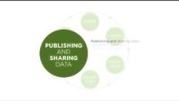
What is research data & the data life cycle?
Can be in any form (text, photos, objects, numbers etc.)
Generated to be analysed

Slide 62
What do you know about General Data Protection Regulation (GDPR)?
Photo by Jason Leung on Unsplash
Notes:
Discussion here (stop sharing slides) – aware/what do they know about it/experience?

Slide 63

General Data Protection Regulation (GDPR)
A major difference to previous legislation is the ‘right to be forgotten’.
The right to be informed if your personal data is being used
The right to get copies of your data
The right to get your data corrected
The right to get your data deleted
The right to limit how organisations use your data
The right to data portability
The right to object to the use of your data
Rights in relation to automated decision making and profiling
Uploaded to YouTube by Wall Street Journal (2018)
Taken from Information Commissioner’s Office, Your Data Matters, https://ico.org.uk/your-data-matters licensed under the Open Government Licence.

Slide 64
Data
Personal data | Special categories of personal data
“... Only includes information relating to natural persons who: can be identified or who are identifiable, directly from the information in question; or who can be indirectly identified from that information in combination with other information.” “A combination of identifiers may be needed to identify an individual” e.g. name, identification number, location data, online identifier (IP address) ALWAYS subject to GDPR | "Personal data revealing racial or ethnic origin, political opinions, religious or philosophical beliefs, trade-union membership; data concerning health or sex life and sexual orientation; genetic data or biometric data." Additional protections
“If personal data can be truly anonymised than the anonymised data is not subject to the UK GDPR”
Taken from Information Commissioner’s Office, Your Data Matters, https://ico.org.uk/for-organisations/guide-to-data-protection/guide-to-the-general-data-protection-regulation-gdpr/ licensed under the Open Government Licence.

Slide 65

Research data management
[Add institution specific guidelines]
When conducting research, you collect, process, store and use data.
You also collect and record your data so that it can be audited and reproduced (if required) e.g. claims of scientific misconduct
Research data has a special position within GDPR however, sensitive personal data has particular provisions
Notes:
Discussion – do you recall any public data breaches? Why/how might this happen…

Slide 66
Processing data
Privacy concerns – sensitive data (e.g. names, contact details) need to be processed with care
[Add project specific approach]
e.g.
  You will NOT have any information personal information on participants other than their name (which may be a pseudonym). We will set up interviews & anonymise transcripts afterwards.
  On the day of interviews, you may be made aware of sensitive data. Do NOT record this anywhere – this includes on paper, email etc.

Slide 67

Storing data
Photo by Wesley Tingey on Unsplash
Security issues
Research data can be highly sensitive.
[Add project specific approach] e.g.
  This is why we store our data in an encrypted environment which is on a separate server from the main Imperial College network.
[Add project specific approach]
e.g.
We will record all interviews using our Zoom Business account (only certain members of PERC have access to this).
  Audio recordings will be downloaded and saved in an encrypted server until it has been transcribed.
  We will delete any recordings on Zoom immediately after interviews.
We will only share anonymised transcripts using a trusted environment (tbd – ethics).

Slide 68
Privacy and confidentiality
Photo by Wesley Tingey on Unsplash
All personal information must be kept confidential
  Names, contact details health status
  Do not keep personal details in notes
  Destroy any if you do (shred)
You must protect the privacy of participants in research
  Do not share if someone has decided to take part in your study
Personal and pseudonymised data files should be encrypted

Slide 69
Photo by Annie Spratt on Unsplash
Online Quiz
Notes:
Kahoot quiz – We created a quiz on Kahoot with the following Q&A:
What is the major difference between GDPR and previous legislation?
The right to be forgotten
The right to correct your data
The right to getting copies of your data
The right to limit how organisations use your data
GDPR stands for General Data Protection regulation and was introduced in 2021
True
False
Sensitive personal data includes…
Racial or ethnic origin
Health data
Political opinions
Religious or philosophical beliefs
I can and should keep notes which include the names and contact details of participants
True
False
Issues surrounding data management include..
Privacy
Security
Confidentiaity
Visualisaiton

Slide 70

Scenarios
Photo by Caleb Jones on Unsplash
Notes:
Emphasise that this is a learning process. All (in theory) could happen.

Slide 71

Scenario 1
It’s the day of your first interview. You join the Zoom call and have a good conversation with the participant. Towards the end of the interview, they share that they have felt suicidal & do not have any close friends or family to support them.
What do you do?
Notes:
Flag with research coordinator – she will flag with supervisor who will decide best approach. May just need to be signposted to some resources. Be honest with yourself about how it has affected you. Discuss as a group to help protect your own wellbeing. Usually if someone is talking about suicide this means they are open to help (Mental Health First Aid Training).

Slide 72

Scenario 2
Someone you interviewed has sent you a “friend request” on social media and were asking intrusive questions about your personal life during interviews.
What do you do?
Notes:
Flag with research coordinator (from interview stage). At the interview – only share what you feel comfortable sharing. Do not share contact details/personal information you do not want them to know. Reject friend request. Ensure you have sufficient security permissions on social media so no personal information is visible (that you do not want publicly available).

Slide 73



Good practice (Remember: SSSU)
Storage
Do NOT keep any physical or electronic notes which contain any personal or sensitive data – especially as you do not have College approved device etc.
Sharing
Do NOT share any personal information about participants with anyone outside of the project. We will have team meetings to discuss any worries or concerns.
Unsure?
If in doubt, contact project coordinator who will advise
Safety
Always consider your own safety as a peer researcher. Do NOT share any personal information with participants including personal contact details. If you think someone needs some additional support, raise with project coordinator in the first instance.

Slide 74
Next steps
Add when the next training session will be
Explain process of ethics (if still waiting for approval)

Slide 75

Recommended resources
Photo by Beth Jnr on Unsplash
Ethics & Research Data Management
Future Learn University of Leeds (Introduction to Research Ethics: Working with People): https://www.futurelearn.com/courses/research-ethics-an-introduction
Free e-Learning (provided by Medical Research Council) – sign-up required https://byglearning.com/mrcrsc-lms/course/index.php?categoryid=1
  ‘Research, GDPR and confidentiality – what you really need to know (8 part module)
Free e-Learning (provided by the Global Health Network) – sign-up required: https://globalhealthtrainingcentre.tghn.org/elearning/
  Introduction to data management (Parts 2-7)
  Introduction to informed consent (all)
Safeguarding
[add links from your institution]
COVID-19 Psychological First Aid: https://www.futurelearn.com/courses/psychological-first-aid-covid-19
Safeguarding considerations for researchers: https://www.nottingham.ac.uk/healthsciences/documents/safeguarding-researcher-guidelines.pdf
Notes:
Relevant courses - can access as many/little as you like… we are also here to support you

Slide 76

Any questions?
Photo by Kelly Sikkema on Unsplash

Slide 77
References
Slides on ethics have been adapted from Sarah Jasim and Ruth Plackett, “Planning, Analysing & Writing Up Mixed Methods”. Lecture, LISS006 Introduction to Mixed Methods Research Course (LISS DTP), February 2021.
Future Learn University of Leeds (Introduction to Research Ethics: Working with People): https://www.futurelearn.com/courses/research-ethics-an-introduction
Independent Commissioner’s Office. Guide to the UK General Data Protection Regulation (UK GDPR). Available from: https://ico.org.uk/for-organisations/guide-to-data-protection/guide-to-the-general-data-protection-regulation-gdpr/ [Accessed 11 January 2022]
Imperial College London Research Integrity: https://www.imperial.ac.uk/research-and-innovation/about-imperial-research/research-integrity/ethics/human/
World Medical Association (2022). Available from: https://www.wma.net/what-we-do/medical-ethics/declaration-of-helsinki/ [Accessed 10 January 2022]
The Research Ethics Guidebook: a resource for social scientists (Last updated 2012). Available from: http://www.ethicsguidebook.ac.uk/Defining-and-assessing-competence-to-consent-92.html [Accessed 10 January 2022]

Slide 78

Session 2 Training:
Qualitative Research & Public Involvement
Photo by Jacek Dylag on Unsplash

Slide 79
Agenda
Time | Topic
5.30pm-5.40pm | Team building: lightning scavenger hunt
5.40pm-5.50pm | Since our last meeting: reflection points and ethics amendment
5.50pm-6.20pm | Introduction to Qualitative Research
6.20pm-6.30pm | Group activity: creating interviewer reflection sheets
6.30pm-6.40pm | Tea break
6.40pm-7.10pm | Introduction to Public Involvement in Research
7.10pm-7.20pm | Participatory Action Research (Peer Research)
7.20pm-7.30pm | Next steps

Slide 80
Reminders…
Allow everyone to speak, one at a time
Respect everyone’s comments and suggestions (no wrong answers)
Keep your microphone muted unless you have something to say
Raise your hand to let us know you would like to speak or use the chat to add any comments
Use the chat/raise hand to ask any questions – please do stop and ask any questions throughout
We will be recording the meeting to help us keep track of comments & so you can re-watch in your own time
Notes:
We will save the recording in a OneDrive folder along with all other relevant study documents and share after the session for you to listen back if you’d like to.

Slide 81

Team building: Lightning Scavenger Hunt
First person to find the following wins:
Your favourite mug
Face mask
Your favourite book / the last thing you read
Photo by Wilhelm Gunkel on Unsplash

Slide 82
Updates since last meeting
Add

Slide 83

Photo by Jason Goodman on Unsplash
Qualitative Research

Slide 84
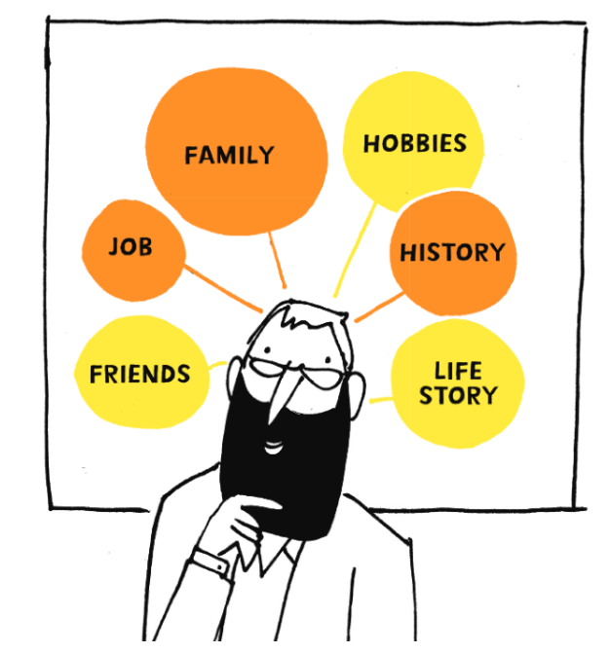
What is Qualitative Research?
Qualitative research provides an understanding of a topic in its contextual setting giving explanations and accounts of why people do the things they do
Notes:
You might sometimes hear about ‘quantitative’ research e.g. surveys. These focus on capturing numbers and presents them as statistics. Quant might ask – how many, or how much?
Quali research focusses on the HOW and WHY rather than the WHAT – data are often words, text & pictures – focussing on values, processes, experiences language & meaning. It is an iterative process

Slide 85

The research paradigm
Notes:
This helps you to establish approach and methodology to best examine what you are looking to investigate
Appreciate research sometimes has a lot of jargon – perhaps you might want to make a note of the next few terms so you can refer back to them

Slide 86
Qualitative research
Add detail on ontology, epistemology and the research paradigm you are using
Notes:
Hypothesis = a proposed explanation for something you see. Something you test based on observations

Slide 87
Types of qualitative research
Interviews
Focus Groups
Observations
Document analysis (e.g. diaries, policies)
Notes:
Focus groups are a form of qualitative interview in which a group of people often with similar experiences are brought together to speak about a given topic. Researchers may undertake focus groups in the hope that as a group participants may generate responses that they may not have during a one-to-one interview by the fact that they are discussing the topic with other people.
Observations allow researchers to explore events that participants may not be able to express during in-depth interviews

Slide 88
What might be some of the advantages/disadvantages of interviews compared to other methods?
Photo by Jason Leung on Unsplash
Notes:
Discussion – stop sharing screen

Slide 89
Notes:
We will be using semi-structured interviews – means you can refine during data collection (explore new themes in more depth in subsequent intervews)
We will go into more detail in session 3

Slide 90
Why are we using interviews to answer our research question?
Explain why this method helps to answer the research question

Slide 91
What are some key considerations for arranging and conducting (online) interviews?
Photo by Jason Leung on Unsplash
Notes:
Discussion – stop sharing screen

Slide 92
Key considerations
At a time (& location) convenient to participant
Quiet location, free from interruptions and background noise
Trust & rapport between participant and interviewer
Notes:
Compare to group suggestions

Slide 93
Importance/Difficulty Matrix
Can replicate by building on Miro
Notes:
Now let’s plot these key considerations on an “importance/difficulty matrix” 5-10 mins

Slide 94
Reflexivity
Researcher needs to acknowledge own views and beliefs that may influence way research is conducted or interpreted
Add an example

Slide 95
What should we capture in our interviewer reflection sheets?
Photo by Jason Leung on Unsplash
Notes:
DISCUSISON – STOP SHARING

Slide 96
Purposive sampling
Most common approach
Quota sampling
Decided in advance (number of people)
Continue until quota is reached
Snowball sampling
Form of purposive sampling
Existing contacts / participants identity other potential participants
Group participants based on predefined criteria relevant to question (e.g. job title, age, gender)
Useful for identifying hard-to-reach
Notes:
Sampling
Process of selecting participants from wider population
Does not try to be representative
We are proposing two approaches in our study.

Slide 97
Our sample population
Add information about where you are sampling from
Notes:
Our sample population.

Slide 98
‘Data saturation’
People often refer to ‘data saturation’ as an indication for when to stop interviewing
This is when no new themes arise from your data
In practice, it can be difficult to determine when this occurs. Also, ethics committees often ask for an exact number of participants.
Notes:
Sometimes people mention ‘data saturation’ – when no new themes arising from the data (meaning you can stop collecting data). In practice, this is sometimes difficult to determine as each narrative can differ. Ethics committees also ask for a number of participants. We will be conducting 20-30 interviews to complement our 14 HIV worker interviews and hopefully provide enough diversity.

Slide 99
How do we assess ‘quality’ in qualitative research?
Triangulation
“Member checking”
Reflexivity
Attention to ‘alternate’ cases
Repeatability
Notes:
Triangulation – compare results from different data sources looking for patterns
“Member checking” – can ask participants to validate interpretations made
Reflexivity – self-consciously reflect on how your position has influenced the research
Repeatability – keep an ‘audit trail’ for data collection & analysis so someone (in theory) could repeat what you did
Attention to alternate cases – search for experiences/opinions that contradict the general consensus made

Slide 100
What are strengths of qualitative research?
Can help us to understand why a phenomenon or experience is occurring where there is limited data
It generates rich, in-depth data which takes the context into account
It is iterative and can be adapted
It allows for the researcher to reflect on their relationship with the topic, participants & influence on the research findings (reflexivity)
It aligns with the philosophy of public involvement in research (e.g. you can ask participants to help interpret/confirm your findings)
Notes:
Iterative (adapted over time) – refined as the process goes on

Slide 101
What are criticisms of qualitative research?
The findings are not generalisable
It might not be reproducible (it is subjective)
Notes:
Ultimately these are fundamentally against the principles of qual research – data may be transferable & context specific
Any others?

Slide 102
Tea break
Photo by Svitlana on Unsplash
Notes:
6.30pm

Slide 103
Public involvement in research
Photo by Nathália Rosa on Unsplash

Slide 104
What is Public Involvement?
The public being actively involved in research. Research being carried out “with” or “by” members of the public rather than “to” them, “about” them, or “for” them.
- NIHR
“Public” includes patients, potential patients, carers and people who use health and social care services as well as people from organisations that represent
people who use services. Whilst all of us are actual, former or indeed potential users of health and social care services, there is an important distinction to be made between the perspectives of the public and the perspectives of people who have a professional role in health and social care services.”
- NIHR

Slide 105
A note on language…
Engagement
Sharing information about research with the public
Participation
Taking part in research as a consenting participant
Involvement
Active involvement in research projects & organisations

Slide 106
The spectrum of Involvement
Degrees of involvement
Consultation: asking members of the public for their views and using these views to inform decision-making
Public-led research: Members of the public design, undertake and disseminate the results of a research project
Collaboration: active, on-going partnership with the public
Co-production: Where researchers and members of the public work together and share responsibility from start to finish

Slide 107
Why involve the public in research ?
Photo by Gayatri Malhotra on Unsplash
Ethical and democratic right
Reflects public’s needs/priorities
Requirement of funders
https://www.hra.nhs.uk/about-us/consultations/make-it-public/

Slide 108
Why involve the public in research?
Reveals subtle nuances
Keeps it relevant
Identifies patients’ unmet needs
Improves quality, design & impact
Benefits people involved
Motivates researchers
Reduces waste research
Photo by Jason Goodman on Unsplash
Notes:
Identifies subtle nuances that researchers may miss because they “can’t see the wood for the trees.”
Keeps research real and more relevant for those it is intended to benefit.
Patients are integral to the identification of unmet need & ways to meet it.
Improves the quality/design of the research
Reduce waste – in 2009 Chalmers and Glaziou considered that 85% of research was wasted - Chalmers I, Glasziou P. Avoidable waste in the production and reporting of research evidence. Lancet. 2009 Jul 4;374(9683):86-9.
Choosing the wrong questions for research
Doing studies that are unnecessary, or poorly designed
Failure to publish relevant research promptly, or at all
Biased or unusable reports of research
On 13 September 2018:
A new interactive website, eu.trialstracker.net, shows that 49% of clinical trials on the EU clinical trials register have not reported results. EU rules say clinical trial results must be reported onto the EU register for every trial there within 12 months of the end of the trial. Only 51% of trials on the register are currently complying with this. No one has ever been sanctioned for breaking the European rules.
The EUTrialsTracker also shows that European academic institutes are lagging far behind companies in complying with the reporting rules – 68% of company-sponsored trials that are due to report results onto the register have but only 11% of academic trials have. This means that nearly 90% of the trials sponsored by European universities, governments, charities and research centres are breaking EU rules.
Researchers at the DataLab at the University of Oxford built the EUTrialsTracker.
In 2012 the European Medicines Agency (EMA) which oversees the EU Clinical Trials Register and medicines regulation in the EU announced the new rule stating that results must be reported on the register. Clear deadlines were set for reporting – one year from the end of the trial for most trials, and within six months of completion for trials involving children.
Reporting on a register has several advantages over academic journal publication: it is much easier to locate results; it is much easier to track compliance; and registers mandate important information that must be included in the results report. By contrast, there is extensive evidence to show that results reports in academic journals are incomplete[2], of poorer quality than registry reports, and less complete on important issues such as adverse events data[3].

Slide 109
Examples of Public Involvement around the research cycle
Collaborate with researchers to evaluate the research process
Evaluate the impact of the involvement on the research
Patients/public reflect on their role/what they learned
Patients/stakeholders identify relevant research topics through consultation
Be named as co-applicant
Ensure protocol/methods are patient appropriate
Assist with recruitment & retention strategies
Define outcome measures
Assist to steer project
Develop research tools
Review/draft PIS & informed consent forms
Produce patient/participant friendly research updates (communication)
Increase likelihood of results being implemented due to patient support/lobbying
Assessment of value
Analysis of benefit/risk
Advise on avenues for dissemination
Jointly present research findings
Contribution to publications
Draft lay summaries of results
Collaborate in publishing results e.g. via charities/patient groups
Collaborate in data collection e.g. with phone apps, conducting interviews/surveys
Analyse/interpret data & results
Review & draft research funding proposals
Ensure the research & methods are ethical
Notes:
In an ideal world PPI would happen at all stages in the research cycle
The earlier it starts the more meaningful
But start wherever you are in your project

Slide 110
Participatory Approaches
(Focus: Peer Research)
Photo by Natalie Pedigo on Unsplash
Notes:
NIHR INVOLVE Jargon buster: This is a type of research where researchers and people who use services or carers are partners in a research project. The research addresses an issue of importance to service users or carers, who are involved in the design and conduct of the research, and the way the findings are made available. The aim of the research is to improve people’s lives. This isn’t a research method – it’s an approach to research, a philosophy.
we will also refer to participatory action research here but sometimes referred to as community based participatory research or just action research

Slide 111
Participatory action research
Notes:
Up to 1:25

Slide 112
What are the benefits or barriers to participatory approaches in research?
Photo by Jason Leung on Unsplash
Notes:
DISCUSISON – STOP SHARING
For people involved/communities
For researchers

Slide 113
What are the strengths of PAR?
Improve honesty, reliability & depth of responses
Reduces power dynamic
Establishes a natural rapport
Add credibility to research
Improve the experience of taking part in research – less hierarchical or intimidating
Photo by Natalie Pedigo on Unsplash
https://www.coursera.org/learn/public-involvement-in-research

Slide 114
What are the limitations of PAR?
Resource & time intensive
Can be selective or partial
Some participants may prefer to be interviewed by an external researcher
Biased perceptions of community researchers (similar to an external researcher)
Ritchie et al (2013)
Photo by Natalie Pedigo on Unsplash

Slide 115
Peer research
Aims to move away from ‘extractive’ model of social research to one of empowerment & positive change by research participation on their own communities
Use lived experience & contextual understanding of social/geographical community to help generate information
Involvement in assisting with all, or several, stages of the research cycle
But also, some ‘implicit tasks’
  Sharing HIV status & applying lived experience to research
  Engaging in emotional labour
  Advocating for meaningful engagement in research
Photo by Natalie Pedigo on Unsplash
Adapted from Institute for Community Studies (2021)
Notes:
Can be people affected by a condition
People who belong to community/population under study
People whose life has been closely touched by issue being studied
Most likely not formally trained in research, or accredited as a researcher.

Slide 116
What do you hope to get out of being involved in this project?
Photo by Jason Leung on Unsplash
Notes:
DISCUSISON – STOP SHARING
expectations, what they hope to get out being a peer researcher? Any barriers they perceive about being a peer researcher and/or any concerns?
Act as bridge between community and researchers
Keep professional/personal boundaries
Maintain high ethical standards and confidentiality
Promot and represent study in community
Reflect voice of PLHIV throughout all phases of research study
Would a terms of reference be helpful? A handbook of what training has covered? How else can we support you?

Slide 117
Reflections
Add a Jamboard link for anonymous reflections
Rose – what have you enjoyed so far?
Thorn – what has been least enjoyable?
Bud – what are you looking forward to?
Photo by Nikita Tikhomirov on Unsplash
Notes:
Experiences on project so far – to do after the

Slide 118
Imperial College London: Public Involvement in Research Coursera course
Week 1: Differentiating public involvement and co-production in health research
Week 2: Role of public involvement and co-production throughout the research cycle
Week 3: What is the role of public involvement and co-production throughout the stages of the research cycle?
  Stage 4 – Undertaking and analysing
  Stage 5 – Disseminating
  Stage 6 – implementing
Week 4: How can you evaluate public involvement and co-production in health research?
Link to course: https://www.coursera.org/learn/public-involvement-in-research
Notes:
Goes through public involvement in each stage of the research cycle in more detail.
New online course, freely available

Slide 119
Next steps
Add when next training session will be
Add next steps in terms of project management/research process
Notes:
I will be sharing a link to a shared folder where everything will be stored for all to access. (OneDrive)
Sessions 3 + 4 mandatory for peer researchers & optional for AG members

Slide 120
Recommended resources
Photo by Beth Jnr on Unsplash
Qualitative Research
Brooks, H., Bee, P., & Rogers, A. (2018). "Introduction to qualitative research methods". In A research handbook for patient and public involvement researchers. Manchester, England: Manchester University Press. Retrieved Mar 4, 2021, from https://www.manchesteropenhive.com/view/9781526136527/9781526136527.00012.xml
Public Involvement in Research
NIHR Involve Public Information Pack: How to get actively involved in NHS, public health and social care research
Participatory Action Research
Coursera (Weeks1-4 Public Involvement in Research): https://www.imperial.ac.uk/patient-experience-research-centre/ppi/ppi-training/ (see course FAQs about accessing for free as ‘member of the public’)
Peer Research
For Us, By Us: Peer Research 101 https://vimeo.com/2780761 - provides a good summary of what participatory approaches to research are but is quite lengthy (30 mins long)
Videos with peer researchers discussing their work on The Positive Effect – see Lynne, Patricia and Mary’s videos: https://www.positiveeffect.org/stories
Notes:
Relevant courses - can access as many/little as you like. We are also here to support you

Slide 121
Any questions?
Photo by Caleb Chen on Unsplash

Slide 122
References
Brooks, H., Bee, P., & Rogers, A. (2018). "Introduction to qualitative research methods". In A research handbook for patient and public involvement researchers. Manchester, England: Manchester University Press. Retrieved Mar 4, 2021, from https://www.manchesteropenhive.com/view/9781526136527/9781526136527.00012.xml
Institute for Community Studies (2021). What is peer research? Available from: https://icstudies.org.uk/peer_research_network/what-peer-research [Accessed 11 January 2022]
Mays N, Pope C. Assessing quality in qualitative research BMJ 2000; 320:50
NIHR Centre for Engagement and Dissemination (2021). Briefing notes for researchers* – public involvement in NHS, health and social care research (version 1.0 – April 2021). Available from: https://www.nihr.ac.uk/documents/briefing-notes-for-researchers-public-involvement-in-nhs-health-and-social-care-research/27371#Identifying_and_prioritising_research [Accessed 10 January 2022]
NIHR INVOLVE. What is public involvement in research? Available from: https://www.invo.org.uk/find-out-more/what-is-public-involvement-in-research-2/ [Accessed 10 January 2022]
Oliver S, Clarke-Jones L, Rees R, Milne R, Buchanan P. Involving consumers in research and development agenda setting for the NHS: developing an evidence-based approach. Health Technol Assess 2004;8(15)
Ritchie, J., Lewis, J., Nicholls, C.M. and Ormston, R. eds., 2013. Qualitative research practice: A guide for social science students and researchers. SAGE. Available from: https://books.google.co.uk/books?id=EQSIAwAAQBAJ&lpg=PP1&pg=PP1#v=onepage&q&f=false
Slides on peer researchers have been adapted from resources kindly shared by James Watson based at the MAP Centre for Urban Health Solutions, St Michaels Hospital, Toronto.

Slide 123
Session 3 Training: Interviewing Skills & Emotional Wellbeing
Photo by Compare Fibre on Unsplash

Slide 124
Reminders…
Allow everyone to speak, one at a time
Respect everyone’s comments and suggestions (no wrong answers)
Keep your microphone muted unless you have something to say
Raise your hand to let us know you would like to speak or use the chat to add any comments
Use the chat/raise hand to ask any questions – please do stop and ask any questions throughout
We will be recording the meeting to help us keep track of comments & so you can re-watch in your own time
Notes:
We will save the recording in a OneDrive folder along with all other relevant study documents and share after the session for you to listen back if you’d like to.

Slide 125
Agenda
Time | Topic
5.30pm-5.40pm | Team building: Pictionary
5.40pm-5.50pm | Since our last meeting & Reflections from a Peer Researcher
5.50pm-6.30pm | Interviews as a method (including practice)
6.30pm-6.40pm | Tea break
6.40pm-7.10pm | The ‘Interviewer’ (including practice)
7.10pm-7.25pm | Emotional wellbeing as a peer researcher
7.25pm-7.30pm | Wrap up & next steps
Notes:
Before we get started today, you may wish to grab a pen/pencil and some paper to take notes as we will have run through a few practical tasks

Slide 126
Team Building:
Pictionary
Photo by Sincerely Media on Unsplash
Notes:
Team building
Quick game of Pictionary – XX to send random word to nominated artist in 2 teams to draw. https://randomwordgenerator.com/pictionary.php (draw using Whiteboard/pen and paper)
STEP 1: Nominate an artist in your team – the rest need to guess the word before the time runs out. Team who gets the most words wins
5 mins (max. 60 seconds per word)
Cookie
Rabbit
Tree
Kitten
Night
Car
Flag
Dream
Mountains
Candle
Ocean
Moon
Lemon
Octopus
Face
Rainbow
Bike

Slide 127
Since we last met…
Add updates

Slide 128
Reflections from a Peer Researcher: Bakita Kasadha
Bakita was a Peer Researcher (THT) on the INTUIT researcher programme (https://intuitproject.org/)
Some reflections:
Data collection – build trust quickly & ‘read between the lines’ but encourage participants to actually say what they mean to help support data analysis (if comfortable)
Data analysis – takes time especially if this is something new for you. Ask questions until you feel comfortable – understanding what is being done so you can offer reflections in a meaningful way
Impact – consider various places findings might be shared & how this can be done in an accessible way using appropriate language
Self-care and looking after your wellbeing – highlight potentially difficult questions & share difficult experiences with the team. Your involvement is not as a peer support/mentor or community representative so allow your participant to speak their truth & ensure you establish boundaries
https://www.bakitakk.com/
Notes:
We will share Bakita’s detailed document of reflections after today. Video of Bakita’s TED Talk on overcoming self-stigma.
Data collection (interviews/focus groups): one of the benefits of sharing a lived experience with participants, is being (what anthropologists term) an ‘insider’. You may be able to instil trust more quickly and be able to ‘read between the lines’ when a participant speaks. However, it is important to know that reading between the lines isn’t always helpful when analysing data! Even if you know what the participant is trying to say, try (if they are comfortable) to encourage them to actually say it, so that you can use the points in data analysis or quote in papers etc.
Data analysis: data analysis takes time. There are different approaches, but ultimately it is about finding common trends across participants experiences and highlighting where a particular group(s) may have a very specific experience (hence why it’s important to capture a wide range of perspectives).
Working across different disciplines will introduce you to a range of analytical methods it is a great opportunity to broaden your research skills. If any methods are unfamiliar to you ask the lead academic you are working with. Keep asking questions until you feel comfortable with the approach. The peer researcher role offers a unique perspective at every stage of the research, so it is important that you understand what is being done so that you can offer your reflections in a meaningful way.
Impact: research impact is the effect research has beyond academia (culturally impact, technological impact, medical impact, social impact, policy influence etc.).
You may think of other places the insights could be shared (e.g. HIV charity conferences/events or blog posts). It is important to consider the various places your work might be shared, and how to share the insights in an accessible way - accessible in terms of ease of understanding and appropriateness of language.

Slide 129
Interviews as a method
Photo by David Pisnoy on Unsplash
Notes:
First part of this evening, we will look at interviews as a research method & have a go at practising interviewing

Slide 130
The 3 types of interviews
Notes:
3 types of interviews – unstructured, semi-structured and structured interviews

Slide 131
What is the difference between an open and closed question?
Notes:
Closed - Answered by ‘yes’ or ‘no’
Open – more than 1 word answer

Slide 132
Examples of interview questions
[add examples of open and closed ended Qs from your interview topic guide]
Notes:
These are taken from our interview topic guide
Use a reaction to share if you think:
Thumbs up if open ended
Thumbs down if closed
answers on next slide

Slide 133
Examples of interview questions
[Indicate answers if open/closed ended]
Notes:
Thumbs up if open ended
Thumbs down if closed
(taken from topic guide)

Slide 134
9 types of interview questions
Introductory
“Can you tell me about…?”
Follow-up
(e.g. direct question of what was just said)
Probing
“Could you say something more about that?”
Specifying
“What did you actually do…?”
Direct
“Have you ever…?”
Indirect
“How do you believe other people…”
Structuring
“I would now like to introduce another topic…”
Silence
Interpreting
“Is it correct that you feel that…?”
Notes:
Probes help to keep participants ‘on track’ but also to elaborate their answers or help to understand more

Slide 135
Notes:
Other types of questions
You will recognise some of these types of questions from the interview topic guide you reviewed. These address specific research aims and objectives.

Slide 136
Activity: Interviewing Practice
Photo by Lucas Alexander on Unsplash
Round 1
Notes:
Advisory group + peer researcher + member of research team. XX & XX to observe and prepare notes for feedback. XX will pop into rooms to also observe.
Your breakout room will be recorded so you can watch back in your own time
In this round we will focus on the background Qs of the topic guide
[Drop topic guide into chat & put into breakout rooms]
15 minutes practice, 5 mins feedback after

Slide 137
Debrief & feedback
Photo by Jason Leung on Unsplash
Notes:
How did you find that?
What did you learn?
5 mins feedback

Slide 138
Tea break
Photo by Tim Foster on Unsplash

Slide 139
The ‘interviewer’
Photo by Christina @ wocintechchat.com on Unsplash
Notes:
For this part of the evening, we will be looking at qualities of the interviewer & key things to consider at each stage of the interview process

Slide 140
What are the qualities of a ‘good’ peer interviewer?
Photo by Jason Leung on Unsplash
Notes:
Discussion here (stop sharing slides)

Slide 141
Key qualities of an interviewer
Knowledgeable & Critical
Sensitive & Gentle
Steering & Structure
Open, Interprets & Remembers
Balanced & Clear
Ethically Sensitive
Notes:
Knowledgeable + Critical - prepared to challenge what is said e.g. inconsistencies or ambiguities
Sensitive - listens attentively and empathise + Gentle - let people finish what they are saying, tolerate pausing and don’t interrupt
Steering - know what they want to find out, use Qs, prompts, probes + Structure - start with purpose and round off at end
Balanced - shouldn’t talk too much and not too little either + Clear - simple, easy and short Qs
Open - responds to what is important, flexible in Qs asked + Interprets e.g. summarise what already been said + Remember - especially what already has been said and avoid asking things already spoken about
Ethically sensitive e.g. dimension of interviewing; purpose of research and confidentiality

Slide 142
Safeguarding scenarios – what would you do?
Interviewee begins to describe very sensitive, personal history
Interviewee asks you if you are also living with HIV
Interviewee notes that they find your questions intrusive
These scenarios should be adapted as relevant to your research project.
Notes:
Now, let’s think about potential scenarios with participants which may arise and how you would respond to these. Some are based on our own experiences as a researcher. This is to recognise that taking part in research can make a person feel vulnerable. There are 4 key areas we are trying to encapsulate with these scenarios:
being aware of power relationships between researcher and participants
thinking about the impact of exploring sensitive issues
understanding and maintaining professional boundaries as a researcher
How to handle disclosure of abuse
Interviewee has built a really strong relationship with you. When you begin to ask them about their living situation, they disclose a past experience of domestic violence. You find the information shared distressing. What do you do?
Give them the time to process their emotions. Acknowledge body language and cues from the participant. Find a natural silence to acknowledge them sharing this with you and try to guide the interview back to the original interview question asked or suggest a break (if needed). At the end of the interview, allow time to check in with them & flag with the team to take note & escalate if needed. Can discuss at a debrief meeting – use the emotional wheel to identify how you are feeling (see later slides)
Interviewee asks you during the interview process whether you are also living with HIV. What do you do?
If you feel comfortable, you can share your status with them. If you’d prefer not to, you can simply remind them that you are a researcher and this information is personal. Set boundaries from beginning if possible.
You ask an interviewee about their personal life – they respond to say they find that intrusive and would prefer not to answer. This is followed by an awkward silence What do you do?
An awkward silence is fine. Allow time to regather your thoughts, and remind the interviewee that this is fine. If appropriate, try to explain why you have asked the question (e.g. to understand more about how this might have changed during COVID-19) but be mindful that you do not unnecessarily pressure them into feeling like they must answer.

Slide 143
Peer Researcher Safety (Online)
Not sharing personal details
Use virtual background if do not want home showing
Be aware of the ‘emotional costs’ to you
Check-in email afterwards to let us know how it was
Raise any concerns with the research team
Identify need for follow-up or signposting (for you & interviewee)
Photo by Chris Montgomery on Unsplash
Notes:
Also, specific considerations if in person (telling someone where you are going & when + going in pairs) – lone worker safety protocols
No matter how small or trivial concerns seem to you – good to flag as otherwise we won’t know

Slide 144
Key considerations before, during & after interviews
Photo by Gabrielle Henderson on Unsplash

Slide 145
At the start
Create connection
Introduce who you are (as much as you feel comfortable with)
Remind them purpose of study – [add]
Remind them of set-up and check if they are still able to talk for time allocated (adapt if needed)
Remind that the interview will be recorded (only audio to be used to generate transcripts for study)
Always remember boundaries
Photo by visuals on Unsplash
Notes:
Sharing personal information (e.g. sharing HIV status – up to you)

Slide 146
During the interview
Timekeeping
Technology
Active listening & reflecting
Unconscious bias (further reading/video)
Assumptions (everything on recording) – when to probe
Can take notes to keep track (but keep focus on interview)
Think about what is not being said (e.g. body language, eye contact etc)
Always remember interview bias
Notes:
If technology fails on day – send coordinator email flagged as ‘high importance’ & try to rejoin call.
Interview bias – where the interviewer might influence results of the research, perhaps without even realising (be aware and try to avoid)
Frown at a response → participant feels uncomfortable and stops answering
Leading question to give specific answer
Tone of voice or emphasise words to make people answer a certain way
Use different body language for each interview
See image – research to suggest no matter where you are in the world there are 6 facial expressions everyone can identify – see https://www.bbc.co.uk/bitesize/guides/zctwqty/revision/9
A – anger, B- disgust, C- fear, D- joy, E – sadness, F - surprise

Slide 147
After the interview
Thank them for time & explain what happens next – study coordinator will send follow-up email
Jot down initial afterthoughts (fieldnotes)
Study coordinator can share transcript (if they request)
Share findings once ready
Flag any concerns before/during debrief meetings
Always remember emotional wellbeing & self-reflection
Photo by visuals on Unsplash
Notes:
Fieldnotes - It is good practice to keep a note of key topics and feelings following an interview so that you don’t forget any key takeaways

Slide 148
Activity: Interviewing Practice
Photo by Lucas Alexander on Unsplash
Round 2
Notes:
Advisory group + peer researcher (switch) – again 15 mins, 5 mins after to feedback
Your breakout room will be recorded so you can watch back in your own time
In this round we will focus on the xxx Qs of the topic guide
[Drop topic guide into chat & put into breakout rooms]

Slide 149
Debrief & feedback
Photo by Jason Leung on Unsplash
Notes:
How did you find that?
What did you learn?
5 mins feedback

Slide 150
Self-reflection & Emotional Wellbeing
The following section has been developed using the Essential Tools for Support and Stability (ETSS) – Peer Researcher Resource Kit
Photo by AJ on Unsplash
Notes:
As peer researchers, you may experience moments (before, after or during an interview) that impact on your own emotions. Conversations may ‘trigger’ particularly difficult moments in your life either in the past or that you are currently experiencing. It is important to acknowledge these emotions and apply techniques to help you navigate these in the moment and process them afterwards. We will be discussing three key concepts in this section – bracketing, emotional first aid and self-reflection. However, XXXX are an organisation which is renowned for its peer support services. We would therefore recommend reaching out to XXXX to join a peer support group (if you would like) or to be assigned a peer mentor to help support you through the final few months of the project.

Slide 151
Notes:
Consider your interactions across the 4 levels and the impact of each-
Working as a peer with people living with HIV, who may have other similar life experiences has an interpersonal impact
This means often relating to people who share challenging and sometimes difficult stories with you
You may feel your own emotions and remember past situations more vividly because of these interactions, otherwise known as a ‘trigger’
This can therefore impact on your own sense of well-being because: you open yourself to other people’s stories including loss, trauma and ongoing changes. You expand your own sense of community to include these individuals in some way.
Level 1 – recognise personal significance of peer work to your own life (emotions etc)
Level 2 – direct interactions with participants and other research team members – both personal and professional environment
Level 3 – own understanding of job description and what must be done to engage with community members
Level 4 – reclaims person as social being. Acknowledges that although a peer researcher has an assigned role to fulfil, you may also have a social network that overlaps with person being interviewed etc. So beyond personal impact of someone’s story (trigger) , and empathy for lived challenges someone else experiences, is having to incorporate new information that comes through contact with someone & how that may impact who you are in another role of your life.

Slide 152
Bracketing
Acknowledge that there is an issue that needs bracketing.
Identify what part of your own story is being triggered
Make a contract with yourself to later remove the brackets
Breathe, bend your knees, look around!
“I am feeling sad, angry, etc. at what I am hearing…”
“This is reminding me about…”
“I am not going to relate to this experience right now; I will remain focussed on the person in front of me”
“When can I look at these feelings & what or who will support me to do that?”
Notes:
A process where a person notices an issue that is contributing to feelings of sadness, fear or anger and they temporarily put aside the issue so they can pay attention to the present situation.
Important that we recognise and take care of these ‘emotional triggers’
Must have the intention of returning to remove the brackets (unbracket) which means that we then experience our own feelings and reactions at some time more suitable, convenient or appropriate.
Ongoing practice or self-awareness is needed to notice shifts in your own levels of emotional intensity
Self-assessing by using the levels of impact model can help you categorise a trigger – personal, interpersonal, community
Here it is important to not judge your own reaction, you are accepting that it is happening but choosing to prioritise your current interaction
Strong language (‘a contract’). It is helping you take your own feeling seriously, not just push them aside while working and then ignore them. It is a commitment to taking the time to debrief
To help yourself pay more attention to the present situation; longer, deep breath and movements will help.

Slide 153
Emotional First Aid
Photo by Bibiann Avelar on Unsplash
Only support when you are comfortable with the emotion (anger, fear, sadness)
Non-judgemental peer support communicates that “experiencing emotions is natural and normal”
Offer acceptance with words, gestures, facial expressions and touch (with permission)
Make no attempt to deepen the emotions, give advice or direct someone
Get support for yourself to debrief
Notes:
Series of supportive techniques for being with someone who is experiencing spontaneous expression of sadness, anger or fear.
• These techniques enable us to support someone through the natural expression of their emotions. The techniques come from Sean Haldane’s book, Emotional First Aid, and are natural and intuitive responses to care for another human being.
Slow down your own breathing to become more present and have slower pace of communication helps
Our own beliefs about certain emotions can impact how we react to others. Do not try to help a person to express an emotion that you yourself are not able to express comfortably
Pausing a question to allow space for another person’s emotional state and not trying to rush them could be an EFA moment
EFA is the opposite of trying to talk someone else out of their feelings – respect whatever is surfacing and give time and attention. Asking a person what is supportive to them is essential to respect their process
If someone is an escalating intensity of emotion, use your own judgement, and know your environment, support people and protocols
Demonstrating care and empathy for someone else's feelings does not make you a counsellor. It simply humanises an interaction and allows people to be authentic as they tell their stories. Stopping yourself from giving well-meaning advice or trying to offer solutions is really important
Sadness is considered a high-empathy emotion – it is easy to feel sad around other’s sadness

Slide 154
Shame &
Notes:
[IF TIME]
In pairs, for 10 mins we want you to 1) reflect and write down your responses to sentences on screen (post in chat). Then, one person will start sharing with speaking sentences and second person will write down speakers words in blanks provided.
We only have time to do one exercise today but you can do this in your own time to reflecrt on:
Emotion you find least comfortable to express
Emotion you find most comfortable to see expressed by others
Emotion you find least comfortable to see expressed by others

Slide 155
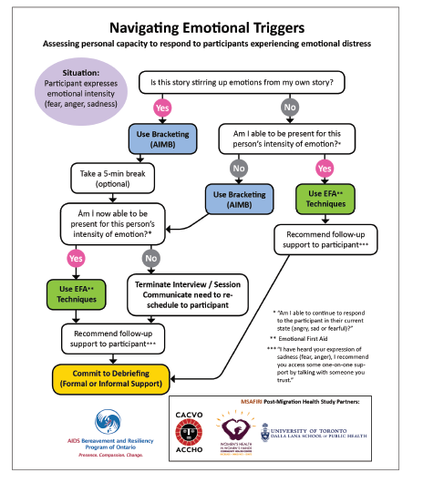

Slide 156
Coping with difficult interviews
Exercise
Going into nature
Cooking a nice meal for ourselves or others
Talking to a friend, partner or family
Having a bath, reading a book and unwinding
Yoga, meditation or prayer
De-brief meetings
Everyone in the research team
Check-in on how you are finding the experience
Troubleshoot issues, identify ways forward & reflect on your emotions
Can also arrange 1:1 debriefs when preferred
Self-care can also help you when navigating negative emotions – who and what?

Slide 157
Shame &
[SELF-CARE]
To take care of myself today, I will __________________ (write activity in blank)
Notes:
Please complete on your own now – and you can use these before & after each interview to check in with your emotions. Please remember that we are here to support you.

Slide 158
Next steps
Add when next training will be
Add any upcoming opportunities

Slide 159
Recommended resources
Photo by Beth Jnr on Unsplash
Unconscious bias training
[add links from your institution]
The Royal Society, Understanding unconscious bias explainer video: https://www.youtube.com/watch?v=dVp9Z5k0dEE&t=60s
Safeguarding
[add links from your institution]
COVID-19 Psychological First Aid: https://www.futurelearn.com/courses/psychological-first-aid-covid-19
Safeguarding considerations for researchers: https://www.nottingham.ac.uk/healthsciences/documents/safeguarding-researcher-guidelines.pdf
The National Council for Voluntary Organisations: https://knowhow.ncvo.org.uk/safeguarding/what-is-safeguarding
Emotional wellbeing
Guy Winch’s TED Talk on ‘how to practice emotional first aid’: https://youtu.be/F2hc2FLOdhI
Bakita’s TED Talk on ‘overcoming self-stigma to achieve your potential’: https://youtu.be/NqSB91rKqSU
AIDS Bereavement and Resilience Program of Ontario – Holistic Check-In learning module: https://abrpo.org/abrpo-news/
AIDS Bereavement and Resilience Program of Ontario. Essential Tools for Support and Stability (ETSS) – Peer Researcher Resource Kit: https://abrpo.org/wp-content/uploads/2018/09/Essential-Tools-Peer-Researcher-Resource-Kit.pdf
Pozcast. A podcast that “challenges the status quo and celebrates people living with HIV”: https://www.positiveeffect.org/pozcast
Notes:
we are also here to support you

Slide 160
Any questions?
Photo by Priscilla Du Preez on Unsplash

Slide 161
References
Kvale S, Brinkmann S. Interviews: Learning the craft of qualitative research interviewing. SAGE; 2009.
Brooks, H., Bee, P., & Rogers, A. (2018). " Introduction to qualitative research methods". In A research handbook for patient and public involvement researchers. Manchester, England: Manchester University Press. Retrieved May 6, 2021, from https://www.manchesteropenhive.com/view/9781526136527/9781526136527.00012.xml
AIDS Bereavement and Resiliency Program of Ontario. Essential Tools for Support and Stability (ETSS) – Peer Researcher Resource Kit. Available from https://abrpo.org/resources/essential-tools-for-support-and-stabiliity/ [Accessed 23 November 2021]
YouTube Video – The 3 Types of User Interviews: Structured, Semi-structured and Unstructured by NN group: https://www.youtube.com/watch?v=KUZ6iGvJlGI&t=1s&ab_channel=NNgroup [Accessed 20 January 2022]

Slide 162
Session 4: Analysing Interview Transcripts
Photo by Hugo Rocha on Unsplash

Slide 163
Reminders…
Allow everyone to speak, one at a time
Respect everyone’s comments and suggestions (no wrong answers)
Keep your microphone muted unless you have something to say
Raise your hand to let us know you would like to speak or use the chat to add any comments
Use the chat/raise hand to ask any questions – please do stop and ask any questions throughout
We will be recording the meeting to help us keep track of comments & so you can re-watch in your own time
Notes:
We will save the recording in a OneDrive folder along with all other relevant study documents and share after the session for you to listen back if you’d like to.

Slide 164
Agenda
Time | Topic
6pm-6.05pm | Welcome
6.05pm-6.10pm | Team building: a picture is a thousand words
6.10pm-6.20pm | Since our last meeting
6.20pm-6.30pm | Sharing interviewing experience, recap on qualitative research
6.30pm-6.40pm | Tea break
6.40pm-7.10pm | Qualitative data analysis: thematic analysis and the DEPICT model
7.10pm-7.55pm | Coding interview transcripts individually (& as a group)
7.55pm-8pm | Wrap up & next steps

Slide 165
Team building
Share your favourite photograph with the group
Photo by Annie Spratt on Unsplash
Notes:
Share your favourite photograph with the group

Slide 166
Since we last met…
Add any updates

Slide 167
Reflections from experiences
Photo by Juan Davila on Unsplash
Notes:
Ask peer researchers to present for 2-3 mins on reflections from (shadowing/conducting) interviews so far: 3 key takeaways

Slide 168
Recap: qualitative research
Photo by freestocks on Unsplash

Slide 169
Fundamentals of qualitative research
Source: Matt Lavoie https://bit.ly/2CNGH83
Focuses on the ‘how’ and ‘why’
Generates rich and context-specific data
What?
How & Why?
Notes:
See training session 2 for more

Slide 170
Tea break
Photo by Clay Banks on Unsplash

Slide 171
Qualitative data analysis
Photo by Christa Dodoo on Unsplash
Notes:
You have your data… now what?

Slide 172
Transcription
Start of your data analysis
Time consuming
Memos
Link to fieldnotes (if have)
Always remember: confidentiality
Notes:
Can take a very long time which is why we have outsourced to an external company, UK Transcription, of which we have a confidentiality agreement with. For instance, it can take around 6 hours to transcribe a 1hr interview. We anonymise all transcripts.
Won’t have had chance to send beforehand but we will distribute one via chat for you to begin reading during tea break. Will introduce how to analyse this afterwards. Password protected (we will tell you password on day) – will be same one for each transcript so please keep a note somewhere secure
Memos – things that might spring to mind as you are transcribing e.g. ideas or concepts

Slide 173
Data management & reduction
Different approaches to this including:
  Computer-aided qualitative data analysis software (CAQDAS) e.g. NVivo
  Cut & paste
  Highlighter
  Matrix
  And many more…
Notes:
Different approaches:
Computer-aided qualitative data analysis software (CAQDAS) e.g. Nvivo –Different packages for different methods: use for theory building or concept maps/diagrams etc.
Cut and paste – coded data cut up and pasted on large sheets of paper and organised into themes
Manual using highlighter pen (we will use this approach combined with “sticky notes”)
Reduce data to a matrix – each respondent in rows and each key theme or concept as column (Word or Excel) – pixture is from NVivo
Other methods include:
Use cognitive mapping – visually chart beliefs and concepts held by one individual and see how much each of these are linked and in what direction
Transferring single concept onto index cards – each card represents a theme and summarises all respondents views on a single card
Clustering results in ‘dendrograms’ – visualize patterns by grouping themes/concepts that share similar words or attributes or are coded similarly – graphical representation of similarities and differences.
Remember whichever you choose you will begin to lose some of the meaning behind the words… as you try to quantify

Slide 174
Thematic analysis
Photo by Jo Szczepanska on Unsplash
Notes:
There are lots of different approaches to data analysis. We will be focusing on a type of thematic analysis.
Thematic analysis- thematic coding used in many different analytic traditions (e.g. grounded theory, content analysis) so some argue that it is more of a generic method rather than an approach of its own

Slide 175
Thematic analysis
Discovering, interpreting and reporting patterns and clusters of meaning within the data – into themes (Braun & Clarke, 2006)
Notes:
Thematic analysis= one of the most common approaches to QDA
Coding data and organisation of coded data into themes or other patterns and associations
Stages in thematic data analysis:
1. organise the data
2. code the data
3. generate categories or themes
4. test emergent understandings of the data
5. search for alternative explanations of the data
6. write-up the data analysis

Slide 176
Thematic analysis
Notes:
Summarises previous picutre

Slide 177
The ‘DEPICT’ model
Adapted from Flicker and Nixon (2014)
Photo by Jason Goodman on Unsplash
Notes:
This is a specific model used in participatory research & as you will see it is very similar to thematic analysis
Today you will learn HOW to code transcripts and categorise codes into themes. However, much of your work will take place after today’s call. You will each be assigned a “buddy” who will guide you through the other steps before we meet once more as a group to finalise our findings.
We will share transcripts with you by email (password protected) to keep these safe. We recommend that once you have finished analysing them you send them back & delete from your workspace.

Slide 178
Step 1: Dynamic reading
Review your transcripts (1-2 each) a few times
Make notes on important concepts – draw on your experiences
You may wish to use a highlighter
Meet as a group to discuss
“What ideas seem to be important in these texts?”
Photo by Nathan Aguirre on Unsplash
Notes:
We will send you each transcripts with a password (same for each one) – make a note now.
We will set a deadline and meeting time to have completed this by.

Slide 179
Time to practice
Step 1: Dynamic Reading
Photo by Nathan Aguirre on Unsplash
Notes:
Let’s have a read of transcript B01 now as a group. Read out loud for 5 minutes.

Slide 180
Step 2: Engaged codebook development
Photo by Aaron Burden on Unsplash
Organise codes into categories
Can be based on your own experiences, literature, or questions asked as well as those appearing from data itself
Use sticky notes to note specific ideas and cluster into categories
Agree on a preliminary codebook (as a group) – build on today
“What is our agreed list of categories & sub-categories?”
“Are there any missing?”
“Do we understand what they mean and how to apply them?”
Flicker and Nixon (2014)
Notes:
Thematic framework or index systematically applied to the data in their textual form.
Data ‘lifted’ from original context and rearranged according to appropriate thematic reference.
Researchers immerse self in data – identify topics/subjects of interest – therefore, whatever labels developed are grounded/supported by data
Possible topics – refine & sort into themes and subthemes (initial thematic framework)
Emergent themes + ones derived from research questions/aims (+ interview topic guide)
“we took a combined approach to analysis, enabling themes to be developed both inductively from the accounts (experiences and views) of research participants and deductively from existing literature."
Step 3: indexing or applying framework
Use thematic framework to annotate & label data. Sometimes referred to as ‘opic coding’
Indexing:
All data are read and annotated according to the thematic framework. Indexing references- recorded on the margins of each transcript. It involves making judgements on the meaning and significance of the data, it is not a mechanical, routine exercise (subjective, but transparent process)
Indexes provide a mechanism for labelling data in manageable ‘bites’ for subsequent retrieval and exploration.
If more than one population is being studied, then it may be necessary to develop separate indexes for each group; or alternatively have a common index, but have additional elements through extra sub-categories- this helps identify both common and divergent themes.

Slide 181
But how to do I code?
Simply highlight anything of relevance – usually words, phrases, sentences or whole paragraphs
Generate categories by noting patterns
Meaning of each develops into a concept / link to theoretical construct
Characterising patterns (Hatch, 2002; pg. 155)
Similarity
Difference
Frequency
Sequence
Correspondence
Causation
Photo by Aaron Burden on Unsplash
Notes:
Characterising patterns
Similarity – things happen the same way
Different – they happen in predictably different ways
Frequency – happen often or rarely
Sequence – happen in certain order
Correspondence – happen in relation to other activities or events
Causation – one appears to cause another

Slide 182
Time to practice
Photo by Aaron Burden on Unsplash
Step 2: Engaged codebook development
Notes:
Let’s do it now with our example
You will spend 10 mins coding alone – can do this simply by highlighting in word & adding notes to file
We will then meet as a group and discuss our codes to develop a codebook together.
Create individual Jamboards for people to use

Slide 183
Step 3: Participatory coding
Using final codebook you will code subset of transcripts
Each transcript coded by at least 2 team members
Return coding work to your partner, meet and send final codes to [name] by [date]
“Which sections of the transcript fit into which categories of our codebook?”
Notes:
You will continue your coding after today to start and finish coding 1 transcript each.

Slide 184
Step 4: Inclusive reviewing and summarising of categories
Re-review each category to see how everyone has coded similarly/differently
You will meet with your transcript partner (name) separately to determine codes
You will develop a category summary for each code together ready to be shared by [date]
“What are the main ideas?”
“Where is there disagreement?”
“What are some key quotes?”
“Are there silences worth noting?”
“What else is important to note that might help in the analysis of the larger project?”
Notes:
https://academic.oup.com/heapro/article/30/3/616/624351?login=true

Slide 185
Step 5: Collaborative analysing
Review summaries before meeting
Team reconvenes to discuss objectives and make sense of data – reflection on project & determine 3 key findings on [date]
“What does it all mean?”
“What were our most important findings?”
“What do we need to share and with whom?”
“What questions do we still have?”
“For critical analyses, what structural factors may help us understand why people chose to tell us the stories they shared (e.g. homophobia)”
Notes:
https://academic.oup.com/heapro/article/30/3/616/624351?login=true

Slide 186
Step 6: Translating
Create our dissemination plan – how should we share our findings & with whom (on [date])
“Who needs to know what?”
“How do they need to hear it?”
“Who are the best messengers?”
“How do we get the word out?”
“Who on our team will be responsible for what and by when?”
Notes:
https://academic.oup.com/heapro/article/30/3/616/624351?login=true

Slide 187
Next steps
Add when next meeting will be
Add any other opportunities

Slide 188
Recommended resources
Photo by Beth Jnr on Unsplash
Qualitative Data Analysis
Brooks, H., Bee, P., & Rogers, A. (2018). " Introduction to qualitative data analysis". In A research handbook for patient and public involvement researchers. Manchester, England: Manchester University Press. Retrieved Jul 6, 2021, from https://www.manchesteropenhive.com/view/9781526136527/9781526136527.00013.xml
Noble H, Smith J. Qualitative data analysis: a practical example. Evidence-Based Nursing. 2014 Jan 1;17(1):2-3.
Thematic analysis
(See Part II): Richards L, Morse JM. Readme first for a user's guide to qualitative methods. Sage; 2013. https://books.google.co.uk/books?id=BKMKc7_Vac0C&lpg=PP1&ots=gFwshH8Ljj&dq=.%20Read%20me%20first%20for%20a%20user's%20guide%20to%20qualitative%20methods.%20London%3A%20Sage%20Publications%2C%202002.&lr&pg=PP1#v=onepage&q&f=false
YouTube Video - Thematic Analysis of Qualitative User Research Data by NN group: https://www.youtube.com/watch?v=KUZ6iGvJlGI&t=1s&ab_channel=NNgroup
Easy-read introduction to thematic analysis: https://www.nngroup.com/articles/thematic-analysis/
Notes:
We are also here to support you

Slide 189
Any questions?
Photo by Sergey Shmidt on Unsplash

Slide 190
References
Braun V, Clarke V. Using thematic analysis in psychology. Qualitative research in psychology. 2006 Jan 1;3(2):77-101.
Brooks, H., Bee, P., & Rogers, A. (2018). " Introduction to qualitative data analysis". In A research handbook for patient and public involvement researchers. Manchester, England: Manchester University Press. Retrieved Jul 6, 2021, from https://www.manchesteropenhive.com/view/9781526136527/9781526136527.00013.xml
Flicker S, Nixon SA. The DEPICT model for participatory qualitative health promotion research analysis piloted in Canada, Zambia and South Africa. Health Promotion International. 2015 Sep 1;30(3):616-24.
Hatch, J.A., 2002. Doing qualitative research in education settings. SUNY Press.
Miles, M.B. and Huberman, A.M., 1994. Qualitative data analysis: An expanded sourcebook. SAGE.
Ormston, R., Spencer, L., Barnard, M. and Snape, D., 2014. The foundations of qualitative research. Qualitative research practice: A guide for social science students and researchers, 2, pp.52-55.
Pope C, Ziebland S, Mays N. Analysing qualitative data BMJ 2000; 320 :114
Ritchie, J., Lewis, J., Nicholls, C.M. and Ormston, R. eds., 2013. Qualitative research practice: A guide for social science students and researchers. SAGE.
Ritchie, Jane, and Liz Spencer. "Qualitative data analysis for applied policy research." The qualitative researcher’s companion 573.2002 (2002): 305-329.
Rosala, M. (2019). How to analyze qualitative data from UX research: thematic analysis. Nielsen Norman Group. Available from: https://www.nngroup.com/articles/thematic-analysis/ [Accessed 11 January 2022]
Saldaña J. The coding manual for qualitative researchers. sage; 2021 Jan 27.

