Slide 1
Group | IHD | T2DM | Hyp
1. CABG-NDM | 1 | 0 | 0
2. CABG-DM | 1 | 1 | 0
3. AVR | 0 | 0 | 1
4. MVR | 0 | 0 | 0
Table 1. By comparing patients undergoing coronary artery bypass graft (CABG) surgery with and without T2DM (CABG-DM and CABG-NDM respectively), with non-CAD patients without T2DM undergoing aortic valve replacement (AVR) surgery and non-CAD patients without T2DM undergoing mitral valve repair (MVR) surgery we will consider the effects of 3 disease features: ischaemic heart disease (IHD), type 2 diabetes mellitus (T2DM), hypertrophic remodelling (Hyp). The table indicates which features are present (1) or absent (0) in each group.

Slide 2
A
B
3 pigs undergoing CPB
3 pigs undergoing CPB
Left ventricular biopsies
sampled post-CPB
Citrate plasma
sampled post-CPB
RNA extraction protocols
RNA extraction protocols
A
B
C
D
E
F
G
H
Each protocol ± proteinase K*
Each protocol ± glycogen
3 RNA samples/condition
3 RNA samples/condition
Spectro
-photometry
Capillary electrophoresis
RT-qPCR:
cel-miR-39-3p
miR-16-5p
miR-21-5p
miR-92a-3p
Figure 1. Summary of experimental design for figures 2-4. A. Left ventricular biopsies were taken from three pigs undergoing cardio-pulmonary bypass (CPB). 7 biopsies were taken per pig. RNA was isolated from the biopsies using four commercially available kits. A = RNAqueous micro; B = mirVana; C = miRCURY tissue; D = miRNeasy micro. Three kits (A, B, D) were tested with and without an additional proteinase K digestion step, giving 7 protocols in total. *Kit C protocol includes a proteinase K digestion, therefore this kit was not tested without this. RNA samples were characterised by spectrophotometry and capillary electrophoresis. B. Blood samples were taken from three pigs undergoing CPB and processed to plasma. RNA was isolated from the plasma using four commercially-available kits. E = miRNeasy serum/plasma; F = mirVana; G = miRCURY biofluids; H = Norgen Biotek plasma/serum. Each kit was tested with and without glycogen as a co-precipitant, giving 8 protocols in total. RNA samples were evaluated by RT-qPCR for the exogenous spike-in cel-miR-39-3p, and endogenous miRNAs miR-16-5p, miR-21-5p, miR-92a-3p.

Slide 3
Figure 2. Spectrophotometry analysis of LV biopsy RNA. RNA extracted according to each manufacturer’s protocol, with the addition of a proteinase K digestion in half the samples. n = 3 biopsies/experimental condition, mean±SEM. N.B. Exiqon miRCURY tissue protocol requires proteinase K, therefore no –proteinase K condition was done with this kit. A. RNA yield, assessed as ng RNA recovered per mg input tissue, was not significantly different between the protocols (Kruskal-Wallis test with Dunn correction), and additional proteinase K digestion in the RNAqueous micro, mirVana and miRNeasy micro protocols did not significantly improve RNA yield (Kruskal-Wallis test with Dunn correction). B. 260/280 and 260/230 ratios provide an assessment of the purity of the RNA. Ratio <2.0 indicates possible contamination with protein, phenol or salts. All protocols produced an acceptable 260/280 ratio. RNA extracted using the mirVana protocol had low 260/230 ratios, indicating probable phenol or guanidine carryover. Numbers in brackets indicate the number of samples in each group.

Slide 4
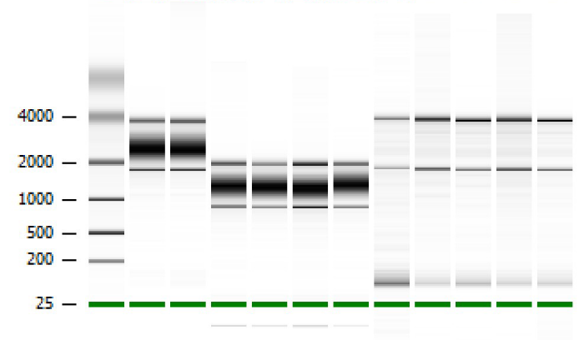
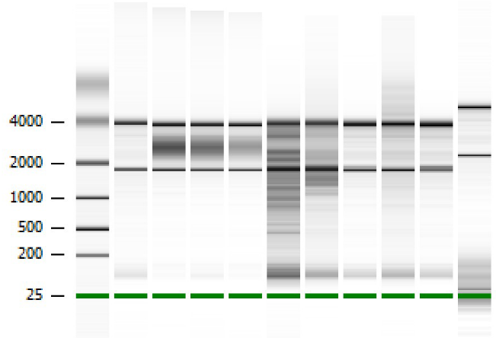
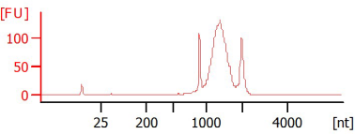
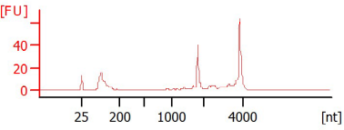
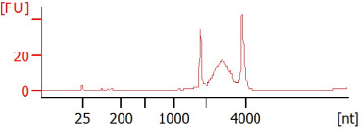
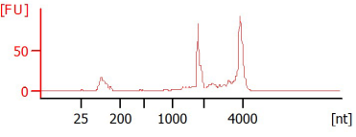
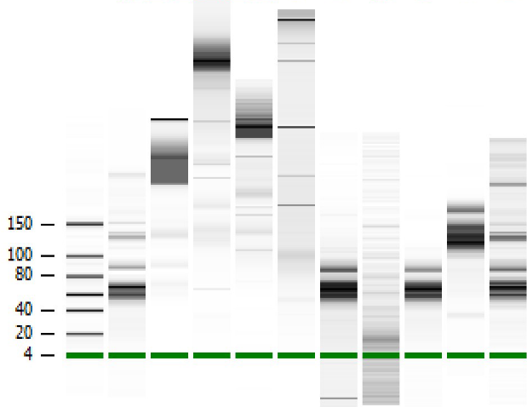
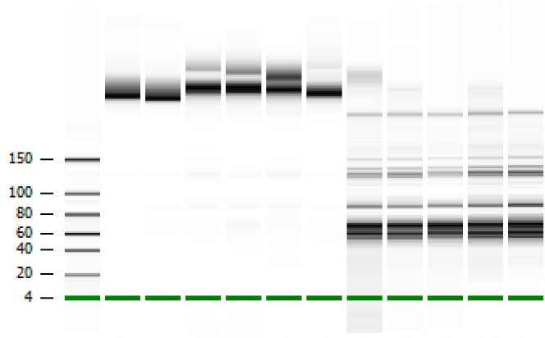
A
RNAqueous
mirVana
miRCURY
tissue
miRNeasy micro
1
2
3
4
B
C
1
RIN: N/A
2
RIN: 8.7
3
RIN: 8.6
4
RIN: 8.7
D
RNAqueous
mirVana
miRCURY
tissue
miRNeasy micro
*
*
*
Figure 3. A. Bioanalyzer nano chip traces of all tested samples. Inspection of electropherograms provides additional information to assess RNA quality and protocol performance. B. Representative traces from each protocol with respective RIN values. Numbers 1-4 correspond to numbered boxes in A. Note that trace 3 has a high RIN despite a large smear in the gel. C. Summary of RIN values of all the samples tested (mean±SEM). The RNAqueous protocol had undetectable RINs. The mirVana and miRCURY tissue protocols gave consistently high RIN values, while despite high average RIN, the samples from the miRNeasy micro protocol are more variable. Numbers in brackets indicate the number of samples in each group. D. Bioanalyzer small RNA chip traces for each kit. Although the RIN of samples marked * were similar (8.6-8.7), the spectrum of small RNAs recovered is highly heterogeneous.

Slide 5
Figure 4. As biofluid RNA is below the detection limit of standard quantification tools, all RT-qPCRs were performed using 1.5 µL RNA extracted from 200 µL plasma. Lines indicate paired samples i.e. aliquots of plasma from the same blood draw. A. RT-qPCR for the spike-in cel-miR-39-3p using the four kits with and without glycogen. B-D. RT-qPCR for three endogenous miRNAs isolated using the four kits with and without glycogen. E. The miRNeasy serum/plasma protocol recommends elution in 14 µL, compared with 100 µL for the mirVana protocol. To control for effects of this, RNA extractions were performed with both protocols, eluting in 30 µL or 50 µL. RT-qPCR for cel-miR-39-3p, hsa-miR-16-5p and hsa-miR-21-5p were performed to evaluate the different elution volumes.

Slide 6
Identify the ‘challenges’ e.g. small, fibrous, low RNA content, glycogen-rich etc.
Capillary electrophoresis for small RNAs
yes
Test a range of protocols suitable to sample type
Are small RNAs of interest?
[RNA]
<15 ng/µl
?
Spectrophotometry (concentration, 260/280, 260/230)
Capillary electrophoresis – inspect trace, not just RIN
no
yes
RT-qPCR panel
rRNA present
?
Capillary electrophoresis for small RNAs if relevant
no
yes
Consider capillary electrophoresis
Figure 5. Decision tree for optimising appropriate protocols for RNA extraction from challenging samples

Slide 7
Figure S1. Bioanalyzer Nano chip quantification of LV biopsy RNA was similar to the spectrophotometry quantification presented in figure 2A. RNA extracted according to each manufacturer’s protocol, with the addition of a proteinase K digestion in half the samples. n = 3 biopsies/experimental condition, mean±SEM. N.B. Exiqon miRCURY tissue protocol requires proteinase K, therefore no –proteinase K condition was done with this kit. Numbers in brackets indicate the number of samples in each group.

Slide 8
Figure S2. The mirVana protocol recommends elution in 100 µL water; with small tissue samples this can result in a sample too dilute for some downstream applications. Reducing the elution volume to 50 or 30 µL produced a more concentrated preparation without appreciable loss of RNA yield, measured by spectrophotometry (p = 0.2359, Kruskal-Wallis test).

Slide 9
Figure S3. Two randomly selected pig plasma RNA samples were screened for the presence of 7 candidate circulating miRNAs predicted to be conserved between humans and pigs.

Slide 10
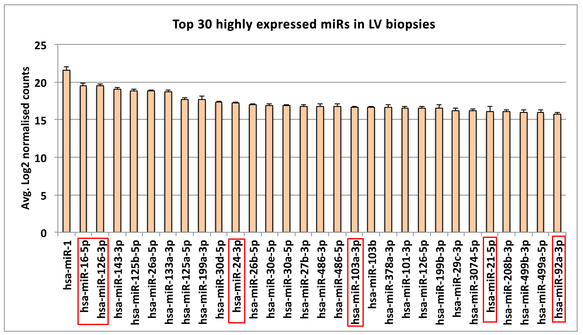
Figure S4. The expression levels of the top 30 miRNAs in LV biopsies are plotted as average log2 normalised counts. The expression levels of the candidate circulating miRNAs from pig plasma are highlighted in red boxes. miR-15b-5p is expressed in human LV but is not among the top 30 expressed miRNAs.

Slide 11
Figure S5. The expression levels in human plasma of the 7 candidate circulating miRNAs from pig plasma. Mean C_{q} values are expressed after inter-plate calibration.

Slide 12
Figure S6. A. RNA yield is constant over the range of biopsy masses from 1-6 µg. Linear regression y = -0.0161x + 1.326 B. For biopsies weighing <1 mg, the yield is no longer constant; non-linear regression, least-squares fit y = 1.503x^{-0.4715} C. The RIN remains constant across the range of biopsy masses.

Slide 13
Biopsy number | Total RNA (ng) | RIN
1 | 49.23 | 8.3
2 | 28.85 | 7.8
3 | 22.65 | 8
4 | 31.20 | 8.4
5 | 28.63 | 8.6
6 | 30.70 | N/A
7 | 20.18 | 8.3
8 | 30.33 | 8.2
9 | 16.75 | 2.4
10 | 22.48 | 7.9
11 | 44.15 | 8.1
12 | 42.80 | 8.3
13 | 8.33 | 7.7
14 | 31.78 | 8.3
15 | 52.90 | 8
16 | 23.90 | 7.6
17 | 50.15 | 8.3
18 | 53.63 | 7.7
19 | 29.60 | 8.4
20 | 5.88 | 7.8
21 | 31.55 | 8
22 | 48.13 | 8.2
23 | 40.18 | 8.2
24 | 33.90 | 8.5
25 | 46.18 | 8.5
26 | 34.98 | 8.3
27 | 42.68 | 8.6
28 | 23.60 | 8.3
29 | 24.90 | 8.1
30 | 46.18 | 8.4
31 | 54.33 | 6.8
32 | 53.65 | 8
33 | 58.08 | 8
34 | 52.63 | 7.9
35 | 47.20 | 8.2
36 | 52.63 | 8
37 | 34.40 | 8.1
38 | 62.13 | 7.7
39 | 58.78 | 8.3
40 | 40.20 | 7.9
41 | 29.13 | 8.1
42 | 44.98 | 8.4
43 | 35.05 | 8.5
44 | 32.13 | 8.3
45 | 40.90 | 8.4
46 | 51.55 | 8.2
47 | 32.70 | 8.5
48 | 48.65 | 7.9
Biopsy number | Total RNA (ng) | RIN
49 | 79.08 | 7.5
50 | 44.93 | 8.2
51 | 12.85 | 7.8
52 | 40.45 | 8
53 | 84.48 | 8.4
54 | 16.70 | 8
55 | 60.68 | 5.5
56 | 19.18 | 8.2
57 | 16.43 | 8.4
58 | 33.40 | 8.4
59 | 64.60 | 8.3
60 | 63.98 | 8.4
61 | 35.95 | 7.5
62 | 59.03 | 7.7
63 | 84.63 | 8.1
64 | 15.08 | 8.5
65 | 61.10 | 8.2
66 | 87.98 | 8.1
67 | 53.33 | 8
68 | 30.15 | 8.4
69 | 51.00 | 8.2
70 | 82.08 | 8.3
71 | 63.43 | 7.7
72 | 75.68 | 7.2
73 | 85.03 | 7.9
74 | 72.90 | 8.1
75 | 72.73 | 8.1
76 | 83.15 | 7.8
77 | 81.13 | 8.3
78 | 94.68 | 8
79 | 32.85 | 8.3
80 | 72.45 | 8.4
81 | 87.68 | 8
82 | 79.98 | 7.5
83 | 71.95 | 8.1
84 | 65.33 | 8.5
85 | 67.53 | 8.4
86 | 78.73 | 8
87 | 68.35 | 8.5
88 | 71.58 | 7.8
89 | 58.00 | 7.2
90 | 89.23 | 8.1
91 | 67.78 | 8.3
92 | 53.58 | 8.2
93 | 65.45 | 8.3
94 | 76.63 | 8.2
95 | 55.93 | 8.5
96 | 67.70 | 8.4
Table S1. RNA yield and RIN from each human LV biopsy extracted with the modified mirVana protocol. Biopsy mass 0.1-6 mg.

