Slide 1
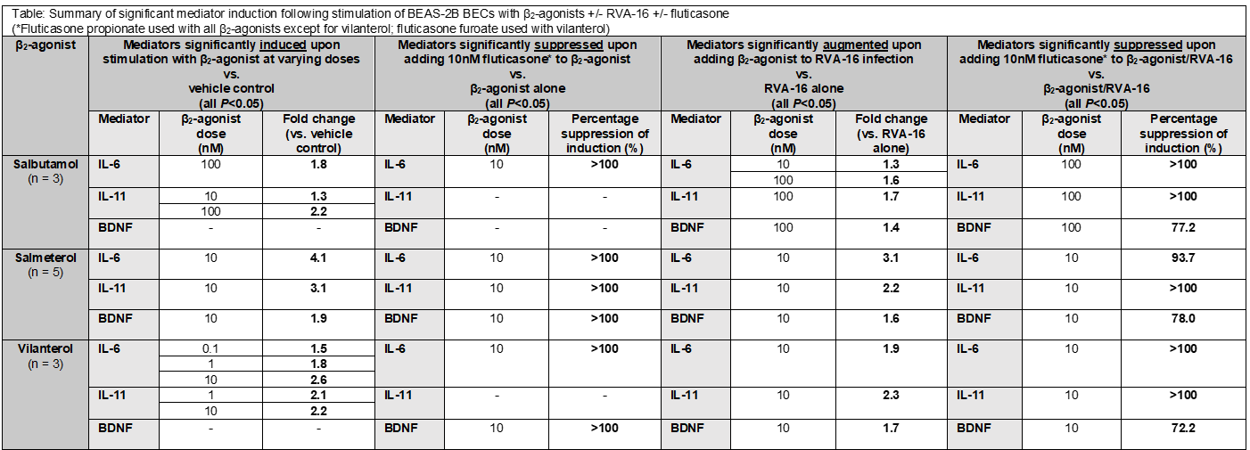
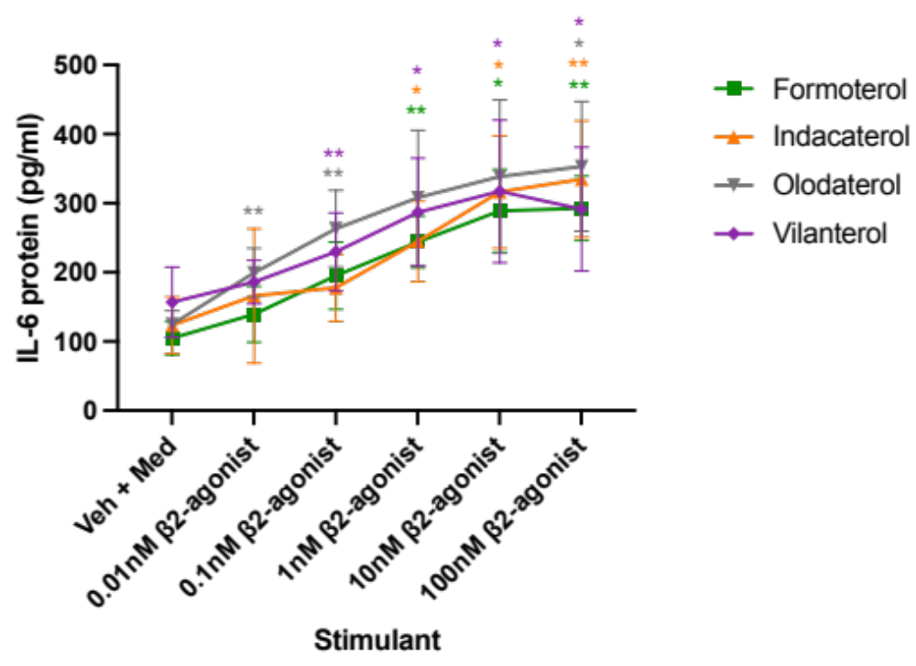
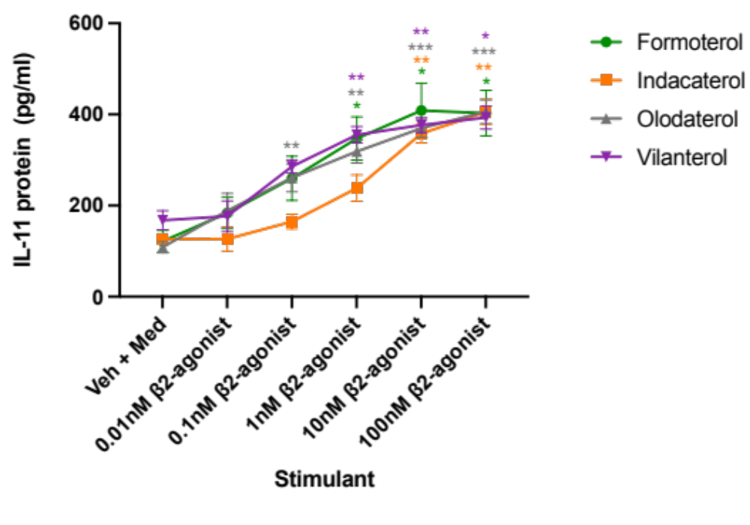

β2-agonists Induce and Augment Rhinovirus-Induction of Pro-Inflammatory Mediators in Bronchial Epithelial Cells
E. Fiorenzo¹, K. Kumar¹, T. Kebadze¹, F. Losa², P. Mallia¹, A. Singanayagam¹, M. Edwards¹, S. Johnston¹
¹National Heart and Lung Institute, Imperial College London - London (United Kingdom), ²University of Cagliari - Cagliari (Italy)
Rationale Salmeterol and formoterol induce pro-inflammatory mediators in bronchial epithelial cells (BECs). We investigated whether other β2-agonists or muscarinic antagonists, exhibit similar effects.
Methods BEAS-2B BECs were stimulated with vehicle control or 0.1-100nM of short-acting or long-acting β2-agonists (LABAs), ultra-LABAs and short or long-acting muscarinic antagonists; +/- rhinovirus A(RVA)-16 infection to mimic use during exacerbations; +/- 10nM fluticasone propionate (furoate with vilanterol). IL-6, IL-11 and brain-derived neurotrophic factor (BDNF) release were quantified by ELISA.
Results IL-6 and IL-11 were induced 2-4-fold by all β2-agonists in a dose- and time-dependent manner (all P<0.05). LABAs also induced BDNF (1.6-1.85-fold, P<0.05). Salbutamol mostly induced at 100nM; LABAs induced at concentrations as low as 0.1nM. Salbutamol (100nM) significantly augmented RV-induction of all three mediators by 1.4-1.7-fold and LABAs (10nM) by 1.6-3-fold (P<0.05). Induction potency was salbutamol<fenoterol<formoterol=salmeterol<indacaterol=olodaterol=vilanterol. Adding fluticasone to β2-agonist alone abolished induction of all three mediators and to β2-agonist/RVA, suppressed by 72-100% (P<0.05). Ipratropium, tiotropium, aclidinium and umeclidinium did not induce any mediator (all P>0.05).
Table 1. Summary of significant mediator induction following stimulation of BEAS-2B BECs with β₂-agonists +/- RVA-16 +/- fluticasone (*Fluticasone propionate used with all β₂-agonists except for vilanterol; fluticasone furoate used with vilanterol)
A
B
Conclusion β2-agonists, but not muscarinic antagonists, upregulate BEC production of asthma-relevant pro-inflammatory mediators with/without RVA. ICS co-administration abolished these pro-inflammatory effects. This may explain the adverse effects associated with β2-agonist use without ICS. In vivo studies need to determine the clinical significance of these findings.
Graph 1. A Dose-dependent induction of IL-6 by formoterol, indacaterol, olodaterol and vilanterol in BEAS-2B BECs in-vitro. B Dose-dependent induction of IL-11 by formoterol, indacaterol, olodaterol and vilanterol in BEAS-2B BECs in vitro. *p<0.05; **p<0.01; ***p<0.001. n=5
Reference
1) Ritchie AI, Singanayagam A, Wiater E, Edwards MR, Montminy M, Johnston SL. β2-agonists enhance asthma-relevant inflammatory mediators in human airway epithelial cells. Am J Respir Cell Mol Biol. 2018;58(1):128-132.
Funding:
European Research Council Advanced Grant 788575; Imperial NIHR Biomedical Research Centre

