Slide 1
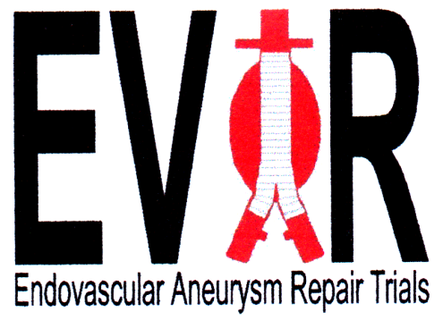

Endovascular repair of AAA in patients physically ineligible for open repair – very long-term follow-up of the EVAR 2 trial
Michael Sweeting: University of Cambridge
Rajesh Patel, Janet Powell & Roger Greenhalgh,
: Imperial College, London
For the EVAR 2 trial investigators
Notes:
Add Imperial College logo?

Slide 2
Disclosure
Speaker names:
Michael J Sweeting, Roger M Greenhalgh
I have the following potential conflicts of interest to report:
  Receipt of grants/research support MS RG
  Receipt of honoraria and travel support
  Participation in a company sponsored speakers‘ bureau
  Employment in industry
  Shareholder in a healthcare company
  Owner of a healthcare company RG
I do not have any potential conflict of interest

Slide 3
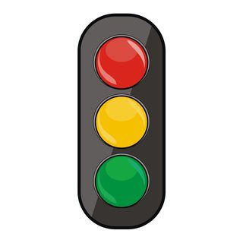
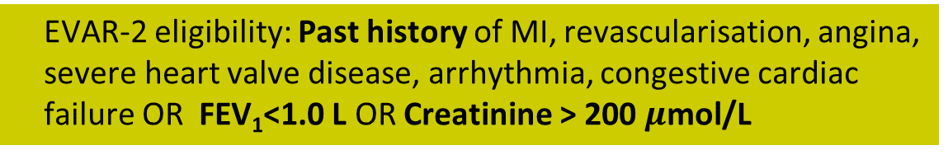
EVAR-2: Patient eligibility
Remains the sole randomised trial to identify whether EVAR reduces mortality rates in patients ineligible for open repair
Traffic light system to determine patient fitness & eligibility
  Optimise fitness - Neither EVAR-1 or EVAR-2: MI, onset of angina, unstable angina at night or at rest within last 3 months
  EVAR-2 eligibility: Past history of MI, revascularisation, angina, severe heart valve disease, arrhythmia, congestive cardiac failure OR FEV₁<1.0 L OR Creatinine > 200 $μ$mol/L
  EVAR-1 eligibility: None of the above
NEJM 2010

Slide 4
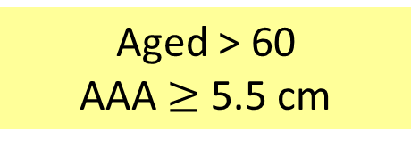
Randomisation between September 1999 and August 2004
404 patients randomised from 33 UK centres
EVAR
N=197
No intervention
N=207
Aged > 60
AAA $≥$ 5.5 cm
Mean age 77 years
86% male
Mean AAA diameter 6.7 cm

Slide 5
Very-long term follow-up beyond 8-years:
Sept 2009 – June 2015
Follow-up the remaining 20% of patients
  Physically fittest of all patients enrolled
  May benefit most from EVAR
Centres reminded to continue regular follow-up (protocol specified annual), including those with lapsed follow-up
Complications and reinterventions recorded by trial centres
Record-linkage until June 2015 for mortality records (NHS Digital)
  Causes of death adjudicated by Trial Endpoint Committee

Slide 6
Survival up to 12-years post-randomisation
Lower aneurysm-related mortality: HR=0.46; p=0.02
No benefit in terms of total mortality: HR=1.07; p=0.52
7% survival probability at 12-years
Aneurysm-related mortality
EVAR
No intervention
HR = 0.46; p=0.019
All-cause mortality
EVAR
No intervention
HR = 1.07; p=0.52

Slide 7
Summary of main results
  High 30-day operative mortality in the EVAR group: 9%
Half the number of aneurysm related deaths in EVAR group over full follow-up (14% vs. 29%)
But… no overall survival benefit
  Limited life expectancy (mean 4.2 years in both groups)
  High comorbidities:
    17% died of CHD within 4-years
    9% died of cancer within 4-years
    8% respiratory deaths within 4-years
    (12% in EVAR group, 5% in no repair group)

Slide 8
Cross-overs (elective repairs)
However….
  31% of no intervention group received an elective AAA repair during follow-up
    61% of those still alive at 4-years
    68% of those still alive at 8-years
Patient fitness was better in those that underwent elective EVAR in the no intervention group (mean CPI*5.97) vs. the EVAR group (mean 10.13), p=0.011
*CPI - Customised probability index (higher is worse fitness)

Slide 9
Per-protocol
Censors individuals at the time of cross-over
But the less fit patients do not cross-over!
  So more deaths are seen in the no intervention group
  Biases results in favour of the EVAR group
Aneurysm-related mortality
EVAR
No intervention
HR = 0.41; p=0.0008
All-cause mortality
EVAR
No intervention
HR = 0.82; p=0.14

Slide 10
Randomisation-based causal estimate
Results similar to intention-to-treat analyses
Aneurysm-related mortality
EVAR
No intervention
HR = 0.46; p=0.019
All-cause mortality
EVAR
No intervention
HR = 1.10; p=0.52
Notes:
Possibly remove this slide

Slide 11
Predictors of long-term survival
Those who survived more than 8 years…
  were on average 3-years younger (p=0.013)
  had higher mean BMI (27.8 vs. 26.2 Kg/m²; p=0.017)
  had higher mean % predicted FEV₁ (70.1 vs. 63.6; p=0.0038)
  had higher mean eGFR (63 vs. 57; p=0.0043)
However, no evidence of an overall survival benefit from EVAR for any particular subgroup
  e.g. patients with better lung function fared better no matter which group they were randomised to

Slide 12
Limitations
Many of the no intervention group crossed over.
The proportion of patients alive at >8 years is small.
Devices of today and epidural anaesthesia (not 47%) could give a different trial result.
Reinterventions of today could be better performed.
Loss to follow-up reduced reporting of:
  Complications
  Re-interventions
  AAA-related mortality.
Frailty may have prevented re-intervention.

Slide 13
Strengths
Complete follow-up for total mortality
Insight from supporting causal analysis
EVAR 2 highlights high patient co-morbidities
All-cause mortality is the driver

Slide 14
Summary for EVAR 2
EVAR did not increase overall life expectancy
EVAR did reduce aneurysm-related mortality

