Slide 1
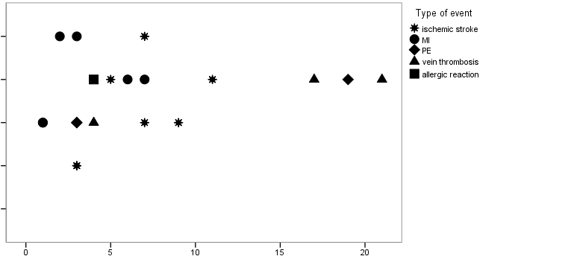
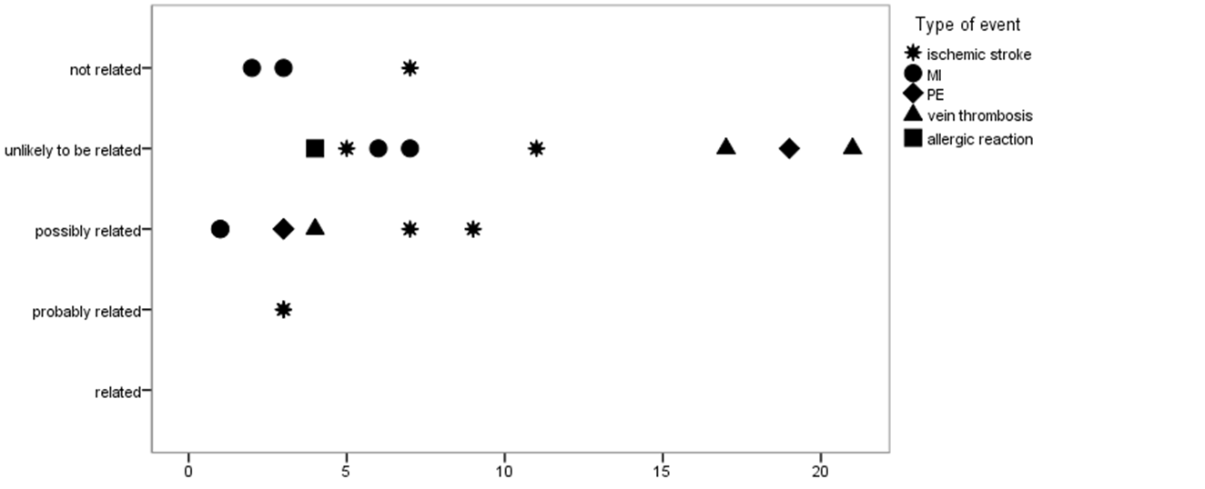
Type of event
not related
IS (Ischemic stroke), (n=7)
MI (Myocardial infarction), (n=6)
unlikely related
PE (Pulmonary embolism), (n=3)
Deep vein thrombosis, (n=3)
possibly related
Allergic reaction, (n=1)
Supposed relationship to PCC treatment
probably related
related
Days

