Slide 1

Carbon
A lightweight tool for estimating the carbon emissions of HPC jobs
Dr Jack Coker
CIUK – Manchester – 4/12/25

Slide 2


About Me
PhD in organic semiconductor physics (renewable energy)
  Involved heavy use of Imperial’s HPC clusters
Attended launch event for ICICLE collaboration
  Collaboration between Imperial, Intel, and Lenovo
  A focus on sustainable scientific computing
For last ~9 months, on the HPC and RSE Experience Programme with Imperial’s RCS team
For last ~6 months, have worked on Carbon
Notes:
Attempting to find/improve the materials we use in renewable energy generation.
But, what is the environmental impact of the computational work itself?
Was at the launch event where I first
1) encountered the term sustainable computing, solidifying some concepts I had been thinking about
2) heard about the HPC and RSE experience programme
I applied to experience program and expressed my interest in sustainable computing
Serendipitously, some money was available from the collaboration to fund a position on the experience program.

Slide 3




Motivation
HPC is critical to research but can consume large amounts of energy and contribute to emissions
Growing need for simple, transparent ways to make the environmental cost of computing visible
We should be able to measure something if we want to improve it!

Slide 4
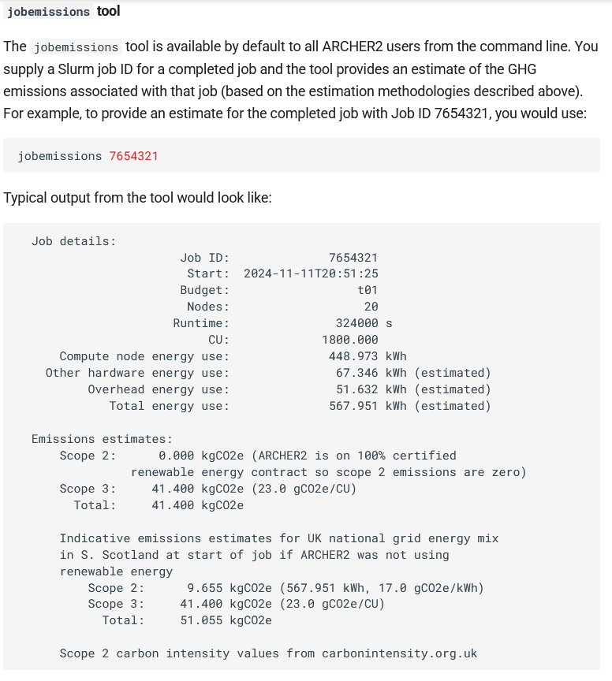

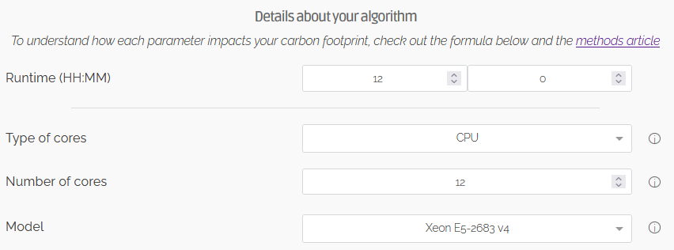


Inspiration / Existing tools
Green algorithms project
jobemissions tool on ARCHER2
Loïc Lannelongue (Cambridge)
Andy Turner (EPCC)
Notes:
One major difference between writing a tool for Imperial clusters versus ARCHER2 is
We generally don’t enforce exclusive node access for jobs! This leads to some interesting
Consequences regarding the power consumption you can assign to jobs.

Slide 5
Goal
A command line tool that estimates CO2 emissions from a given HPC job
Requirements:
  “Non-invasive” / portable
  Not heavily coupled to Imperial’s systems
  Modular
  Reasonably accurate!
A theoretical issue: Processes (jobs) don’t use energy – computers do!
  At Imperial: non-exclusive nodes.
  How to represent a “fair share” of power usage?
Notes:
Fair share: Jobs that request less resources should be represented as using less power. If power estimate of a job is only a function of e.g. which executing node it is placed on (something the user has little control over), then the tool isn’t useful for incentivising wise/conscientious choices.

Slide 6

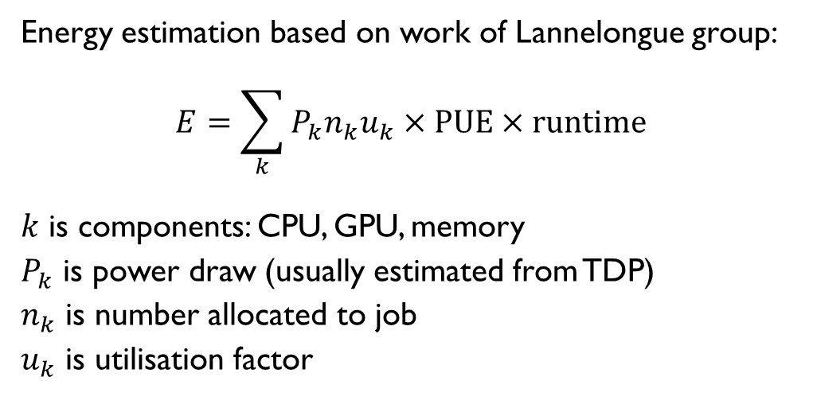
Method
Server
Web
$$G=E×I$$
PBS
(Workload manager)
carbonintensity (Web API)
CPU load, memory, chip model, date
Emissions (in gCO₂)
Energy consumption (in kWh)
Carbon intensity (in gCO₂/kWh)
Carbon intensity
(dated)
Energy estimation based on work of Lannelongue group:
$$E=\sum_{k}{P_{k}n_{k}u_{k}}×PUE×runtime$$
$k$ is components: CPU, GPU, memory
$P_{k}$ is power draw (usually estimated from TDP)
$n_{k}$ is number allocated to job
$u_{k}$ is utilisation factor
Job id
Carbon (python script)
Job id
gCO2e
User
Login node

Slide 7
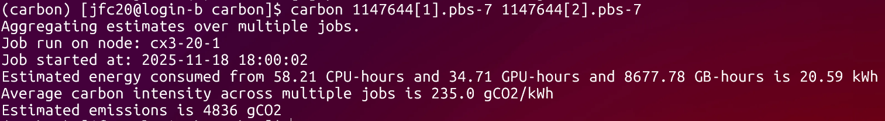
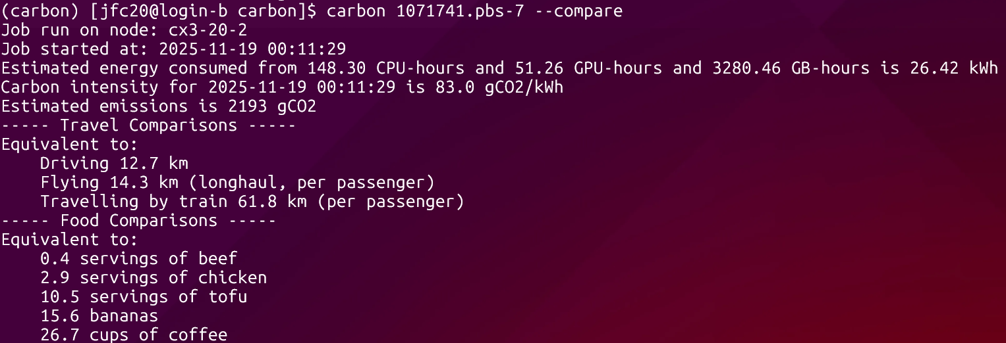
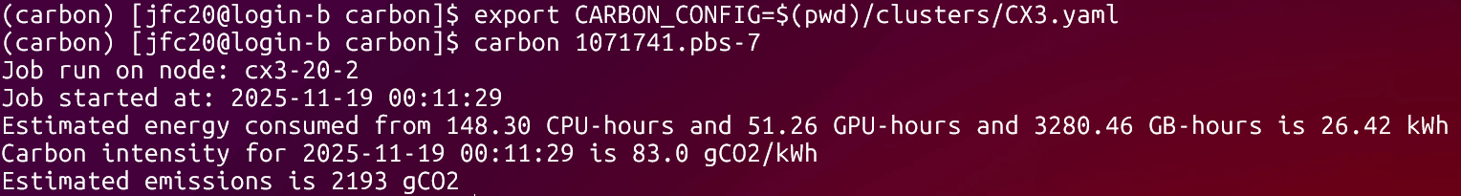
UX
Flag for showing comparisons
Environment variable used to set configuration to this cluster
Multiple jobs
Notes:
(Normally would do demo here)
Show off what its like from user side
Show comparisons
Show use on single and multiple jobs (aggregated and split)
BIG CAVEAT: Energy that Imperial purchase for its clusters is certified as 100% renewable (REGO). Value reported by carbon is emissions AS IF clusters were supplied by London-average energy mix of renewables vs fossil fuels. STILL VALUABLE as (access to) renewable energy is a limited resource! (Oxymoron not intended!)

Slide 8
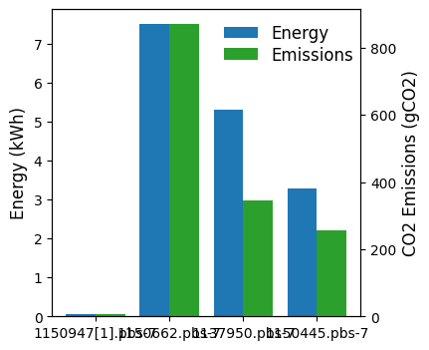
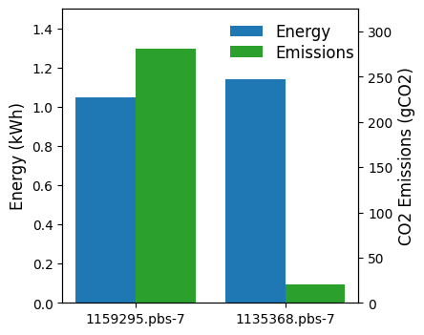
Use cases
Comparing similar jobs with different start times
Comparing different jobs
Single core
Full node
Large memory
GPU
7 PM
3 AM
Notes:
Don’t spend too long! The main purpose is simple: give users feedback on the energy/emissions cost of their jobs, and hopefully motivate more judicious use of computing resources / energy!
Compare a selection of jobs.
Single core: 9 hrs, 1 core, 8 GB
full node: 12 hrs, 128 cores, 100 GB
Large memory: 11hrs, 64 cores, 1000 GB
GPU: 8 hrs, 4 cores, 32 GB, 1 GPU
Low carbon: 32 hrs, 32 cores, 64 GB, started at 3:30am 17-11-25
High carbon: 16 hrs, 32 cores, 128 GB, started at 7:00pm 21-11-25
Note the long runtimes means it probably isn’t correct to just use carbon intensity at start time!!!
But this is something that could (and should) be updated quite easily in the code.

Slide 9
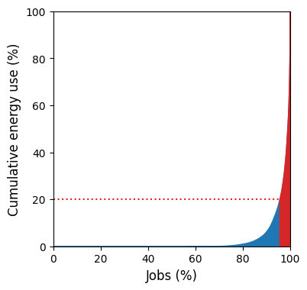
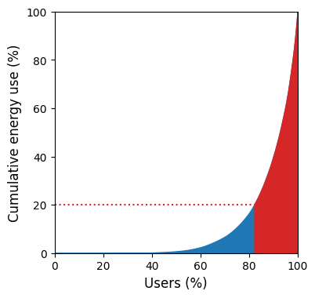
Use cases
Power share by jobs
Power share by users
4.4% of jobs use 80% of energy
18% of users use 80% of energy
Notes:
From analyst/manager perspective, could also have some uses, e.g. identifying particularly ‘heavy’ job-types, or users

Slide 10
Use cases
Share of power/emissions from…
GPU jobs: 21%
High-throughput jobs (single core): 11%
Single highest user: 2% (from 654 users)
Notes:
(Probably remove this slide)
Some more stats

Slide 11
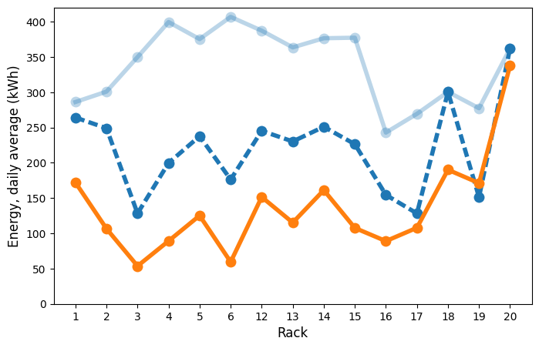
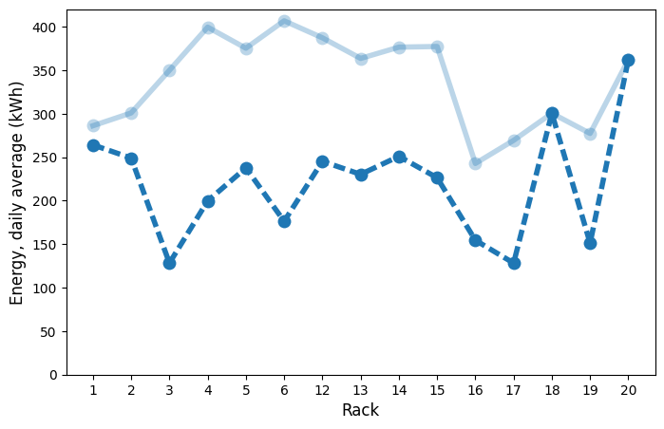
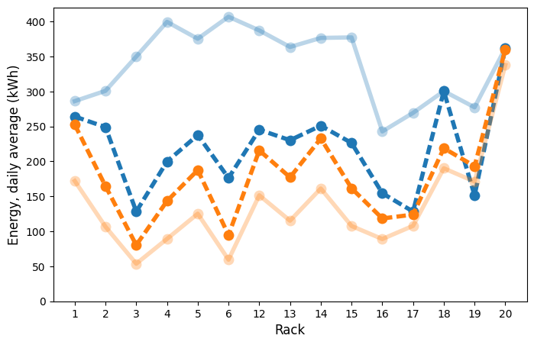
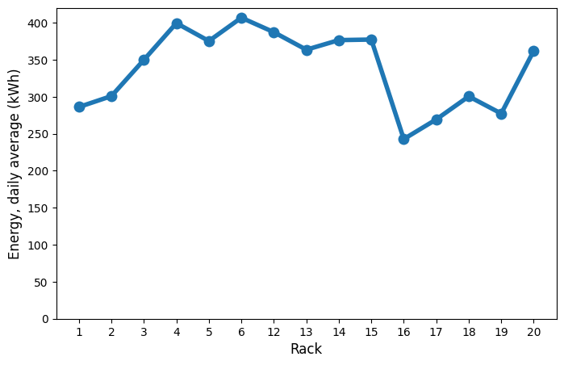
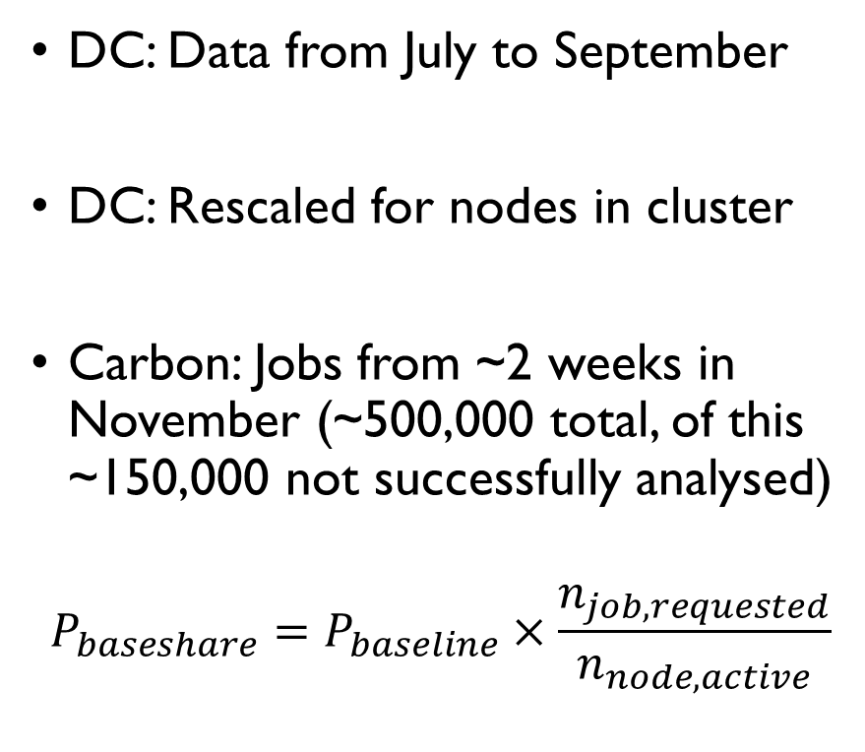
Benchmarking
DC: Data from July to September
DC: Rescaled for nodes in cluster
Carbon: Jobs from ~2 weeks in November (~500,000 total, of this ~150,000 not successfully analysed)
$$P_{baseshare}=P_{baseline}×\frac{n_{job,requested}}{n_{node,active}}$$
DC racks (raw)
DC racks (raw)
DC racks (raw)
DC racks (raw)
DC racks (scaled)
DC racks (scaled)
DC racks (scaled)
Carbon + baseshare estimates
Carbon estimates
Carbon estimates
Notes:
DC origin > DC rescaled > carbon > carbon + baseshare
Dashed line means it comes with caveats.
Standard carbon model (from GA project) tends to underestimate rack power by 40% on average.
Carbon + baseshare tends to underestimate by 18% on average.
Bare in mind, even low-level software-based power measurement tools (e.g., perf, powerstat, RAPL) tend to underestimate power by up to 50% (check, and link to paper)
I would like to compare at the node level if possible (need the data!)

Slide 12
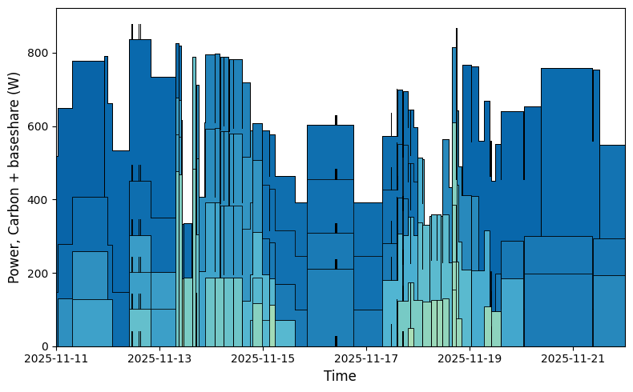
Benchmarking
Job power over time, single node
Each box = a job
Cumulative job power should should average out to around 500 W (non-GPU node)
Looks like it does!
Notes:
Just for fun!

Slide 13
Conclusions
Can get reasonably close estimates of node power consumption by summing power consumption of components
Possible to assign power consumption numbers to jobs. Requires qualitative judgement about responsibility for power consumption
It’s better to have something than nothing! And not hard to set up a tool that gives reasonable estimates based on scheduler data alone
Notes:
To improve estimates. May need to consider overheads, and also may need empirical measurements of nodes.
Although its somewhat symbolic, you can assign power consumption numbers to processes (jobs). Since, from a physical perspective, jobs are fundamentally an abstraction, this requires some qualitative judgement about how responsibility for power consumption should be shared between multiple users
Something better than nothing: Especially in a time when its important to be conscious of sustainability / environmental impact of research
Carbon is open-source if you want to use it. Works with PBS atm, but code structure has been designed with extensibility in mind!

Slide 14

Thank you for your attention
Link to the GitHub repo:
Thanks to my sponsors:

