Slide 1




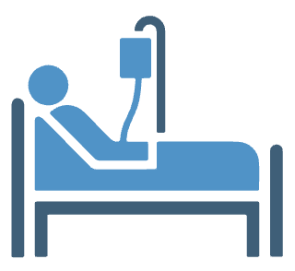
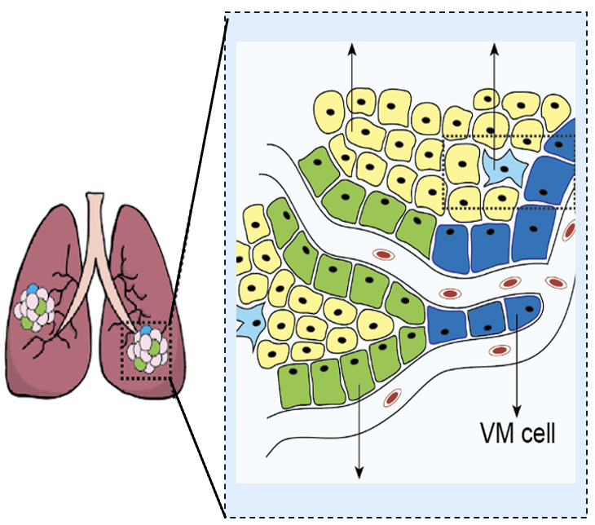
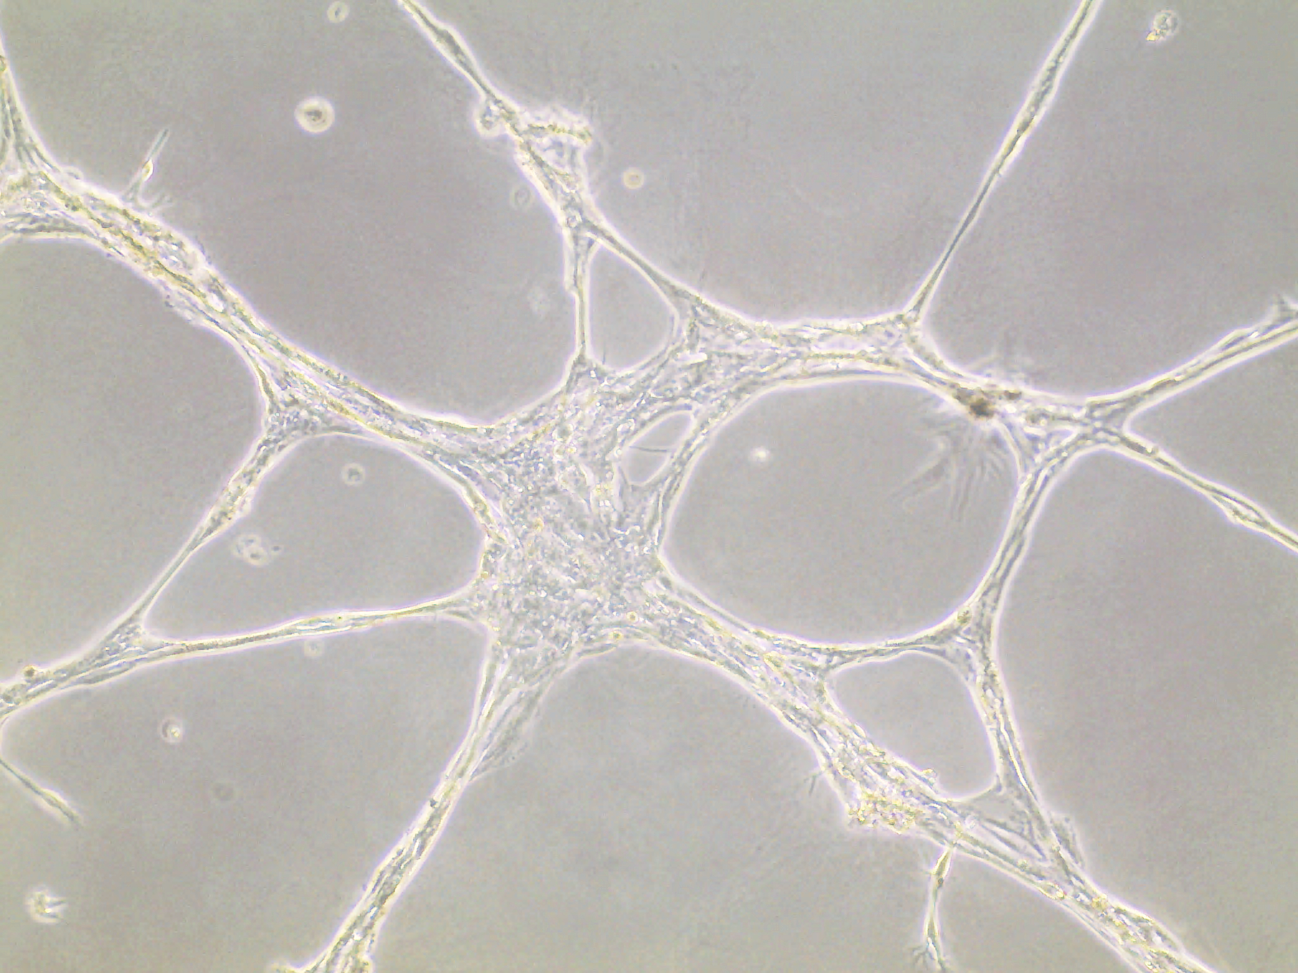
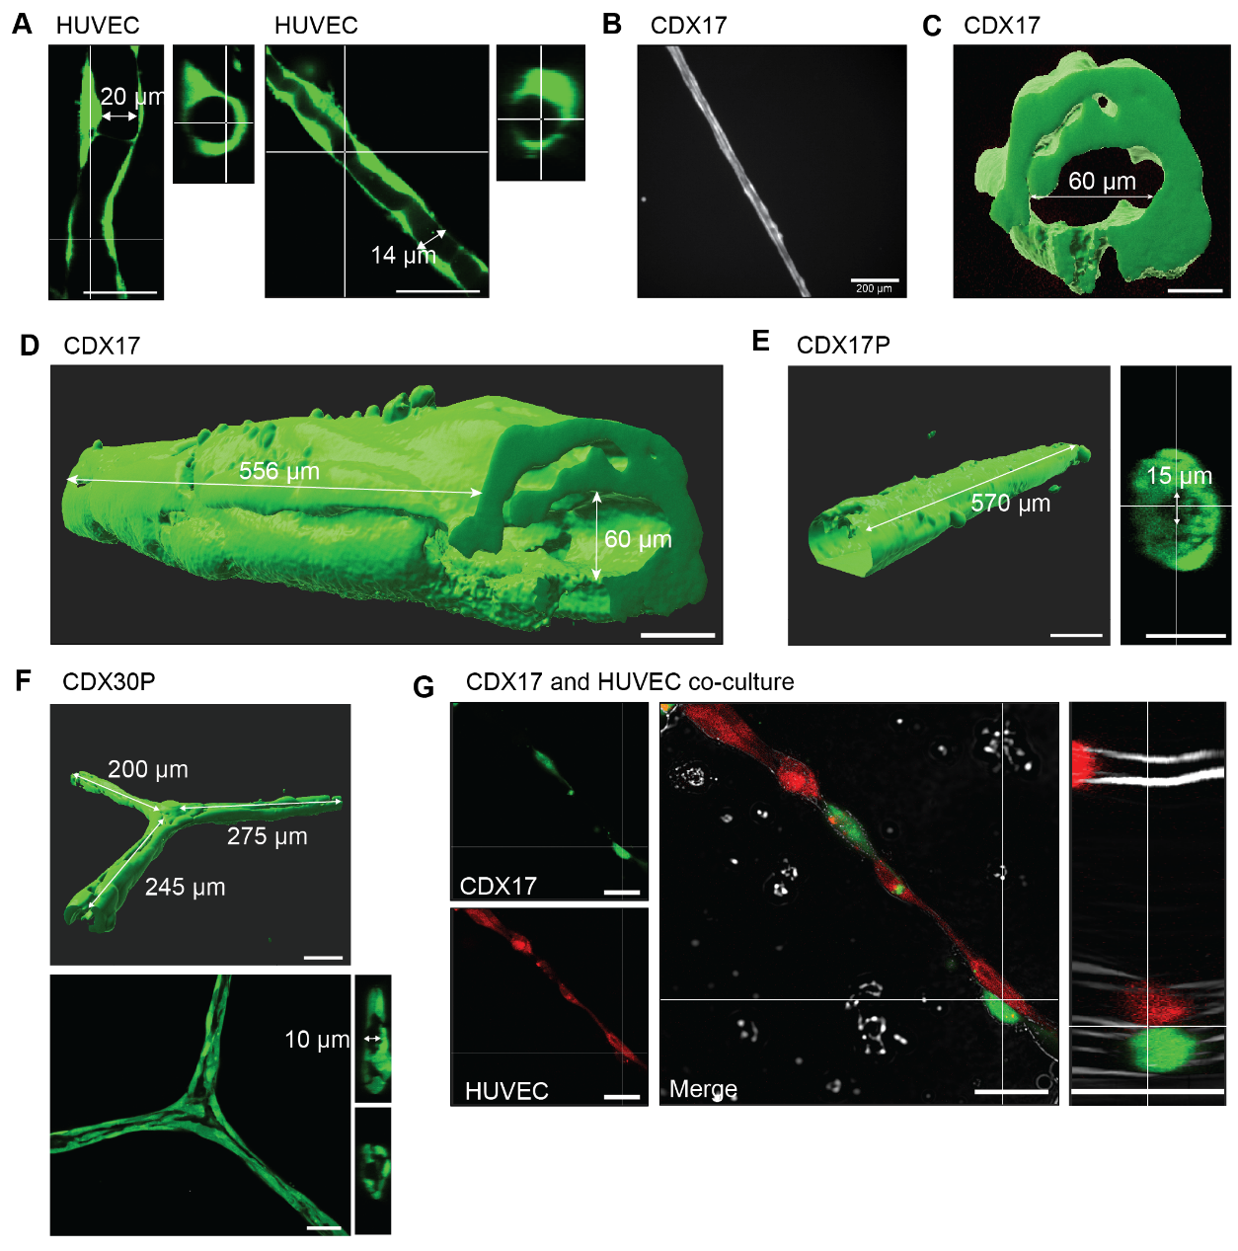
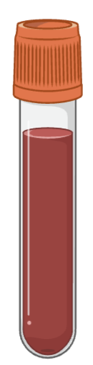
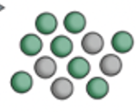
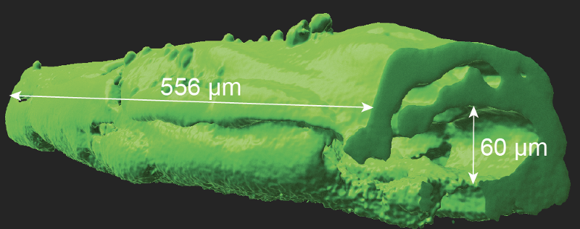
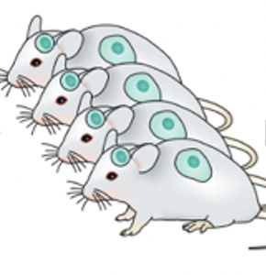
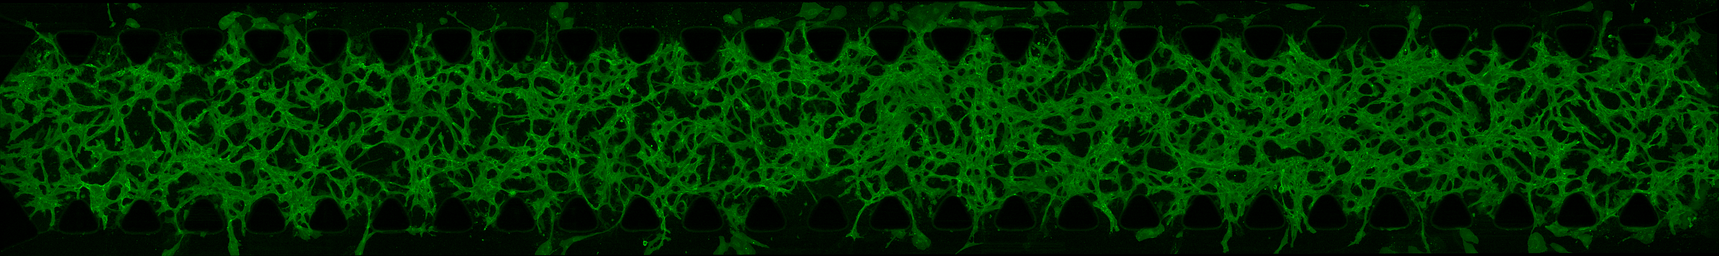
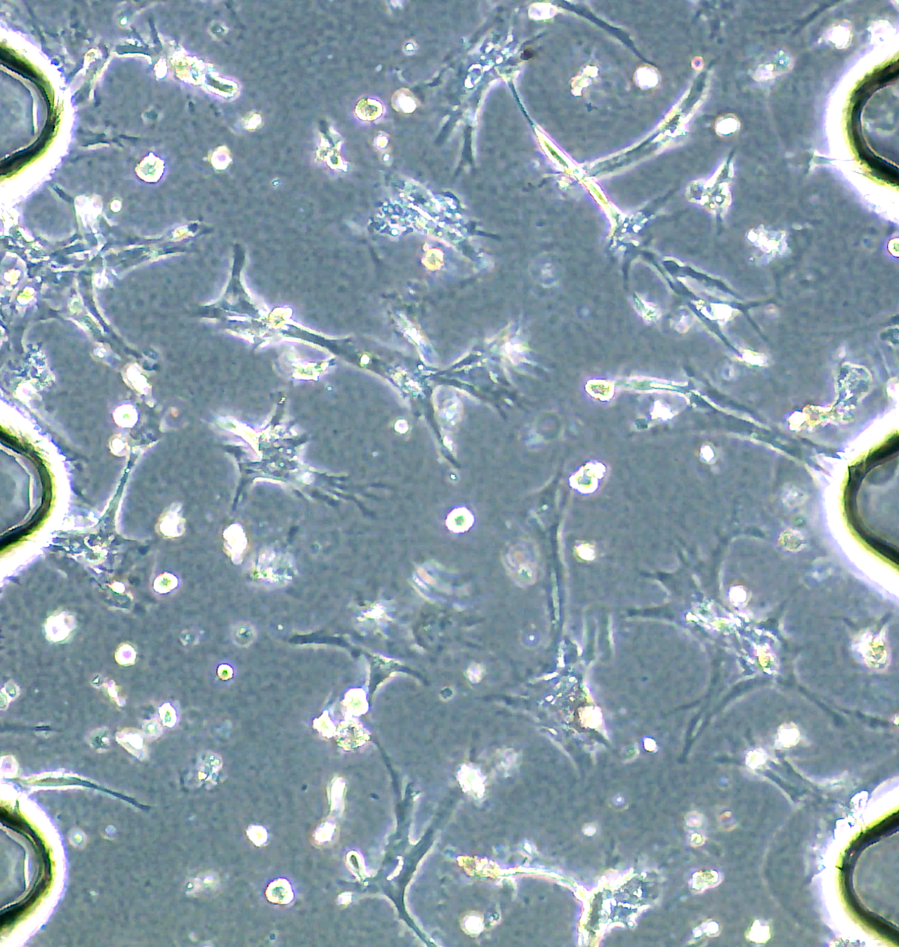
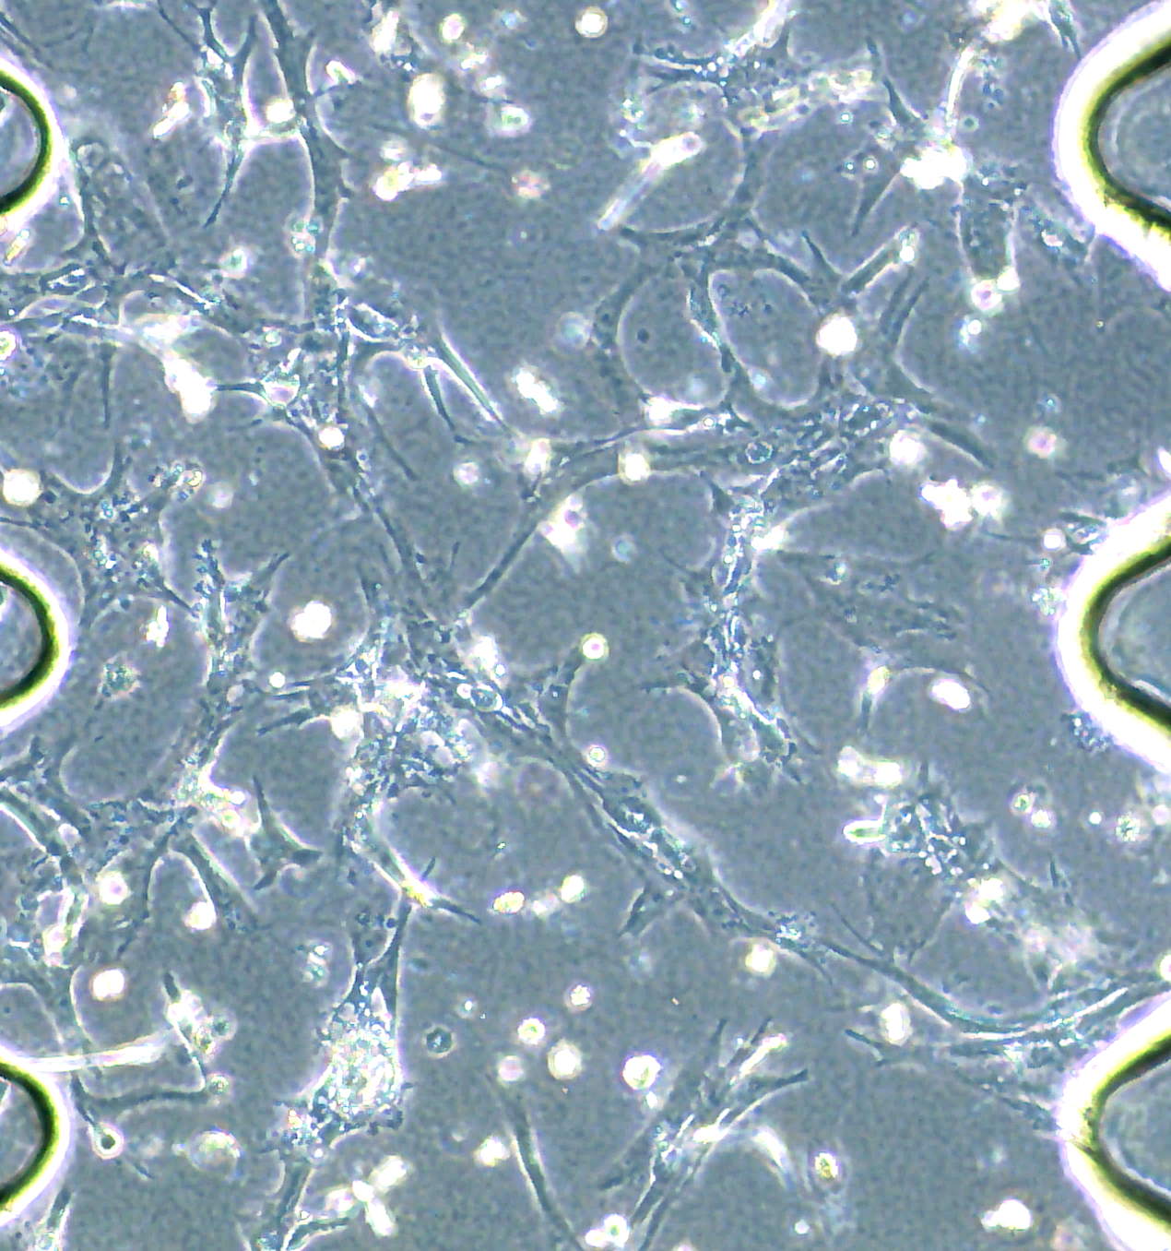
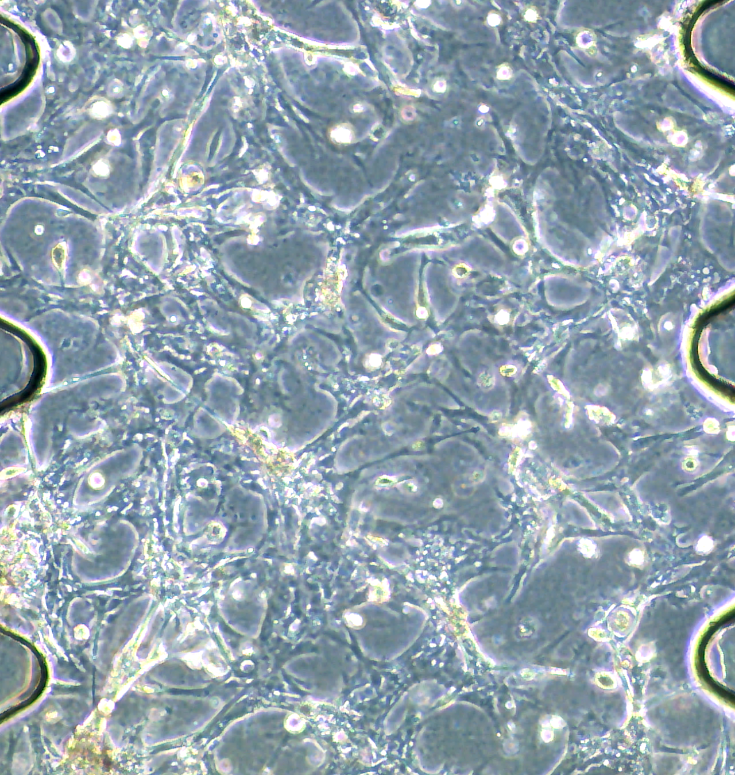
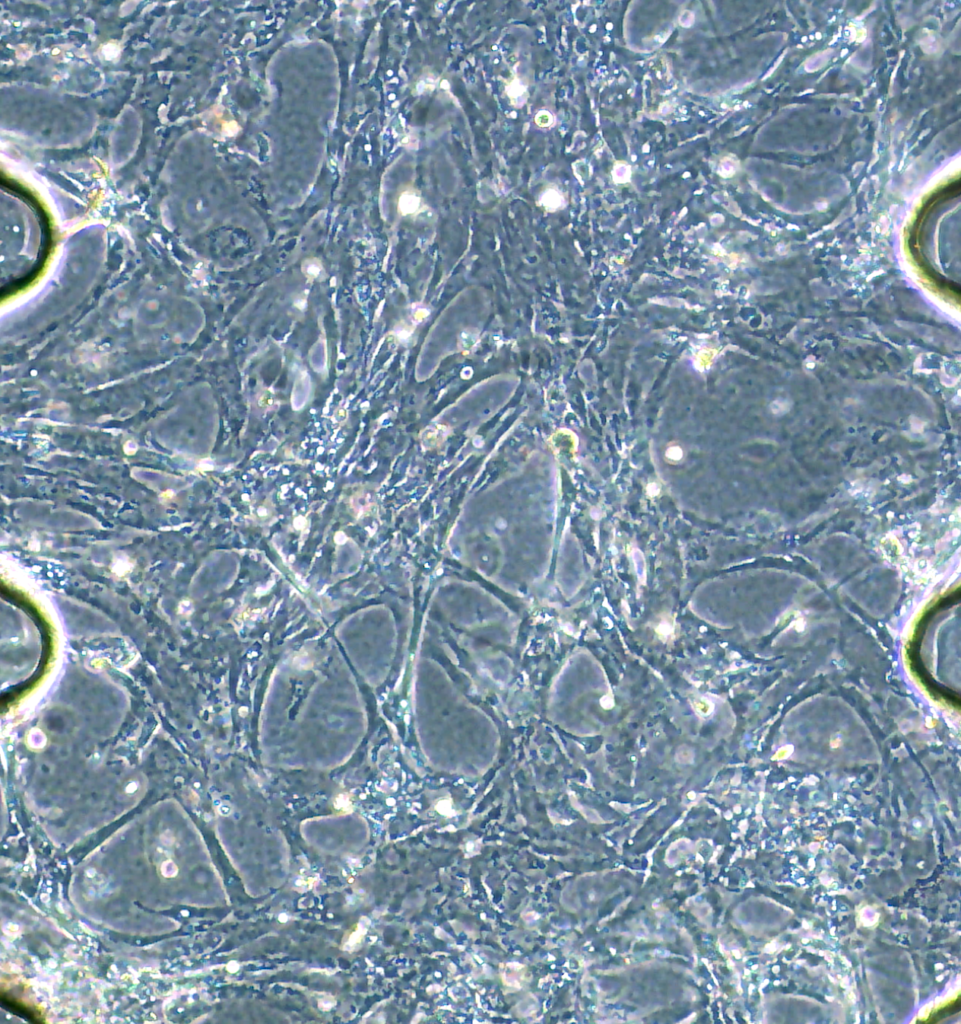
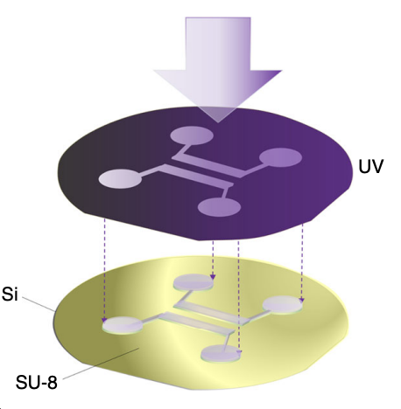
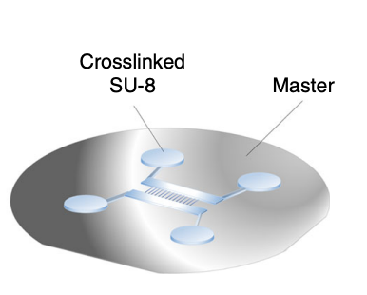
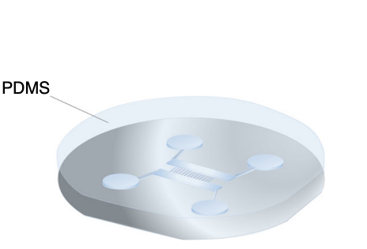
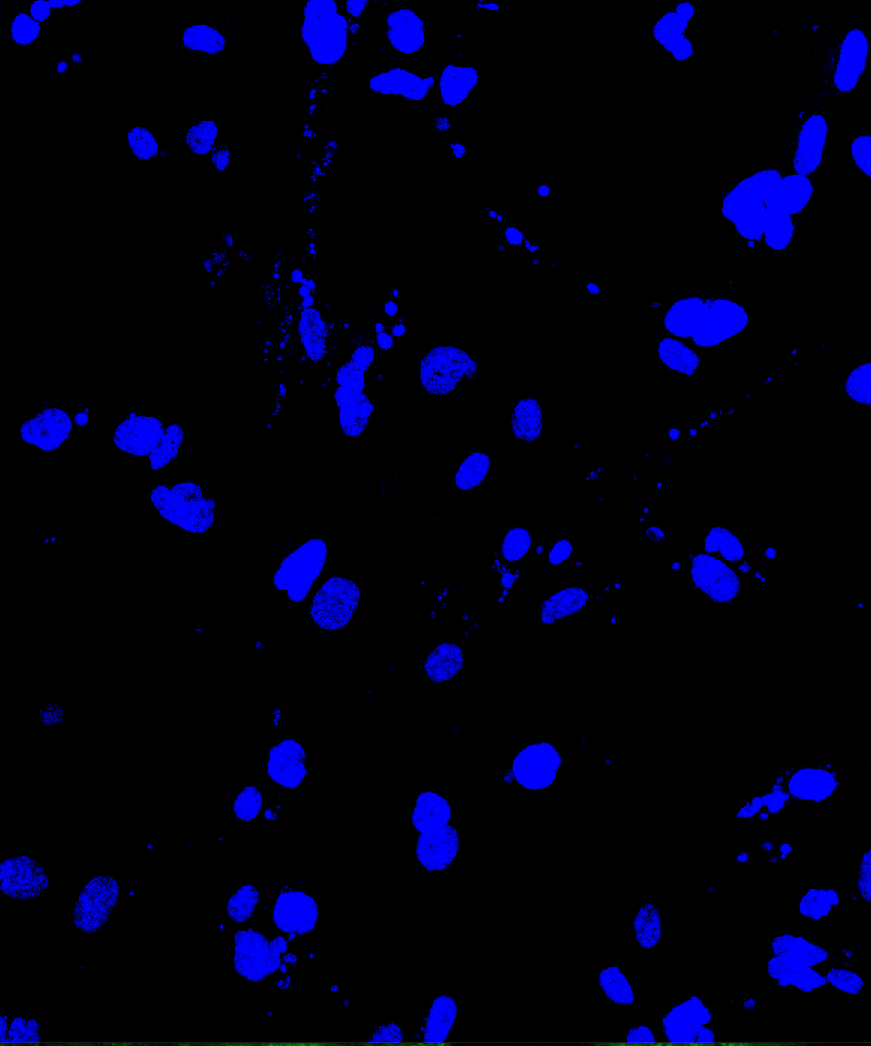
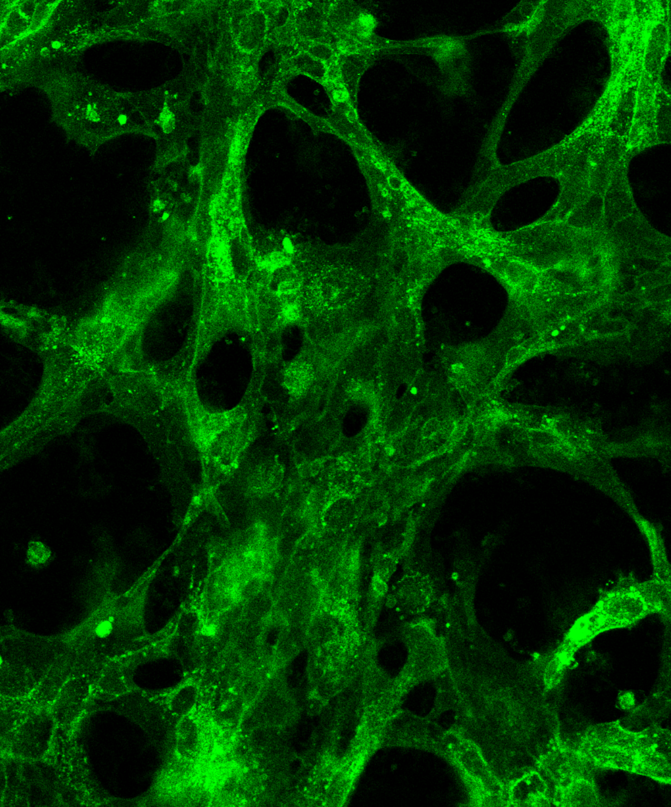
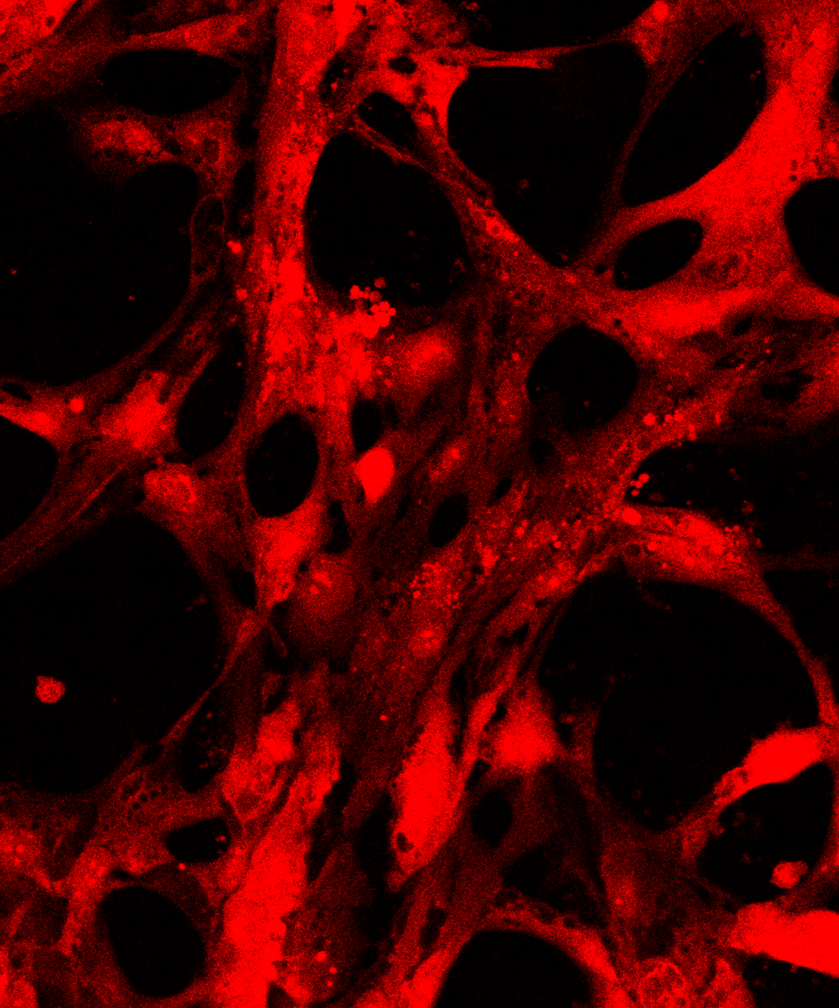
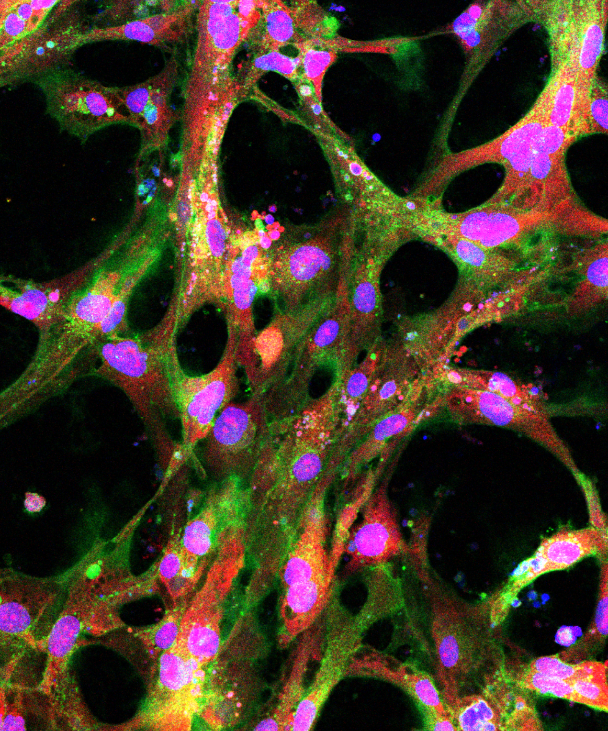
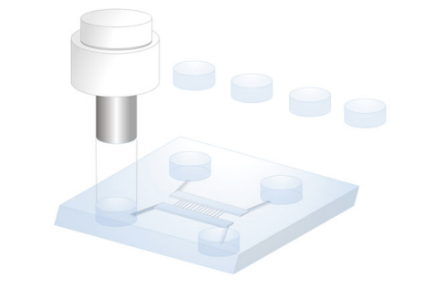
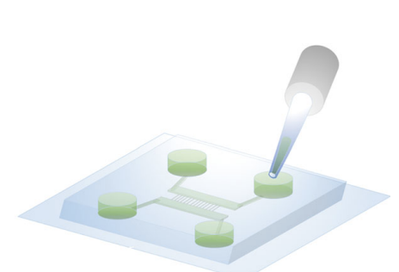
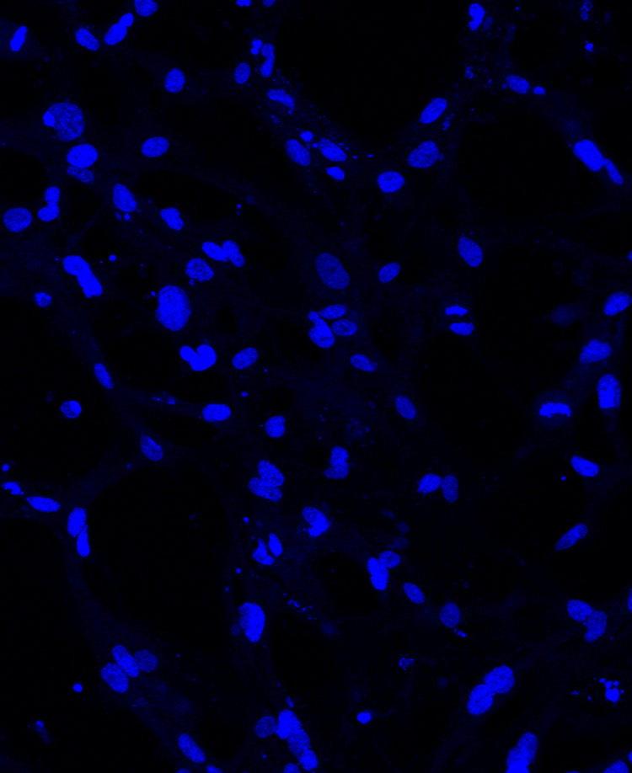
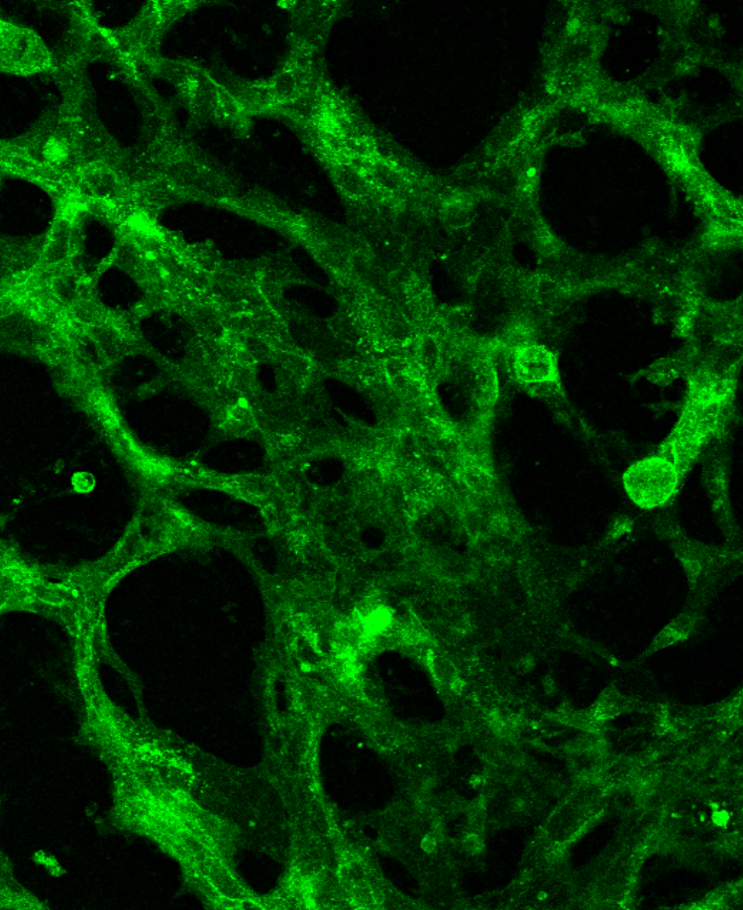
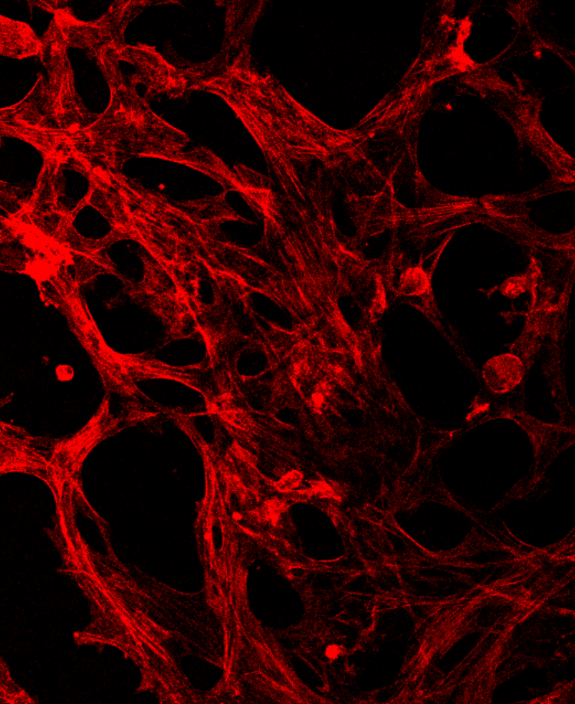
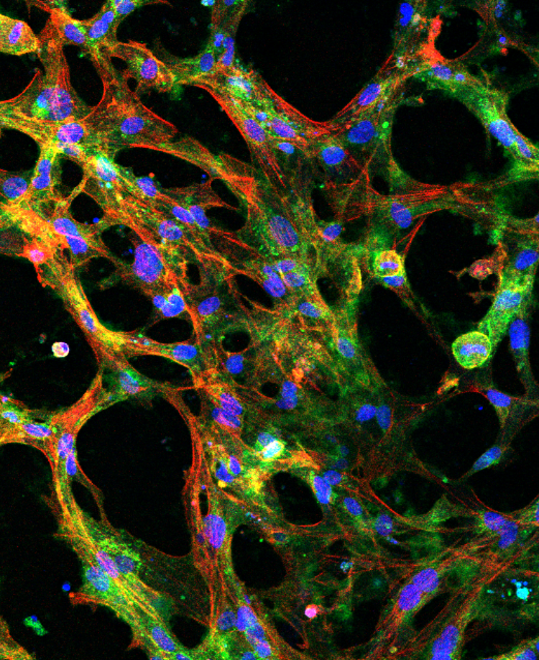
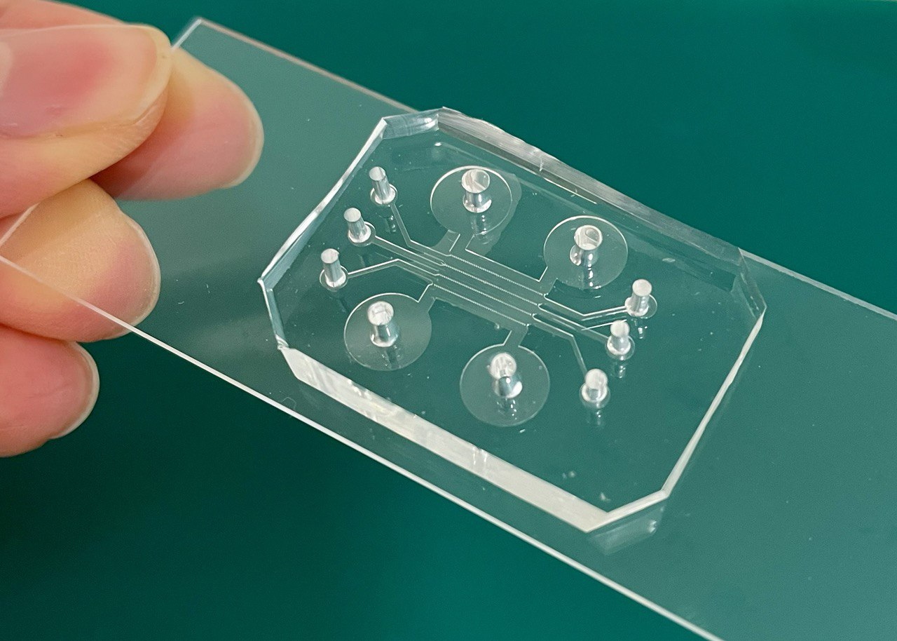
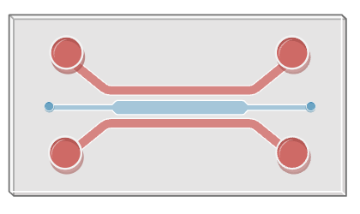
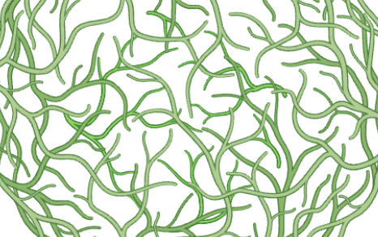
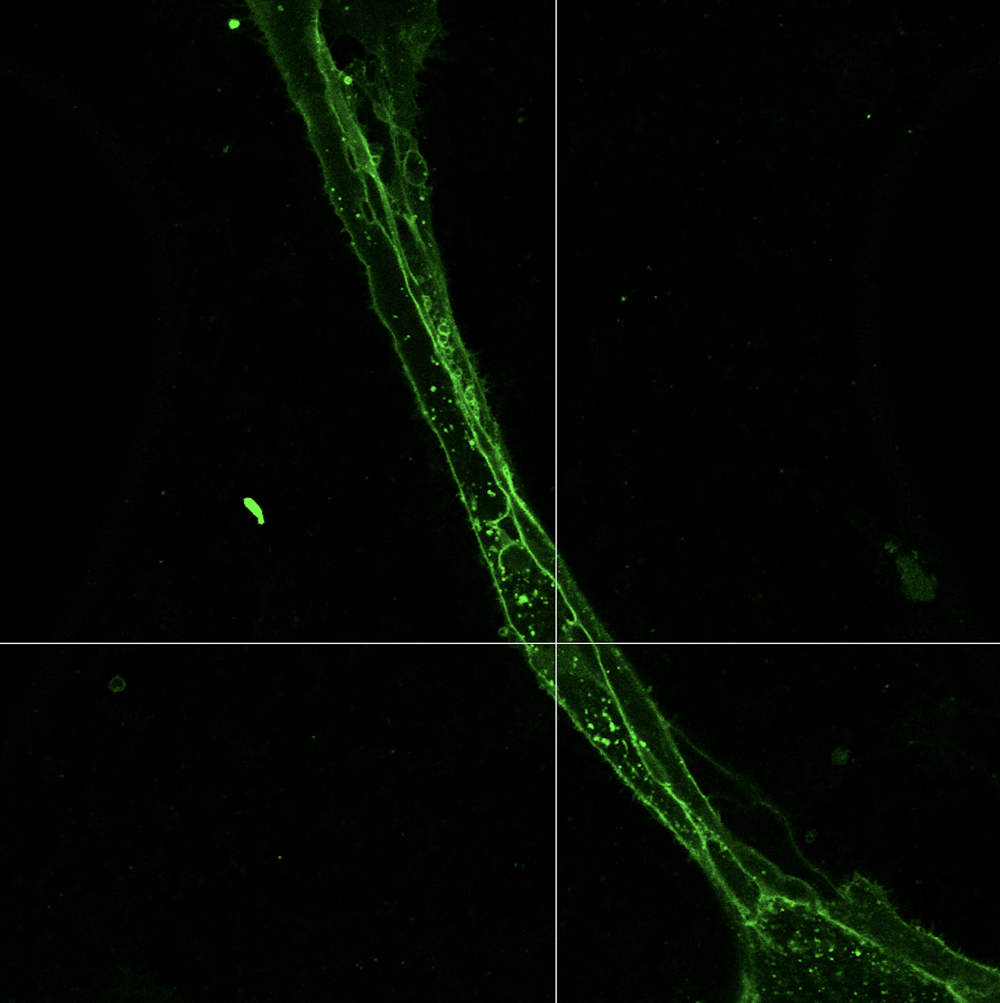
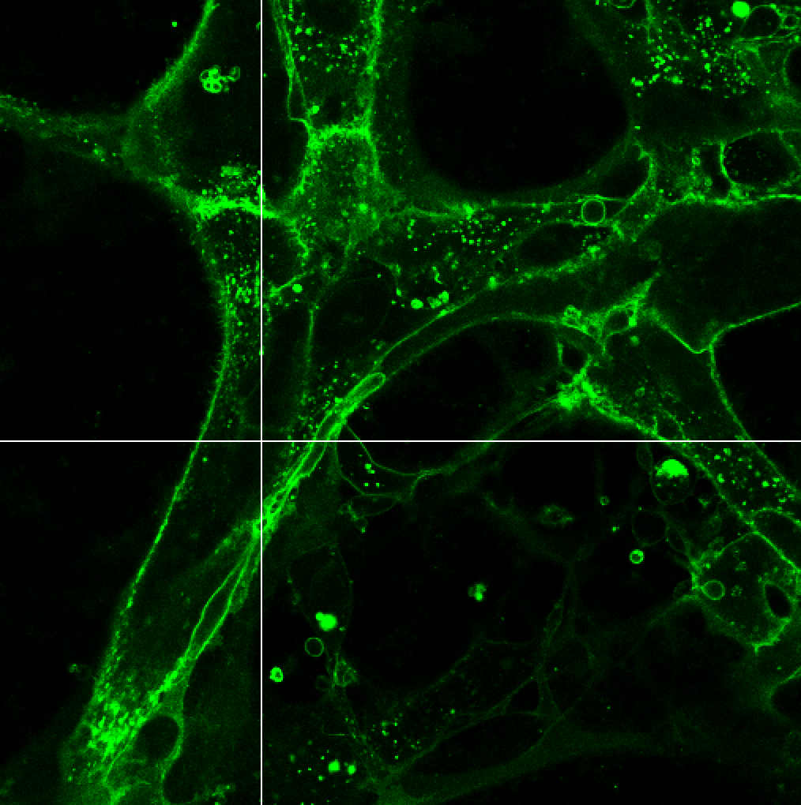
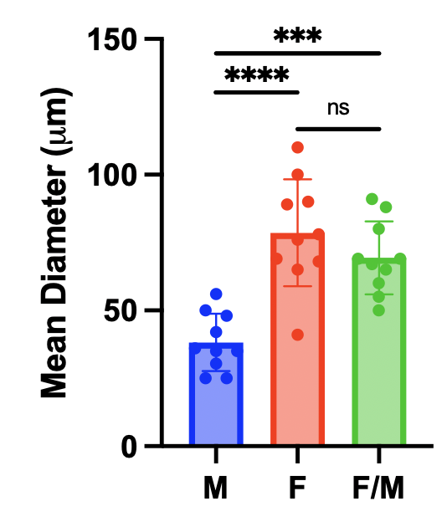
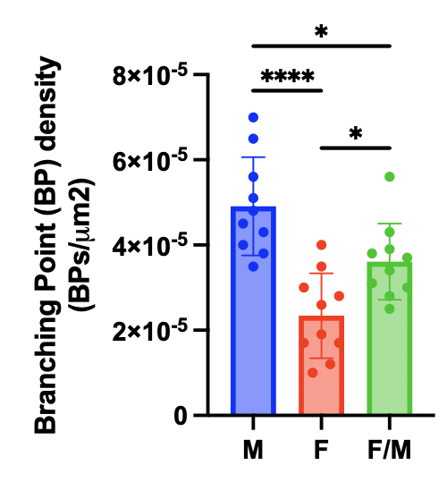
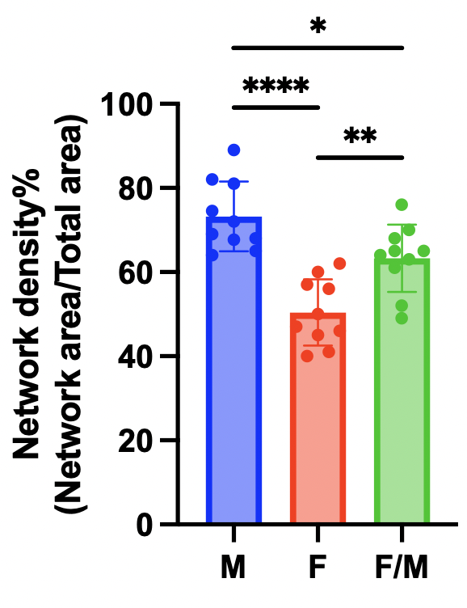
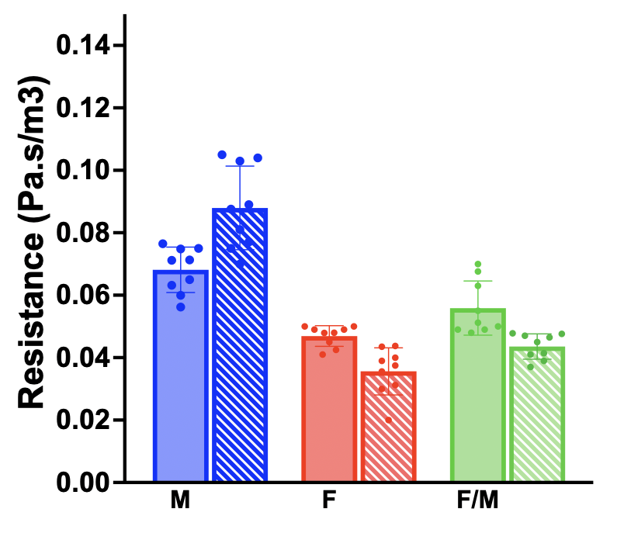
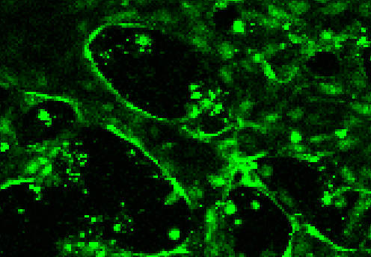
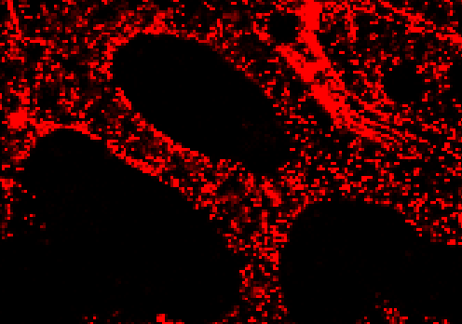
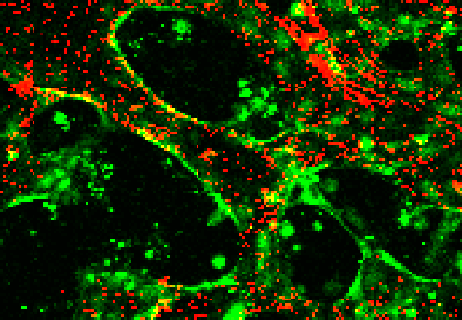
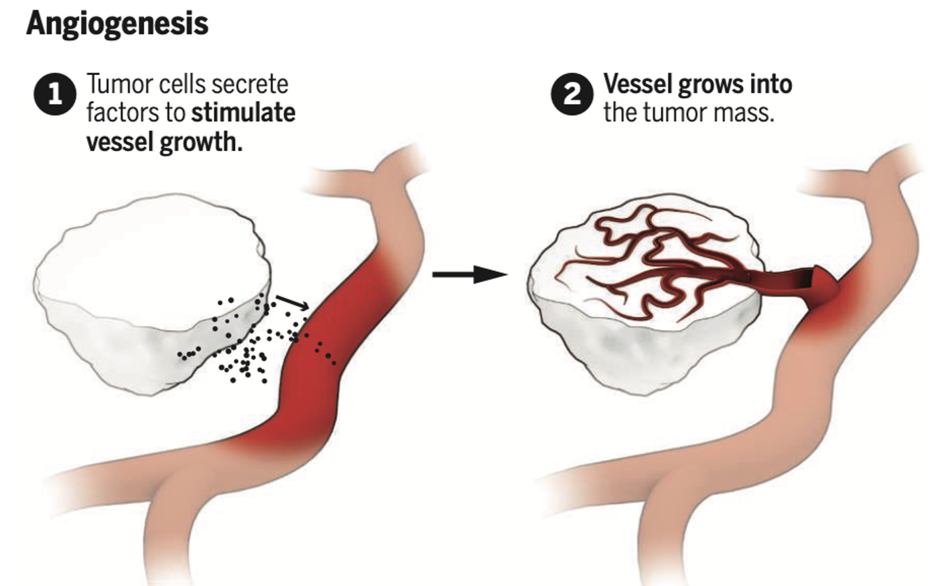
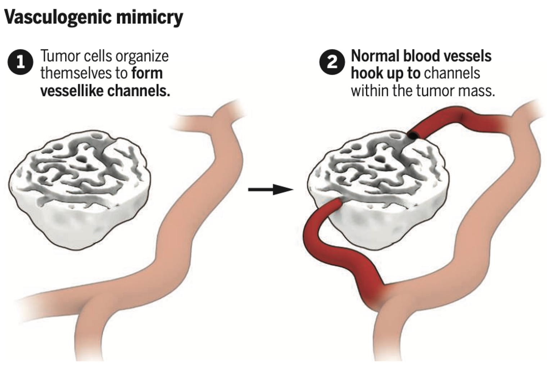
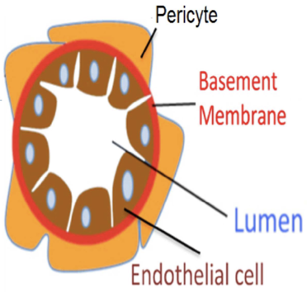
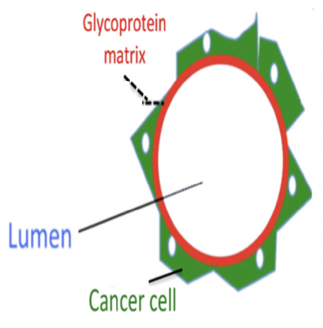
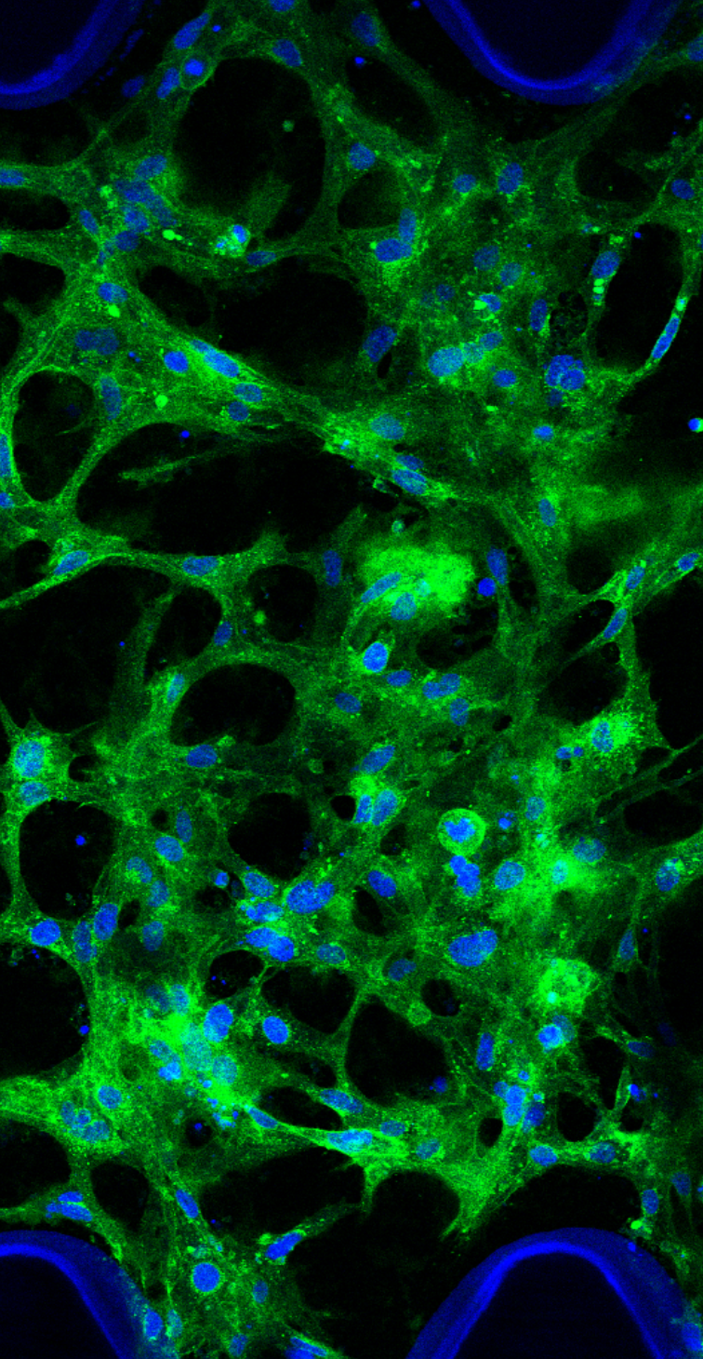

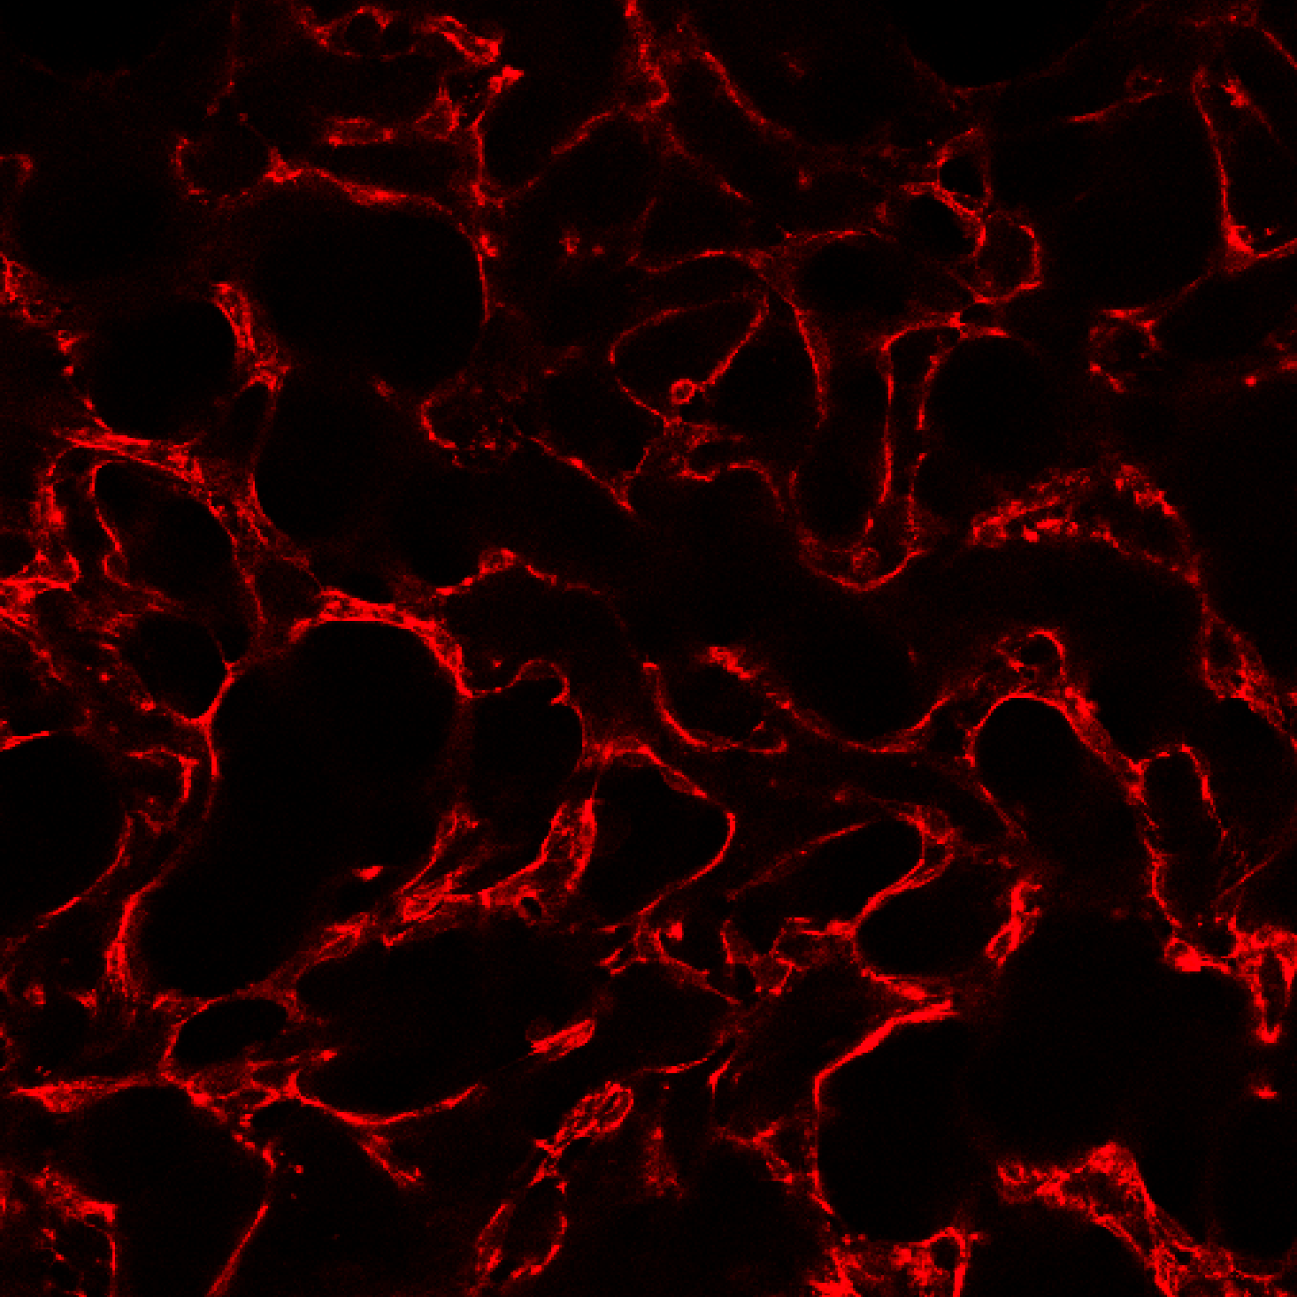

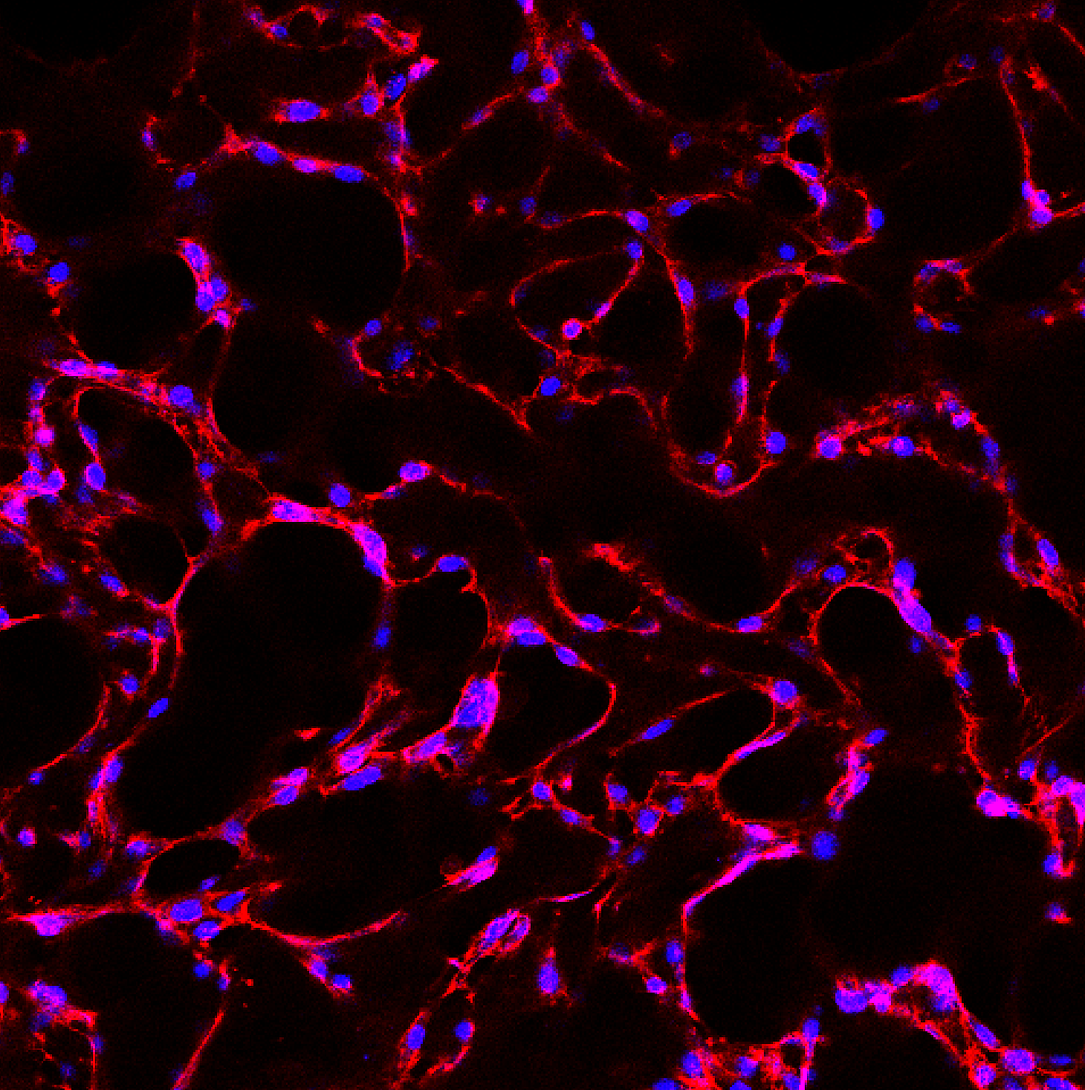
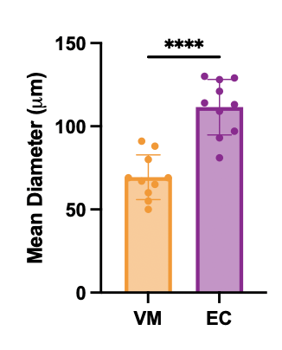
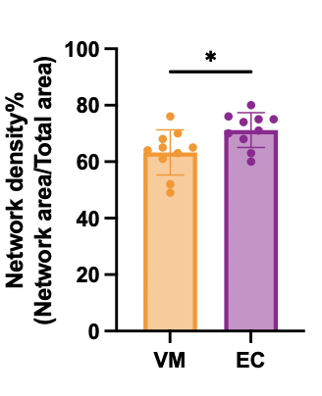
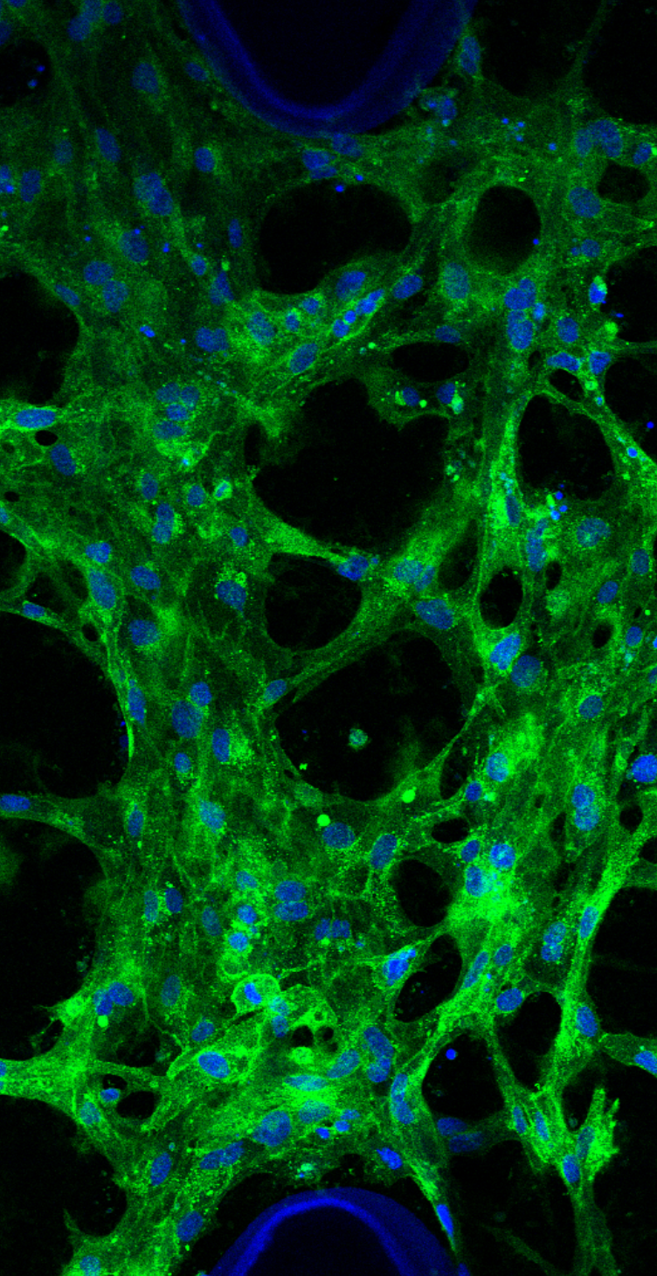
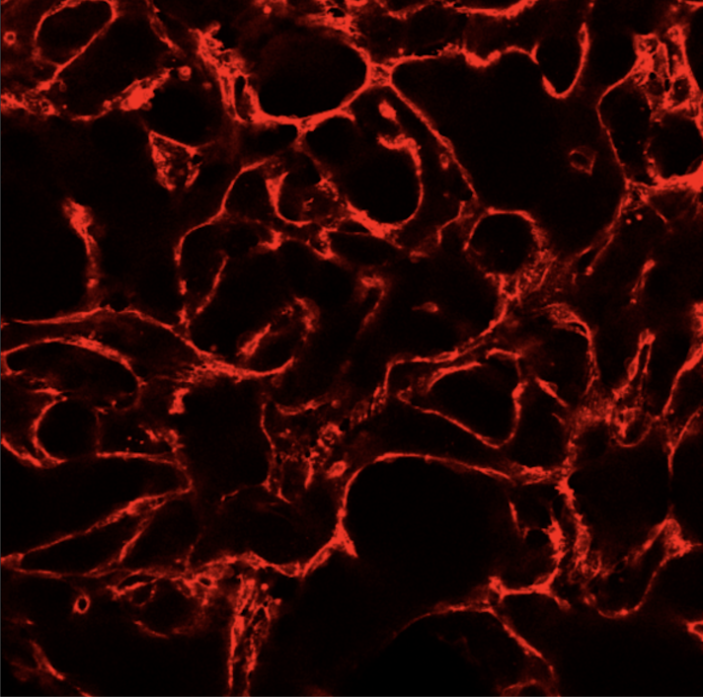
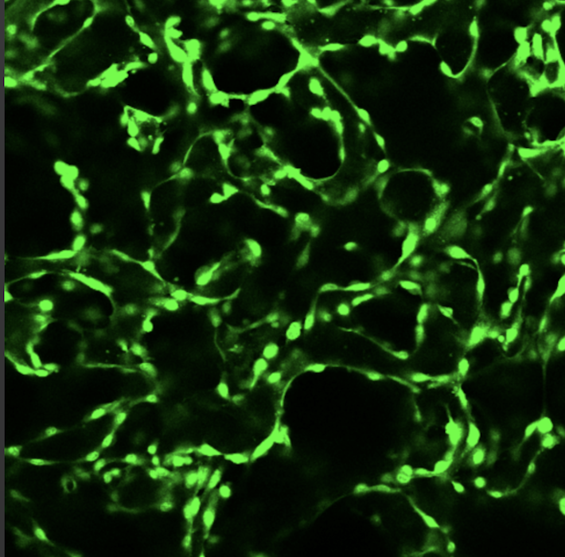




Organ-on-a-chip Models to Investigate the Genesis and Transport Capabilities of Vessels during Vasculogenic Mimicry in Small Cell Lung Cancer
Salime Bazban-Shotorbani ª, Kathryn Simpson ^{b}, Sam Au ª
ª Department of Bioengineering, Imperial College London, London, UK
^{b} Cancer Research UK, Lung Cancer Centre of Excellence, Manchester, UK
Introduction
Angiogenesis, the formation of new blood vessels by endothelial cells, is the most studied mechanism utilised by solid tumours to overcome nutrient limitations. Vasculogenic Mimicry (VM) is an alternative, tumour-autonomous mechanism of de novo vessel genesis. During vasculogenic mimicry, Tumor cells organize themselves to form vessel-like structure. Then, normal blood vessels hook up to channels within the tumor.
VM correlates with poor prognosis in multiple cancers including small cell lung cancer (SCLC). Traditional in vitro platforms cannot recapitulate physioloigically relevant contexts required to study VM due to several limitations of these models, including lack of 3D architecture, absence of fluid flow, lack of dynamic forces, limited real-time analysis, and limited cell-cell and cell-matrix interactions. Organ-on-a-chip technology can overcome these limitations and serve as a crucial bridge between in vitro and in vivo models in VM studies.
Results
NNE cells express endothelial, integrin, and ECM remodeling genes, priming them for VM. These cells form vessel-like structures in 2D with sufficient ECM and microenvironment (Fig. 1).
NNE CDX models successfully form 3D VM networks on developed chips in this study (Fig. 2).
The chips allow studying the effects of various parameters on VM networks. ECM gel significantly affects VM network density and diameter; Combination of Matrigel and Fibrin yield higher density and larger diameter networks (Fig. 3).
The developed chips were utilized to prove the fluid-conductivity of VM networks for the first time, which is a novel achievement in this study (Fig. 3).
Chips can be used to compare VM and EC. VM networks lack endothelial markers, form smaller networks, and have more branching points (Figs. 4, 5).
NE cells
NNE cells
Endothelial Cells
Figure 1. Patient Derived EXplants (CDX) cells to study VM in SCLS.
Day 1
Day 2
Day 3
Day 4
Photo
lithography
Soft
lithography
DAPI
WGA
GAPDH
Merge
DAPI
WGA
Phalloidin
Merge
Conclusion
The VM chip developed in this study can serve as a vital link between in vitro and in vivo models, enhancing our understanding of VM genesis and transport. Therefore, this innovative tool can significantly contribute to the development and refinement of therapies and the investigation of tumour-drug distributions.
ECM + Cells
Methods
Microfluidic chip fabrication
In this study, we designed and developed an organ-on-a-chip platform using poly dimethyl siloxane (PDMS). The developed chip consists of three independent channels, separated by micropillars, which can provide a 3D biomimetic environment for patient-derived SCLC cancer cells. Standard photolithography and soft lithography techniques were utilized to fabricate the chips.
Development of NNE-CDX models
Blood samples were obtained from patients. Circulating tumour cells (CTCs) were enriched via RosetteSepTM and CTCs implanted into the flank of mice. After development of CDX tumours in mice, the tumours were removed from mice and dissociated into single cells. Immunomagnetic depletion of mouse cells and dead cells was performed. After development of CDX cells, NE and NNE cells were separated based on their markers.
3D Microfluidic cell culture
The cell lines (i.e., HUVECs and NNE CDX models) were mixed with ECM-simulating gels (i.e., Matrigel and Fibrin) and injected into the middle channel of the chip. Then, the side channels were used to provide the media. The microfluidic devices were kept in the incubator (37ᵒC, 5% CO2) and media was exchanged every 24 h.
Media + Supplements
Figure 2. Development of organ-on-a-chip models to study VM in SCLC.
WGA
Microparticle
Merge
Future Works
The developed VM-on-a-chip model will be used to investigate the pseudo-hypoxic and chemo-resistant behavior of VM networks. This investigation aims to elucidate the underlying mechanisms driving pseudo-hypoxia and chemo-resistance, as well as identify potential biomarkers associated with these behaviors.
Figure 3. Fluid-conductivity of VM models.
Figure 4. Angiogenesis vs vasculogenic mimicry (VM).
VM
Lectin
CD-31
Merge
More information about this project
EC
Lectin
CD-31
Merge
Figure 5. VM-on-a-chip vs EC-on-a-chip.
Let’s connect on LinkedIn
References:
Pearsall, Sarah M., et al. "Lineage plasticity in SCLC generates non-neuroendocrine cells primed for vasculogenic mimicry." Journal of Thoracic Oncology 18.10 (2023): 1362-1385.
Williamson, Stuart C., et al. "Vasculogenic mimicry in small cell lung cancer." Nature communications 7.1 (2016): 13322.
Leung, Chak Ming, et al. "A guide to the organ-on-a-chip." Nature Reviews Methods Primers 2.1 (2022): 33..

