Slide 1
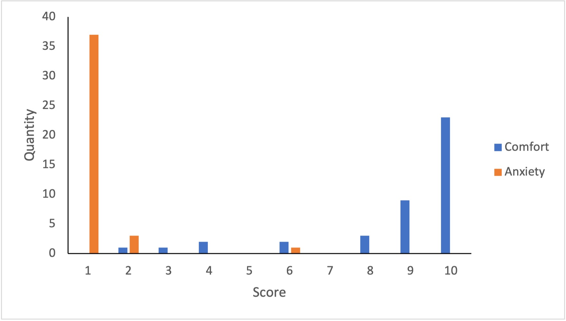
Magseed-Guided Wide Local Excision during the Covid-19 Pandemic: A Tenable Solution to Barriers in Accessing Elective Breast Cancer Surgery
Jhia J Teh¹, Wenyi Cai¹, Martha Kedrzycki¹, Paul T R Thiruchelvam², Dan S Elson³, Daniel R Leff²
1. Department of Surgery and Cancer, Imperial College London, 2. Hamlyn Centre for Robotic Surgery, Institute of Global Health Innovation,
3. Imperial College Healthcare Trust
Introduction
Magseed-guided localisation is a suitable alternative to wire-guided localisation (WGL) for small or impalpable breast cancers.
Advantages include advanced insertion, simpler logistical planning, and decreased risk of displacement (1).
Given the severe disruption to elective surgeries during the Covid-19 pandemic, a local Magseed pathway was developed enabling safe patient flow. (i.e. time to self-isolate and obtain a negative Covid swab prior to admission to a dedicated Covid-free operation suite)
Methodology
A prospective service evaluation was conducted in an University hospital.
This study was registered and granted permission by the local Audit Committee (Registration number 410).
Patients who underwent Magseed-guided wide local excision (WLE) from 01/07/2020 to present were surveyed to detail their experiences on the Magseed pathway.
Qualitative data investigating anxiety and comfort post-insertion were reported using 10-fold Likert scales.
Quantitative data was collected retrospectively on patient demographics and tumour specifications.
Results
41/46 women underwent Magseed guided WLE
median age 65 years (IQR 53-72)
median BMI 26.5 kg/m² (IQR 22.4-30.8)
median time between Magseed insertion and WLE was 13 days (IQR 4-13).
Tumour histology | n | %
IDC without DCIS | 24 | 58.5
IDC with DCIS | 5 | 12.2
DCIS alone | 3 | 7.3
ILC | 3 | 7.3
Other | 6 | 12.2
Surgical Outcome | n | %
Magseed retrieval | 41 | 100
Re-excision of margins | 7 | 17
10% women found the procedure uncomfortable
98% women reported low anxiety over seed displacement
Given the choice, 98% patients would prefer Magseed over WGL.
Magseed (encircled in red) visible within the tumour on specimen radiography.
Magseed (encircled in red) visible within the specimen during histopathological cut-up.
Table 1. Tumour subtype and surgical outcomes in Magseed patients.
Figure 1. Bar chart presenting the distribution of scores in terms of comfort after Magseed insertion (high score = more comfortable) and anxiety over seed dislodgement (low score = low anxiety)
Conclusions
References
The new Magseed pathway is positively regarded among patients. Recent study has found that delayed treatment beyond 90 days is associated with worse survival rates (2). Therefore, ensuring the continuity of breast cancer treatment in a safe manner is especially important given the ongoing disruption in elective surgery capacity. Given the difficulties associated with the COVID-19 pandemic both in terms of operational capacity and patient safety, Magseed localisation provides a viable alternative to WGL to ensure continuous provision breast cancer surgeries.
1. Harvey JR, Lim Y, Murphy J, et al. Safety and feasibility of breast lesion localization using magnetic seeds (Magseed): a multi-centre, open-label cohort study. Breast Cancer Res Treat. 2018;169(3):531-536. doi:10.1007/s10549-018-4709-y
2. Ho PJ, Cook AR, Binte Mohamed Ri NK, Liu J, Li J, Hartman M. Impact of delayed treatment in women diagnosed with breast cancer: A population-based study. Cancer Med. 2020;9(7):2435-2444. doi:10.1002/cam4.2830
Contact: wc1615@ic.ac.uk

