Slide 1
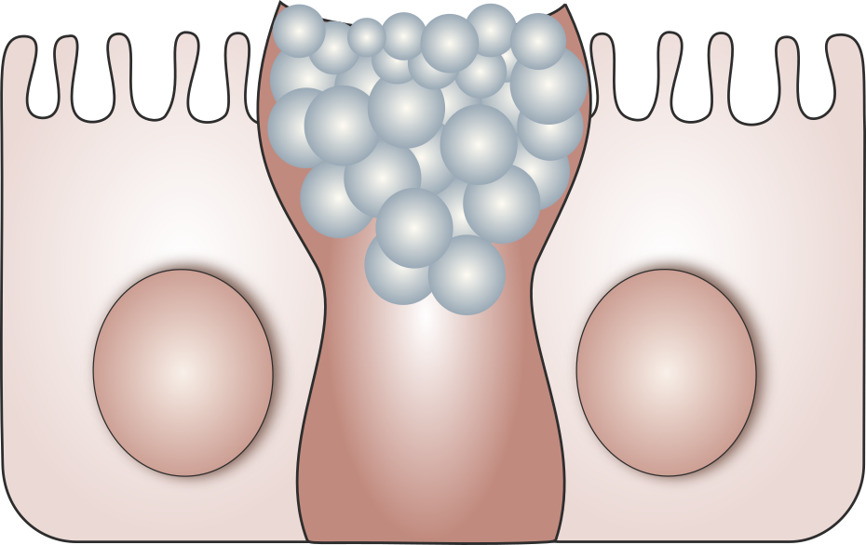
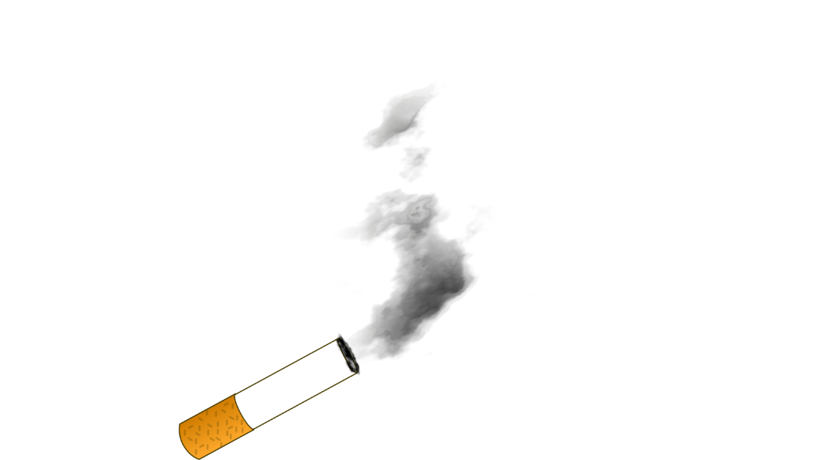
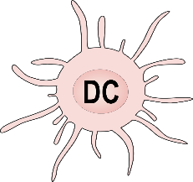
Figure 1
B
A
C
Inflammation
B
Inflammation

Slide 2
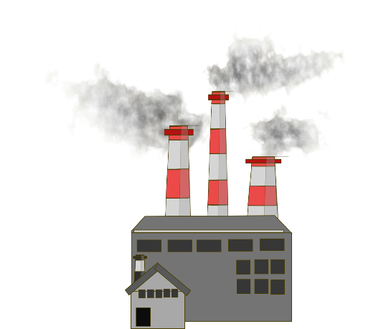
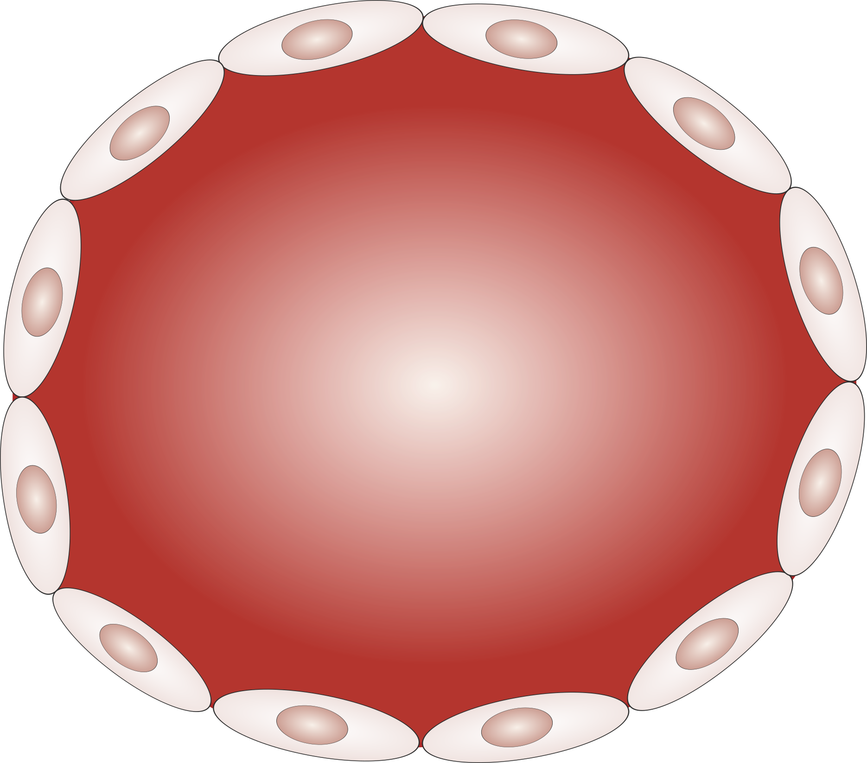
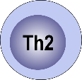
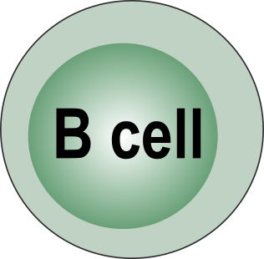
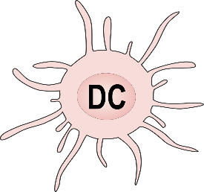
Figure 2
A
B
PM₁₀
PM₁₀
Black Carbon
NLRP3
NLRP3
Demethylation
IL4
CXCL1
IL-6
IL-4
IgE
Increased
mucus production
IL4

Slide 3
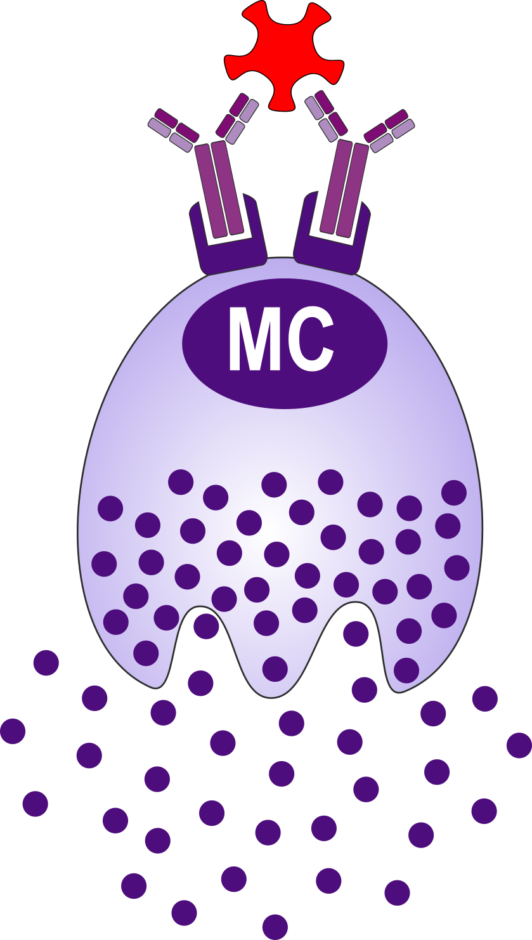
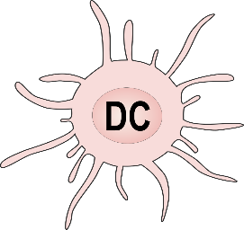
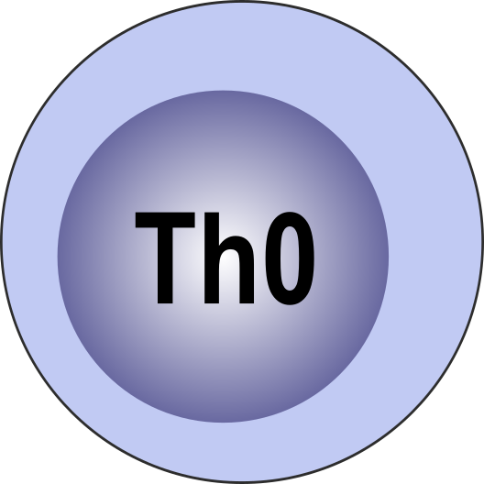
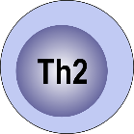
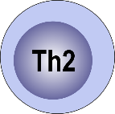
Outdoor pollution
Global warming
Extreme
climate events
Figure 3
_{Prolonged}
_{vegetation periods}
A
B
E
F
Increased production
of pollen grains
More allergens
per pollen grain
C
D
More PALMs
per pollen grain
Nitration
of allergens
_{Sudden release of massive}
_{amounts of allergens}
January
March
May
July
September
G
Aeroallergen
Aeroallergen
J
Asthma attack
Pollen grain
G
A, B, E
I
A, B, E, F
Allergen
Epithelium-derived
mediators
IL-4
C, D
H
Histamine, tryptase, lipid mediators, cytokines
PALM
Histamine, tryptase, lipid mediators, cytokines
Nitrogen oxide
High affinity IgE
High affinity IgE

