Slide 1
ONLNE SUPPLEMENT
Characteristics of altered immune response and susceptibility to streptococcal pneumonia after experimental stroke
Supplementary Methods
Experimental stroke. Spontaneously breathing mice were anesthetized with 1.5-2% isoflurane in N₂O:O₂ (2:1). To measure relative cerebral blood flow changes, a laser Doppler probe (P403, Perimed, Sweden) was placed 3 mm lateral and 1 mm posterior to the bregma, and relative perfusion units were obtained (Periflux 4001, Perimed, Sweden). Baseline blood flow was defined as 100%. A ventral cervical incision was made to expose the left common carotid artery, which was gently separated from its sheaths and vagal nerves, and an incision was made on it between 2 ligations, into which a silicon-covered 8–0 nylon monofilament (Doccol Corporation) was inserted and advanced through the internal carotid artery to occlude the middle cerebral artery (MCA). Successful MCA occlusion (MCAO) was defined as a decrease of perfusion to <20% of baseline blood flow measured by laser Doppler. The filament was fixed in this position by ligation, the neck closed, the Doppler probe removed and the mouse replaced into its cage. Sixty min after filament insertion, the mouse was re-anaesthetized and the filament was removed. Sham operation was performed identically except that the sham group only underwent brief introduction of the filament into the external carotid artery. A feedback controlled heating pad was used to maintain body temperature (37°C) during surgery. Following the closure of the skin, mice were placed under an infrared heating lamp between the operations and until recovery from anaesthesia. The total anaesthesia time was approximately 20 min in filament-induced MCAO and sham procedures, respectively.
Assessment of infarct size. Brains of sacrificed mice were removed from after transcardial perfusion with cold saline. Brains were immediately frozen and 20 µm thick coronal cryosections were cut every 400 µm and stained with cresyl violet. We scanned the stained sections at 600 dpi, and measured the infarct areas using a public domain image analysis program (ImageJ). The total infarct volume was obtained by integrating measured infarct areas and distance between sections. Correction for brain edema was applied by subtraction of the ipsilateral minus contralateral hemisphere volume from the directly measured infarct volume. Evaluators were blinded to treatment assignment.
Semiquantitative scoring for lung inflammation: (1) perivascular edema (0: absent; 1: mild to moderate, involving fewer than 25% of the perivascular spaces; 2: moderate to severe, involving more than 25% but less than 75% of perivascular spaces; 3: severe, involving more than 75% of perivascular spaces); (2) perivascular/peribronchial acute inflammatory cell infiltration (0: absent; 1: mild acute inflammation in the perivascular edematous space, with fewer than 5 neutrophils per high-power field; 2: moderate acute inflammation in the perivascular spaces, extending to involve the peribronchial spaces, with more than 5 neutrophils per high-power field in these regions; 3: severe, acute inflammation in the perivascular and peribronchial spaces with numerous neutrophils encircling most [> 50%] of bronchioles); (3) goblet-cell metaplasia of bronchioles (0: absent; 1: few goblet cells present in one or two bronchiolar profiles; 2: large numbers of goblet cells present); (4) eosinophilic macrophages in alveolar spaces (0: absent; 1: present in fewer than 25% of alveolar spaces; 2: present in > 25% of alveolar spaces).

Slide 2
Flow cytometric analysis: Blood was taken by cardiac puncture into heparinized tubes followed by transcardial perfusion with saline and collection of spleens and brains. After hypotonic lysis of red blood cells, single cell suspensions were used for flow cytometric analysis. The infarcted brain hemispheres were mechanically homogenized, cell suspensions were incubated in dissociation buffer (10 mL PBS, 180 units collagenase IV, 250 units Dnase) for 20 min, and overlaid on Percoll gradients with concentrations of 70, 45 and 30% diluted in PBS. After gradient centrifugation, the collected mononuclear cells were used for flow cytometry. Leukocyte subpopulations were identified by cell surface staining for anti-mouse CD3, CD4, CD8, B220, Ly-6G, CD11b, CD69, MHC II and the appropriate isotype control following the manufacturers’ protocols (eBioscience). We performed multicolor flow cytometry on a Becton Dickinson LSR II and analysed the data by FACS Diva software. Gates were set according to unstained samples and isotype controls, compensation was adjusted using BD CaliBRITE Beads (BD Bioscience).

Slide 3
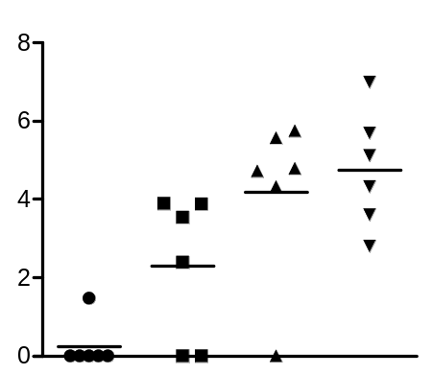
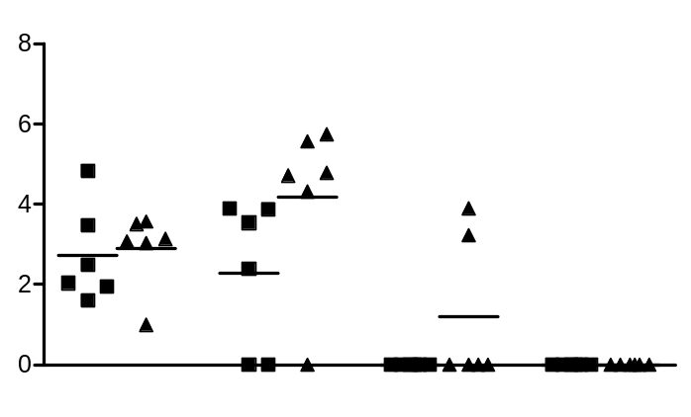
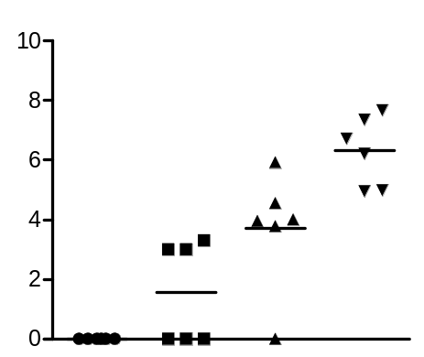
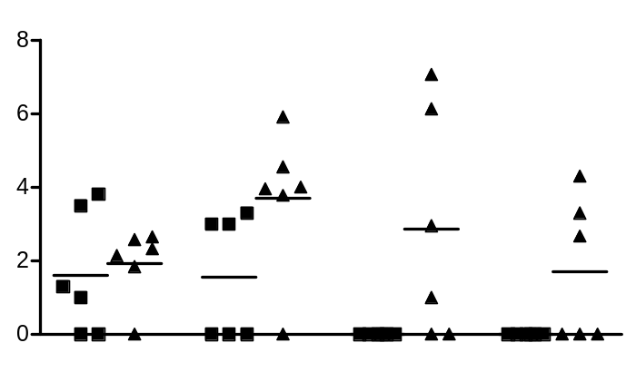
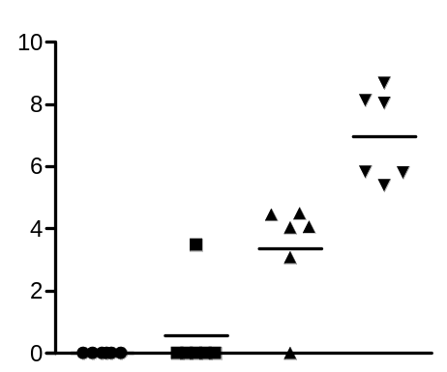
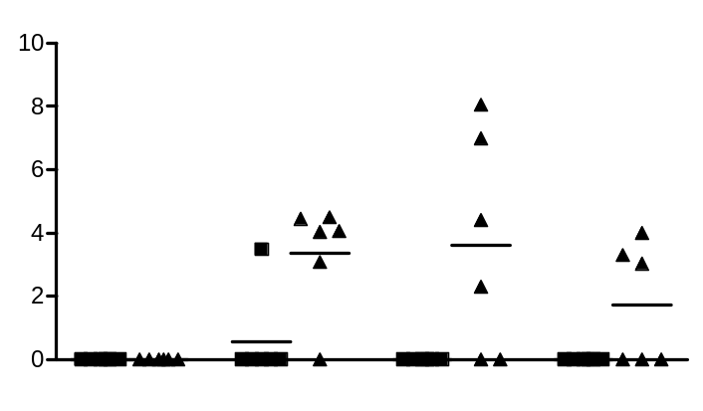
A
B
100x
10x dilution of OD₆₀₀=0.3
CFU / mL BAL (log10)
CFU / mL BAL (log10)
1000x
100x
10x
1x
12h
24h
48h
72h
Dilution of OD₆₀₀=0.3
100x
10x dilution of OD₆₀₀=0.3
CFU / lung (log10)
CFU / lung (log10)
1000x
100x
10x
1x
12h
24h
48h
72h
Dilution of OD₆₀₀=0.3
100x
10x dilution of OD₆₀₀=0.3
CFU / mL blood (log10)
CFU / mL blood (log10)
1000x
100x
10x
1x
12h
24h
48h
72h
Dilution of OD₆₀₀=0.3
Supplementary Figure I Establishment of intra-tracheal infection with S. pneumoniae in naive mice. (A) Number of CFU in BAL (upper panel), lung (middle panel) and blood (lower panel) 24h after infection with S. pneumoniae using 10-fold serial dilutions of the liquid bacterial culture in midlogarithmic growth phase (OD=0.3; ~2.5x10⁶ bacteria in 20 μL). (B) Number of CFU in BAL (upper panel), lung (middle panel) and blood (lower panel) at the indicated time point after inoculation with S. pneumoniae using 10- and 100-fold dilution of the OD=0.3 liquid bacterial culture (~2.5x10⁵ and 2.5x10⁴ bacteria in 20 μL). Dot plots display a line at mean calculated from the log10 values of CFU counts.

Slide 4
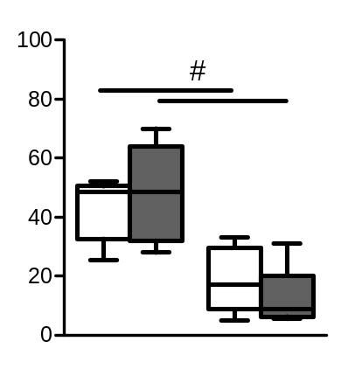
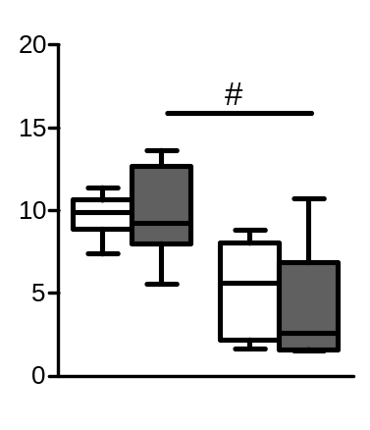
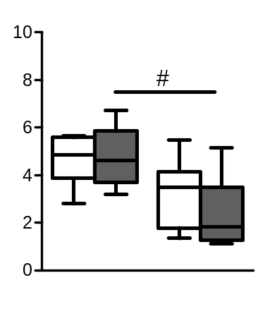
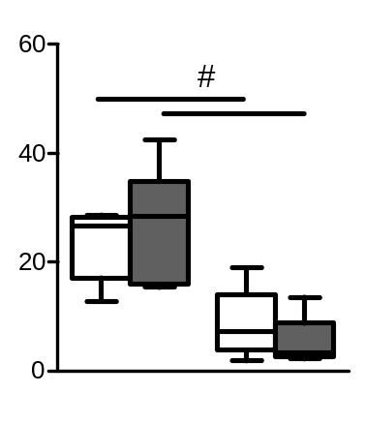
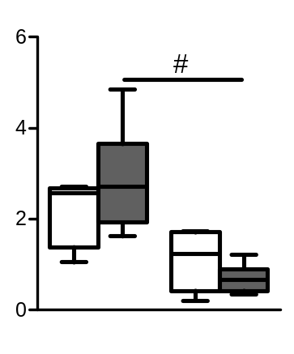
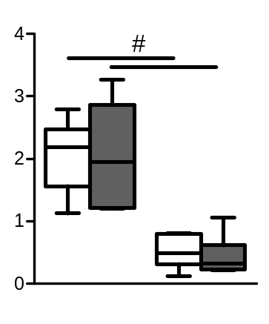
PBS
S. pneumoniae
Leukocytes / spleen (x10⁶)
CD4+ T cells / spleen (x10⁶)
CD8+ T cells / spleen (x10⁶)
Sham
MCAO
Sham
MCAO
Sham
MCAO
B cells / spleen (x10⁶)
Granulocytes / spleen (x10⁶)
Monocytes / spleen (x10⁶)
Sham
MCAO
Sham
MCAO
Sham
MCAO
Supplementary Figure II Stroke reduces splenocyte numbers. Flow cytometric analysis of total leukocytes, CD3+/CD4+ and CD3+/CD8+ T cells, B220+ B cells, Ly-6G+ granulocytes and Ly-6G-/CD11b+ monocytes in the blood of sham-operated and MCAO mice 24h following intra-tracheal injection of S. pneumoniae (S. pn.) or PBS (n=6/group). Whiskers show 5-95 percentiles. # p<0.05: SHAM vs MCAO.

