Slide 1
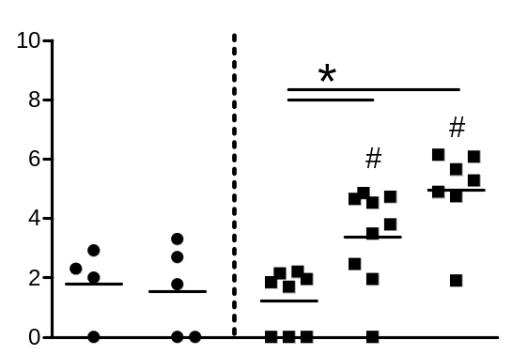
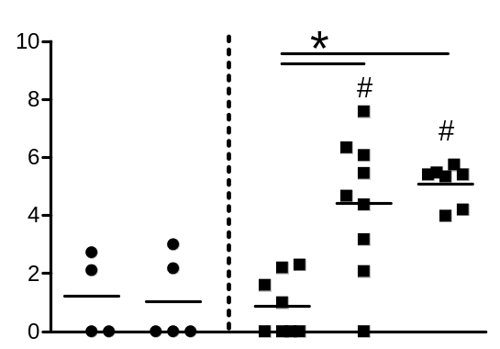
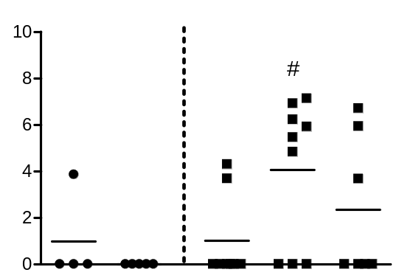
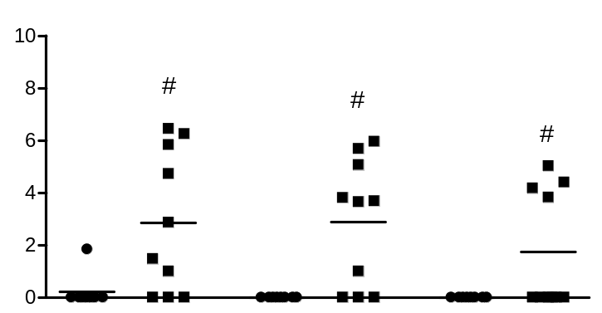
A
d0
d1
d2
d3
d4
d5
d6
†
†
CFU / mL BAL (log10)
†
surgery
inoculation
sampling
1d
3d
1d
3d
5d
†
after Sham
after MCAO
CFU / lung (log10)
CFU / mL blood (log10)
1d
3d
1d
3d
5d
1d
3d
1d
3d
5d
after Sham
after MCAO
after Sham
after MCAO
B
d0
d3
d5
†
CFU / mL (log10)
Sham
MCAO
Sham
MCAO
Sham
MCAO
BAL
Lung
Blood

