Slide 1
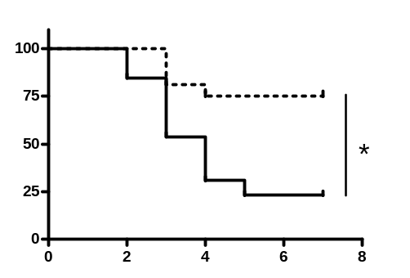
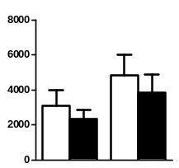
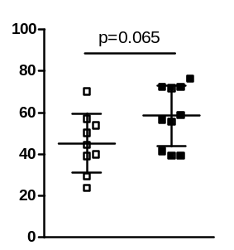
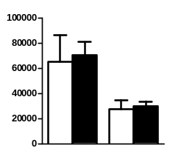
A
MCAO PBS
MCAO S. pneumoniae
Survival (%)
Days after infection
B
MCAO PBS
MCAO S. pneumoniae
Cells/hemisphere
T cells
B cells
Infarct size (mm³)
Cells/hemisphere
Gran
Mon

