Slide 1
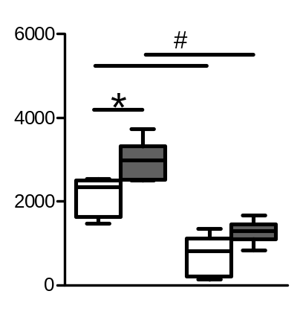
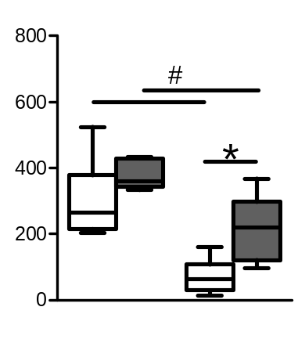
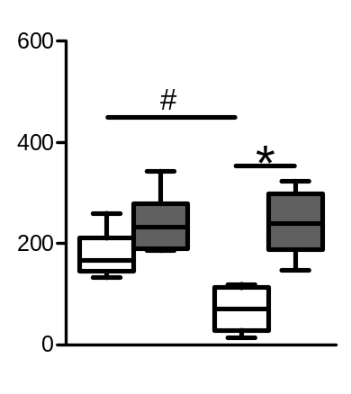
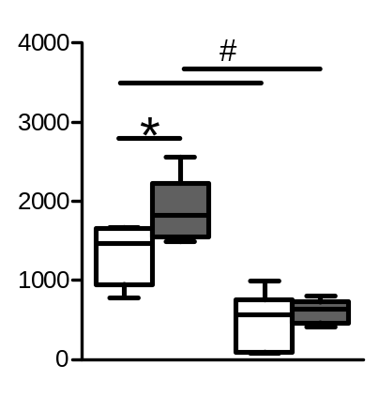
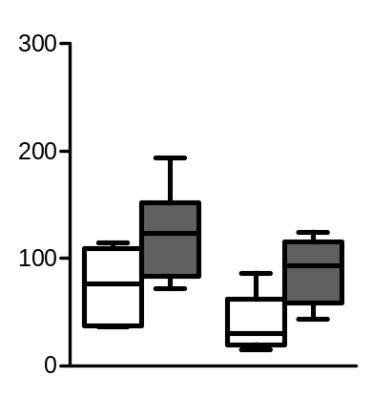
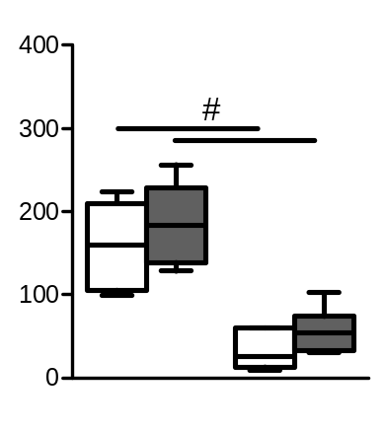
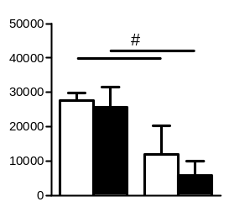
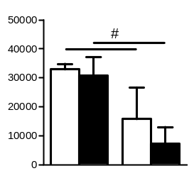
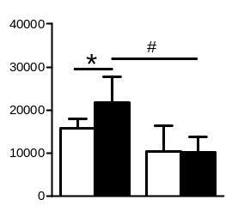
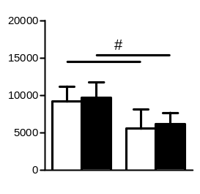
A
PBS
S. pneumoniae
Leukocytes / μL blood
CD4+ T cells / μL blood
CD8+ T cells / μL blood
Sham
MCAO
Sham
MCAO
Sham
MCAO
B cells / μL blood
Granulocytes / μL blood
Monocytes / μL blood
Sham
MCAO
Sham
MCAO
Sham
MCAO
B
C
PBS
S. pneumoniae
PBS
S. pneumoniae
Blood
Spleen
Blood
Spleen
MHC II MFI / B cells
CD11b MFI / granulocytes
Sham
MCAO
Sham
MCAO
Sham
MCAO
Sham
MCAO

