Slide 1
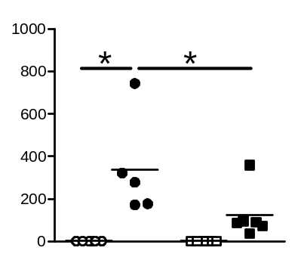
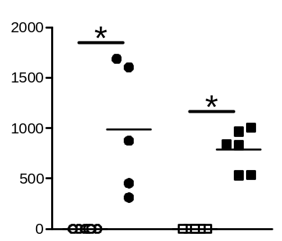
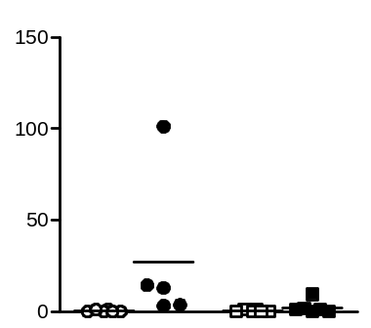
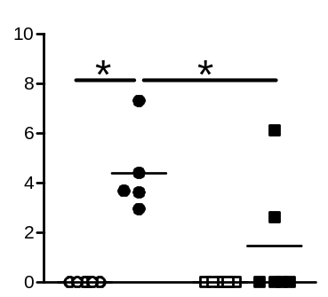
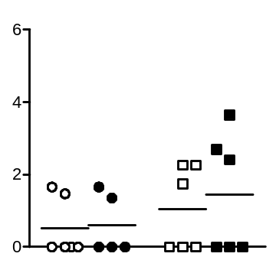
Sham PBS
Sham S. pneumoniae
pg/mL IL-6
pg/mL TNF-α
MCAO PBS
MCAO S. pneumoniae
pg/mL IFN-γ
pg/mL IL-17
pg/mL IL-10

