Slide 1
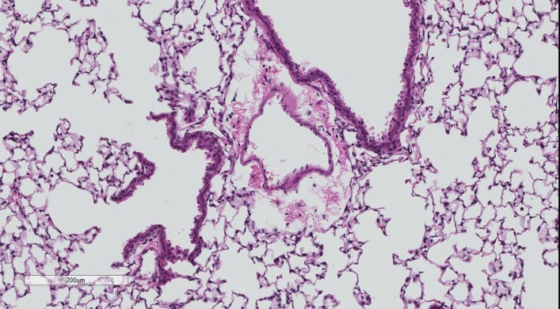
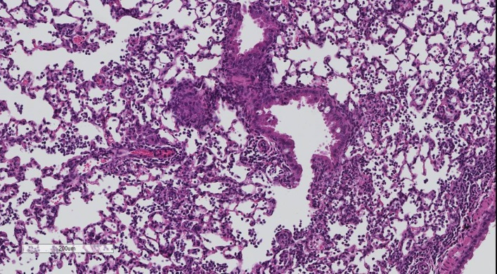
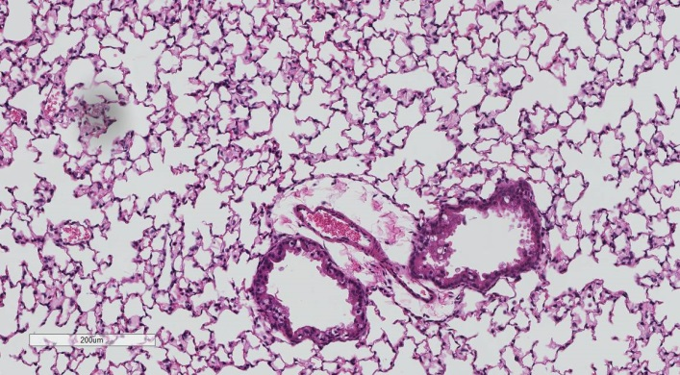
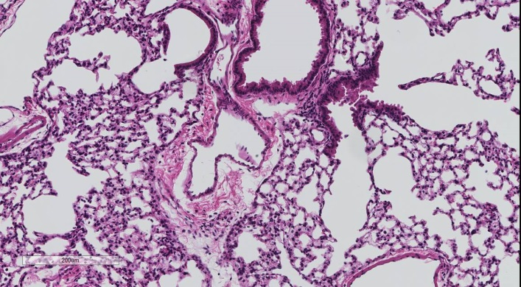
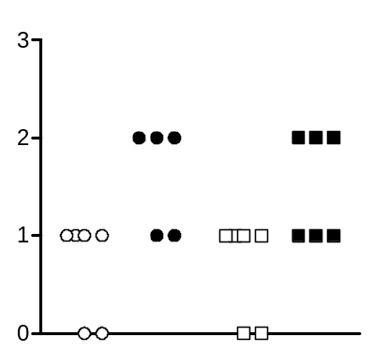
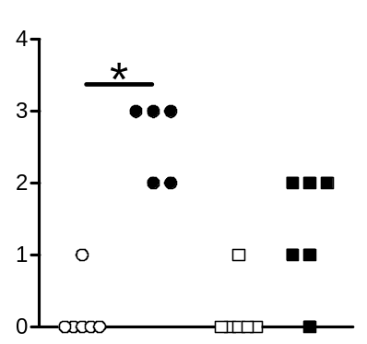
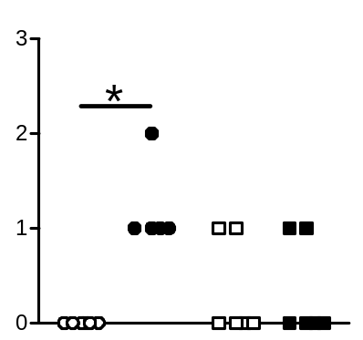
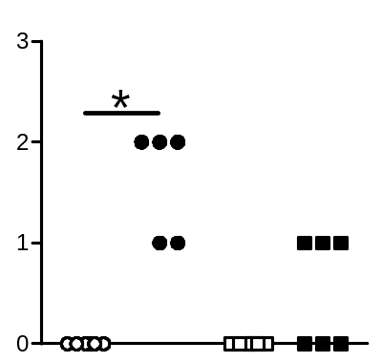
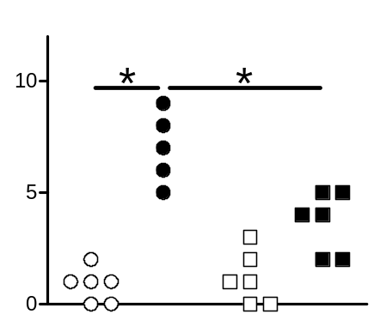
A
Sham PBS
Sham S. pneumoniae
MCAO PBS
MCAO S. pneumoniae
B
Perivascular edema
Perivascular/peribronchial neutrophil-infiltration
Sham PBS
Sham S. pneumoniae
Score (arbitrary unit)
MCAO PBS
MCAO S. pneumoniae
Goblet cell metaplasia
Eosinophil macrophages
Sum of scores
Score (arbitrary unit)

