Slide 1



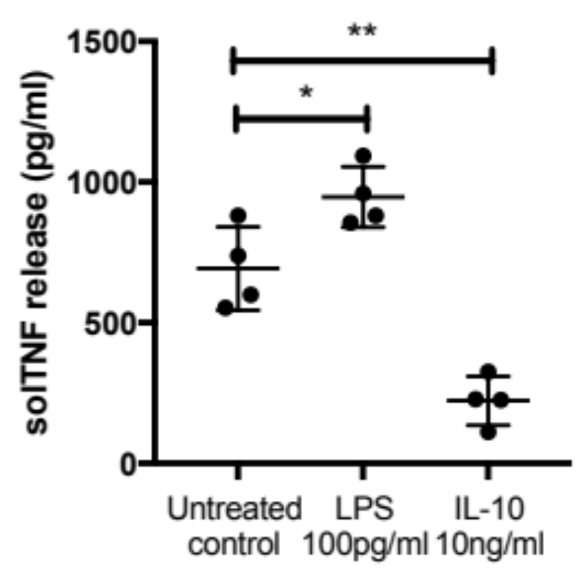
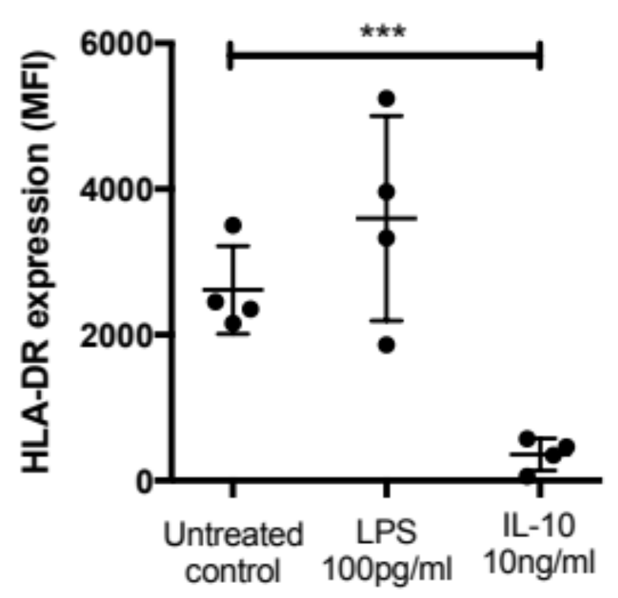
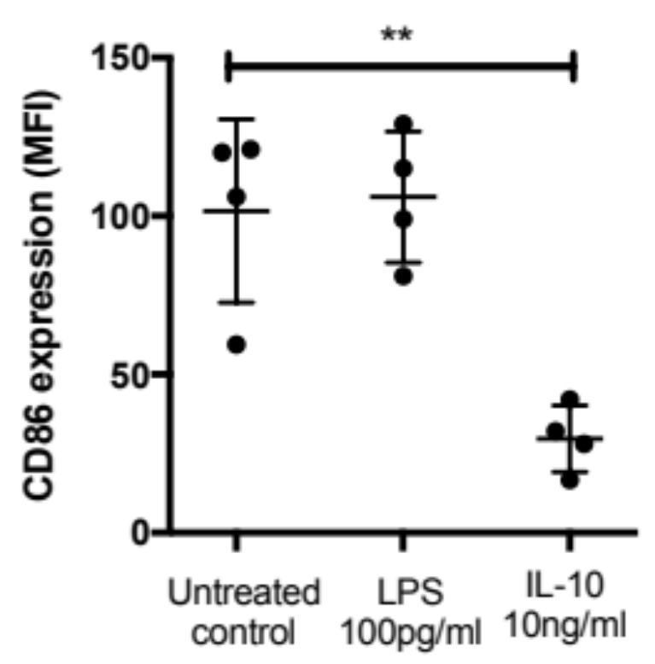
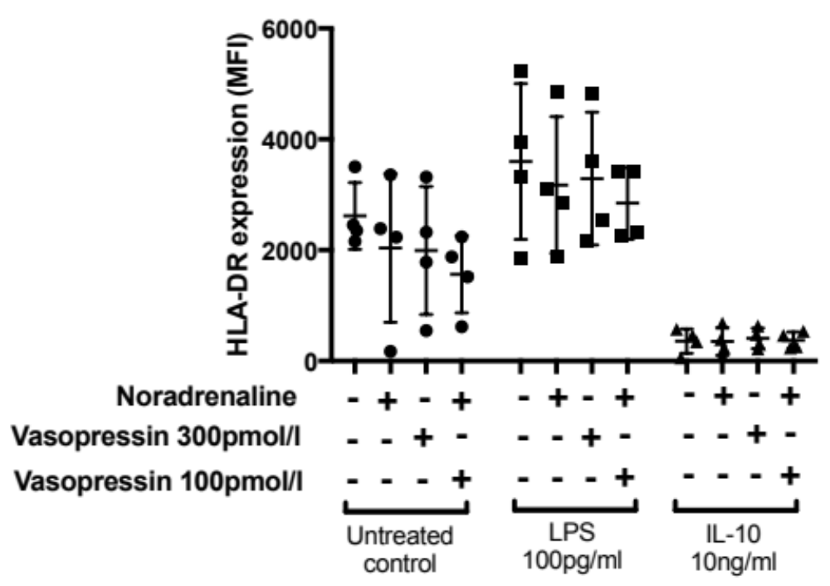
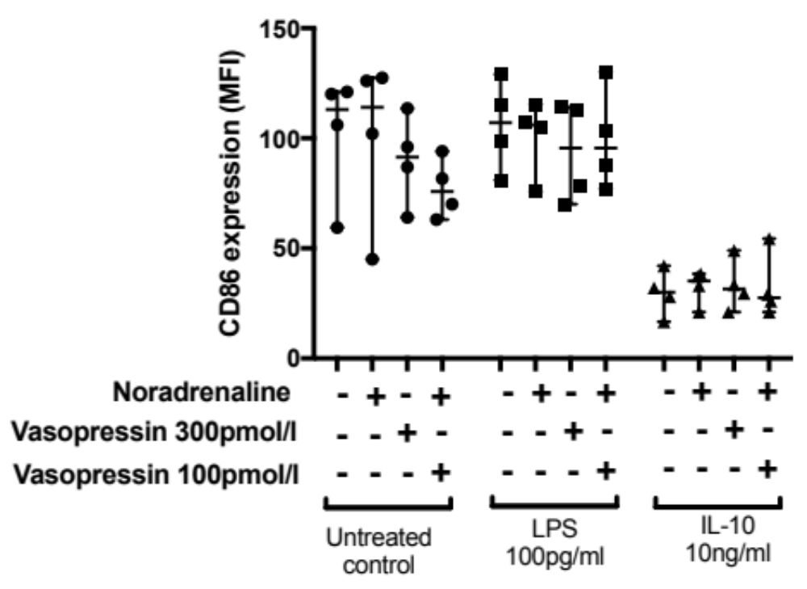
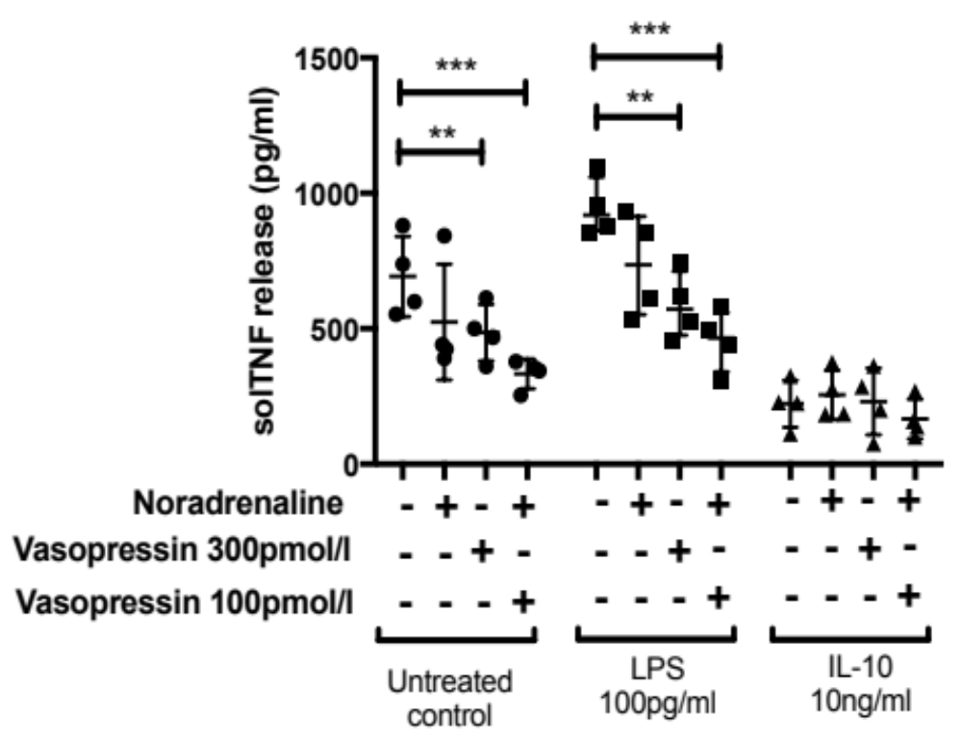
Vasopressin alone and with noradrenaline attenuates TNF-α production in an in-vitro model of monocyte priming and deactivation
R Davies, KP O’Dea, S Soni, JK Ward, DJ O’Callaghan, M Takata, AC Gordon
Section of Anaesthetics, Pain and Intensive Care Medicine, Imperial College London, UK
INTRODUCTION
METHODS
Vasopressin is a safe and effective alternative to noradrenaline in the treatment of septic shock [1], but is primarily used as a ‘catecholamine-sparing’ agent.
Vasopressin also has significant in-vitro anti-inflammatory effects including inhibition of endotoxin-induced inflammatory cytokine release from macrophages [2].
In sepsis monocytes exhibit the differential response states of priming and ‘deactivation’, which may reflect the opposing pro- and anti-inflammatory responses, respectively.
During inflammation, monocyte immune-phenotype can be determined ex-vivo by expression of surface markers involved in antigen presentation (HLA-DR, CD86) and production of pro-inflammatory cytokines, such as tumour necrosis factor (TNF).
To further assess the potentially beneficial anti-inflammatory effects of vasopressin, we developed an in-vitro assay of monocyte priming and ‘deactivation’ to model the pro- and anti-inflammatory responses.
Human healthy volunteer (HV) monocytes (CD14+ subset) were isolated by immune-magnetic bead separation and cultured at 37°C for 20hrs with a priming, low dose of lipopolysaccharide (LPS, 100pg/ml) or IL-10 (10ng/ml) in 10% HV serum.
These treatments were supplemented with clinically relevant concentrations of noradrenaline (NA - 5000pg/ml) and vasopressin (VP), at a ‘high’ (300pmol/L) or ‘low’ (‘sparing’) dose (100pmol/L) [3-5].
Monocytes were analysed for surface HLA-DR and CD86 expression by flow cytometry, or stimulated with a ‘second-hit’ of LPS (10ng/ml) for 4hrs and TNF release measured by ELISA (see graphic).
LPS
priming
or
IL-10
VP and/or NA
HLA-DR/CD86
expression
Monocyte pre-treatment – 20hrs
‘Second-hit’ LPS – 4 hrs
TNF release
RESULTS
In-vitro model of monocyte priming and ‘deactivation’ – TNF release and HLA-DR/CD86 expression
A
B
C
Mean ± SD, n=4, *p<0.05, **p<0.01, ***p<0.001.
Pre-treatment of monocytes with LPS resulted in a primed phenotype of increased TNF release on ‘second-hit’ LPS stimulation (10ng/ml – panel A) and a trend toward higher HLA-DR expression (control vs LPS; p=0.25, panel B)
IL-10 pre-treatment resulted in a ‘deactivated’ phenotype of reduced TNF release and HLA-DR/CD86 expression (panel A, B and C).
Vasopressin and noradrenaline do not affect monocyte HLA-DR and CD86 expression
D
E
Median ± interquartile range, n=4.
Noradrenaline and vasopressin had no significant effect on in-vitro monocyte HLA-DR and CD86 expression (panel D and E) .
Vasopressin and noradrenaline reduce LPS-induced monocyte TNF release
F
Pre-treatments | No drug | Vasopressin (300pmol/L) | Noradrenaline | Noradrenaline + vasopressin (100pmol/L)
None | 693±147.5 | 485.4±104** | 524.5±213 | 333±54.5***
Priming dose LPS (100pg/ml) | 947±107 | 586.5±123.5** | 733.5±192 | 455±115***
IL-10 | 222.6±87.3 | 231±123 | 255±91 | 166±72.6
TNF levels (pg/ml) after 2nd hit LPS treatment. Mean ± SD, n=4, * p < 0.05; **p < 0.01; ***p<0.001.
Under normal and priming conditions, co-incubation with vasopressin alone or with noradrenaline significantly reduced TNF production (panel F and Table).
Contrasting with this anti-inflammatory effect, neither vasopressin nor noradrenaline treatments affected IL10-induced downregulation of TNF production (Panel F and Table).
CONCLUSION
REFERENCES
In an in-vitro model of monocyte conditioning we found that vasopressin supressed LPS-TNF responses in non-pre-treated and primed monocytes.
These responses were further suppressed when vasopressin was added to noradrenaline at a ‘sparing’-dose.
In contrast, there was no drug effect on the ‘deactivated’ phenotype.
This selective immune-modulatory effect suggests that vasopressin may be beneficial if used early in the treatment of septic shock to reduce the deleterious clinical consequences of the hyperinflammatory response, and warrants further investigation.
Gordon AC et al. Effect of Early Vasopressin vs Norepinephrine on Kidney Failure in Patients With Septic Shock: The VANISH Randomized Clinical Trial. JAMA. 2016;316:509–18.
Peng T-C et al. Vasopressin inhibits endotoxin-induced upregulation of inflammatory mediators in activated macrophages. Tzu Chi Medical Journal. 2013;25:150–4.
Boldt J et al. Alterations in circulating vasoactive substances in the critically ill—a comparison between survivors and non-survivors. Intensive Care Med. 1995;21:218–25.
Russel, JA et al. Interaction of vasopressin infusion, corticosteroid treatment, and mortality of septic shock. Crit Care Med. 2009;37:811–8.
Gordon AC et al. The Interaction of Vasopressin and Corticosteroids in Septic Shock. Crit Care Med. 2014;42:1325–33.
Funded by the New Investigator Award from the Intensive Care Foundation in the UK

