Slide 1
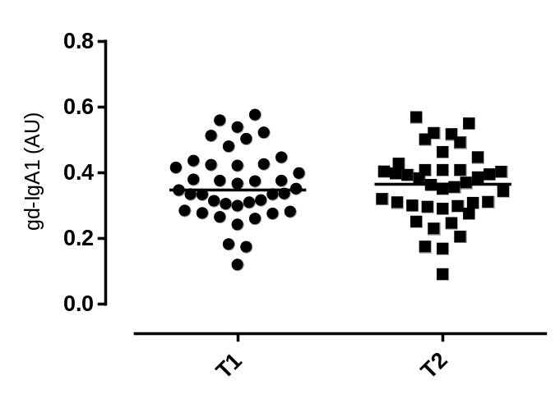
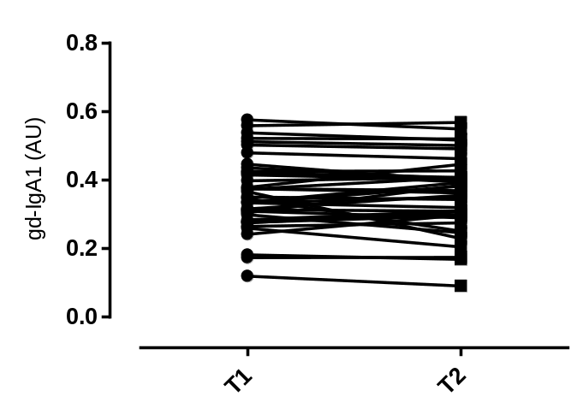
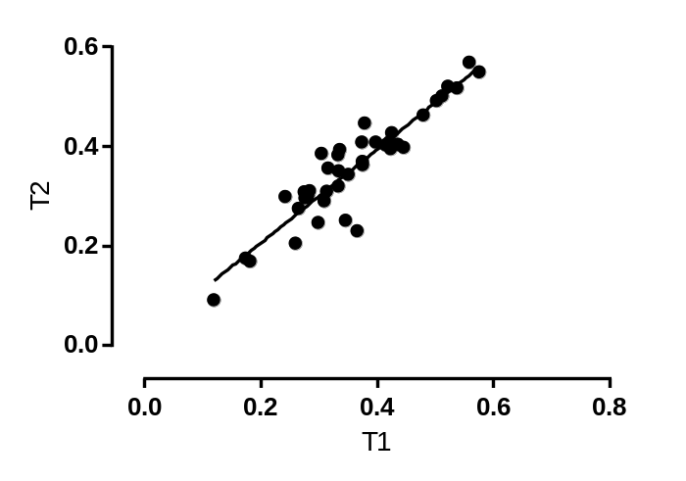
A
B
P = NS
CV = 5.2%
C
r = 0.92
Lomax-Browne et al. Figure 1.

Slide 2
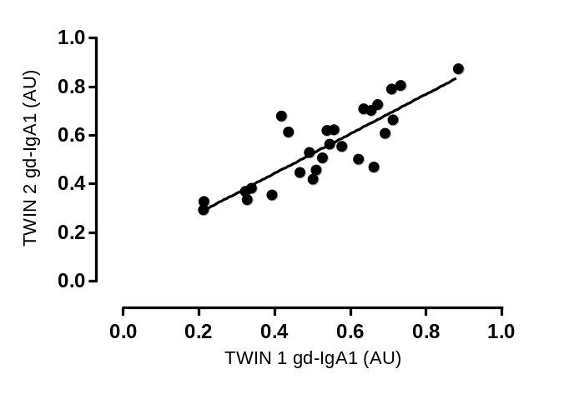
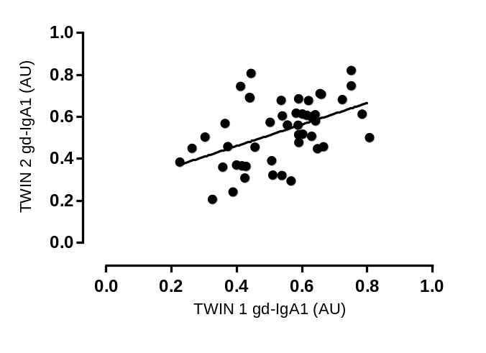
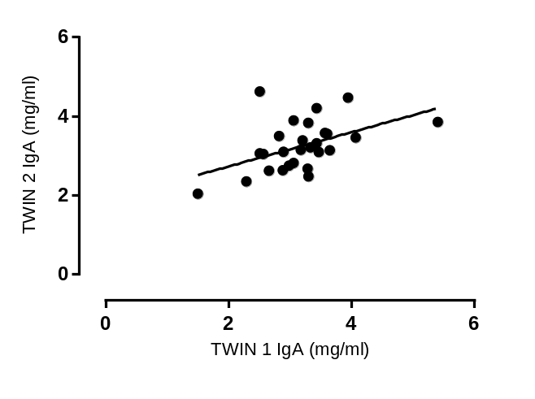
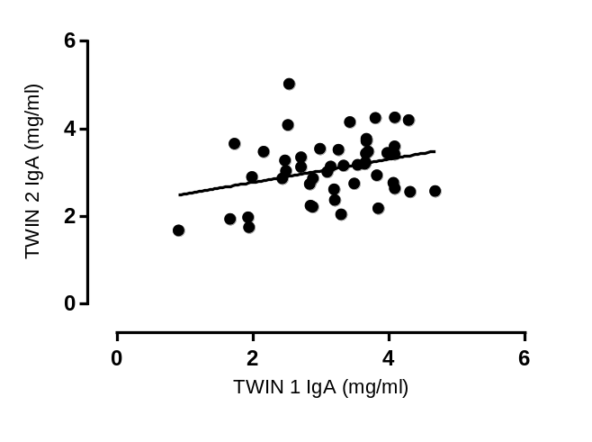
A
B
r = 0.84
r = 0.46
C
D
r = 0.48
r = 0.3
Lomax-Browne et al. Figure 2.

