Slide 1
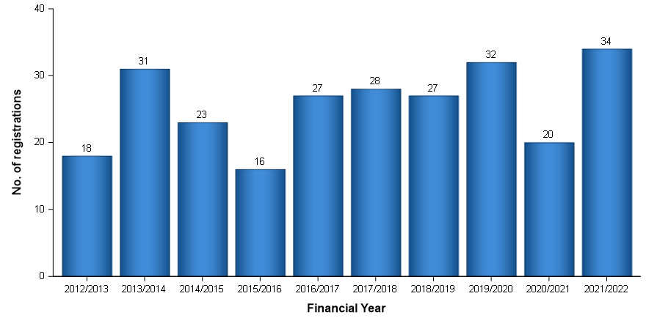
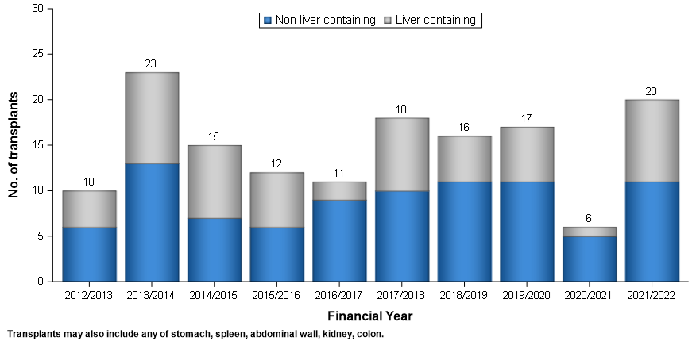
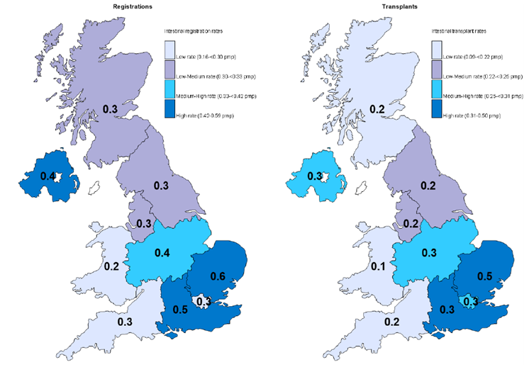
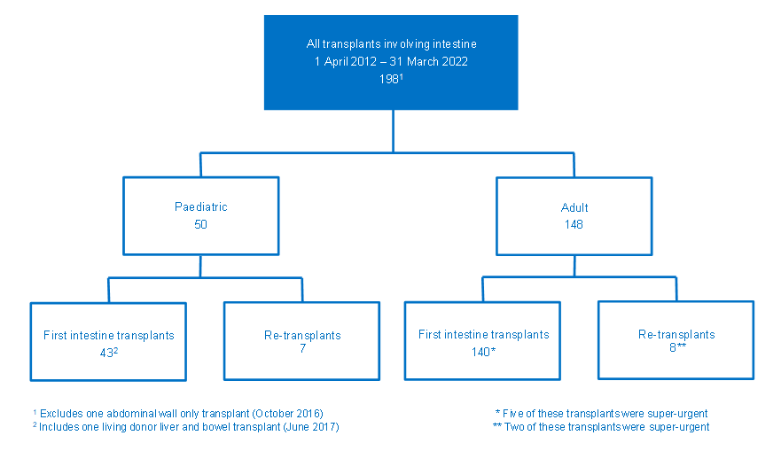
UK National Adult Small Intestine Transplant (NASIT) Forum: Exemplar of collaborative, multidisciplinary care for intestinal rehabilitation patients being considered for intestinal transplant
The Lennard Jones Intestinal Rehabilitation Unit
The Oxford Transplant Centre
The Intestinal Failure Unit
1. Set up in 2005 to discuss adult patients with challenging intestinal failure and appropriate timing for transplant
2. Initially, Cambridge and St Mark’s, then developed to include Oxford and Salford in 2007 and renamed the National Adult Small Intestine Transplant Forum (NASIT).
3. NHS England mandated NASIT’s remit: every patient coming for intestinal transplant within the UK should be discussed at NASIT. NASIT was to be initially gatekeeper for transplants whilst it was in its infancy in the UK.
Background:
Sharkey, L¹; Abraham, A¹; Gabe, S³; Donnelly, S³; Rutter, C¹; Lal, S²; Allan, PJ⁴
¹Cambridge Intestinal Rehabilitation and Transplant, Addenbrookes Hospital, Cambridge, UK
²Salford Royal Intestinal Failure Unit, Northern Care Alliance, Manchester, UK
³Lennard Jones Intestinal Rehabilitation Unit, St Mark’s Hospital, London, UK
⁴Oxford Intestinal Rehabilitation and Transplant, Oxford University Hospitals, Oxford, UK
NASIT workflow:
Patients are presented covering background: medical & surgical history, vascular access, PN, complications of IF (IFALD, metabolic bone disease, renal sequellae, venous anatomy, psychological morbidity)
Discussion about key issues covered and likely organs required at transplant
Opportunities to raise alternative strategies as other options
Decision:
Not for transplant
Delay
List
Methods for study:
Retrospective audit of prospectively maintained list
All referrals to and outcomes from meeting minutes
NASIT between 2005-2022.
Data also derived from yearly report from NHSBT
Results:
Table 1 shows the number of patients discussed and separated into liver vs non-liver containing grafts. Not applicable are those for whom we had data that did not need transplant.
In addition, NASIT was approached to discuss patients from UK paediatric centres (now have own paediatric forum) and internationally from Spain (2), Australia (2) to support their transplant programmes in early days of their programmes or to discuss patients with complexities.
A) Number of registrations onto the active transplant list, 1 April 2012 – 31 March 2022
B) Adult intestinal transplants in the UK, 1 April 2012 – 31 March 2022
Conclusion:
NASIT has developed into a multicentre, collaborative multidisciplinary meeting
Optimisation-focused for patients undergoing intestinal rehabilitation
Offer alternative therapeutic strategies for those for whom intestinal transplant will not work, is not possible or as temporising measure until transplant is possible
Wealth of experience in managing intestinal rehabilitation and transplant for teams to draw on and learn from
Opportunity to discuss the subtle nuances of care and to think outside of the box
An exemplar in allowing patients to be discussed in the round.
Developed from gatekeeper into a “checks and balances” meeting offering maximum opportunity for collegiate discussion of complexities surrounding patients
Year | Liver containing | Liver free | Not applicable | Total
2005 | 2 | 5 |  | 7
2006 | 7 | 11 |  | 18
2007 | 16 | 18 |  | 34
2008 | 3 | 23 |  | 26
2009 | 4 | 29 |  | 33
2010 | 1 | 21 |  | 22
2011 | 17 | 29 |  | 46
2012 | 13 | 20 |  | 33
2013 | 10 | 14 |  | 24
2014 | 7 | 13 |  | 20
2015 | 11 | 16 | 4 | 31
2016 | 12 | 30 | 9 | 51
2017 | 14 | 32 | 2 | 48
2018 | 15 | 22 | 1 | 38
2019 | 7 | 25 | 1 | 33
2020 | 19 | 17 |  | 36
2021 | 18 | 63 | 3 | 84
2022 | 8 | 29 | 1 | 38
Grand Total | 184 | 417 | 21 | 622
C) Comparison of mean annual intestine registration rates (pmp) with mean annual transplant rates (pmp) by recipient country/NHS region of residence, 1 April 2012 – 31 March 2022
D) UK intestinal transplants, 1 April 2012 – 31 March 2022
Figure 1: UK Transplant data 2012 - 2022
Table 1: Numbers of patients discussed at NASIT 2005 - 2022

